Slide 1
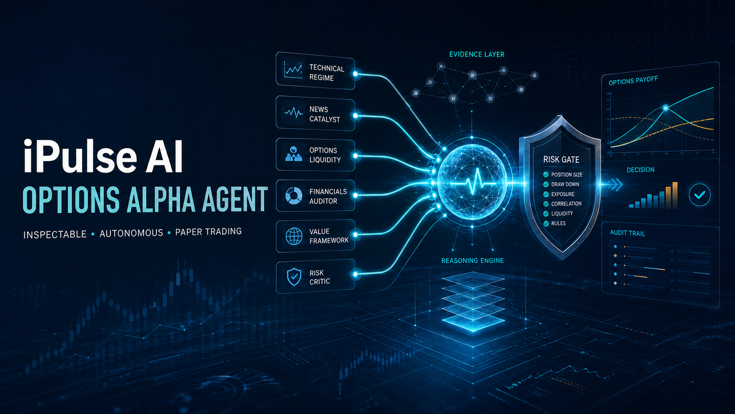
Notes:
Most trading-agent demos optimize for activity. We designed for accountability, including the ability to WAIT.
[Sources]
- https://lablab.ai/ai-hackathons/alpaca-ai-trading-agents-hackathon
- Local generated cover: public/assets/ipulse-options-alpha-agent-cover.png

Slide 2
IPULSE AI OPTIONS ALPHA AGENT
A trade is not proof of intelligence
BLACK BOX
INSPECTABLE AGENT
Signal
Order
Outcome
Evidence
Disagreement
Risk decision
Broker receipt
No visible evidence.
No preserved dissent.
No reason for refusal.
WAIT and REJECT are evidence, too.
02
Notes:
If judges cannot reconstruct the evidence, dissent, vetoes, and broker result, autonomy is indistinguishable from unattended execution.
[Sources]
- Local source: docs/judge_one_pager.md

Slide 3
IPULSE AI OPTIONS ALPHA AGENT
Never let one AI own the conclusion
PROBABILISTIC RESEARCH
01
Technical regime
04
Financials auditor
Consensus
proposes
02
News catalyst
05
Value framework
Deterministic
safety
decides
03
Options liquidity
06
Risk critic
Every advisor cites evidence, contrary evidence, confidence, and an invalidation condition.
03
Notes:
Advisors may CALL, PUT, WAIT, or ABSTAIN. Missing evidence never becomes a guess, and no advisor owns execution authority.
[Sources]
- Local source: src/ipulse_options_alpha_agent/advisors.py
- Local source: src/ipulse_options_alpha_agent/consensus.py

Slide 4
IPULSE AI OPTIONS ALPHA AGENT
Reasoning may evolve. Capital boundaries stay explicit.
01
Environment
Paper account only · two explicit execution switches
02
Market state
Open session · fresh quote · complete broker state · no duplicate
03
Order and portfolio
One contract · limit only · long premium · max loss $500 · circuit breakers
04
Notes:
No advisor or language model can bypass these rules. A failed check returns WAIT or REJECT; it never changes order type, size, or environment.
[Sources]
- Local source: src/ipulse_options_alpha_agent/safety.py
- Local source: src/ipulse_options_alpha_agent/risk.py
- Local source: src/ipulse_options_alpha_agent/execution.py

Slide 5
IPULSE AI OPTIONS ALPHA AGENT
Three fills. Every risk bounded.
Three one-contract paper fills across AAPL, XLF and AMZN. Broker receipts retained; raw account identifiers stay private.
3 FILLS
$825
-$13.09
broker verified
max premium risk
captured paper P&L
AAPL $4.15 • XLF $0.30 • AMZN $3.80 • buy-to-open paper limit fills on 3 Sep 2026.
05
Notes:
The dedicated account began with $100,000, active status, options level 3, and no positions or fills. The raw account ID belongs only in the private judging field.
[Sources]
- Local sanitized source: artifacts/competition/performance.jsonl
- https://docs.alpaca.markets/docs/paper-trading
[Sources] - Alpaca paper dashboard, accessed 2026-09-03 15:49 ET. - https://thefutureedge.github.io/ipulse-ai-options-alpha-agent/evidence/live_strategy_fill.json [/Sources]

Slide 6
IPULSE AI OPTIONS ALPHA AGENT
The challenger survived an untouched holdout
55.9%
PROFIT FACTOR
1.39 on the 2024–2026 holdout.
127 signals • +0.218% average signed two-session underlying move
FROZEN RULE
5d ≥3% • RV ≤25% • reverse • hold 2 sessions
Underlying score only—not options P&L.
06
Notes:
This was the desired result. The system preserved all advisor views and vetoes instead of forcing activity for a demo.
[Sources]
- Local source: artifacts/decisions/advisor_market_evidence.jsonl
- Local source: public/index.html
[Sources] - Alpaca IEX adjusted daily bars for SPY, QQQ and IWM, 2021-2026. - https://thefutureedge.github.io/ipulse-ai-options-alpha-agent/evidence/exhaustion_reversal_v1_scorecard.json [/Sources]

Slide 7
THE PROOF PATH
Open evidence beats a black-box victory claim
01
02
03
Public code
Live receipts
Holdout scorecard
56 tests • strategy • risk gates • MIT
3 fills • $825 defined risk • paper P&L
127 signals • 55.9% wins • PF 1.39
Inspect the code. Challenge the claims. Follow the evidence.
Research and simulated paper trading only. Not investment advice.
Notes:
Close on the inspection path: code, dashboard, evidence, and final paper scorecard. Short paper performance does not predict live returns.
[Sources]
- https://github.com/alpacahq/alpaca-mcp-server
- Local source: docs/judge_one_pager.md
[Sources] - https://github.com/TheFutureEdge/ipulse-ai-options-alpha-agent - https://thefutureedge.github.io/ipulse-ai-options-alpha-agent/ [/Sources]

