Slide 1
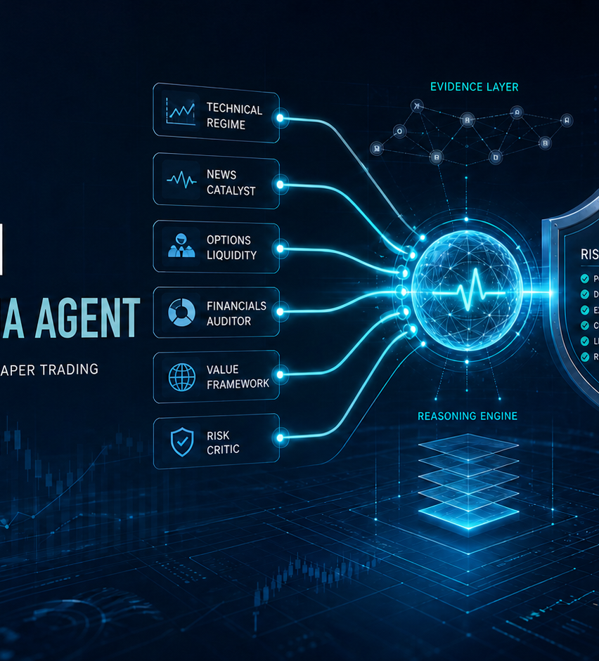
iPULSE AI · OPTIONS ALPHA AGENT
Every trade is a claim.
We keep the evidence.
An inspectable autonomous options-research and Alpaca paper-trading agent.
6 independent advisors
deterministic authority
broker receipts
Open Agentic Investment Research Platform
Russlan Ramdowar · Future Edge Group FZE
Notes:
Most trading-agent demos optimize for activity. iPulse AI optimizes for accountability. Every recommendation, dissent, veto, order, and result stays inspectable. The agent is paper-only and this presentation is not investment advice.

Slide 2
01
Investment teams cannot govern a black-box trading agent.
The buyer is not asking for another signal. The buyer is asking: can we reconstruct why capital moved?
Reasoning drift
Risk bypass
Evidence loss
A plausible narrative can silently change the strategy after every market move.
If the same AI proposes and authorizes, a confident mistake can become an order.
Without dissent, timestamps, and broker reconciliation, post-trade review becomes guesswork.
Starting user
RIA research teams · family offices · sophisticated investors
They need AI-scale synthesis without surrendering policy control, auditability, or the ability to abstain.
iPulse AI Options Alpha Agent · Alpaca paper trading · Not investment advice
Notes:
The focused problem is investment decision governance. The real user is a wealth or research team that wants AI to synthesize fragmented evidence but cannot accept an opaque trade recommendation or an LLM that can override controls.

Slide 3
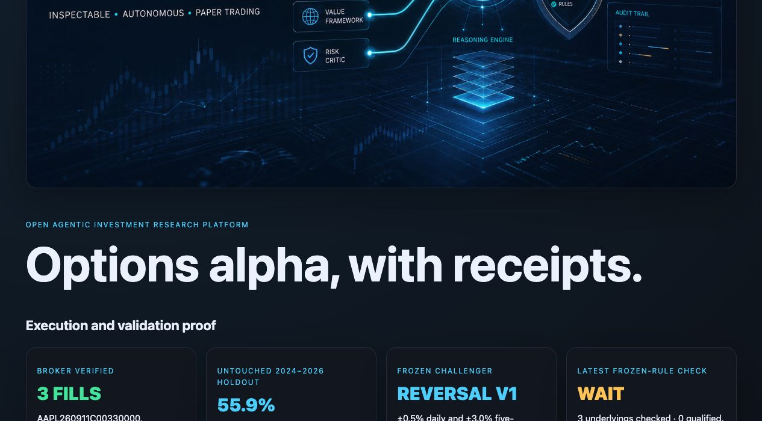
02
A working product—not a chatbot wrapper.
Deployed dashboard, public repository, real Alpaca paper evidence, and a replayable decision trace.
3
broker-verified option fills
Exploratory v0 · one contract each
127
untouched holdout signals
Frozen reversal v1 · 2024–2026
WAIT
latest frozen-rule decision
No qualifying SPY / QQQ / IWM signal
Live proof: thefutureedge.github.io/ipulse-ai-options-alpha-agent/
Notes:
This is the public judge dashboard. It shows the broker fills, the frozen holdout, and the latest WAIT. The GitHub repository exposes the code and scored artifacts. Links are public and require no authentication.

Slide 4
03
One loop. Two kinds of intelligence. One evidence trail.
Probabilistic research proposes; deterministic policy alone authorizes execution.
SIX INDEPENDENT ADVISORS
DETERMINISTIC
RISK AUTHORITY
EVIDENCE
Technical regime
News catalyst
CONSENSUS
ALPACA
Alpaca market + account
Cited research
Financial + valuation inputs
paper-only
market + quote freshness
size + max loss
duplicates + cooldown
position + drawdown
Options liquidity
Financials auditor
CALL · PUT
WAIT · ABSTAIN
Dissent preserved
Paper order
Broker re-read
Receipt
Value framework
Risk critic
evidence · contrary evidence · confidence · invalidation
Append-only evidence: signal → opinions → vetoes → order → broker result → P&L
iPulse AI Options Alpha Agent · Alpaca paper trading · Not investment advice
Notes:
The six advisors are independent roles, not six copies of one answer. They can disagree or abstain. The consensus is a proposal. Only the deterministic gate can authorize a paper order, and the broker is re-read after submission. Every transition is retained.

Slide 5
04
AI handles uncertainty. Code controls capital.
This boundary is the product—not a hidden implementation detail.
AI RESEARCH LAYER
DETERMINISTIC AUTHORITY
Synthesizes technical, news, liquidity, financial, and valuation evidence
Surfaces contrary evidence and invalidation conditions
Expresses calibrated confidence and preserves dissent
Abstains when required evidence is missing
Paper environment and explicit execution switches
Regular session and fresh option quote
One contract · long premium · limit only
USD 500 maximum defined loss
Duplicate, cooldown, position, and daily-loss gates
Why AI? Cross-source interpretation and structured adversarial reasoning do not reduce to one rigid indicator.
Every failed check becomes WAIT or REJECT. No advisor or model can bypass these controls.
AI can abstain. AI cannot bypass.
iPulse AI Options Alpha Agent · Alpaca paper trading · Not investment advice
Notes:
AI is used where interpretation is valuable: combining heterogeneous evidence, articulating competing cases, and stating what would invalidate each view. Deterministic code handles safety-critical authorization. This separation makes the system inspectable and testable.

Slide 6
05
We separate broker proof from strategy proof.
Execution evidence answers “did the safe path work?” Holdout evidence answers “did the frozen idea survive?”
ALPACA PAPER EXECUTION · EXPLORATORY V0
FROZEN REVERSAL V1 · UNTOUCHED 2024–2026
3
$825
–$13.09
127
55.9%
1.39
+0.218%
filled orders
max premium risk
captured P&L
signals
win rate
profit factor
avg signed move
AAPL · XLF · AMZN calls · one contract each · long-premium limits
Event-frequency Sharpe proxy 0.88 · 95% Wilson interval 47.2%–64.2%
Short paper snapshot. Proves broker integration and bounded loss—not v1 profitability.
Underlying two-session directional diagnostic—not options P&L. Fees, spread, decay, and slippage excluded.
2021–2023
2024–2026
development only
untouched holdout
strategy frozen
iPulse AI Options Alpha Agent · Alpaca paper trading · Not investment advice
Notes:
The three paper fills are intentionally separated from the frozen v1 strategy. They prove the broker path and defined risk. The holdout was selected only after development on 2021 to 2023, then evaluated on untouched 2024 to 2026 data. The 0.88 figure is an event-frequency-adjusted proxy, not a portfolio Sharpe ratio. A non-overlapping audit retained 81 signals with 56.8 percent wins and a 1.87 profit factor.

Slide 7
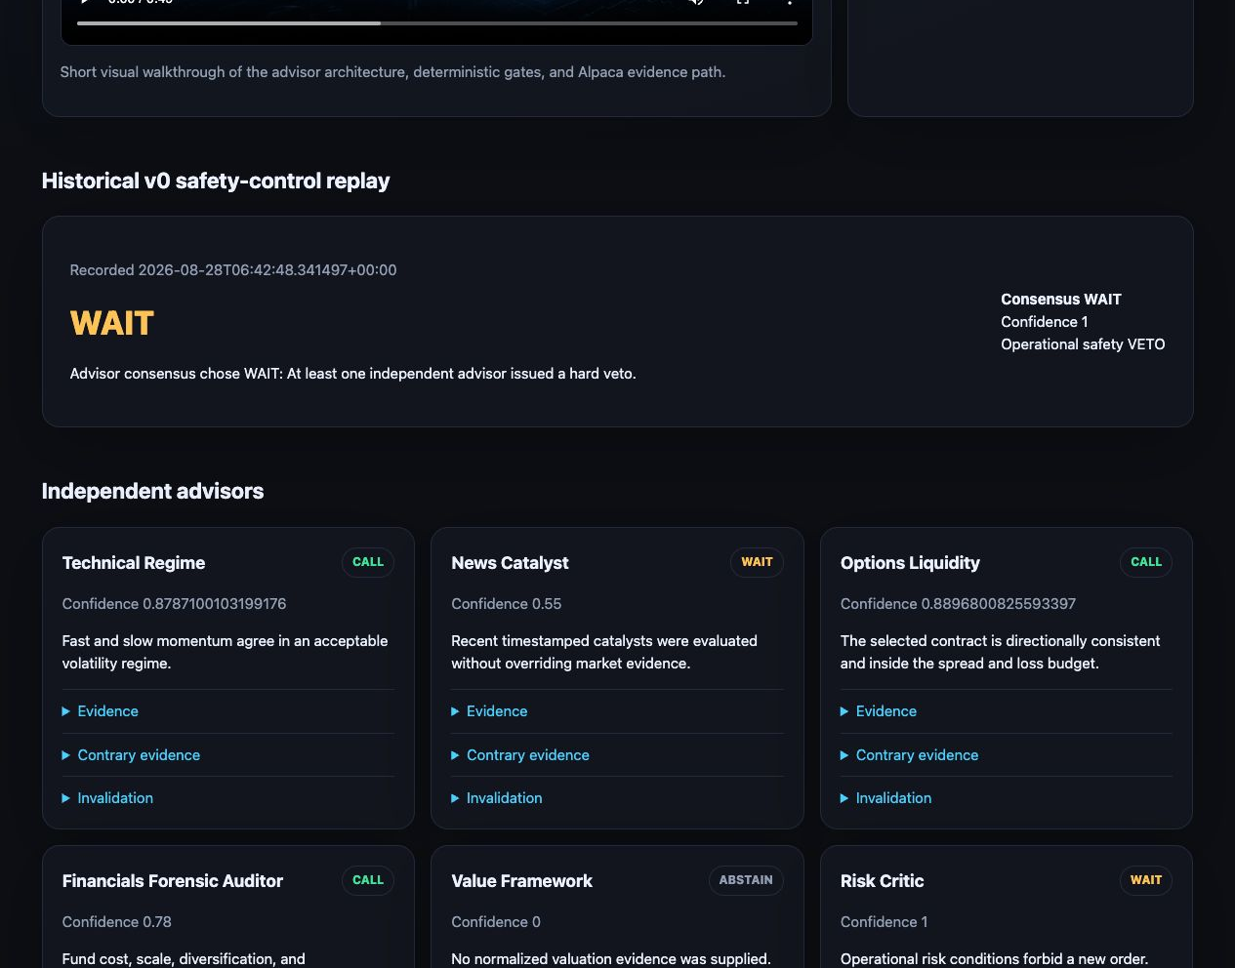
06
Trust grows when the agent shows failure—and restraint.
Negative results and WAIT decisions are product outputs, not presentation problems.
PUBLISHED FAILURE
LATEST FROZEN CHECK
Momentum v0
WAIT
Failed its holdout. We kept the evidence, retired the strategy, and froze the challenger before the next test.
0 of 3 qualified
SPY, QQQ, and IWM did not meet the frozen exhaustion rule. No order was requested.
failure remains public
restraint is observable
iPulse AI Options Alpha Agent · Alpaca paper trading · Not investment advice
Notes:
This is a core differentiator. Momentum v0 did not survive validation, so it was published and retired rather than tuned on the holdout. The latest frozen-rule check also produced WAIT because no symbol qualified. The decision trace still records the evidence and advisor outputs.

Slide 8
07
Governance software for the $177T adviser market.
Start with U.S. investment-adviser research teams that need inspectable AI before scaling autonomy.
22,932
$177T
ILLUSTRATIVE U.S. SOFTWARE TAM
U.S. investment advisers
regulatory AUM
≈ $275M / year
SEC 2025 statistics
SEC 2025 statistics
22,932 advisers × assumed $12k annual contract. Assumption, not a forecast.
Product wedge
TEAM SAAS
ENTERPRISE
API
Evidence-governed research workflow
$499–$1,999 / month
annual license
usage-based
Research teams review advisor evidence, policy vetoes, model limitations, and broker outcomes in one audit trail.
Seats, policies, evidence retention
Private deployment + governance
Research and evidence primitives
Source: U.S. SEC Investment Adviser Statistics, 2025 · TAM uses an explicit annual-contract assumption
Notes:
The SEC reports 22,932 investment advisers and 177 trillion dollars in regulatory assets under management for 2025. The 275 million dollar software TAM is an explicit bottom-up assumption: the adviser count multiplied by a 12 thousand dollar annual contract. The initial business model is team SaaS, enterprise private deployment, and an evidence API. Source: https://www.sec.gov/data-research/statistics-data-visualizations/investment-adviser-statistics

Slide 9
08
The moat is falsifiable research governance.
What judges can verify that many trading-agent demos leave implicit.
Governance proof | Typical agent demo | iPulse AI
Research | One model produces one answer | Six independent advisors preserve dissent and abstention
Authority | Reasoning and execution blur together | AI proposes; deterministic policy alone authorizes
Validation | Headline backtest metric | Development / freeze / untouched holdout / Wilson interval
Failure | Happy path is foregrounded | Failed v0 and WAIT decisions remain public
Execution | Order submitted | Paper-only limit → broker re-read → sanitized receipt → P&L
Originality is observable: the agent treats disagreement, invalidation, and refusal as first-class artifacts.
iPulse AI Options Alpha Agent · Alpaca paper trading · Not investment advice
Notes:
The original contribution is a falsifiable research-governance layer for autonomous investing. The output is not only CALL or PUT. It is the evidence, dissent, confidence, invalidation condition, policy decision, and broker outcome needed to reproduce and challenge the action.

Slide 10
09
Already working. Ready to extend responsibly.
The next milestone is more forward evidence—not broader risk.
NOW
NEXT 30 DAYS
NEXT 90 DAYS
Deployed dashboard
59 passing tests
3 broker-verified fills
Frozen holdout + full ledger
Continuous paper forward test
Position lifecycle + exits
Daily broker reconciliation
Evaluation drift alerts
Shadow mode for adviser teams
Policy packs + approvals
Private deployment
No live capital before gates
Inspect the evidence
Russlan Ramdowar
Live dashboard · GitHub repository
Founder · iPulse AI · Future Edge Group FZE
AI proposes. Deterministic risk decides. Alpaca executes. The evidence remains inspectable.
iPulse AI Options Alpha Agent · Alpaca paper trading · Not investment advice
Notes:
The system is already deployed and testable. The responsible roadmap is deeper forward paper evidence, complete lifecycle monitoring, and adviser-team shadow mode. Live capital is explicitly outside the hackathon scope and remains gated on evidence. Built by Russlan Ramdowar at iPulse AI, Future Edge Group FZE.

