Slide 1
Compilation process
C++ courses

Slide 2
Why compile?
Source C++ file — it is just code, it cannot be run as a program or used as a library.
Each source file must be compiled into an executable, dynamic or static library.

Slide 3
Compilation steps
Preprocessor
Compilation
Linking

Slide 4
Preprocessor
Work with preprocessors directives:
Removes comments.
Replaces #define macros with their values.
Selects the necessary pieces of code according to the conditions of #if, #ifdef and #ifndef.
#include <header> are included in the program, recursively go through the preprocessing stage and are substituted into the final file.
Command example:
-E, preprocesses the given file without compilation.
–o, sets the name of the resulting file.
g++ -E 0001.cpp -o les1_compile.ii

Slide 5
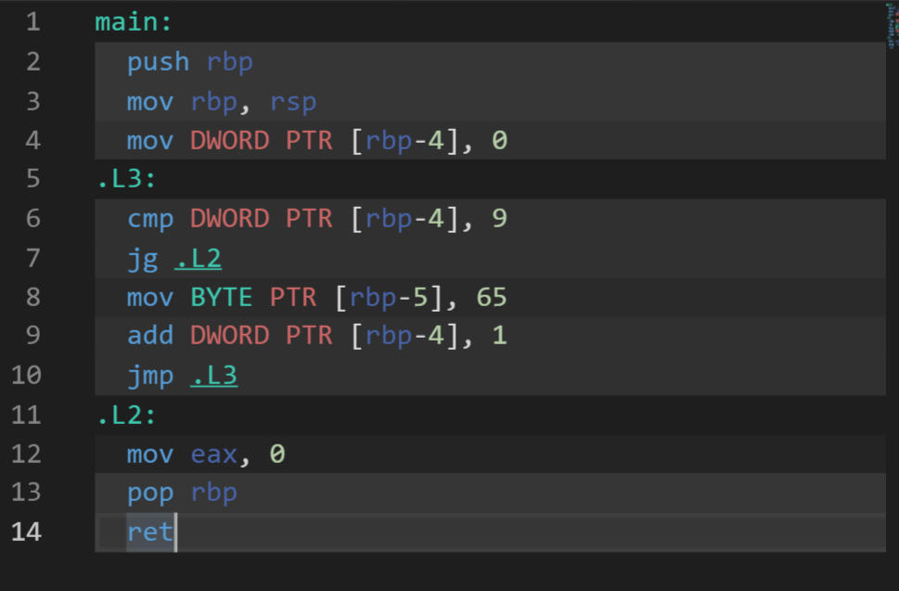
Compilation
At this step, the compiler performs its main task - compiles, that is, converts the code received at the previous step without directives into assembler code.
This code is not yet linked with other files.

Slide 6
Linking
The linker links all the object files and the static library into a single executable file.
A symbol table is a data structure created by the compiler itself and stored in the object files themselves. The symbol table stores the names of variables, functions, classes, objects.

Slide 7
What is the difference between a definition and a declaration? Let's see in the code

Slide 8
More about definition
There are two kinds of definitions for variables:
global variables
exist throughout the entire life cycle of the program (“static allocation”).
available in various functions.
local variables
exist only within the code block ("local location").
available only within this code block.

Slide 9
And …
Static Variables
static local variables
exist throughout a program lifetime, even though they are visible only within the same function.
static global variables
are global, with the only difference being that they are only available within the same file where they are defined.

