Slide 1
GNSS positioning with RTKlib
RTKlib on Raspberry pi 4
Filippo Gavuglio, S4875323
Tommaso Viotti, S5048661

Slide 2
Project goals
Run RTKlib on a Raspberry Pi 4
Achieve a precision of 20cm for the final solution.

Slide 3
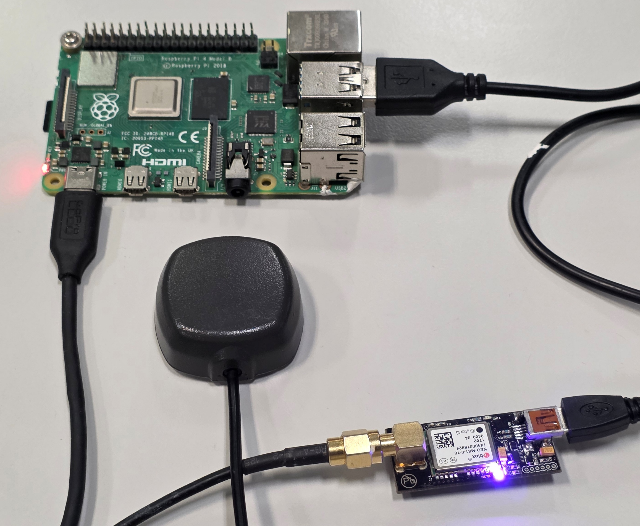
Hardware

Slide 4
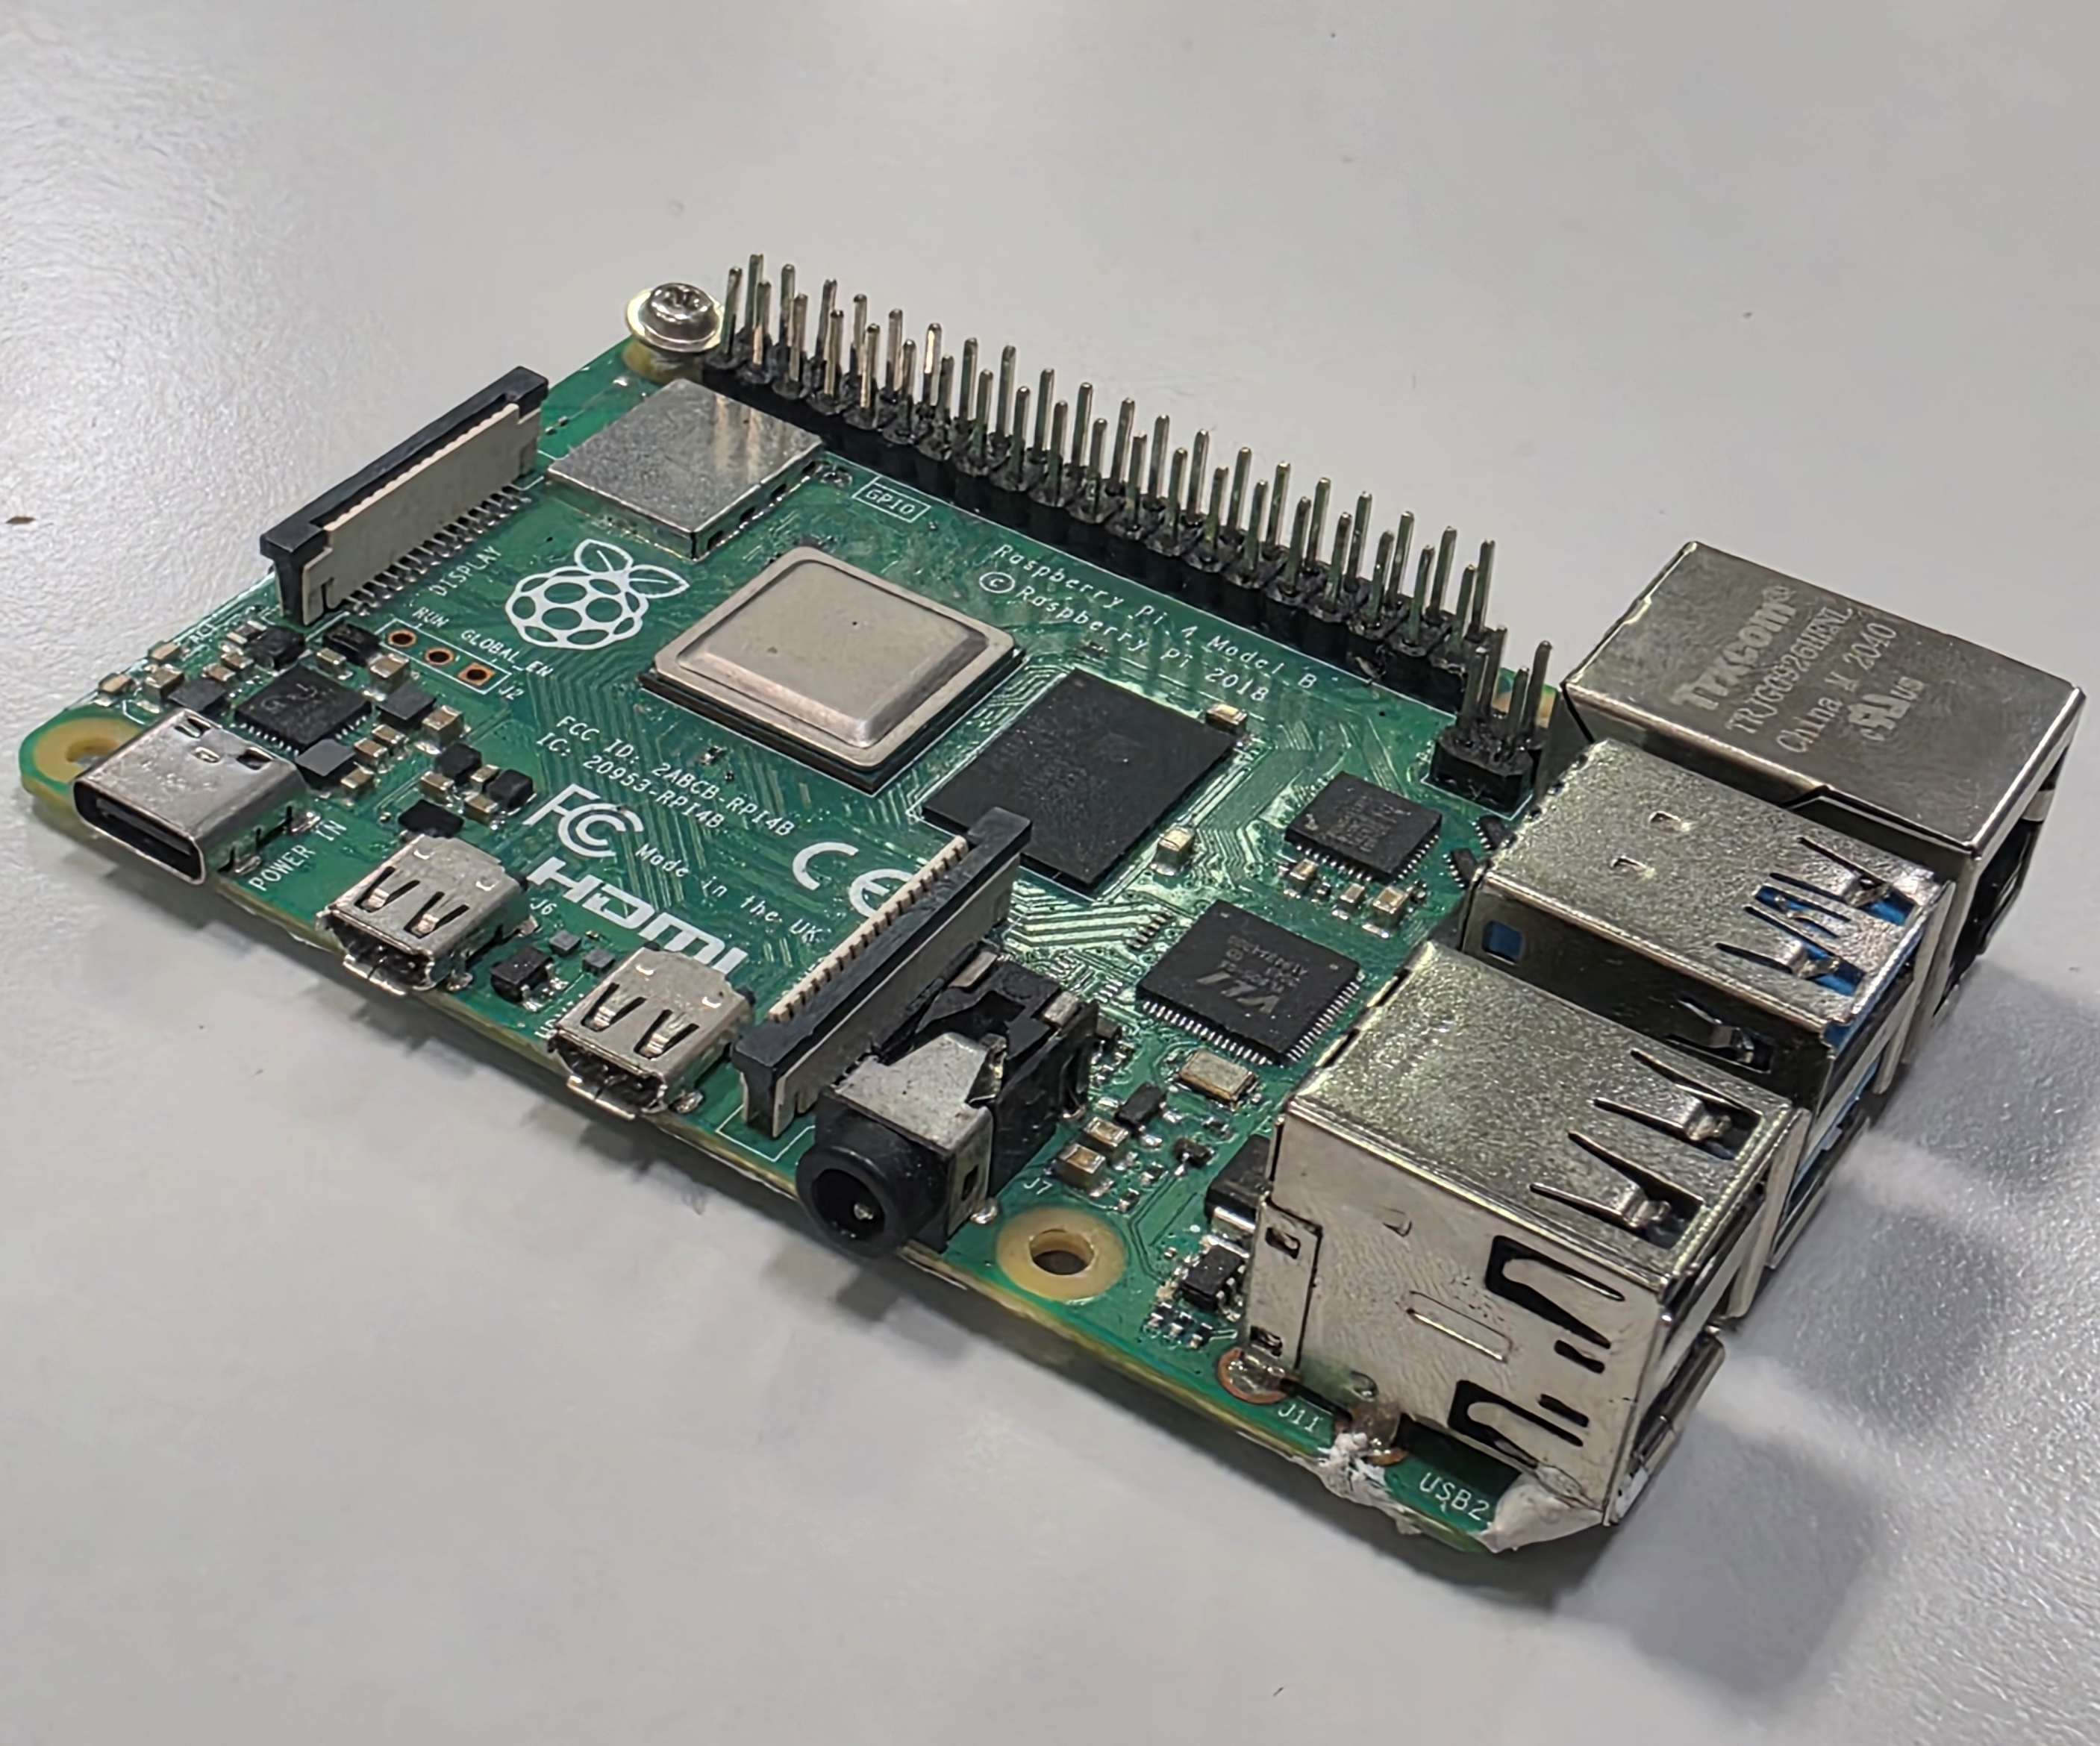
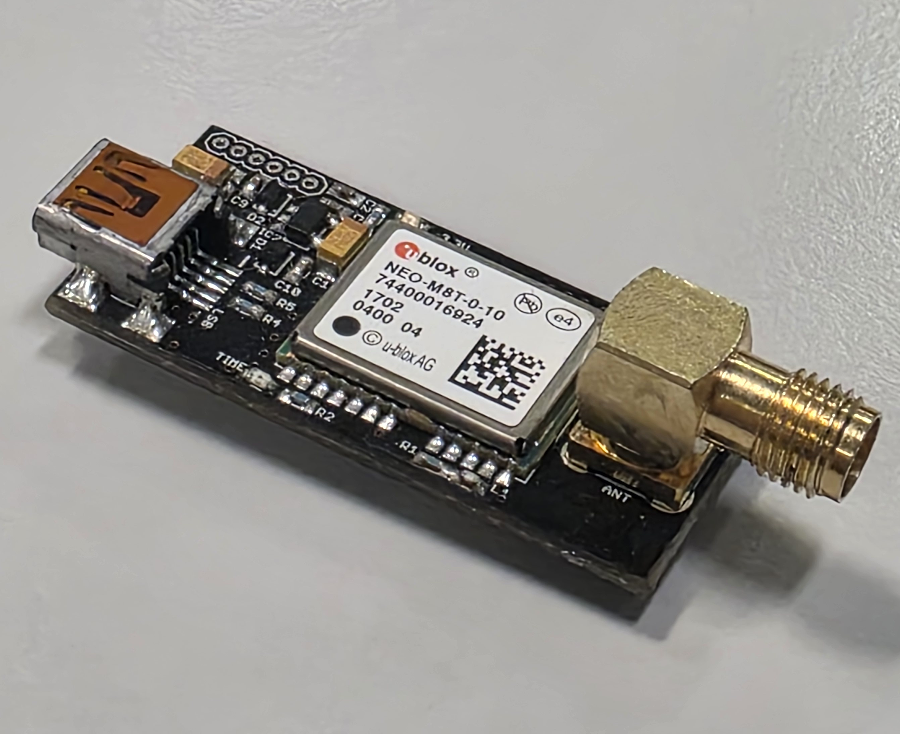
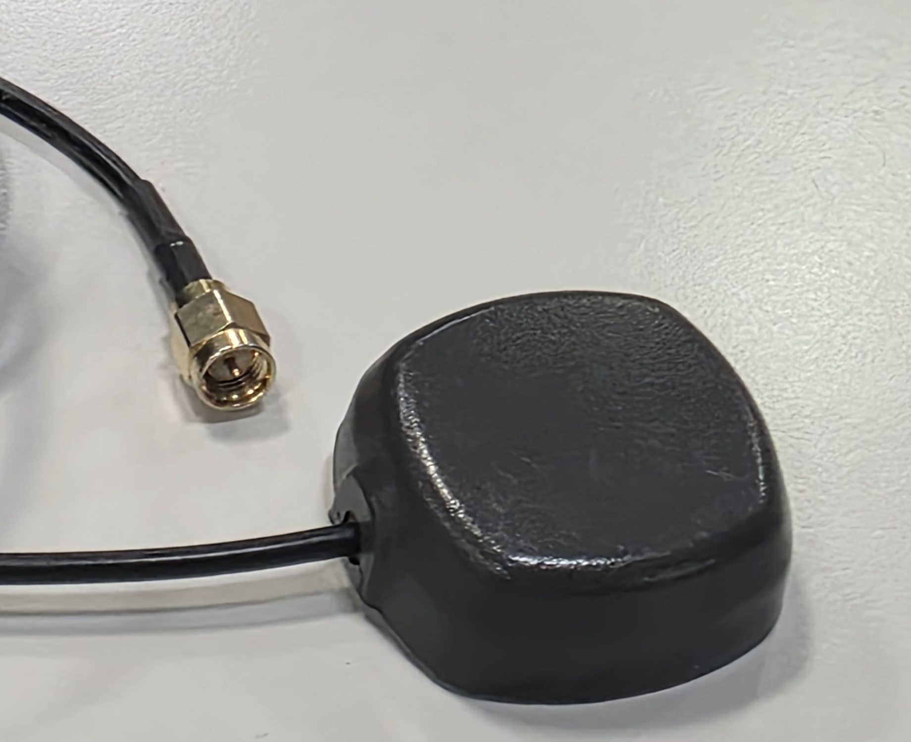
Rover
Raspberry Pi 4B
Ublox NEO-M8T-0
Antenna

Slide 5
Base station
GEOPORTALE – Regione Liguria
Connection to Regione Liguria NTRIP server
MountPoint: NEAR3
Format: RTCM3

Slide 6



Software
Ublox NEO-M8T-0
Raspberry Pi4
Server TCP
RTKlib
NTRIP server
InfluxDB
Live Visualization

Slide 7
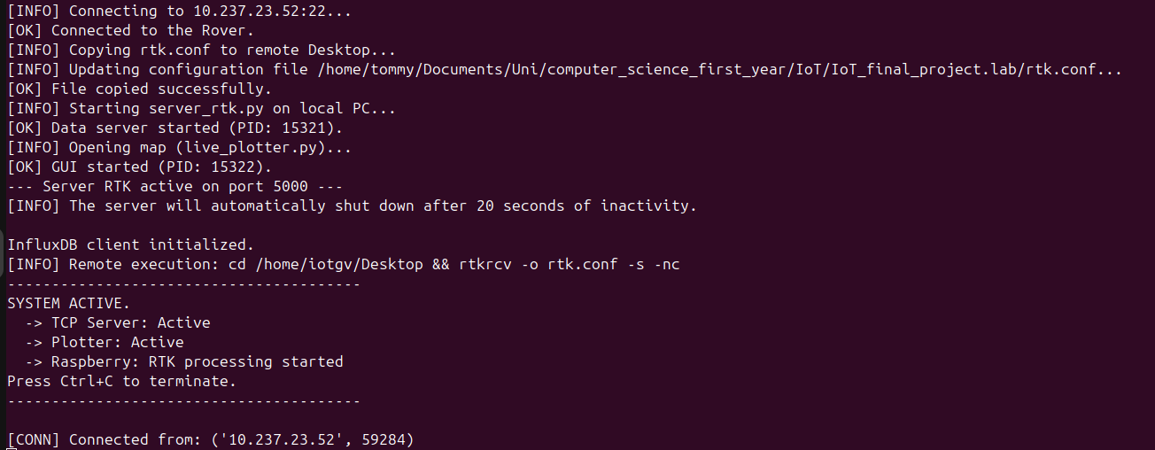
Main_controller.py pipeline
The main_controller.py script manages the connection with the rover (Raspberry Pi) and starts the server and visualization scripts in the following order:
uses SSH to start the RTKLIB instance on the Raspberry Pi
server_rtk.py – handles the rover data stream and the database
live_plotter.py - to visualize the data on the DB
On stdout, the software prints every step of the procedure, displaying error messages and information about the communication status.

Slide 8
Video demo
Test 18/12/2025 Valletta Puggia DIBRIS

Slide 9
Results
We achieved our main goals and reached 20cm precision on the Raspberry Pi. However, because we used low-cost hardware, the results were not always consistent.

