Slide 1
Capital Reserve Study — Physical Condition Survey
315 East 46th Street
New York, NY 10017
RAND Engineering & Architecture, DPC
March 2026

Slide 3
1. Roof

Slide 4
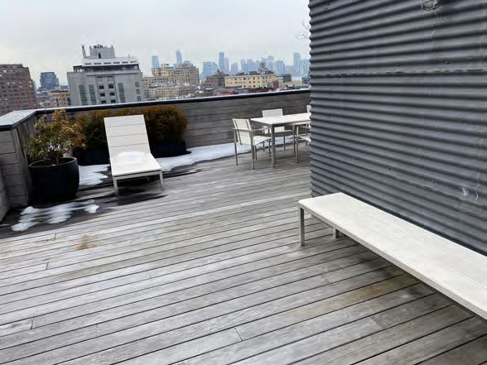
S: Main roof, 10th floor level P: Ponding water on modified bitumen membrane, multiple areas O: Membrane is approx 18 yrs old, ponding observed in 3 areas up to 1.5" deep after rain 2 days ago. Seams lifting at north side. Base flashings cracked at parapet. Wood nailers visible where membrane pulled back. R: Commission roof evaluation ($15K) to determine remaining useful life. Budget full membrane replacement w/ new TPO system incl tapered insulation for positive drainage. T: Year 1 eval, Year 3-5 replacement Cost: $15,000 evaluation + $364,000 replacement

Slide 5
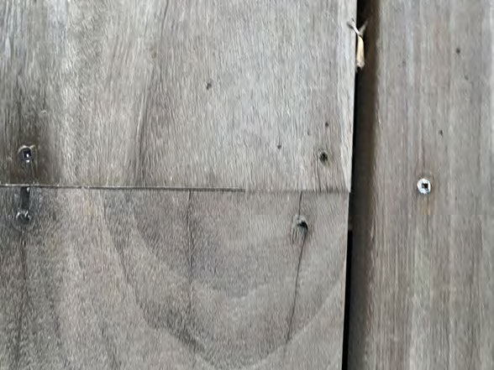
- wood plank decking under membrane at main roof - not code compliant for new construction but grandfathered - fire retardant treatment unknown, prob original 1960s - if membrane replaced need to address decking - could add coverboard or replace w/ non-combustible - info item for now, coordinate w/ membrane replacement

Slide 6
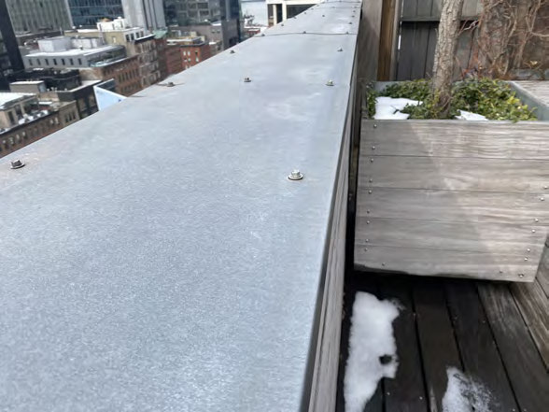
S: Parapet walls all elevations, roof level P: Cracking, spalling, deteriorated coping stones O: Through-wall cracks at multiple locations esp NE corner. Coping stones loose, some missing mortar joints completely open. Water infiltration likely contributing to top floor apt leaks. Will need to be addressed as part of FISP cycle 9 facade work. R: Include in FISP close-out / upcoming cycle scope Cost: approx $250K as part of FISP program

Slide 7
2. Exterior Walls / Facade

Slide 8
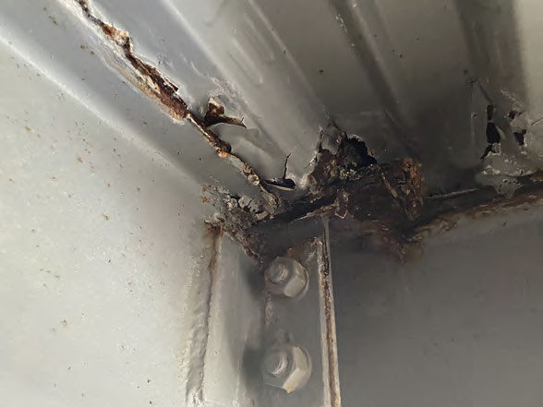
S: East elevation, all floors, brown brick w/ limestone banding P: Spalling brick, cracked lintels, open mortar joints O: FISP cycle 8 close-out completed 2019. Currently in cycle 9 initial inspection phase. Noted spalling at floors 6-8 east side, steel lintels corroding at window heads, efflorescence at limestone bands indicating water migration thru wall assembly. R: Budget for FISP cycle 9 repairs, scaffold full east elevation, repoint, replace damaged brick, clean and paint lintels T: Year 2-4 Cost: $250,000

Slide 9
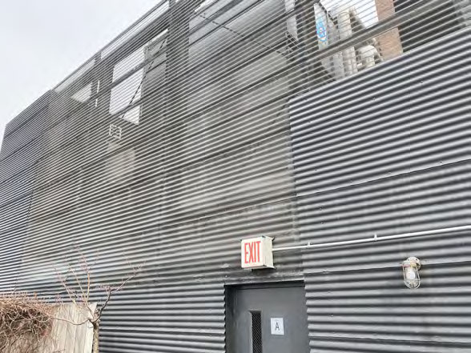
so theres these plexiglass panels at the 4th floor setback terrace area, they were installed maybe 10-15 yrs ago as wind screens but theyre all yellowed and cracked now. a few panels actually missing, just the aluminum frame left. super ugly from the street. honestly dont know why they used plexiglass instead of tempered glass in the first place. gonna need full replacement of all panels w/ new tempered glass or aluminum composite. the framing is aluminum so thats prob ok just needs cleaning and new gaskets. estimate around $171K for the whole thing incl scaffolding access from the setback level. could coordinate w/ facade work to save on scaffold costs. violaiton potential if panels keep falling off.

Slide 10
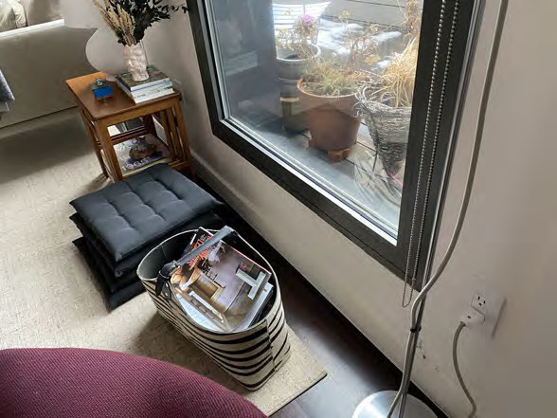
water staining below multiple window heads floors 3-7 east side sealant failed at lintel-to-brick joint, water getting behind facade reseal all window perimeters east elevation ~$15,000

Slide 11
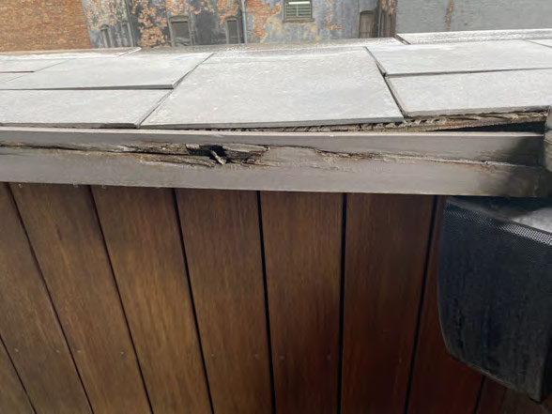
S: Windows all elevations, typ flrs P: Sealant @ window perimeters deteriorated/missing O: Orig sealant approx 20 yrs old, cracked/pulled away from substrate at 60%+ of windows checked. Backer rod exposed in several locations. Air/water infiltration complaints from residents esp upper flrs. Windows themselves are alum thermal break replacements from ~2005, frames in decent shape. R: Remove & replace all ext sealant @ window perimeters bldg-wide T: Yr 1-2 Cost: ~$50K

Slide 12
3. Site / Grounds

Slide 13
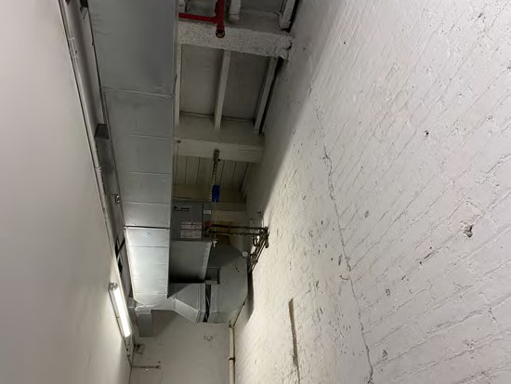
sidewalk flags along 46th st frontage cracked and heaved in a few spots, trip hazard near building entrance. DOT likely to flag on next inspection. building is responsible for sidewalk per NYC admin code. not urgent but should be on the radar. super will monitor and patch as needed. no cost assigned for now, minor concrete patching by staff.

Slide 14
4. Common Areas

Slide 15
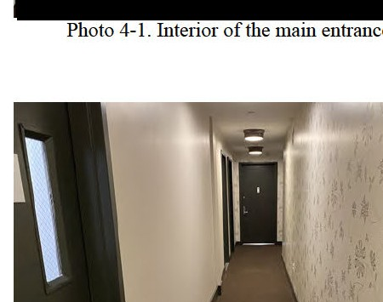
S: Common corridors, all floors P: Carpet worn and stained, some areas torn at seams O: Carpet is approx 15 yrs old throughout corridors. Heavy wear at elevator landings and stairwell entries. Several areas have been patched with non-matching carpet. Underlayment visible at 3rd and 7th floor elevator lobbies. Walls also showing wear — scuff marks, dents from move-ins, paint peeling at several corners. R: Full corridor renovation — new flooring (recommend LVT over carpet for durability), repaint walls, new LED lighting fixtures, update signage. Phase by floor, 2-3 floors per year. T: Year 1-5 phased Cost: $500,000 total phased

Slide 16
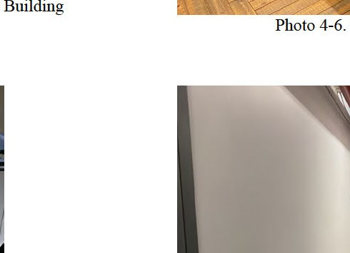
cellar walls are in rough shape — active water seepage at north wall, can see mineral deposits and staining from ongoing leak. paint is bubbling and peeling everywhere down here. the sump pump is running constantly which isnt great (see plumbing notes). theres also some efflorescence on the CMU walls near the boiler room entry which means water is migrating thru. honestly need a waterproofing consultant to come look at this, could be hydrostatic pressure issue or just failed damp-proofing. budget $15K for evaluation and initial remediation. this needs attention soon before it gets worse.

Slide 18
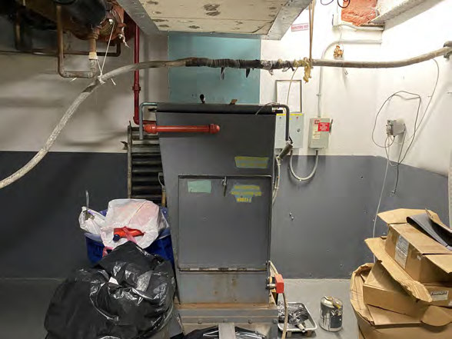
- Trash compactor in cellar service area - Unit is Wilkinson model, approx 12 yrs old - Ram operates but slow, hydraulic fluid leak at cylinder - Container rusted at base, drainage clogged - Odor control system not working - Budget $15K for replacement in yr 3-5 - Current repairs (hydraulic seal + drain clean): $2,500 - Super says it breaks down every few months

Slide 19
5. Interior Finishes

Slide 20
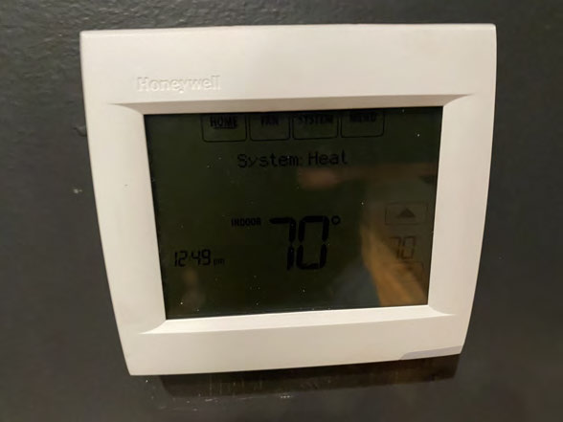
S: Building-wide, energy systems and envelope P: LL84 benchmarking shows poor energy performance score O: Building energy grade is D per NYC benchmarking. Current EUI around 130 which is high for this bldg type. Main drivers are old boiler plant (see HVAC section), no building envelope insulation, single-pane windows at a few remaining original units. anyway the LL97 penalties start hitting in 2024 and this bldg is gonna be over the threshold. need to start planning decarbonization strategy. the low hanging fruit is LED lighting conversion in common areas (mostly done), boiler replacement (see HVAC), and envelope improvements where feasible. R: Develop LL97 compliance roadmap T: Ongoing Cost: est $150,000 for initial improvements (LED completion + controls)

Slide 21
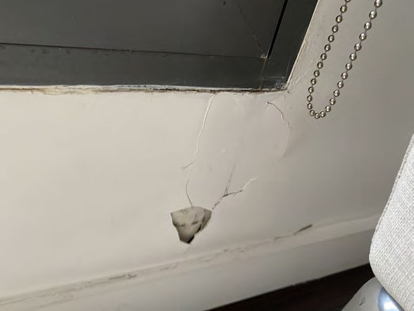
ok so i looked at unit 6B today per the board's request and theres definitely water damage at the ceiling near the exterior wall. looks like its been going on for a while — staining is old and theres some new bubbling in the paint. the plaster is soft when you push on it. this is almost certainly from the facade issues noted on the east elevation — water is getting in at the window head or thru cracks in the brick and running down behind the plaster. once the facade work is done this should stop but the interior damage needs repair too. im gonna say about 30K for interior repairs to affected units on the east side, theres prob 4-5 units with similar issues based on complaint log.

Slide 22
6. HVAC

Slide 23
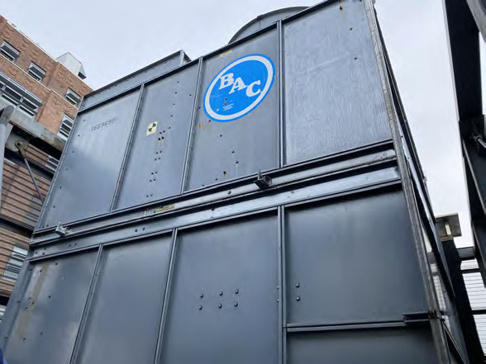
S: Cooling tower, roof level P: Tower is aging, fill media degraded, drift eliminators damaged O: BAC model, approx 20 yrs old. Fill media sagging, several sections of drift eliminators cracked/missing. Basin has corrosion at drain. Motor and fan operational but vibration noted. Water treatment program in place via Chem-Aqua. Tower services lobby and common area AC system only (individual units have their own PTACs). R: Replace fill media and drift eliminators now. Budget full tower replacement in 5-7 yrs. T: Year 1 repairs, Year 5-7 replacement Cost: $15,000 current repairs

Slide 24
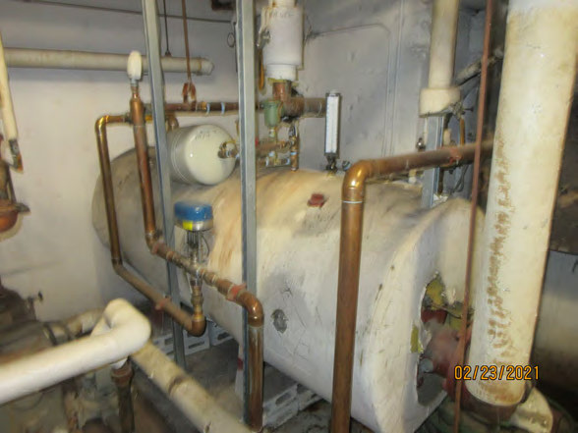
S: Boiler room, cellar level P: Dual boiler plant approaching end of useful life O: Two Burnham V906A cast iron boilers, installed approx 2003, natural gas fired. Boiler #1 has cracked section (repaired but section weeping slightly). Boiler #2 operating ok but combustion test showed 81% efficiency which is below what you'd want. Breeching is original galv steel, rusting at joints. Chimney liner status unknown — recommend video inspection. Controls are Honeywell but the BMS integration is minimal, basically just on/off with OAT reset. R: Plan full boiler plant replacement w/ high-eff condensing units, new breeching, controls upgrade, BMS integration T: Year 3-5 Cost: part of $1M mechanical systems budget

Slide 25
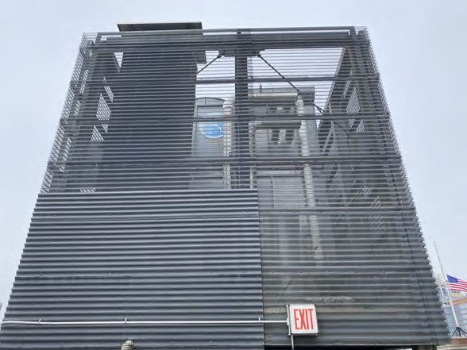
RTU condensing units on roof — 3 units serving common area AC Unit 1: Carrier 50XC, ~15 yr, R-410A, operational, noisy compressor Unit 2: Carrier 50XC, same age, low on charge per super Unit 3: Trane unit, newer ~8 yr, good shape all units on curbs, ductwork thru roof penetrations recommend replacing units 1&2 in next 3-5 yrs coordinate w/ roof membrane replacement part of future mech systems budget

Slide 26
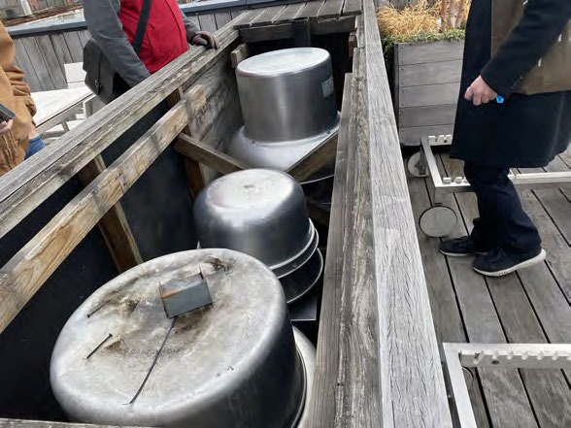
exhaust fan enclosure on roof: [x] kitchen exhaust fan — operational, belt worn [x] garage exhaust fan — operational, loud bearing [ ] bathroom exhaust riser fans — 2 of 4 not working per residents [x] boiler room exhaust — ok [x] electrical room exhaust — ok need to replace belts on kitchen fan, investigate bathroom exhaust minor maintenance items, super can handle most of it

Slide 27
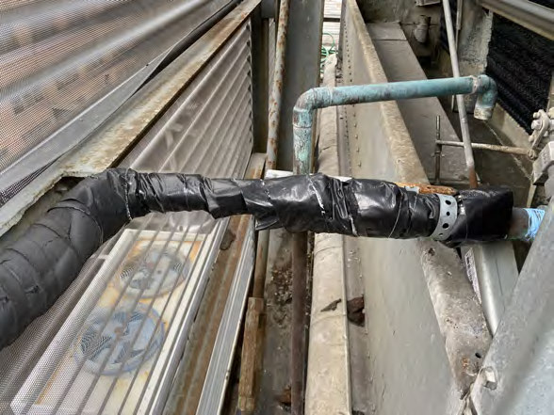
piping insulation throughout cellar and mech spaces is a mess. some sections are original — looks like calcium silicate type, could be asbestos era material (bldg is 1963). other sections were re-insulated w/ fiberglass at some point but the jacketing is torn and falling off. the chilled water lines are sweating where insulation is missing which is causing corrosion on the pipes and water on the floor. honestly the whole cellar needs an insulation survey. if theres ACM thats a whole other budget item for abatement. for now just noting as part of overall mech systems budget super says the asbestos survey from 2018 found some in the boiler rm pipe insulation — need to pull that report

Slide 28
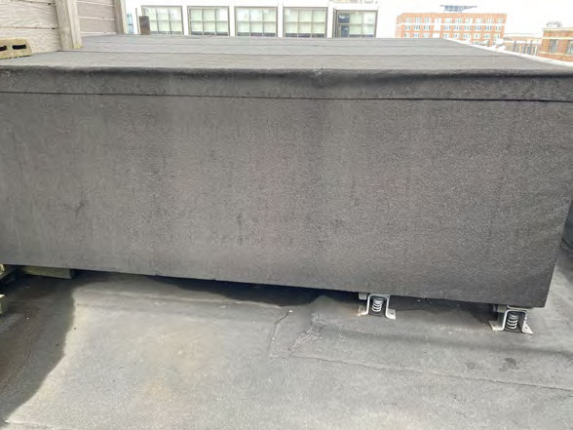
steam humidifier on AHU serving lobby — not operational DriSteem unit approx 10 yrs, cylinder is shot, control board error replace cylinder and control board $4,500

Slide 29
7. Electrical

Slide 30
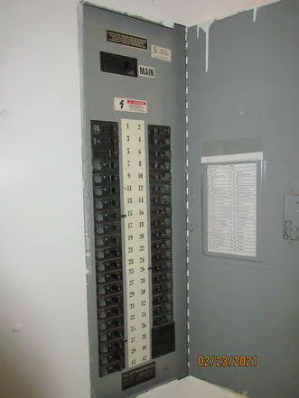
S: Main electrical room, cellar P: Main switchgear and distribution panels O: Main service is 1200A 208/120V 3-phase from ConEd vault. GE Spectra series switchgear, installed approx 2001 during prior electrical upgrade. Panels in fair condition. Arc flash study was done in 2019 — labels present but some are faded/illegible. Working clearances are tight in spots, storage items encroaching on the 36" clear zone per NEC 110.26. Need to clean up the room. R: Update arc flash labels, enforce clearance requirements, thermographic scan recommended T: Year 1 Cost: $5,000 for arc flash update and thermo scan

Slide 32
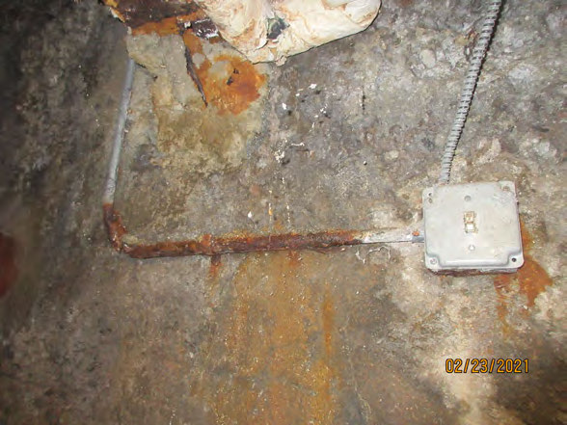
found 3 open j-boxes in cellar corridor: 1. near boiler rm door — no cover, wires exposed, splice w/o wirenut 2. above ceiling at laundry rm — cover missing, abandoned wires 3. mech rm wall — cover loose, conduit disconnected code violation NEC 314.25 — all j-boxes must have covers also saw some BX cable w/ damaged jacket near sump pit electrician to correct all — est $7,500 priority: safety issue

Slide 33
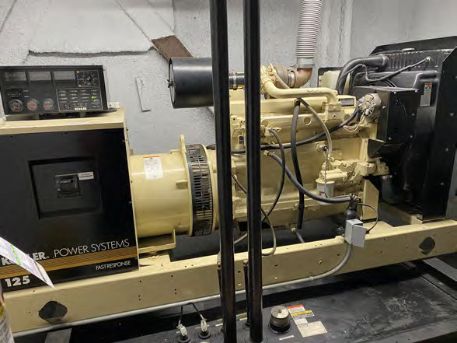
S: Emergency generator, cellar mechanical room P: Diesel generator set for emergency/standby power O: Cummins 100kW diesel genset, installed 2010. Serves emergency lighting, fire alarm, fire pump, and elevator recall per NYC code. Auto transfer switch is Asco 300 series. Unit is load bank tested annually per super — last test report 2024. Fuel oil day tank in cellar, main storage tank (275 gal) in vault. Generator appeared clean and well-maintained. Battery charger operational. Block heater working. Exhaust piping routed to exterior, no visible leaks. R: Continue annual load bank testing and maintenance program. Budget for major overhaul (injectors, turbo, etc) at 15-yr mark. T: Year 5+ for overhaul Cost: future budget item

Slide 34
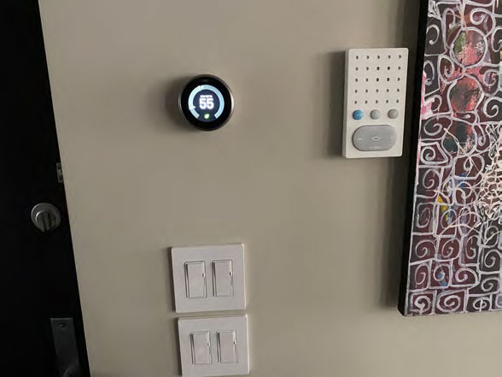
the intercom system in the lobby is one of those old Aiphone units from like the early 2000s. it still works but the handsets in a bunch of units are broken and the directory panel in the vestibule is all scratched up. the super said they keep replacing handsets but its getting hard to find parts. honestly for 19 units its not a huge deal to replace the whole system. the new ones have video and phone integration which the residents have been asking about anyway. not a capital item really, just periodic maintenance and eventual upgrade when parts run out.

Slide 35
8. Plumbing

Slide 36
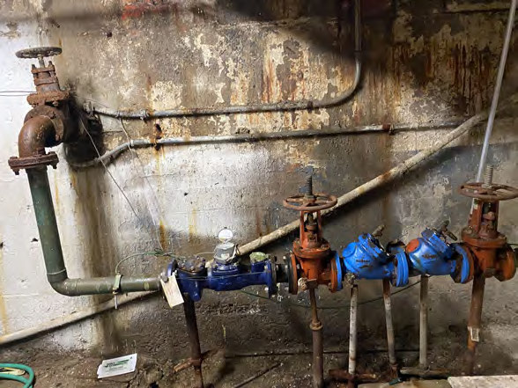
S: Domestic water booster pump, cellar mechanical room P: Booster pump showing wear, vibration, reduced performance O: Grundfos CRE 15-3 variable speed booster pump, installed 2012. Pump is vibrating more than normal — bearings likely wearing. Flow rate adequate but upper floor residents report occasional low pressure during peak usage. VFD display shows no faults but running at higher speed than expected for the demand. Pressure tank bladder may also need replacement — tank is original 2012. R: Rebuild pump (bearings, mechanical seal, impeller inspection). Replace pressure tank bladder. Evaluate if second pump needed for redundancy. T: Year 1-2 Cost: $25,000

Slide 37
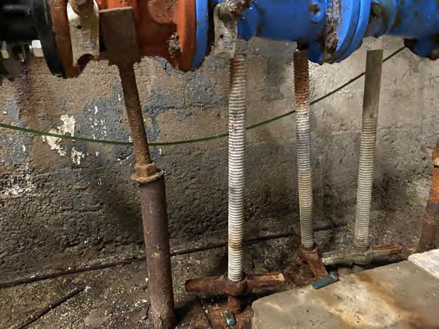
BFP in cellar near water entry: - Watts 909 RPZ, 4", installed ~2015 - annual test current per DOB/DEP reqs - relief valve weeping slightly — needs rebuild kit - test cocks operational - strainer upstream needs cleaning - DEP cross-connection report on file est $5K for rebuild and strainer service mandatory compliance item — must maintain

Slide 38
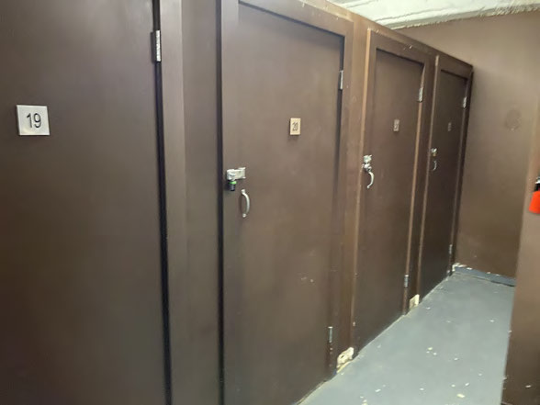
the sump pump situation in the cellar is concerning. theres one sump pit with a single pump — no redundancy at all. the pump is running almost continuously which tells me either groundwater infiltration is significant or the pump is undersized. the pit is full of sediment, hasnt been cleaned in who knows how long. if this pump fails during a heavy rain event the cellar is going to flood. saw water marks on the walls from previous flooding events — super confirmed it happened twice last year. strongly recommend installing duplex pump system with alternator and high water alarm. also clean the pit and install a proper check valve. this should be year 1 priority. Cost: est $5,000

Slide 39
9. Fire Protection

Slide 40
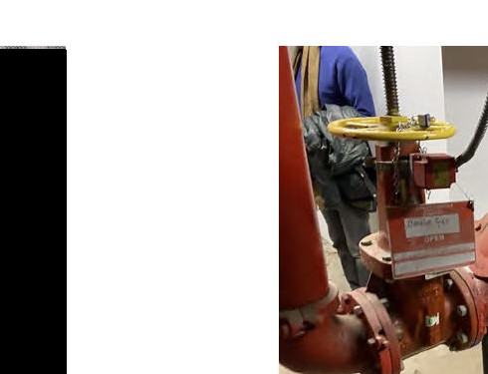
S: Fire pump room, cellar level P: Fire pump operational but components aging O: Aurora 100 GPM electric fire pump, installed 2005. Pump tested annually per NFPA 25 — last test showed adequate flow and pressure. However: jockey pump cycles frequently (possible system leak), controller is showing corrosion at wire terminations, and the test header drain piping is corroded and leaking slightly. Fire dept connection (FDC) siamese on facade is functional but caps are missing. Sprinkler system is wet pipe in cellar and parking only — upper floors are non-sprinklered (pre-LL26 building). R: Current — repair jockey pump, replace test header piping, new FDC caps, investigate system leak. Future — evaluate LL26 sprinkler retrofit requirements and timeline. T: Year 1 current, Year 5-10 sprinkler retrofit Cost: $15,000 current repairs + $125,000 future sprinkler retrofit

Slide 41
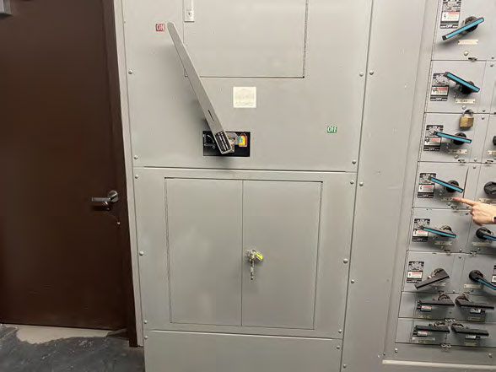
fire alarm panel — Notifier NFS-320, installed 2008 panel showing 3 trouble conditions: 2 supervisory (flow switch zones 3 & 5) and 1 ground fault ground fault needs to be traced and cleared ASAP flow switch issues are prob bad tamper switches — replace also: pull stations in stairwells need testing, havent been tested this year per super FDNY may cite on next inspection if troubles not cleared minor cost — electrician + fire alarm tech, few thousand $

Slide 42
10. Elevators

Slide 43
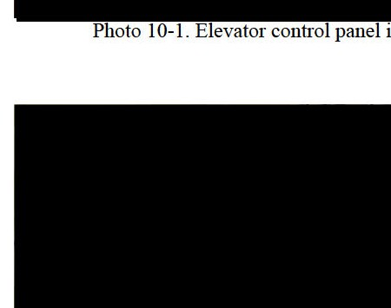
looked at the elevator machine room on the roof — its one hydraulic passenger elevator serving all 10 floors. the machine is a Dover (now ThyssenKrupp) holeless hydraulic from what looks like a 1990s modernization. controller is a Motion Control Engineering (MCE) unit. the machine room is hot — no ventilation fan? need to check code on that. oil in the tank looks dark, when was it last changed? super doesnt know. jack packing is seeping a little. the power unit motor sounds ok but the starter contacts are probably pitted after 30 yrs. the big question is whether this needs a full mod or just component upgrades. cab is worn too (see next slide). maintenance contract is with Champion — need to review the contract scope. ongoing maintenance, no specific cost assigned here

Slide 44
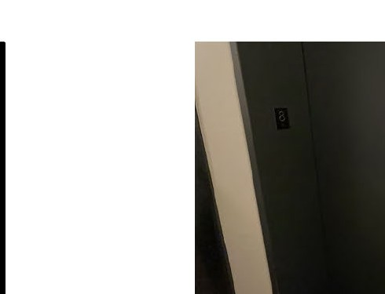
elevator cab interior is pretty tired looking. the pads are always on because of constant move-ins in a 19-unit building which honestly makes sense. underneath the pads the walls are scratched stainless, floor is worn vinyl, ceiling panel is yellowed and one light is out. the door operator is slow and sometimes catches on peoples bags — super gets complaints weekly. handrail is loose on one side. the board has been talking about a cab renovation for a while. recommend doing it as part of a broader elevator modernization that includes new controller, door operator, cab interior, fixtures, and ADA-compliant controls. that way they only shut down the elevator once and do everything together. budget around $250K for full mod including cab T: Year 3-5

