Slide 1

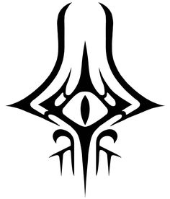
DisPAtron5e
A Discord bot for assistance in dungeons and dragons 5e
Written and coded by Nathan Russell

Slide 2
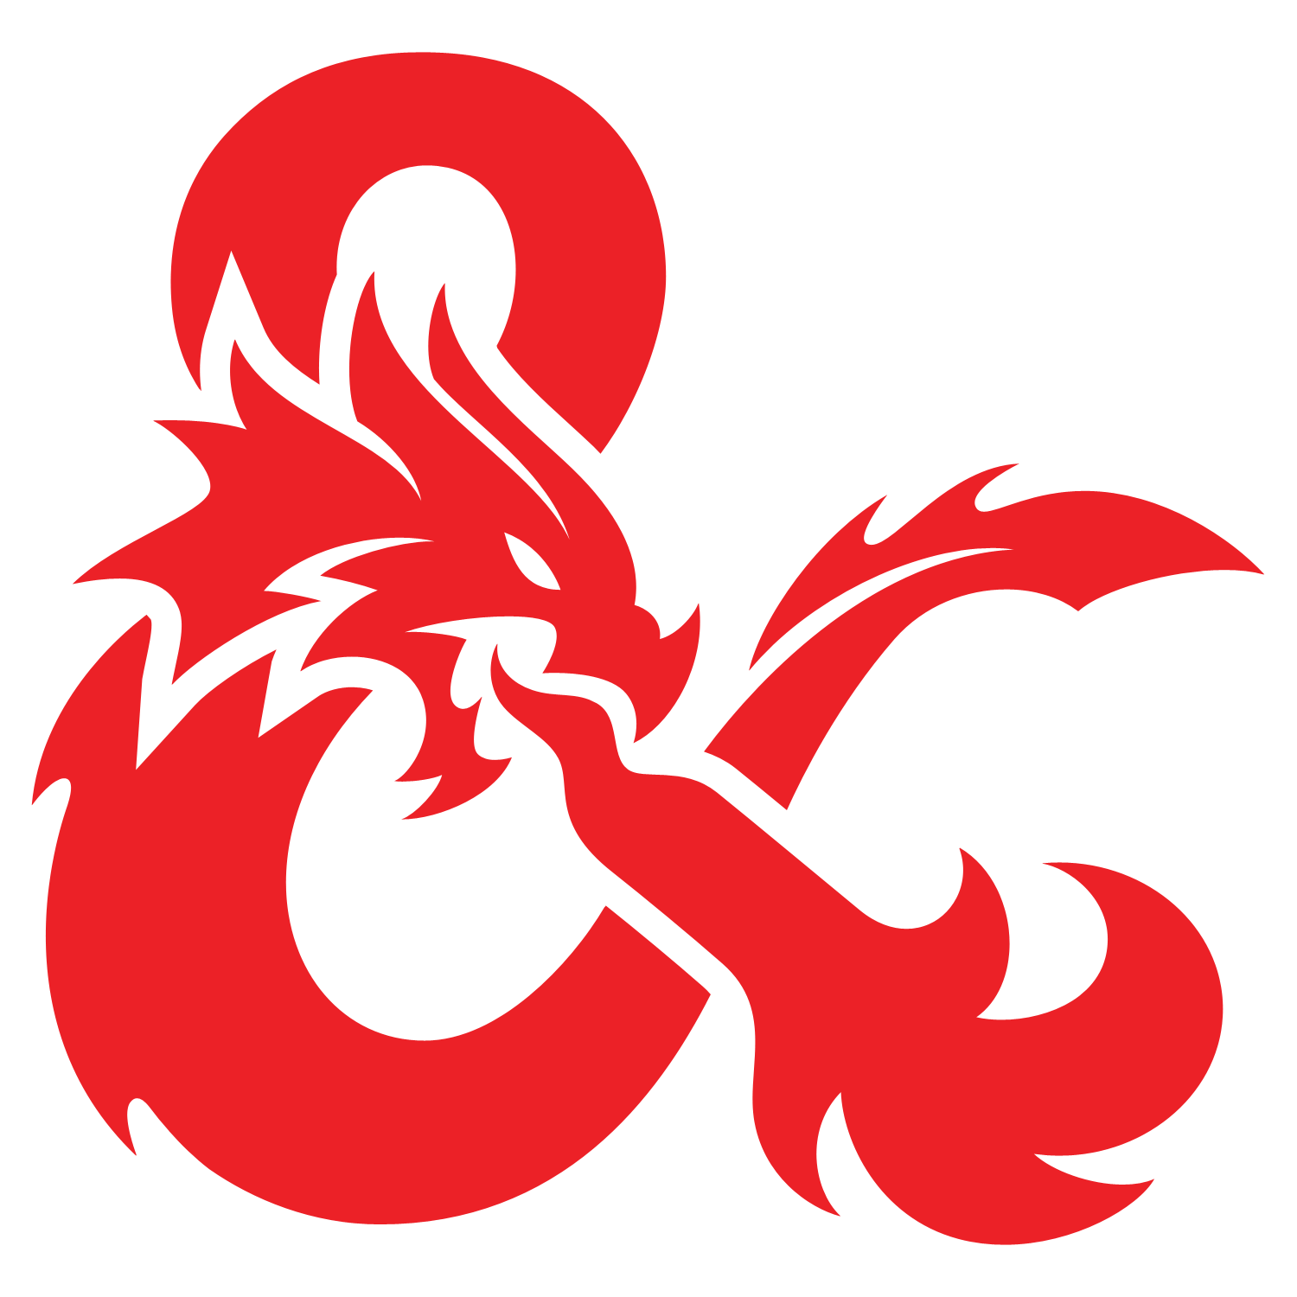
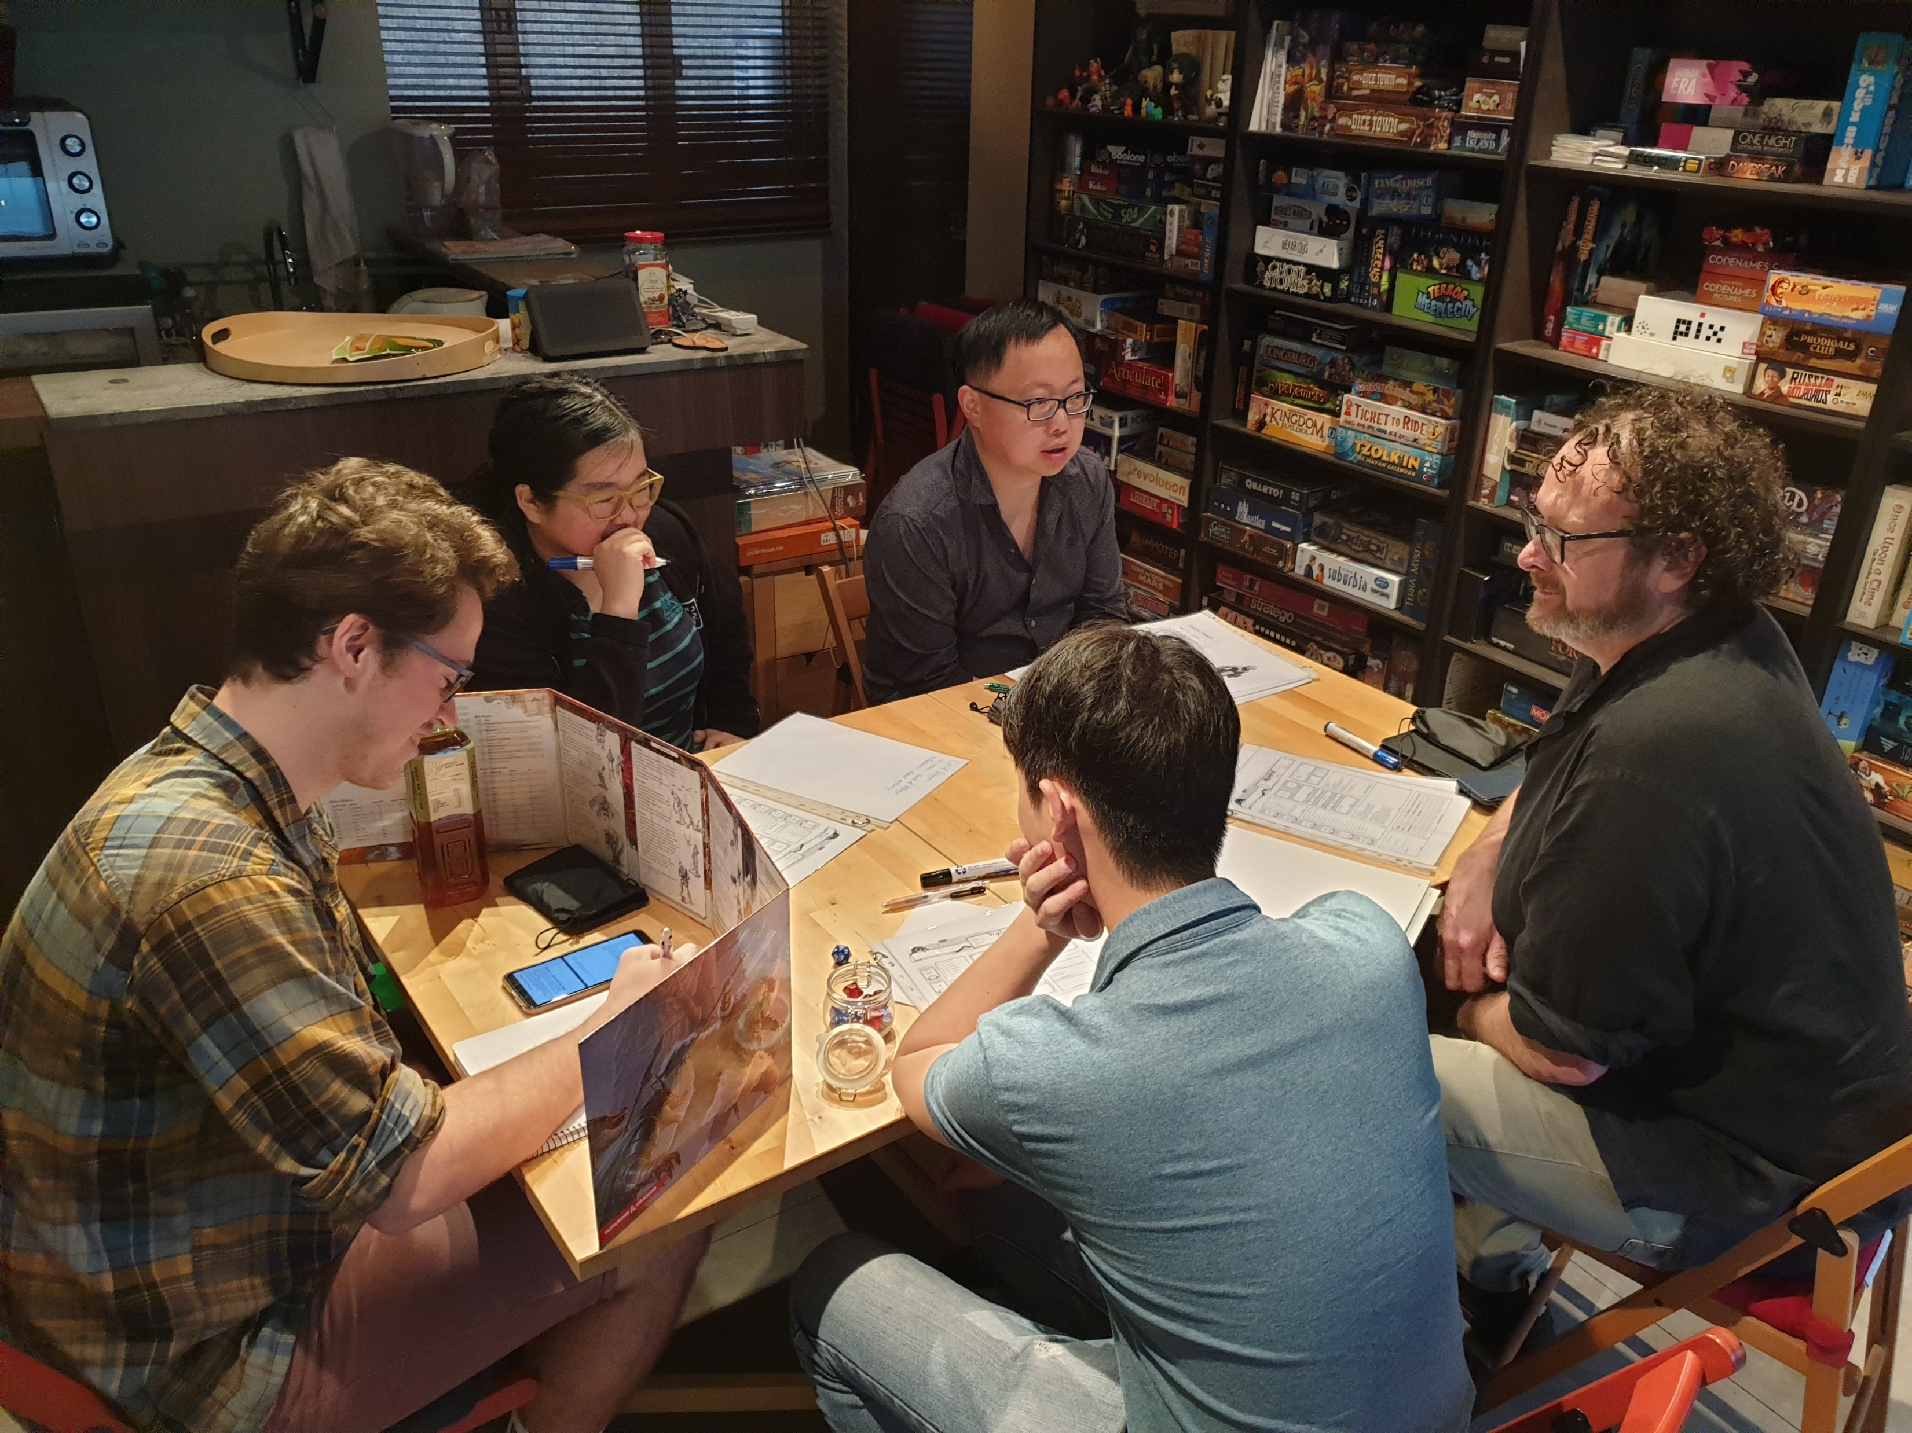
Dungeons and Dragons
Dungeons and Dragons (D&D) is a fantasy table top roleplaying game.
Normally played in person
Players roll dice to perform skill checks that are narrated by a person in charge known as the Dungeon Master (DM)

Slide 3
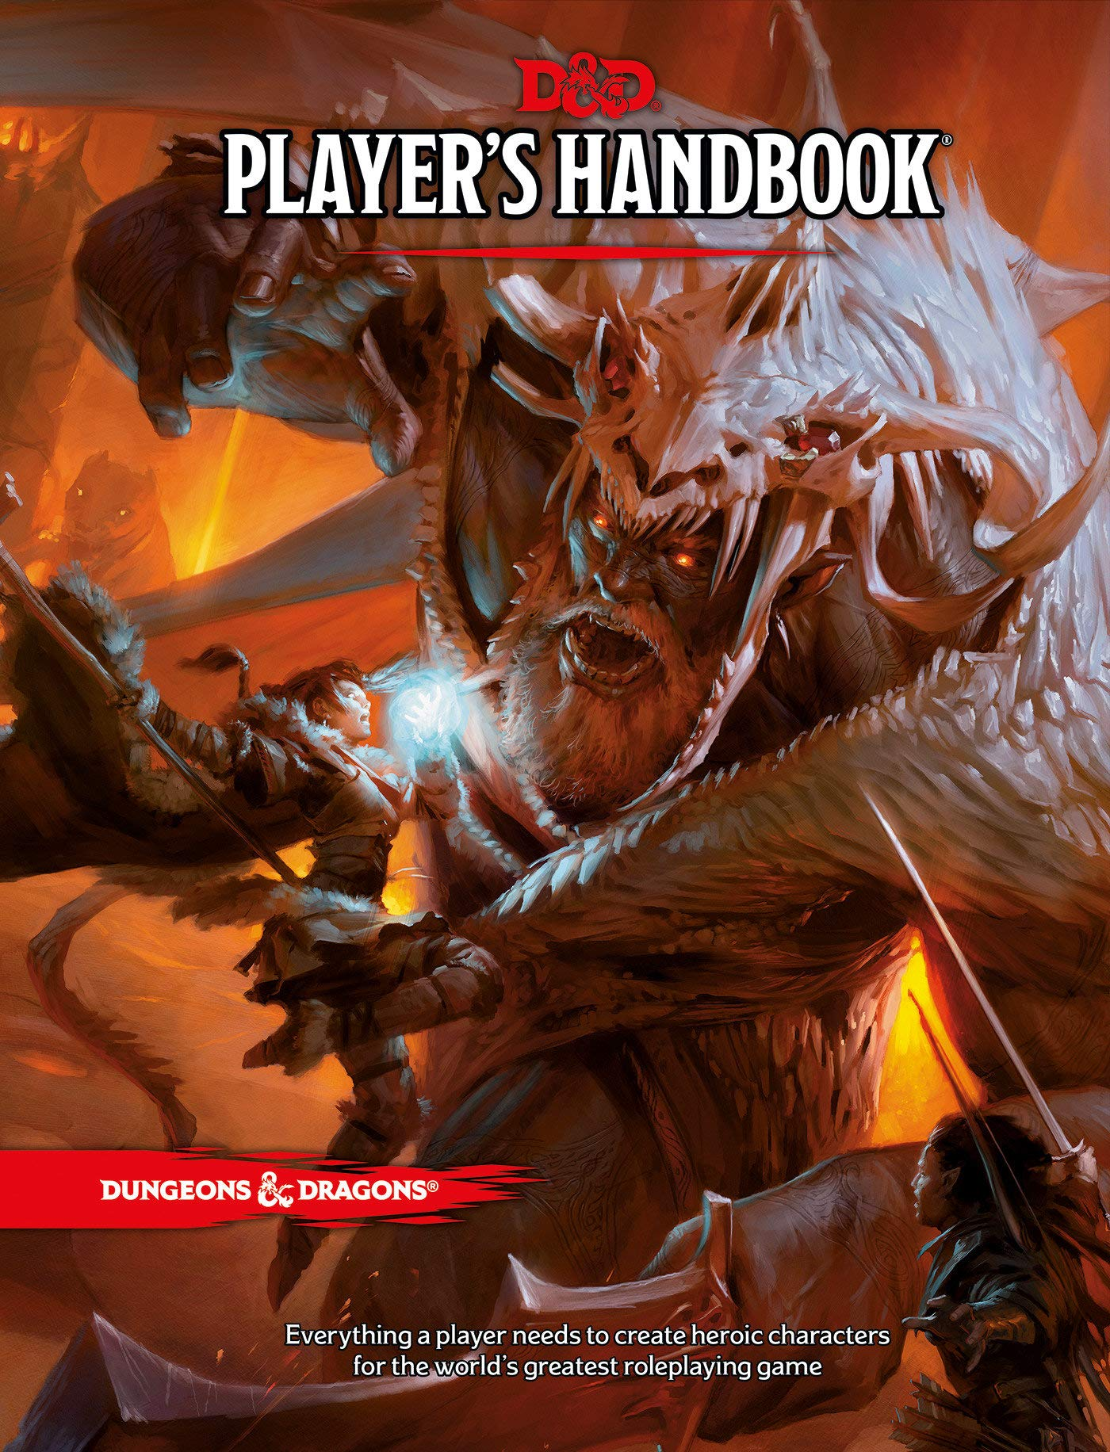
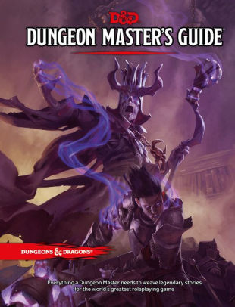
Purpose for the Bot
A great tool for new players, veterans, and any Dungeon Master
Easy access to information from the D&D 5e Player’s Handbook and Dungeon Master’s Guide.
In-game races
Weapons tables
Spell Levels
More
Allows for dice rolls of all kinds
Easy addition of rolls

Slide 4

Utilize both features from discord and DisPatron
Can use secret channels for important rolls by the DM
Public Channels for rolls by the players
Voice Channel can be used for the roleplaying aspects

Slide 5
Live Demonstration

Slide 6

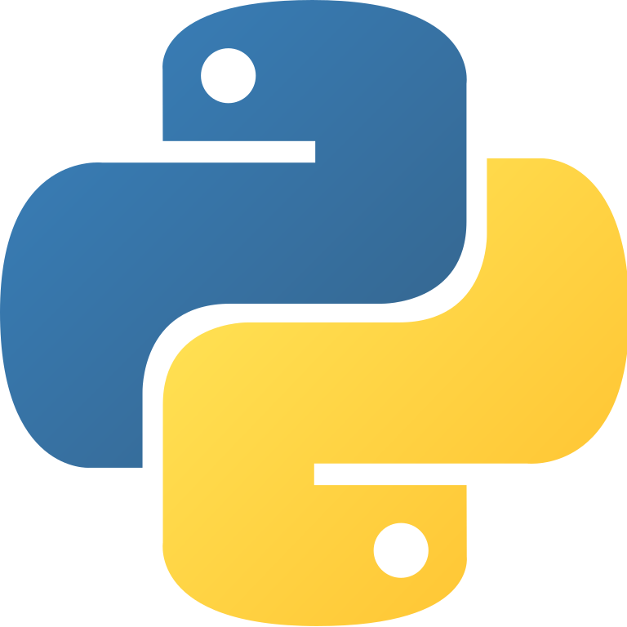
Hosts and tools
Hosted via Pebble
Libraries used
OS, Discord.py, nest_asyncop, dotenv
Created in Python 3.8
IDE used was Spyder 5.0

Slide 7
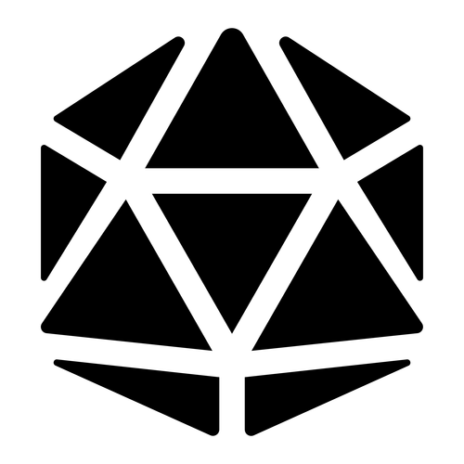
Future Updates
Allow access to submit character sheet information
To make dice rolls automatically add specific information depending on the roll.
Insert more information from the other various D&D handbooks.
Implementations of initiative charts
Information from the monster manual and combat tracker
Much more

Slide 8
Thank you

Slide 9
Resources
Python - https://www.python.org/
Spyder and Development Tools - https://www.spyder-ide.org/
Discord Development - https://discord.com/developers/applications
Pebble Discord Hosting - https://pebblehost.com/bot-hosting
Learning - https://realpython.com/how-to-make-a-discord-bot-python/ & https://betterprogramming.pub/how-to-make-discord-bot-commands-in-python-2cae39cbfd55

