Slide 1
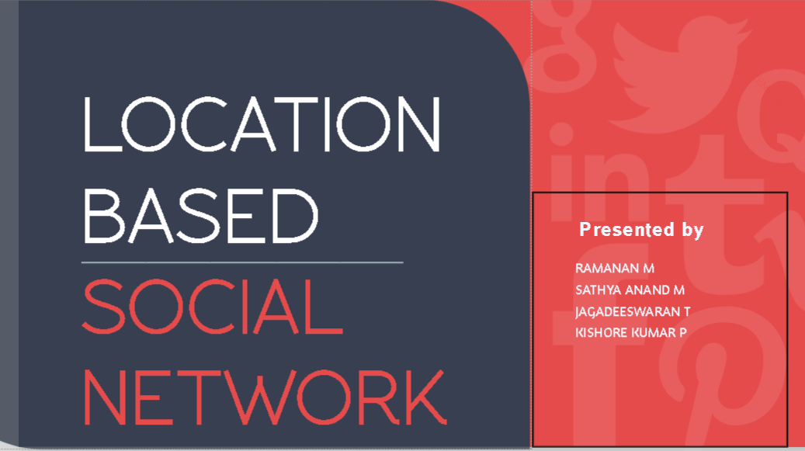

Slide 2
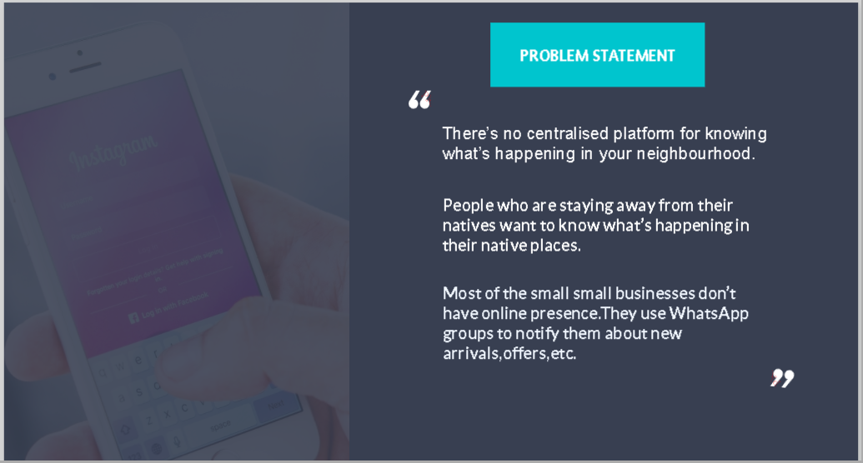

Slide 3


People can know what is happening in their neighborhood like festivals,offers in stores,new business openings etc.
It helps the small businesses to easily advertise their products
It can be used to notify people during emergencies.
It is also used to make the users to select a location to view the public posts in that location

Slide 4
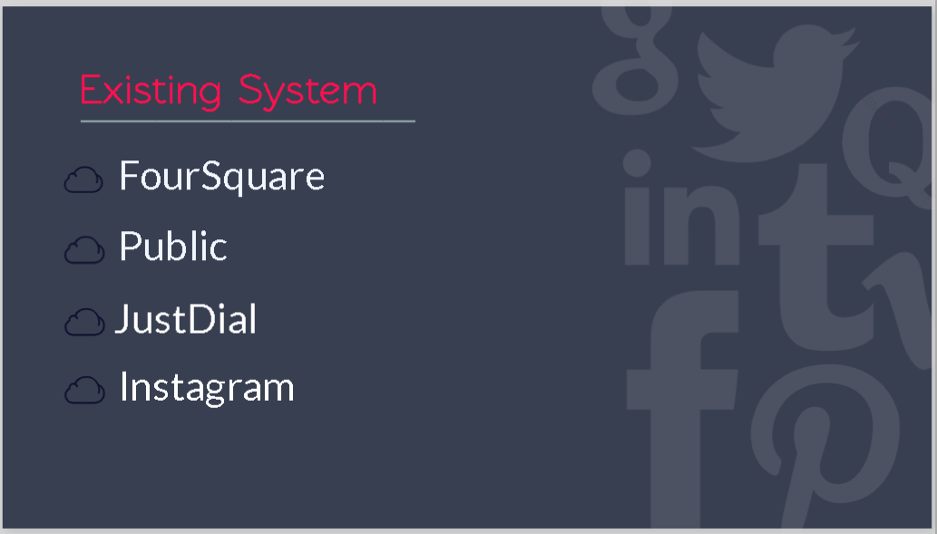

Slide 5
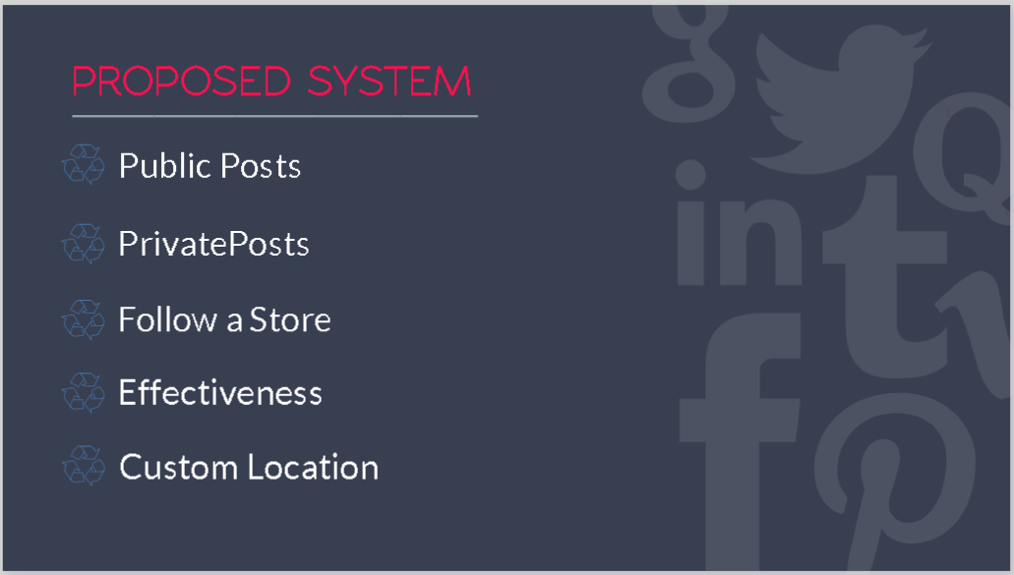

Slide 6
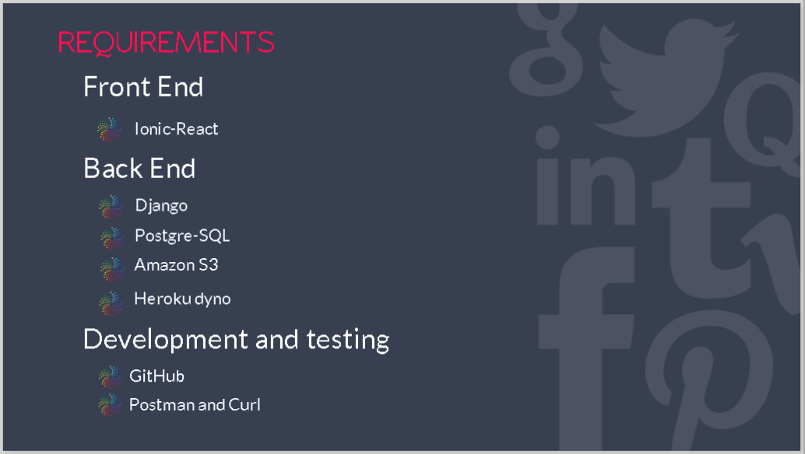

Slide 7
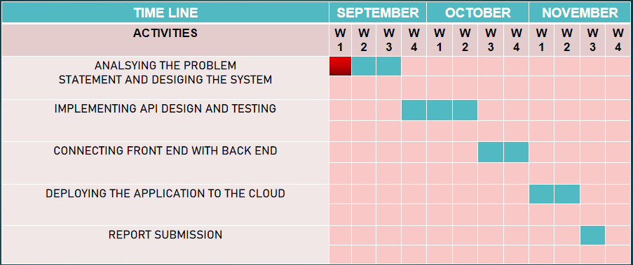
TIMELINE
WORK IN PROGRESS

Slide 8
