Slide 1

Vessel Visualization using Curvicircular Feature Aggregation
-Raphael Krauthann

Slide 2
Agenda
Medical Background
Algorithm
Discussion and Limitations
Alternatives and Comparison
Conclusion

Slide 3
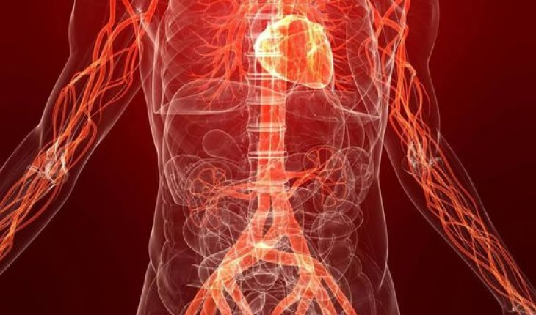
Medical Background
The average human…
…has 96.000km of blood vessels
…pumps 6L of blood every minute
…has 7% of his bodyweight consisting of blood
https://www.livescience.com/39925-circulatory-system-facts-surprising.html

Slide 4
Medical Background
What are Cardiovascular diseases?
Diseases of blood vessels supplying
Brain (cerebrovascular)
Heart (coronary)
Arms and Legs (peripheral)
Heart Diseases
Thrombosis (blood clots that can move to heart/brain/lungs)
CVDs number one cause of death globally
(estimated 17,9 million in 2016 / 31%)
https://www.who.int/news-room/fact-sheets/detail/cardiovascular-diseases-(cvds)

Slide 5
Medical Background
“People with cardiovascular disease or who are at high cardiovascular risk […] need early detection and management using counselling and medicines, as appropriate.”
- WHO

Slide 6
Medical Background
Fast and precise diagnosis is key
Complex data is time-intensive to analyze
Many slices are generated
All viewing angles need to be reviewed
On Computed Tomography Angiography (CTA) data, one angle is not enough to distinguish completely from partially calcificated vesslels

Slide 7
About Curvicircular Feature Aggregation (CFA)
Reducing the amount of interaction
Removing the need to rotate around the vessel
Creating a single static image
Based on Maximum Intensity Projection (MIP) and Curved Planar Reformation (CPR)

Slide 8
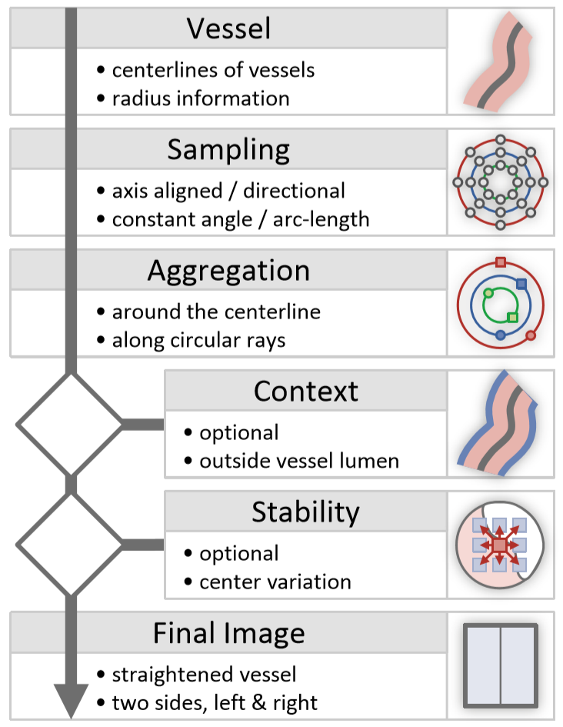
Algorithm

Slide 9
About Curved Planar Reformation (CPR)
Planar cuts along given path (most likely vessels)
Images can be isometric depending on used algorithm
Types: projected, stretched, straightened
Multipath-CPRs possible with multiple branches

Slide 10
Algorithm - Vessel
Just like in CPR, the centerlines are calculated for the vessel, resulting in centerpoints on which samples can be made
Vessel radius is determined (or should be available) for each slice
For each centerpoint the direction of the vessel needs to be found

Slide 11
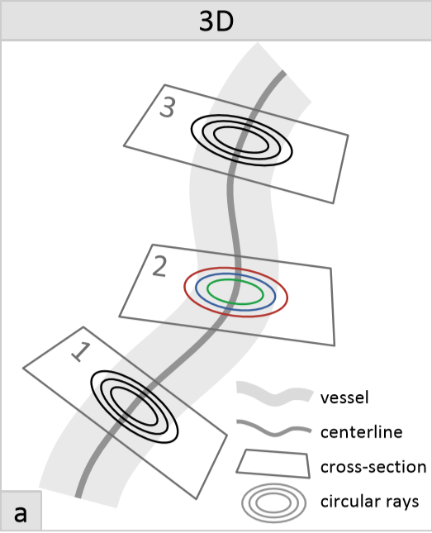
Algorithm - Sampling
For each reformed slice circular rays are cast, either at constant angles or constant arc-length
(constant arc-length may result in long computations on high radii)

Slide 12

Algorithm - Sampling
n are the numbers of samples
X is the center
r and s are the projecting vectors of the plain
(1,0,0) and (0,1,0) if the vessel is orthogonal on the plane
R is the radius of the current circular ray cast

Slide 13
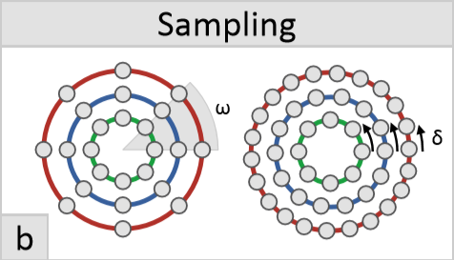
Algorithm - Sampling

Slide 14
Algorithm - Aggregation
For every slice the values of all ray casts are aggregated using either
MIP detects complete califications
Minimum Intensity Projection (MINIP) detects minor plaque
Average Intensity Projection (AVG)
MIP and MINIP are medically the most interesting
The two are presented next to each other

Slide 15
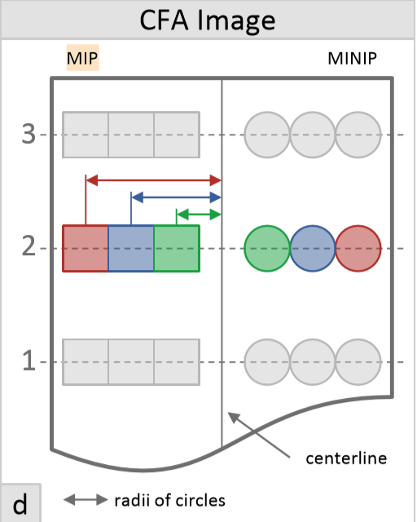
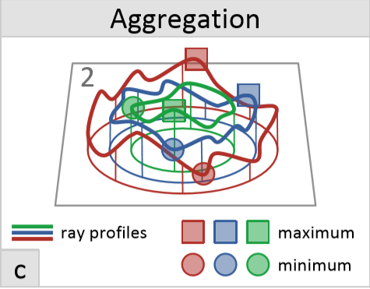
Algorithm - Aggregation

Slide 16
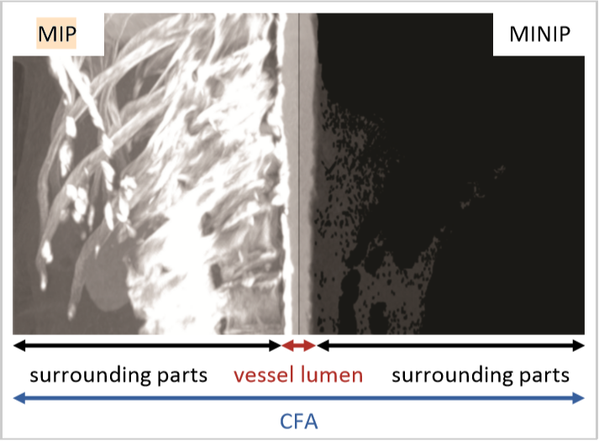
Algorithm - Aggregation
Other aggregation operators possible like AVG
Have to be order independent (like min or max)

Slide 17
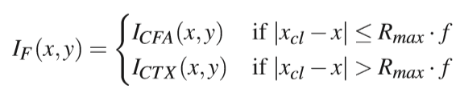
Algorithm – Context (optional)
I_CTX is the context image data
Within the vessel the context image data should be used
The factor f should be greater then one to make sure the context image starts outside the vessel (2 in the paper implementation)

Slide 18

Algorithm – Stability (optional)
i and j are within [–w;w], where w is a user defined positive integer
r and are orthogonal vectors
These points are samples, and the variance between them is the indicator for the stability
High variances are marked red

Slide 19
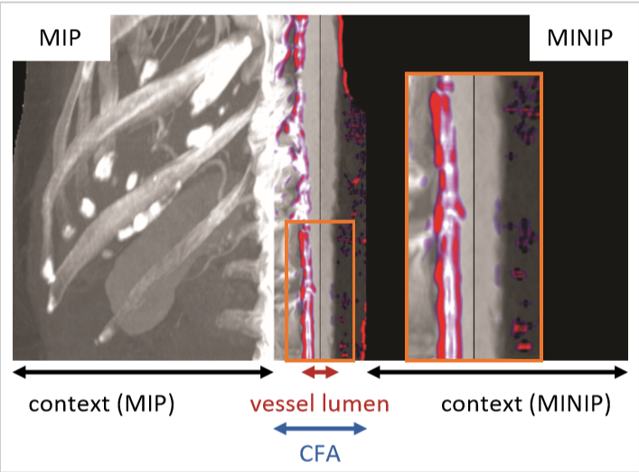
Algorithm – Stability (optional)

Slide 20
Visual Mapping
For every slice the values of all ray casts are aggregated using either
MIP detects complete califications
Minimum Intensity Projection (MINIP) detects minor plaque
Average Intensity Projection (AVG)
MIP and MINIP are medically the most interesting
The two are presented next to each other

Slide 21
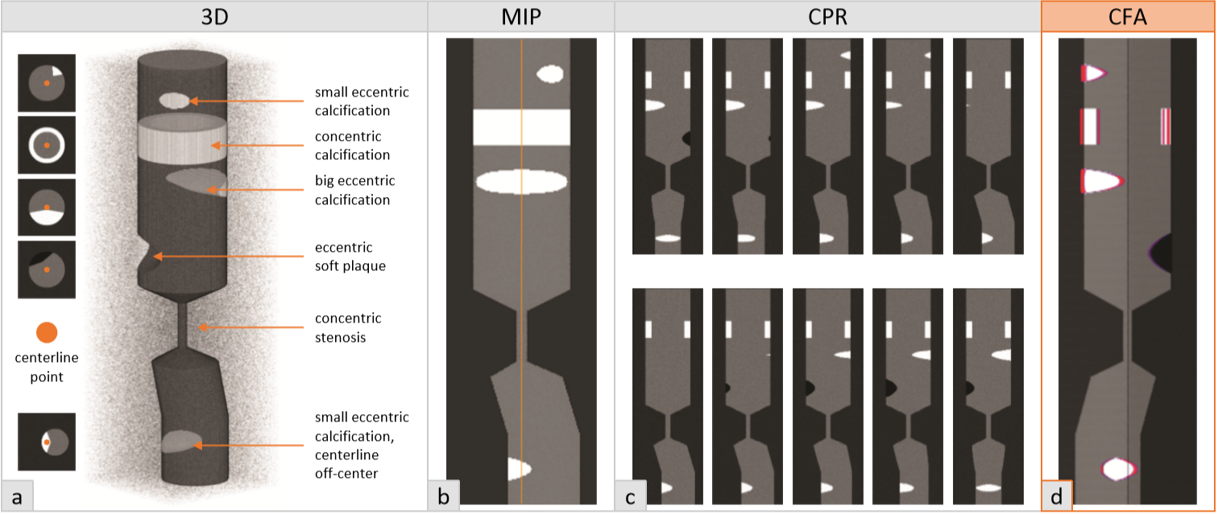
Visual Example

Slide 22
Discussion and Limitations
Problems:
Specific rotation or Size can not be determined
MINIP only shows plaque
MIP only shows calcifications
Errors if the centerline cannot be determined accurately
Advantages:
Gives information about stability of centerlines
Less sensitive to changes of the centerline

Slide 23
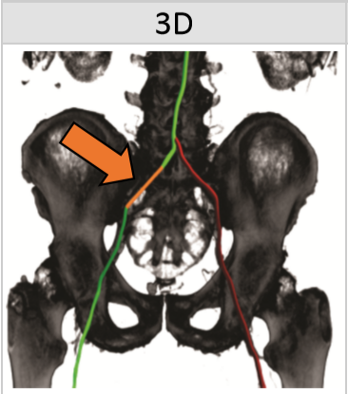
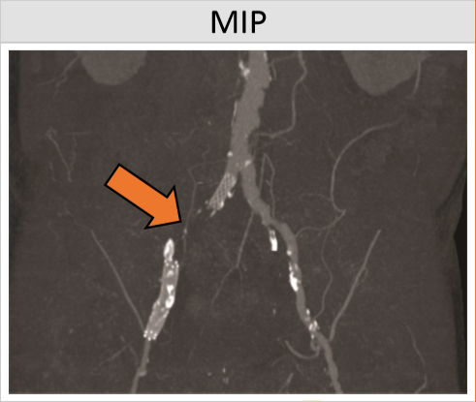
Comparison and Evaluation

Slide 24
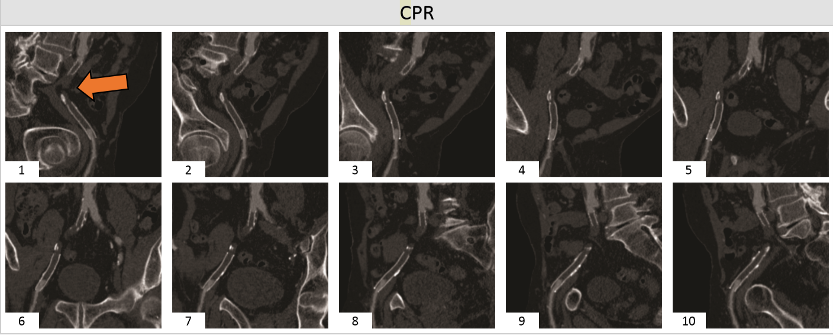
Comparison and Evaluation

Slide 25
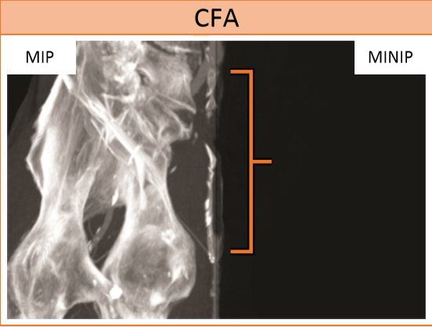
Comparison and Evaluation

Slide 26
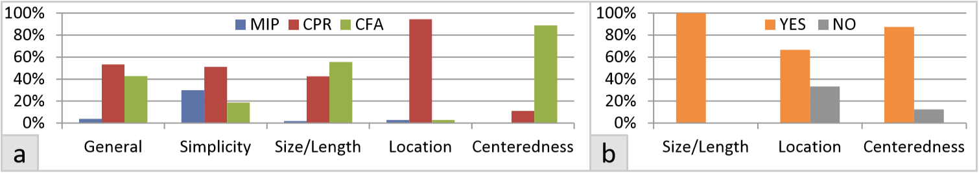
Comparison and Evaluation
9 radiologists have been asked to evaluate the performance of the given images in 5 categories (a)
Additionally they should give their opinion if a specific information is valuable (b)

Slide 27
Discussion and Limitations
Problems:
Specific rotation or Size can not be determined
MINIP only shows plaque
MIP only shows calcifications
Errors if the centerline cannot be determined accurately
Advantages:
Gives information about stability of centerlines
Less sensitive to changes of the centerline

Slide 28
Literature
G. Mistelbauer et al., “Vessel Visualization using Curvicircular Feature Aggregation,” Computer Graphics Forum, vol. 32, no. 3pt2, pp. 231–240, 2013.
Bühler K., Felkel P., Cruz A. L.: Geometric Methods for Vessel Visualization and Quantiﬁcation - A Survey. Springer, 2004, ch. in Geometric Modeling for Scientiﬁc Visualization, pp. 399–419.
Wang W., Jüttler B., Zheng D., Liu Y.: Computation of rotation minimizing frames. ACM Trans. Graph. 27, 1 (2008), 2:1–2:18.
Kanitsar A., Wegenkittl R., Fleischmann D., Gröller E.: Advanced curved planar reformation: Flattening of vascular structures. In Proceedings of IEEE Visualization (2003), pp. 43–50.

