Slide 1
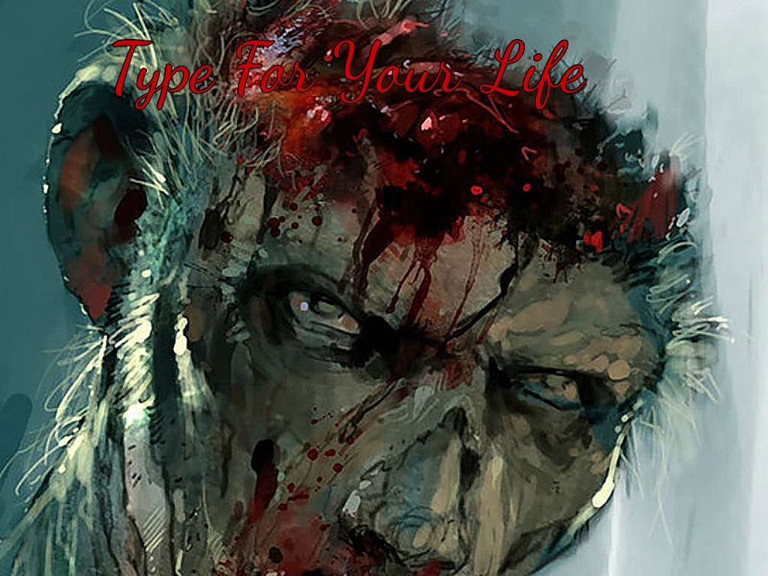
Type For Your Life

Slide 2
Gameplay
Typing game
Time sensitive
Type words in text box to gain points
Mistyping or running out of time decreases health
Lose by running out of health
Level of difficulty increases as health decreases
Basically no way to “win”

Slide 3
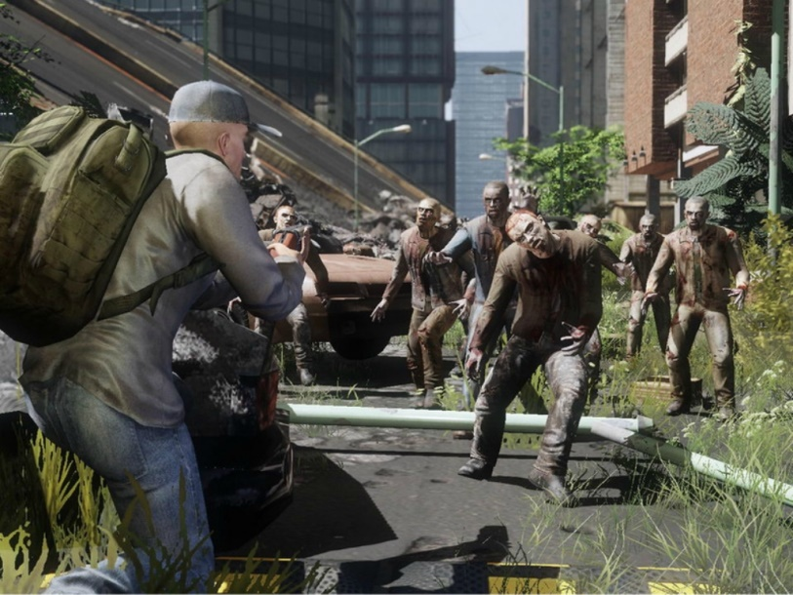
Bugs
Background doesn’t change for different levels
Running out of time reduces health by 20 instead of 10
But typing the word incorrectly reduces health by 10

Slide 4
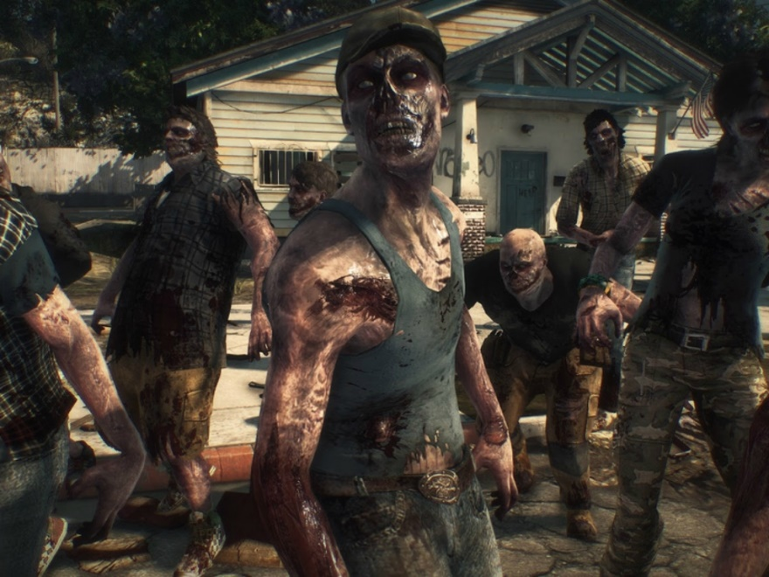
Possible Add-ons
Leaderboards
Animations
Moving text box
Words of subject matter
Tutoring game with vocab words where definition may appear and the student has a certain amount of time to type the correct vocabulary word

Slide 5
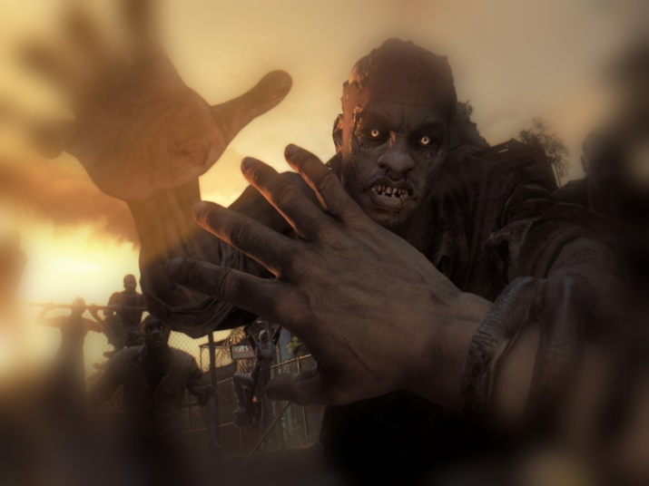
What We Could Have Done Better
Better organization of classes/methods
More time working out of team labs
More collaboration outside of class
More communication outside of class

Slide 6
The Experience
Overall great experience
Allowed us to work in teams and collaborate on a project
Prepares us for co-op and jobs by providing team work experience
Sometimes frustrating

