Slide 1
Data Driven Improvements to RRT
15-780 Grad AI – Spring 2010
Filipe Militão, Karl Naden, Bernardo Toninho

Slide 2
Motivation
Strengths of RRT
Simple
Fast
RRT Weaknesses
Not robust – must be tuned to the world
Gathers no data about the world
Question:
Can we improve on RRT’s weaknesses without sacrificing its strengths?

Slide 3
Extension Length
Prevents robustness
World with large open space and small passages
Possible data collection
Each extension success and failure provides data about good extension lengths

Slide 4
Specific Goals
Gather data about extension length for use
For online learning to impact path planning
For learning about the world for use in re-planning
Constraints
Data gathering and processing must be lightweight compared to testing the world.

Slide 5
Variable Length RRT (VLRRT)
Allows for extensions of varying lengths
Collects on the fly information about the world to vary the extension length:
Each node has a weight ε that multiplies by the base ext. length
Nodes in potentially less cluttered regions will have a higher ε value
Intuition: Larger steps in uncluttered regions, smaller steps in cluttered ones.
How can we learn the values for ε at each node?
Random point
On success
ε'
E
d * ε
d * ε
Increase ε
and continue
ε
ε'
E
Node
E
Node

Slide 6
Variable Length RRT (VLRRT)
How can we learn the values for ε at each node?
On failure
d * ε
Decrease ε
and continue
d * ε’
Random point
ε
ε'
E
Node
E
Node
If extensions succeed, its more likely that the region is uncluttered and so we scale up ε accordingly (and propagate to the new node).
If extensions fail, its less likely that the region is uncluttered and we scale back ε.
Abstracts away much of the topology of the world (can over- and under-estimate!)

Slide 7
Directional VLRRT (DVLRRT)
Builds on the idea of VLRRT by taking into account direction of extensions.
Nodes no longer have a single ε value, but a directional map m(Θ) of values .
Abstracts away less of the topology to (hopefully) increase accuracy.
How do we use and populate the directional map?
Random point
Random point
If m(Θ) is
defined
d * m(Θ)
E
Θ
Increase m(Θ) on success
Θ
m
m
E
Node
E
Node
If m(Θ) is defined, try to extend by the corresponding value
Increase m(Θ) on success and decrease on failure.

Slide 8
Directional VLRRT (DVLRRT)
How do we use and populate the directional map?
If m(Θ) is not defined, we compute it using the closest values in the map within the [Θ-π/2 , Θ+π/2] range.
Assign more weight to closer directions (more reliable estimate):
Random point
Random point
If m(Θ) is
not defined
E
D*ε
Θ₂
Θ
Θ₁
m
E
Node
m
m
E
Node
E
Node
If the extension succeeds, scale up m(Θ). Else scale it down.
New nodes inherit m(Θ) = ε and m(Θ+π) = ε into their directional maps.

Slide 9
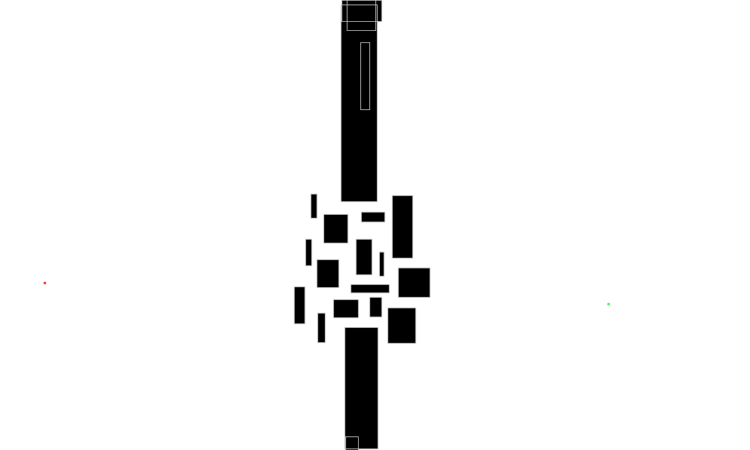
Evaluating VL and DVLRRT
We have yet to specify how to increase and decrease ε values:
Empirical results show best performance with a high increase rate and a higher decrease rate.
We compared the performance of our algorithms with RRT in terms of running time and success in reaching the goal in several worlds:
Alg. | World | Avg. Success | Avg Time (ms)
RRT | obstructed | 95% | 12.0
VLRRT | obstructed | 96% (+1%) | 13.3 (+1.3)
DVLRRT | obstructed | 96% (+1%) | 13.4 (+1.4)

Slide 10
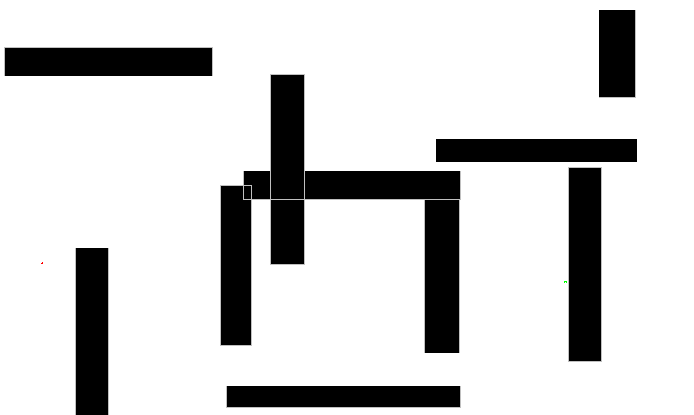
Evaluating VL and DVLRRT
We have yet to specify how to increase and decrease ε values:
Empirical results show best performance with a high increase rate and a higher decrease rate.
We compared the performance of our algorithms with RRT in terms of running time and success in reaching the goal in several worlds:
Alg. | World | Avg. Success | Avg. Time (ms)
RRT | maze | 91% | 17.2
VLRRT | maze | 99% (+9%) | 10.6 (-6.6)
DVLRRT | maze | 99% (+9%) | 10.6 (-6.6)

Slide 11
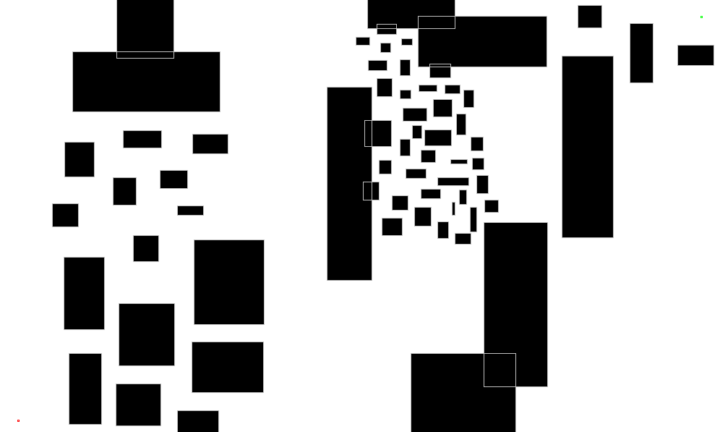
Evaluating VL and DVLRRT
We have yet to specify how to increase and decrease ε values:
Empirical results show best performance with a high increase rate and a higher decrease rate.
We compared the performance of our algorithms with RRT in terms of running time and success in reaching the goal in several worlds:
Algorithm | World | Avg. Success | Avg Time (ms)
RRT | cluttered | 33% | 39.2
VLRRT | cluttered | 60% (+27%) | 33.6 (-5.6)
DVLRRT | cluttered | 60% (+27%) | 33.7 (-5.5)

Slide 12
Re-Planning
World Changed!
Goal: use information gathered on a previous search to try to improve the next.
Problem: competing against just plain (“uninformed”) search.
Extracted information must do better than using that time for plain search.
( Search + Old-Info ) > Search ?

Slide 13
Re-Planning
Extra Information Used:
Previous search tree: initial step size
(memory not an issue to us)
Use the N closest neighbors in the old tree:
(VLERRT) Simple average:
(VLERRT) Weighted average:
(DVLERRT) Pull from neighbors.
Waypoints (fixed number, picked from previous search solution):
Random from previous path (ERRT)
Bias towards less dense nodes

Slide 14
Testing - Initial Step
Changes To Testing:
World changes (small random movements in the obstacles)
Start moves a bit towards the goal (using the path that got closest to it)
Testing Methodology:
Average 1000 runs each with 100 iterations (moving towards goal) using 50 ms time slice.
Compare results for all combinations of information.

Slide 15
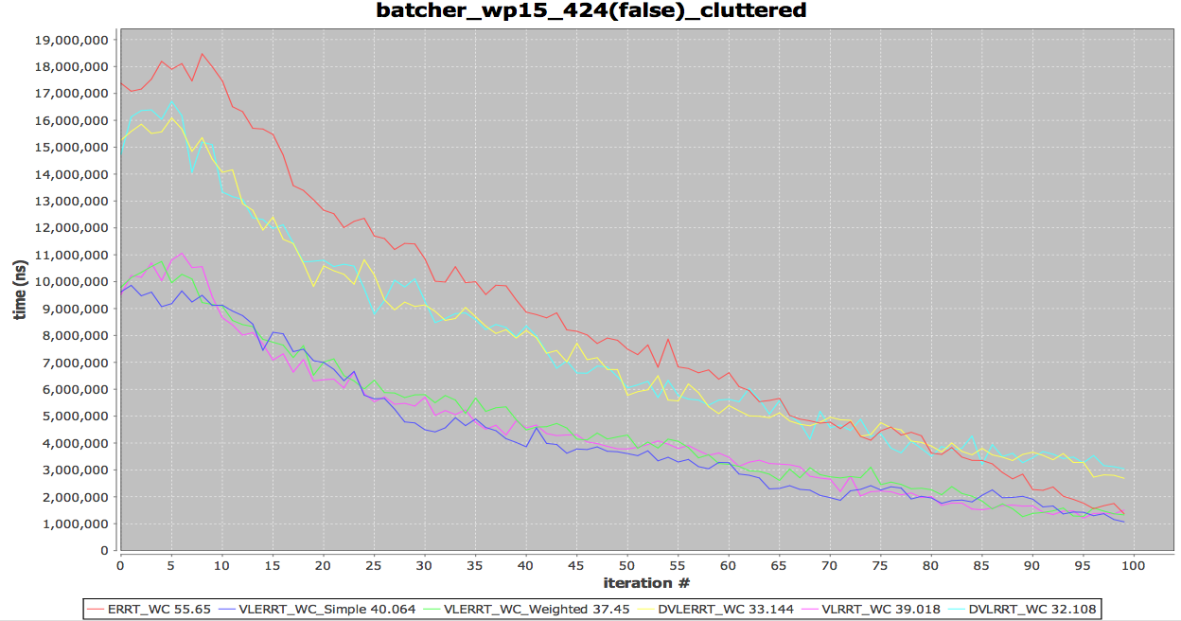
Results: Cluttered
Run Time
( < 50 ms → goal )
All our variants beat ERRT!
No significant gains on the initial step variations

Slide 16
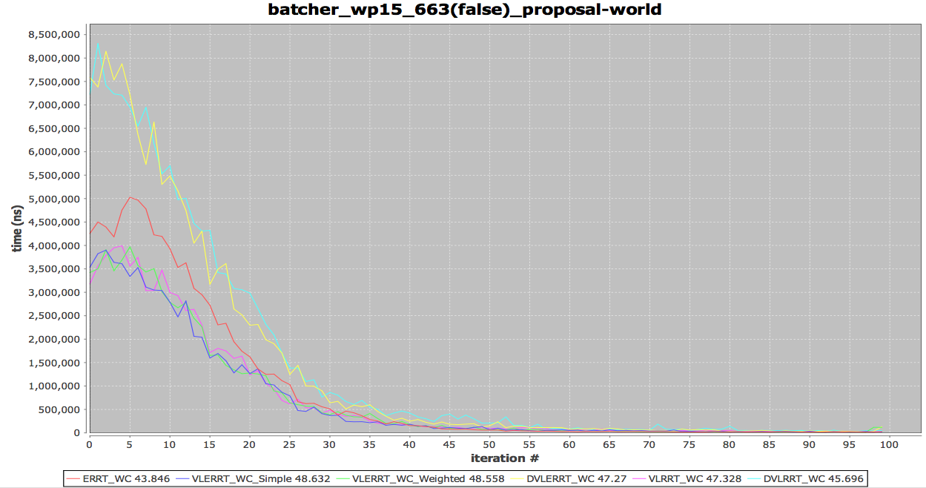
Results: Obstructed

Slide 17
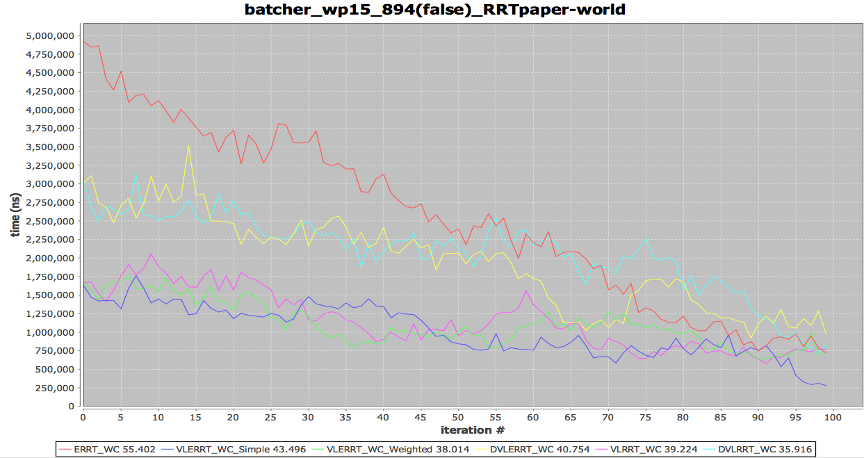
Results: maze

Slide 18
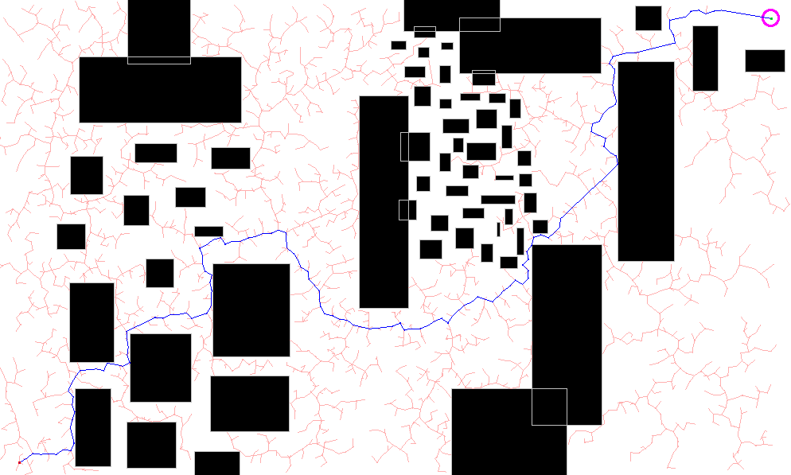
Density based Waypoints
Bias waypoint generation towards useful points:
a less dense node (with fewer neighbors) is likely to be more useful.
more dense
less dense

Slide 19
Results: Densities
However, testing results show that it actual worsens the search… (sometimes 3x longer than just randomly picking nodes)
Probably, needs more tuning:
Larger/Smaller neighborhood?
Just sort instead of random biasing?
Bigger worlds? (waypoints are more valuable)

Slide 20
Conclusions
Online learning helpful
Increased robustness
Decreased planning iteration time
At the cost of Increased path length
Reusing the data for re-planning more difficult
Online learning provides the same information
More precise calculations no different from consulting the world

