Slide 1
Variable Length RRT (VLRRT)
Allows for extensions of varying lengths
Collects on the fly information about the world to vary the extension length:
Each node has a weight ε that multiplies by the base ext. length
Nodes in potentially less cluttered regions will have a higher ε value
Intuition: Larger steps in uncluttered regions, smaller steps in cluttered ones.
How can we learn the values for ε at each node?
Random point
On success
ε'
E
d * ε
d * ε
Increase ε
and continue
ε
ε'
E
Node
E
Node

Slide 2
Variable Length RRT (VLRRT)
How can we learn the values for ε at each node?
On failure
d * ε
Decrease ε
and continue
d * ε’
Random point
ε
ε'
E
Node
E
Node
If extensions succeed, its more likely that the region is uncluttered and so we scale up ε accordingly (and propagate to the new node).
If extensions fail, its less likely that the region is uncluttered and we scale back ε.
Abstracts away much of the topology of the world (can over- and under-estimate!)

Slide 3
Directional VLRRT (DVLRRT)
Builds on the idea of VLRRT by taking into account direction of extensions.
Nodes no longer have a single ε value, but a directional map m(Θ) of values .
Abstracts away less of the topology to (hopefully) increase accuracy.
How do we use and populate the directional map?
Random point
Random point
If m(Θ) is
defined
d * m(Θ)
E
Θ
Increase m(Θ) on success
Θ
m
m
E
Node
E
Node
If m(Θ) is defined, try to extend by the corresponding value
Increase m(Θ) on success and decrease on failure.

Slide 4
Directional VLRRT (DVLRRT)
How do we use and populate the directional map?
If m(Θ) is not defined, we compute it using the closest values in the map within the [Θ-π/2 , Θ+π/2] range.
Assign more weight to closer directions (more reliable estimate):
Random point
Random point
If m(Θ) is
not defined
E
D*ε
Θ₂
Θ
Θ₁
m
E
Node
m
m
E
Node
E
Node
If the extension succeeds, scale up m(Θ). Else scale it down.
New nodes inherit m(Θ) = ε and m(Θ+π) = ε into their directional maps.

Slide 5
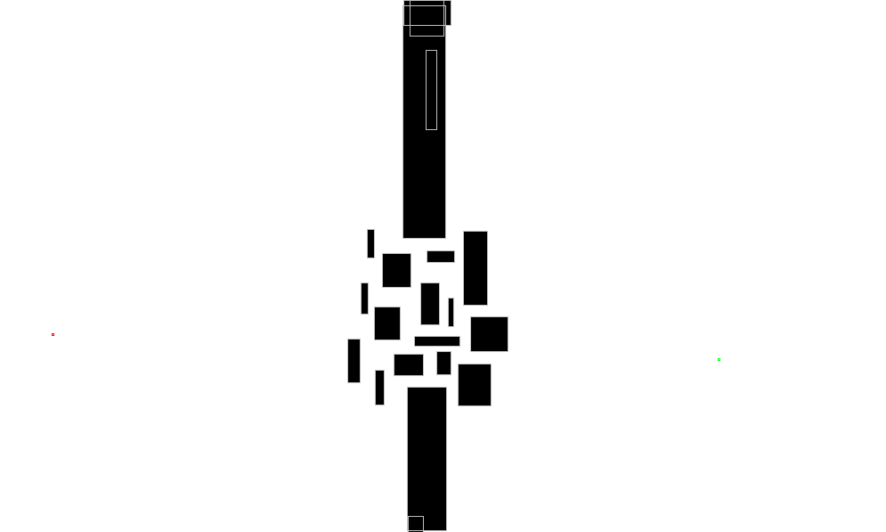
Evaluating VL and DVLRRT
We have yet to specify how to increase and decrease ε values:
Empirical results show best performance with a high increase rate and a higher decrease rate.
We compared the performance of our algorithms with RRT in terms of running time and success in reaching the goal in several worlds:
Alg. | World | Avg. Success | Avg Time (ms)
RRT | obstructed | 95% | 12.0
VLRRT | obstructed | 96% (+1%) | 13.3 (+1.3)
DVLRRT | obstructed | 96% (+1%) | 13.4 (+1.4)

Slide 6
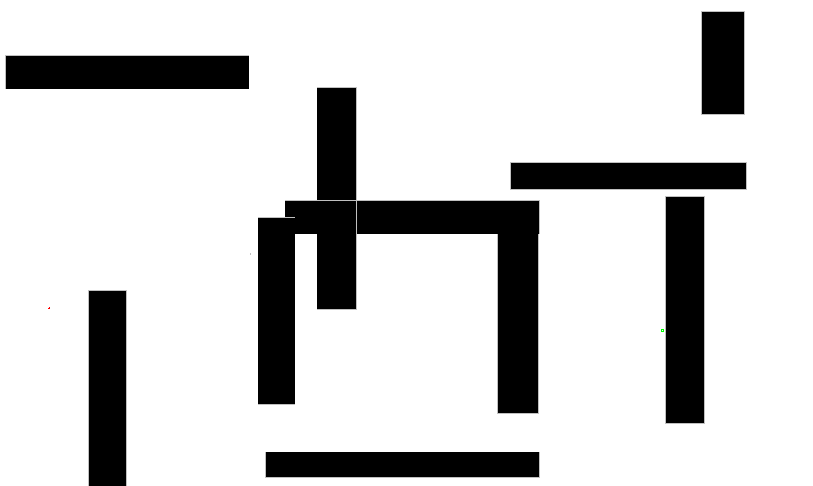
Evaluating VL and DVLRRT
We have yet to specify how to increase and decrease ε values:
Empirical results show best performance with a high increase rate and a higher decrease rate.
We compared the performance of our algorithms with RRT in terms of running time and success in reaching the goal in several worlds:
Alg. | World | Avg. Success | Avg. Time (ms)
RRT | maze | 91% | 17.2
VLRRT | maze | 99% (+9%) | 10.6 (-6.6)
DVLRRT | maze | 99% (+9%) | 10.6 (-6.6)

Slide 7
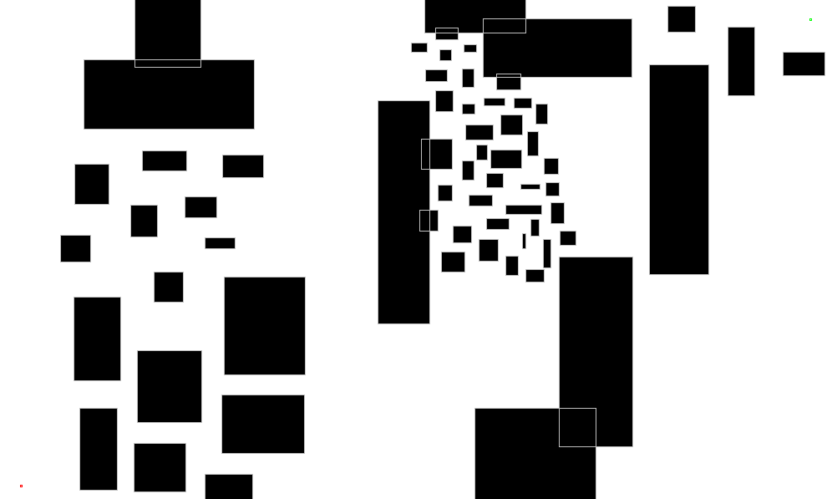
Evaluating VL and DVLRRT
We have yet to specify how to increase and decrease ε values:
Empirical results show best performance with a high increase rate and a higher decrease rate.
We compared the performance of our algorithms with RRT in terms of running time and success in reaching the goal in several worlds:
Algorithm | World | Avg. Success | Avg Time (ms)
RRT | cluttered | 33% | 39.2
VLRRT | cluttered | 60% (+27%) | 33.6 (-5.6)
DVLRRT | cluttered | 60% (+27%) | 33.7 (-5.5)

