Slide 1
Re-Planning
World Changed!
Goal: use information gathered on a previous search to try to improve the next.
Problem: competing against just plain (“uninformed”) search.
Extracted information must do better than using that time for plain search.
( Search + Old-Info ) > Search ?

Slide 2
Re-Planning
Extra Information Used:
Previous search tree: initial step size
(memory not an issue to us)
Use the N closest neighbors in the old tree:
(VLERRT) Simple average:
(VLERRT) Weighted average:
(DVERRT) Push from neighbors.
Waypoints (fixed number, picked from previous search solution):
Random from previous path (ERRT)
Bias towards less dense nodes

Slide 3
Testing - Initial Step
Changes To Testing:
World changes (small random movements in the obstacles)
Start moves a bit towards the goal (using the path that got closest to it)
Testing Methodology:
Average 1000 runs each with 100 iterations (moving towards goal) using 50 ms time slice.
Compare results for all combinations of information.

Slide 4
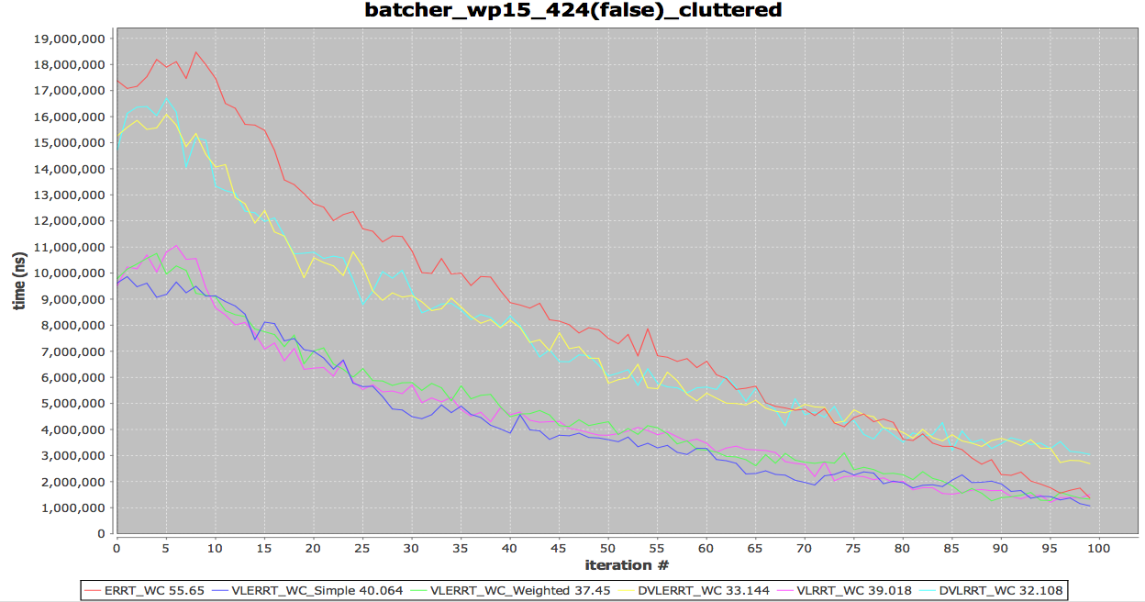
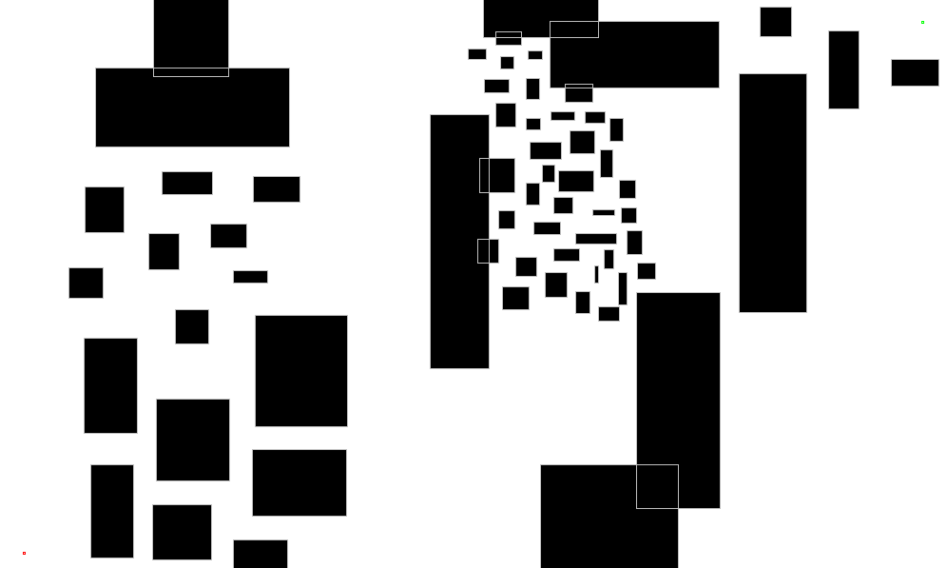
Results: Cluttered
Run Time
( < 50 ms → goal )
All our variants beat ERRT!
No significant gains on the initial step variations

Slide 5
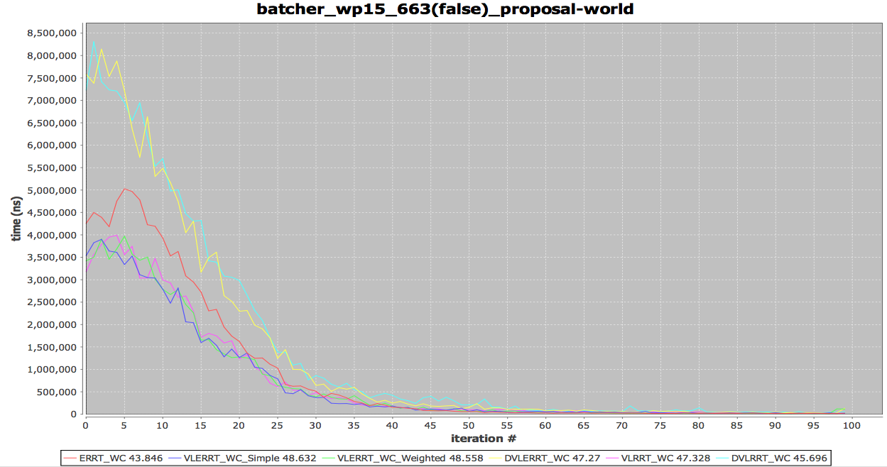
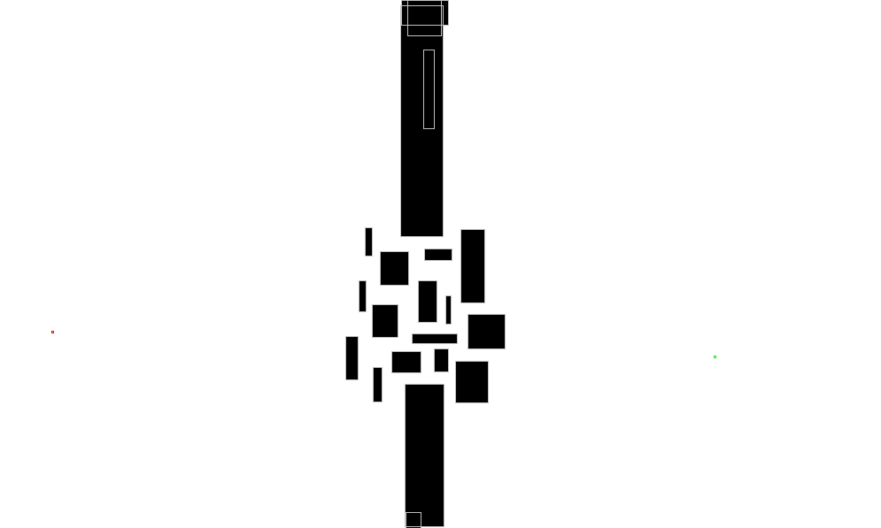
Results: Obstructed

Slide 6
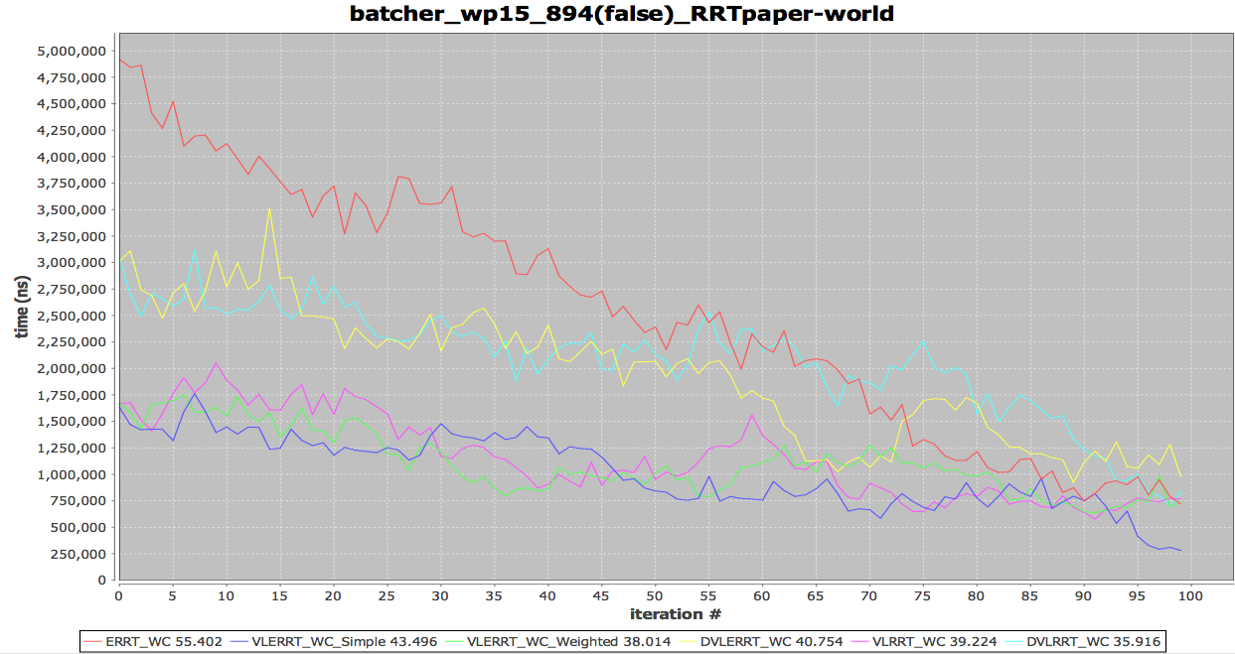
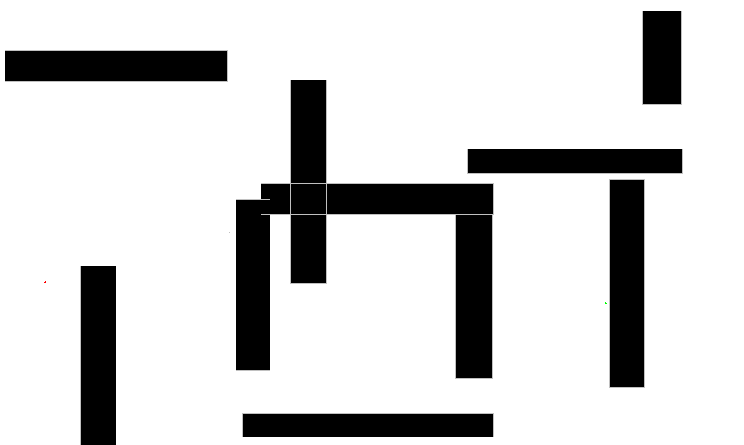
Results: maze

Slide 7
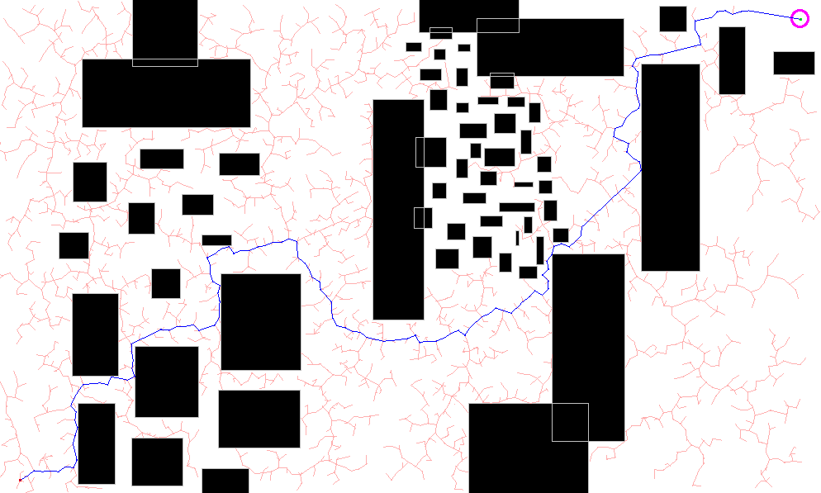
Density based Waypoints
Bias waypoint generation towards useful points:
a less dense node (with fewer neighbors) is likely to be more useful.
more dense
less dense

Slide 8
Results: Densities
However, testing results show that it actual worsens the search… (sometimes 3x longer than just randomly picking nodes)
Probably, needs more tuning:
Larger/Smaller neighborhood?
Just sort instead of random biasing?
Bigger worlds? (waypoints are more valuable)

