Slide 1



Capstone Project
Presentation
Presented by Rahaf, Ghaidaa and Fares

Slide 2



01
Project Objects
Agenda
Capstone project
02
Project Architecture
03
Data Overview
04
Project Steps
05
Future

Slide 3

Project Objects
1. Project Requirements
Ingest data from multiple sources (Postgres DB in AWS RDS and S3 bucket).
Transform and load data into Snowflake data warehouse.
Create a comprehensive data model for BI analysis.
Develop dashboards and reports in Metabase to visualize insights.
2. Tools Used
Airbyte and AWS Lambda for data ingestion.
Snowflake as the cloud data warehouse.
Metabase for BI analysis.
3. Project Process Design
Data Ingestion: Establish connections using Airbyte and AWS Lambda.
Data Transformation: Transform data within Snowflake, develop ETL scripts, and schedule data loading.
Data Analysis: Connect Snowflake to Metabase, generate dashboards, and reports.

Slide 4
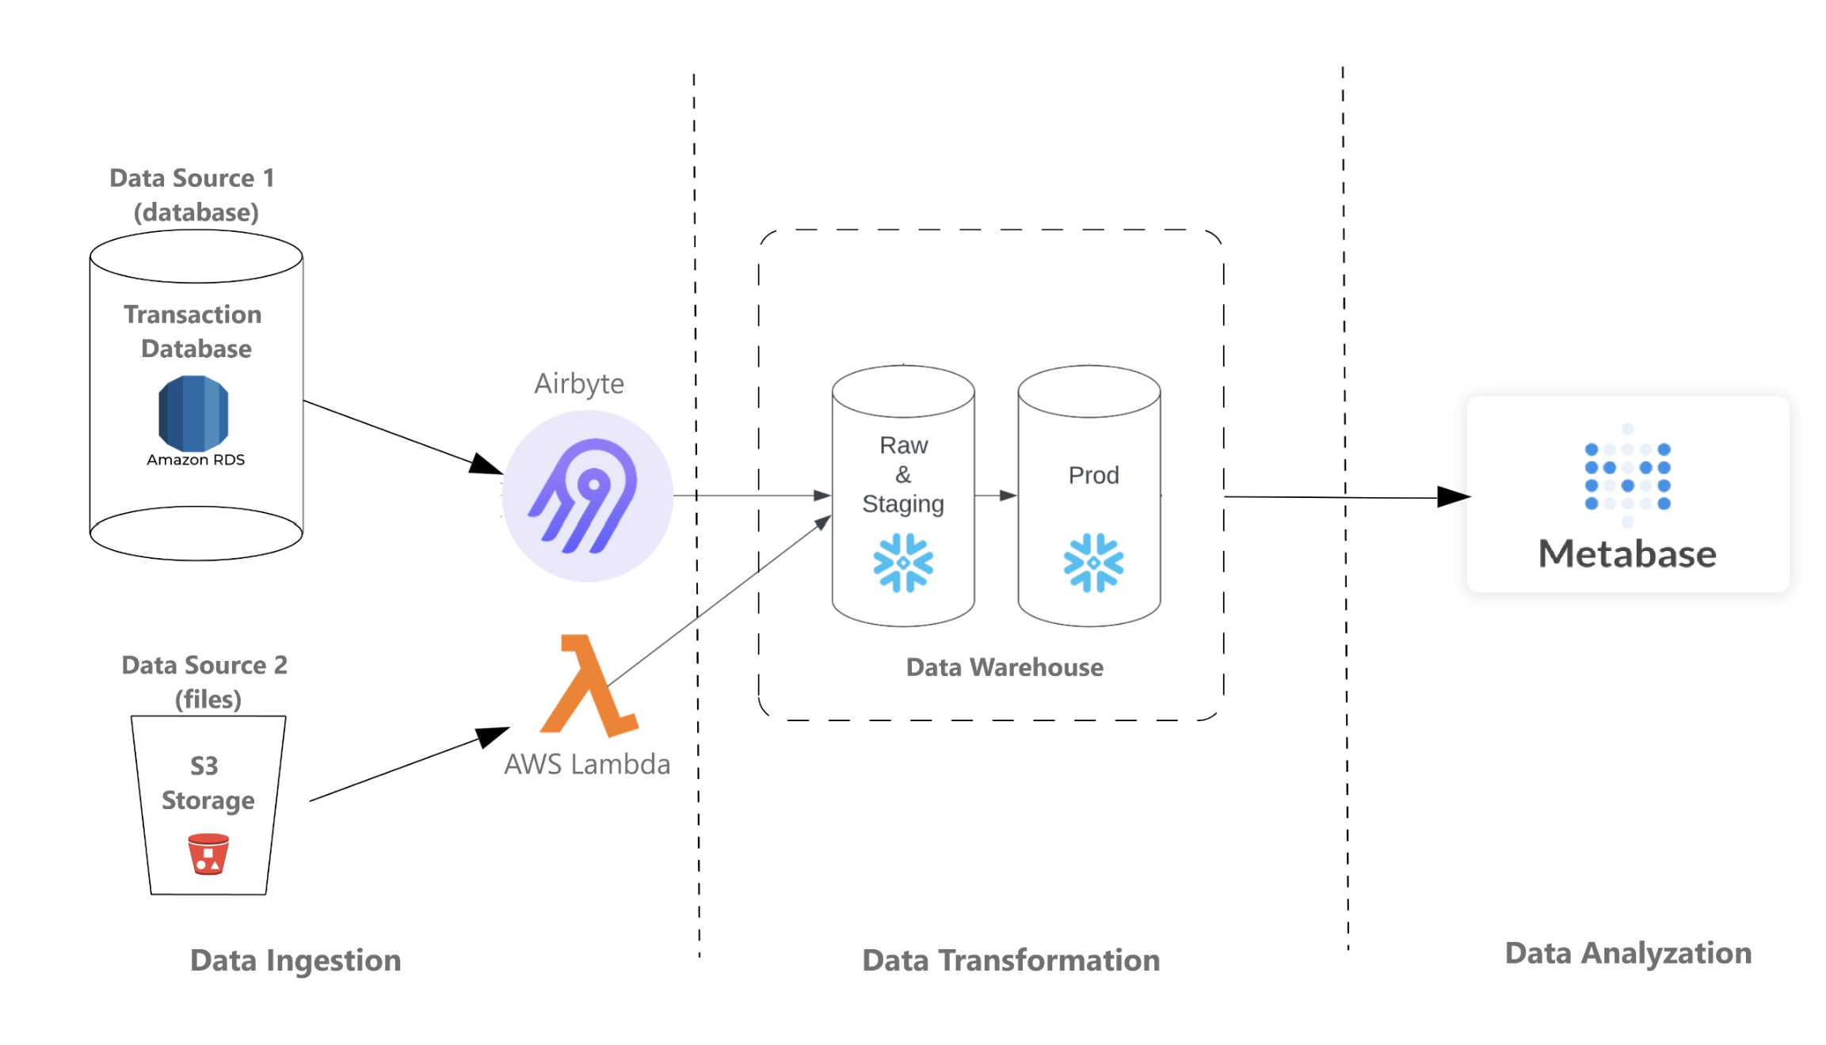
Project Architecture

Slide 5
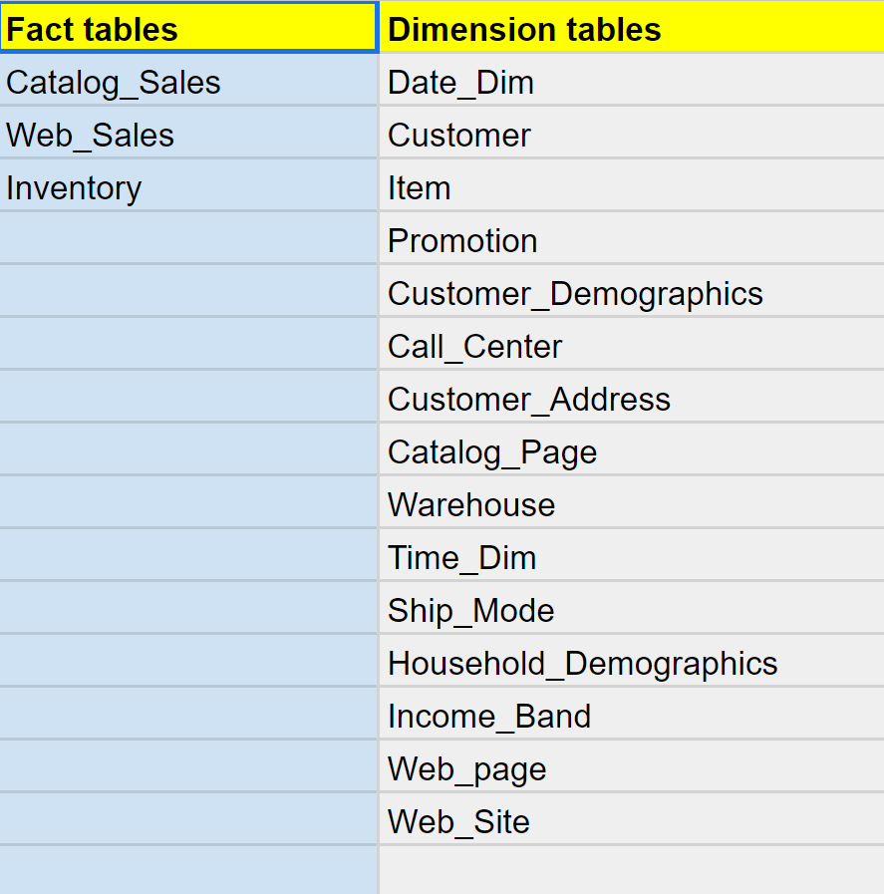
Data Overview
1. Tables Included in the Project:
Sales records from websites and catalogs.
Inventory levels for each item in every warehouse.
Dimensional tables containing customer, warehouse, item, and more.
2. Relationships Between Tables:
Primary keys and foreign keys establish relationships.
Example: Sales tables linked to item and warehouse tables.
3. Continuous Data Loading:
Continuous Loading:
Sales records from Postgres DB (refreshed daily).
Inventory table from S3 bucket (updated weekly).
Loading Once:
Dimension tables containing static information (e.g., customer details, warehouse information).

Slide 6
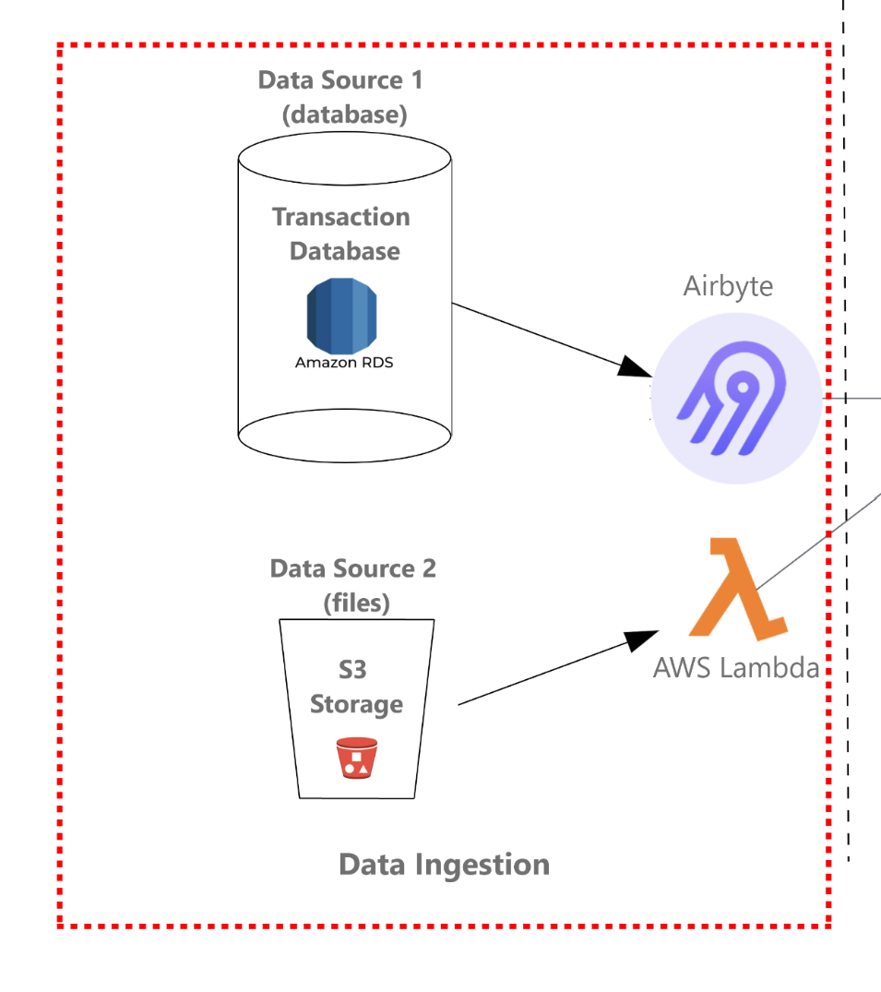
Project Steps
1. Data Ingestion:
Data Source 1: Amazon RDS source database and this was ingested using Airbyte.
Data Source 2: CSV file stored in S3 bucket and this was ingested using AWS Lambda.

Slide 7
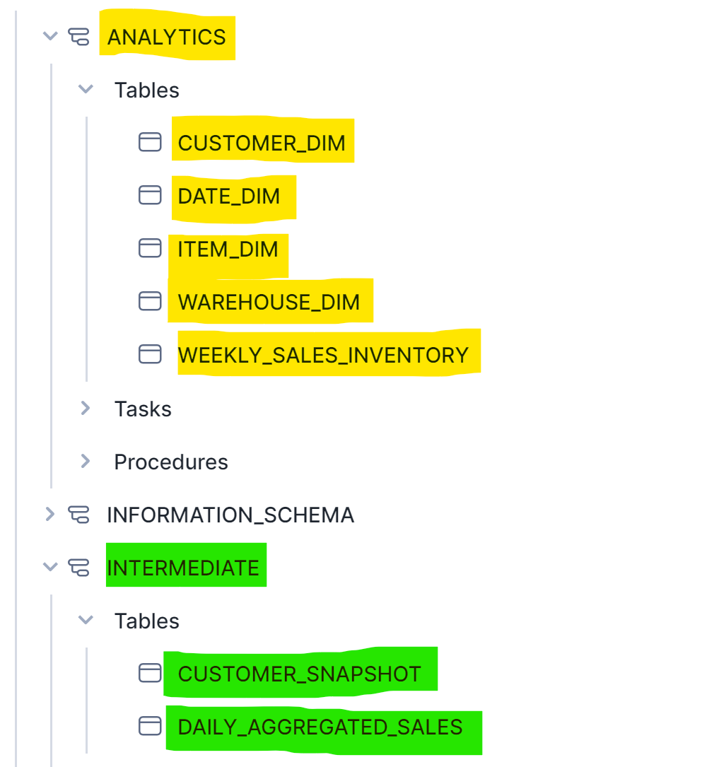
Project Steps
2. Data Transformation:
Data modeling
ETL scripts to populate data from the RAW tables to the Data Model tables
Scheduling tasks
Customer table (daily)
Daily aggregated sales table (daily)
Weekly aggregated sales (weekly)

Slide 8
Project Steps
3. Data Analysis:
Business requirements:
Identify the highest and lowest performing items of the week by analyzing sales amounts and quantities.
Display items with low supply levels for each week.
Detect items experiencing low stock levels, along with their corresponding week and warehouse numbers, marked as "True".

Slide 9
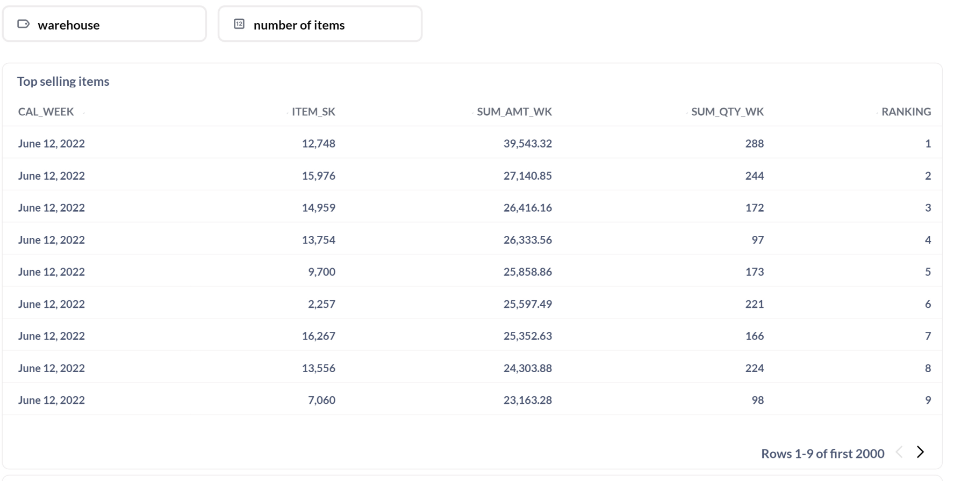
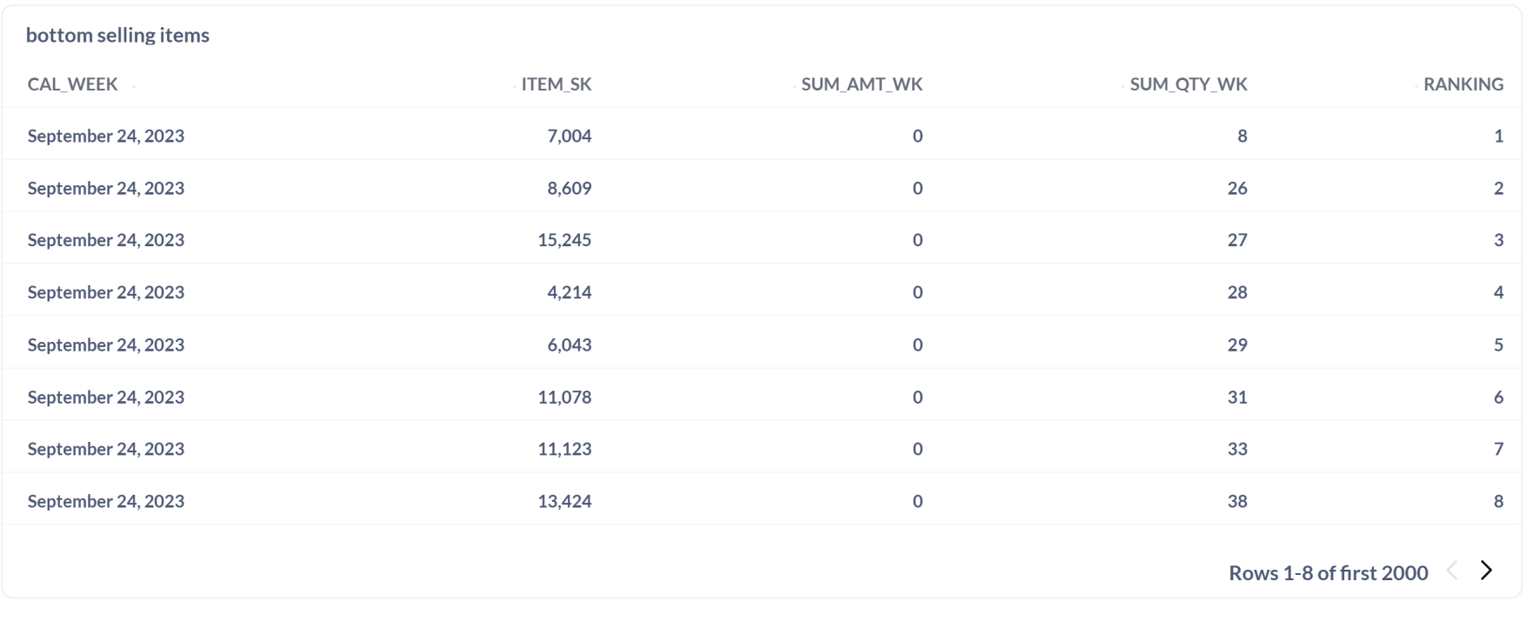
Project Steps
3. Data Analysis:
Identify the highest and lowest performing items of the week by analyzing sales amounts and quantities.

Slide 10
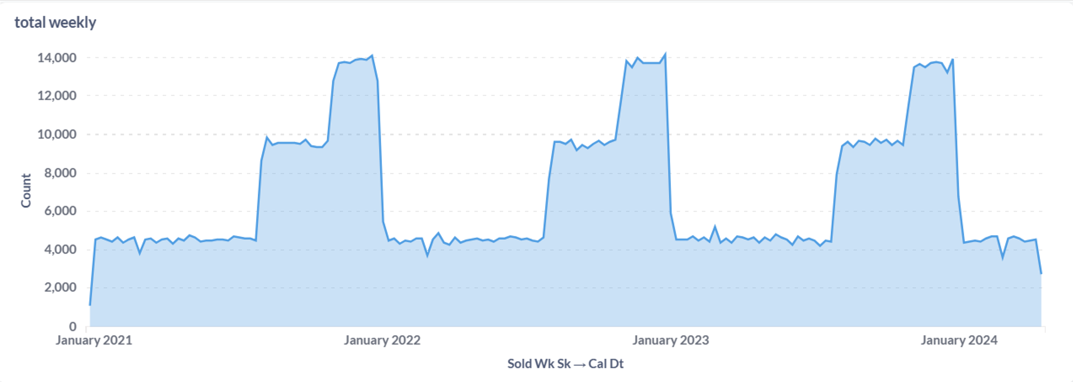
Project Steps
3. Data Analysis:
Display items with low supply levels for each week.

Slide 11
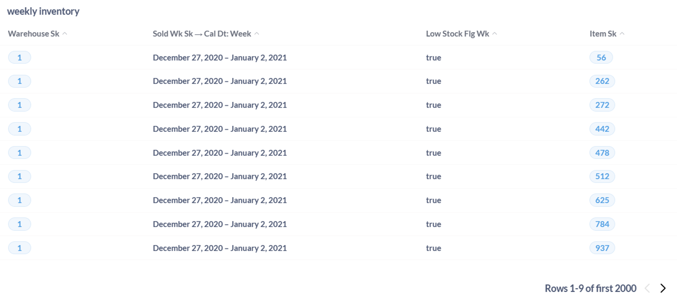
Project Steps
3. Data Analysis:
Detect items experiencing low stock levels, along with their corresponding week and warehouse numbers, marked as "True".

Slide 12
Future
Areas for Improvement:
Time Management: Optimize data processes for efficiency.
Data Quality: Enhance data cleansing for accuracy.
Advanced Analytics: Explore deeper insights.
Future Improvements:
Automation: Streamline processes for scalability.
Scalability: Design for future growth.
User Experience: Improve BI tool usability.
Future Research:
Advanced Analytics: Explore predictive modeling.
Data Governance: Implement robust policies.
Real-Time Analytics: Investigate low-latency option

Slide 13
Thank you!

