Slide 1
Neural Networks - Artificial Neural Networks
Tejvi M.

Slide 2
Why use neural networks
Though less interpretable than most ML models, they are more generalizable and robust. For example, they can perform automatic feature extraction (it is still advisable to perform it beforehand, and not leave it up to the neural network).
Also seen as the brute force algorithms of ML as they start with a blank slate and hammer their way into a being good model.

Slide 3
The perceptron model
The neuron, which is a mathematical unit, takes in the inputs and applies an activation function on their weighted sum(the weights are determined by the weights/significance of their connections), and this is the output of that neuron.

Slide 4
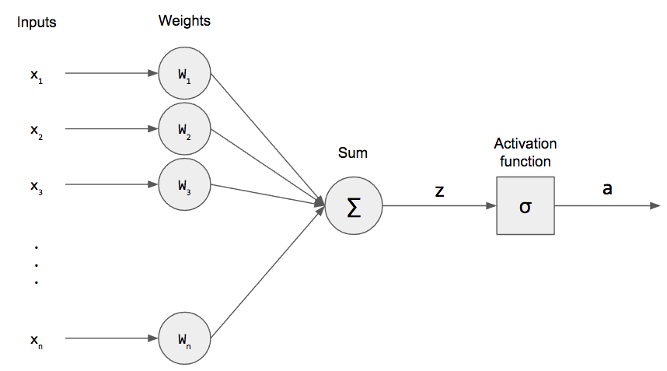
Perceptron

Slide 5
Layers in a neural network
Input: inputs are fed to the neurons. The neurons pass on the input to the next layer through weighted edges and each of the neuron has a constant that it adds to its output, called the bias.
Hidden: every neuron in a hidden layer is connected to every other neuron in its previous and next layer. The neurons take in the inputs from the previous layer and pass it on to the next through a series of weighted connections.
Output Layer: This is the layer at which we get our output and measure the loss.

Slide 6
The feed forward mechanism
We see a flow of data from the input to the output through zero or more hidden layers to the output layer. At each layer, data is multiplied with the weights and has the bias added to it, and then the activation function is applied, and this output is then fed into the next layer.
Weights and bias are represented by a weight matrix and a bias vector at each layer

Slide 7
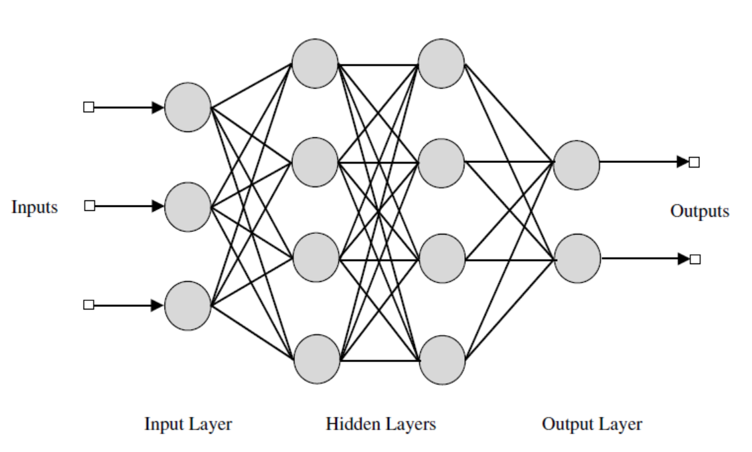

Slide 8
Activation functions
At every level, we perform a linear transformation on the data, i.e.,
Y = w.x + b
However, to approximate all functions, we need to introduce non linearities, and with activation functions, we do exactly that.
Y = activation(wx + b)

Slide 9
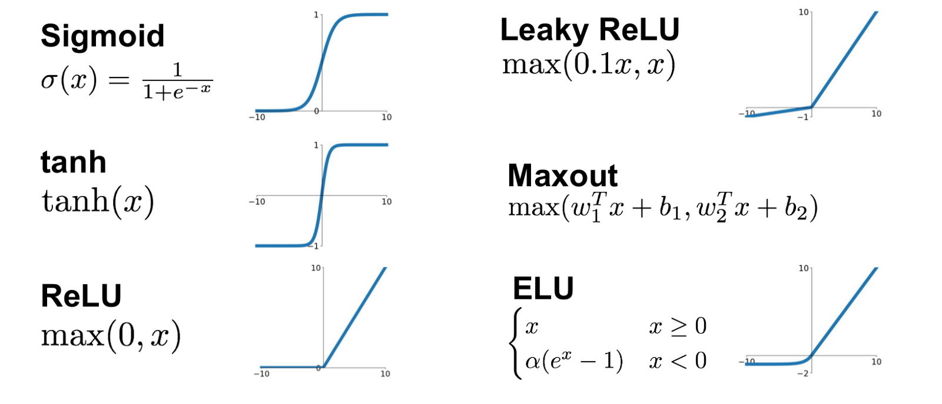
Activation functions
New output = activation(output). Some examples are:

Slide 10
Cost functions and errors
We must minimize the difference between the prediction and the actual target value. So we define the cost function, which is what we will be minimizing.
The cost function is dependent on the type of data and the type of neural network we are using. In most cases of regression we can use mean squared errors. And for categorical data, we can use cost functions like categorical cross entropy.

Slide 11
Back propagation
Backpropagation, short for "backward propagation of errors," is an algorithm we use to compute the gradient of the error function with respect to each of the neural network's weights.
The "backwards" part of the name stems from the fact that calculation of the gradient proceeds backwards through the network.
Calculating the partial derivative of the error with respect to a weight is done using the chain rule of differentiation.

Slide 12
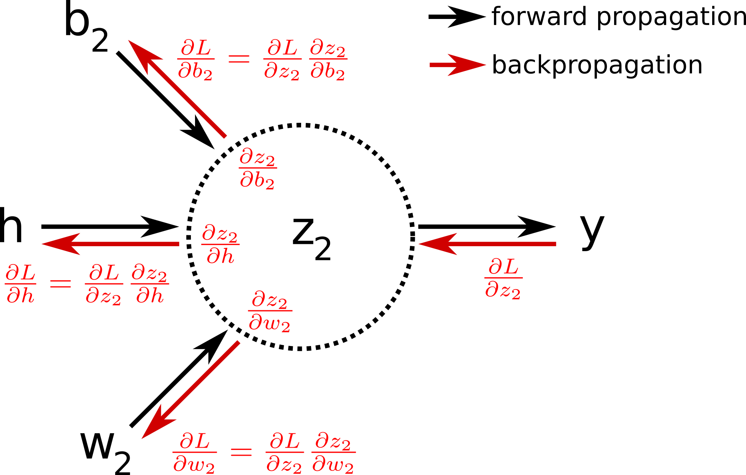

Slide 13
Gradient descent
Gradient descent is the optimization algorithm that we use to reach the optimal values of the parameters used.
From the gradients we calculate during back propagation we increase or decrease a parameters value so that we move in the direction of reduced error.
The intuition behind this being that at the minimum error, the gradient of the cost function is 0 and we can get to this point using the update rule.

Slide 14
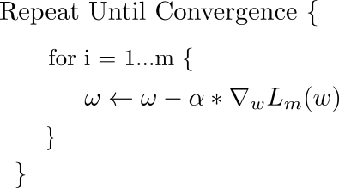
Update rule for gradient descent
Alpha is the learning rate. It is multiplied by the gradient. w is the weight.

Slide 15
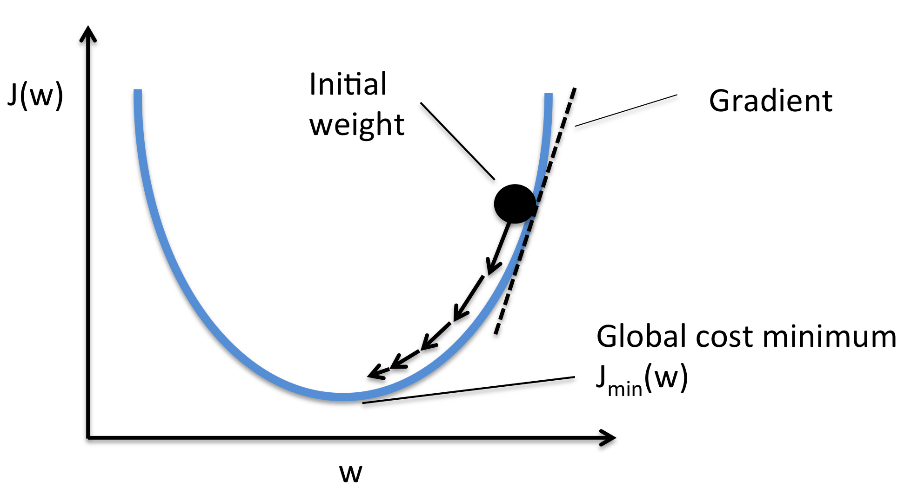

Slide 16
In conclusion
Feed in data to the input layer
Through forward propagation, the data propagates to the output layer
The error is calculated and we back propagate all the way to the input layer
During this process, we update the values of the weights.
After we reach the minima or after a certain number of training iterations, we can use the model (after running it on the test data, of course).

Slide 17
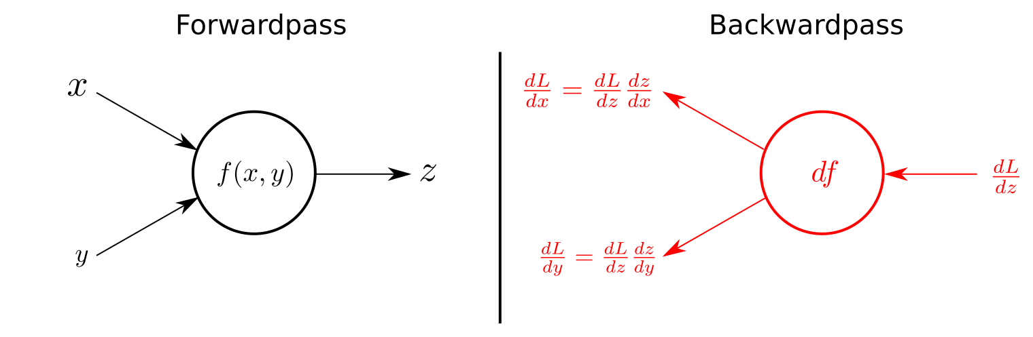
Forward pass, backward pass

