Slide 1
Machine Learning models- part 2

Slide 2
Support Vector Machines
This is a supervised learning algorithm that works as a classifier.
Consists of a hyperplane that separates the data points into classes.
Kernels are transformations that we apply to make the datapoints seperable by a hyperplane.

Slide 3
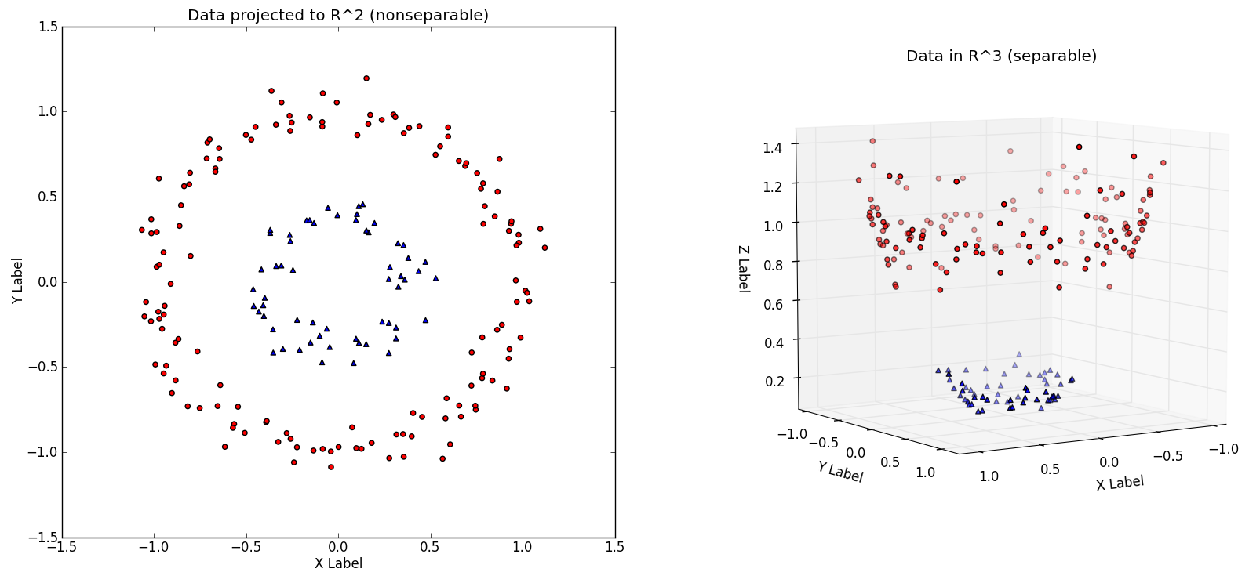
SVM - (before transformation, after transformation)

Slide 4
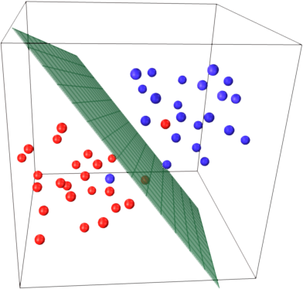
SVM - separating hyperplane

Slide 5
Decision trees
A decision tree is a tree like graph which models decisions and their possible consequences.
They are easy to interpret and stable. And they deal well with non linear relationships.
Especially useful for problems that have a natural if… then... else... constructions.

Slide 6
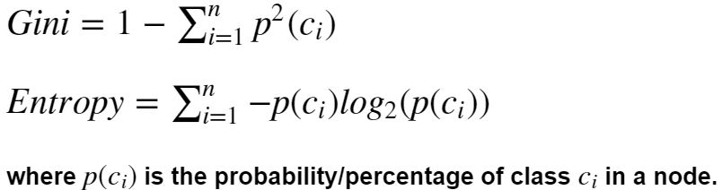
Deciding the split
There are various methods to decide the optimal way to split the tree, like
Gini index
Information gain (entropy based)

Slide 7
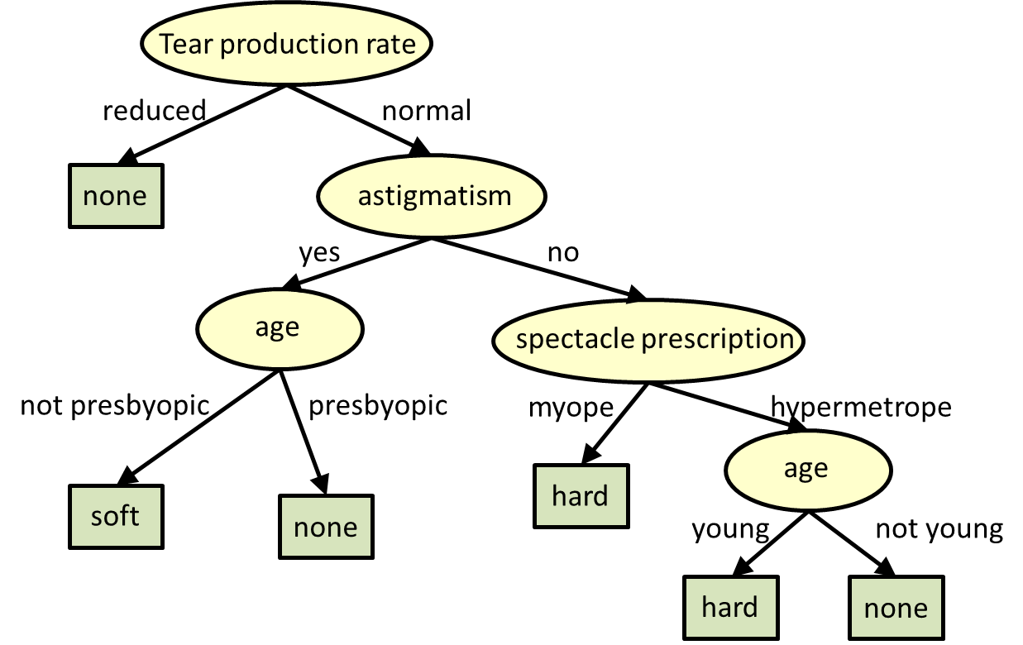
Decision tree

Slide 8
Evaluation Metrics in Machine Learning
Some of the simplest and important metrics are:
Classification accuracy
Confusion matrix (especially important for imbalanced datasets)
Logarithmic loss etc.

Slide 9
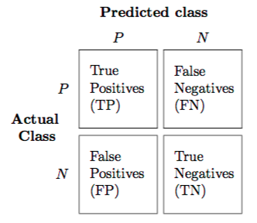
Structure of a confusion matrix

