Slide 1


2024 01 02
Chp7. Hypothesis Tests
Presenter: 工管四乙 109A50009 楊儀珈
Oskar Wladař
Notes:
Entered text
8.1 Single proportions
Tests of single proportions are generally based on the binomial distribution with size parameter N and probability parameter p.
For large sample sizes, this can be well approximated by a normal distribution with mean N p and variance N p(1 − p). As a rule of thumb, the approximation is satisfactory when the expected numbers of “successes” and “failures” are both larger than 5.
Denoting the observed number of “successes” by x, the test for the hypothesis that p = p0 can be based on
u = p
x − N p0
N p0(1 − p0)
which has an approximate normal distribution with mean zero and standard deviation 1, or on u2, which has an approximate χ2 distribution with1 degree of freedom.
The normal approximation can be somewhat improved by the Yates correction, which shrinks the observed value by half a unit towards the expected value when calculating u.
We consider an example (Altman, 1991, p. 230) where 39 of 215 randomly chosen patients are observed to have asthma and one wants to test the hypothesis that the probability of a “random patient” having asthma is 0.15. This can be done using prop.test:

Slide 2
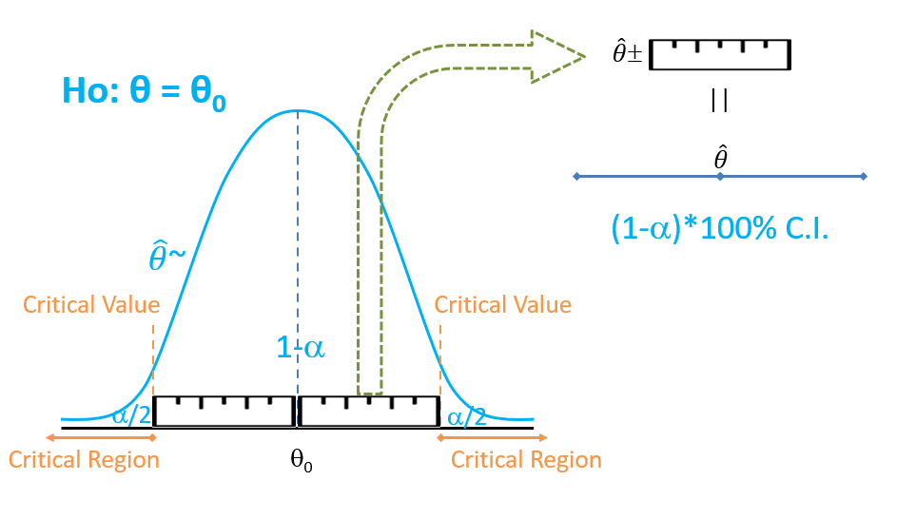
Confidence Interval

Slide 3

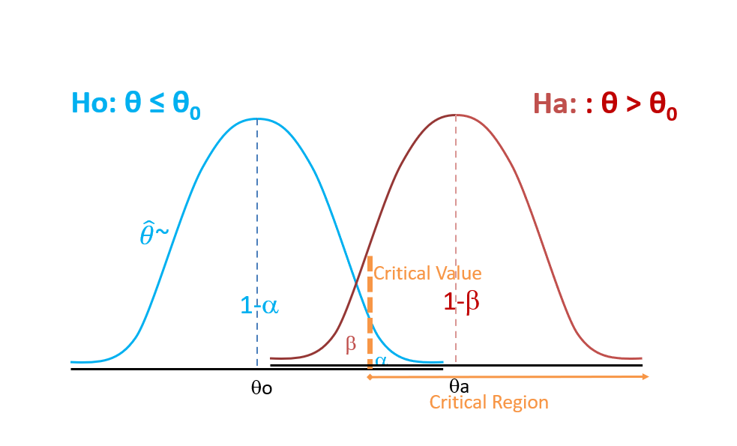

Slide 4
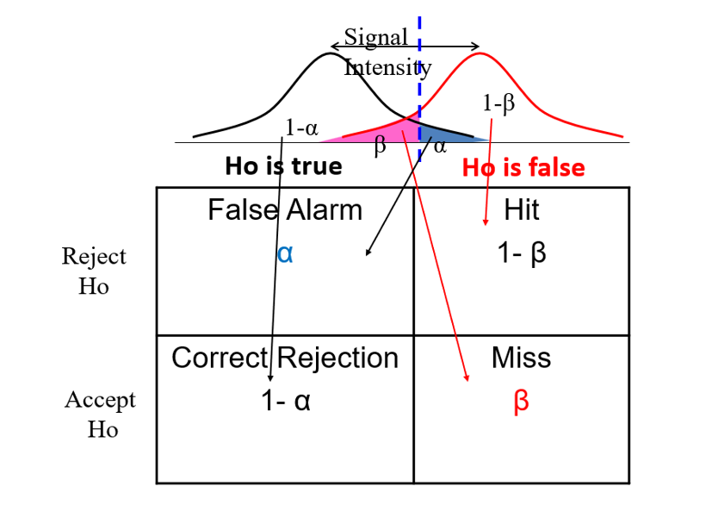

Slide 5
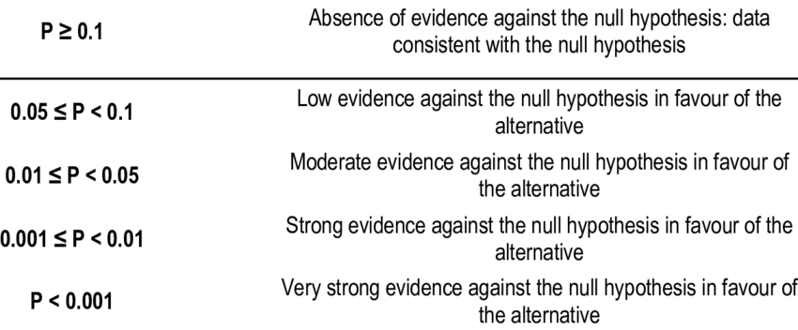

Range of p-value

Slide 6
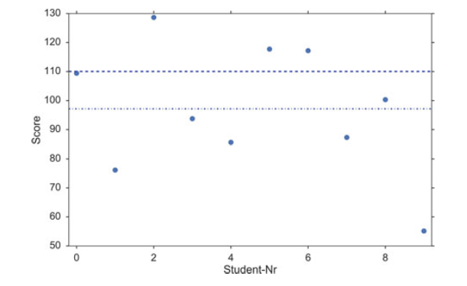
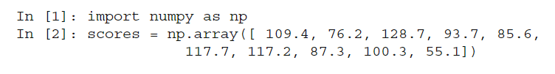
e.g.
Assume that you are running a private educational institution. Your contract says that if your students score 110 in the final exam, where the national average is 100, you get a bonus. When the results are significantly lower, you loose your bonus (because the students are not good enough), and you have to hire more teachers; and when the results are significantly higher, you also loose your bonus (because you have spent too much money on teachers), and you have to cut back on the number of teachers. The final exam of your ten students produce the following scores
Ho : x=110
Is the mean value of the scores (97.1) significantly different from 110?

Slide 7

t < 1.84 and t > 1.84
the likelihood that the population mean is 110 is 9.95 %

Slide 8
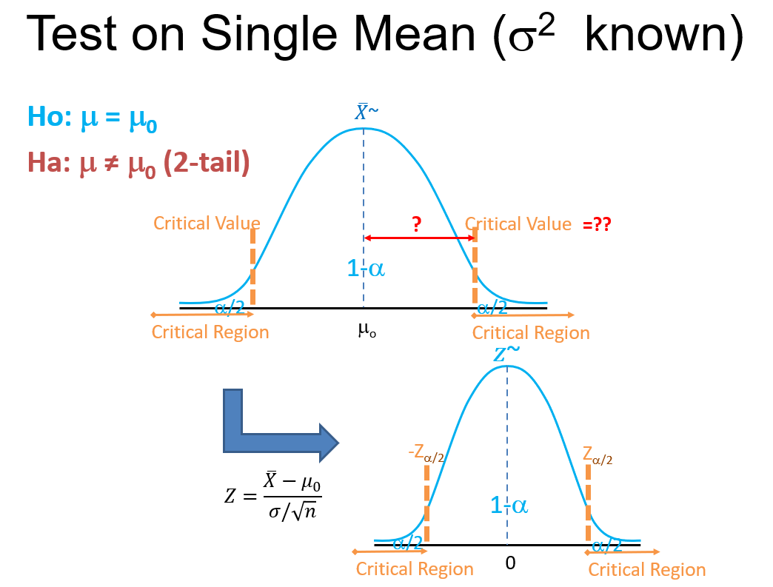

Slide 9
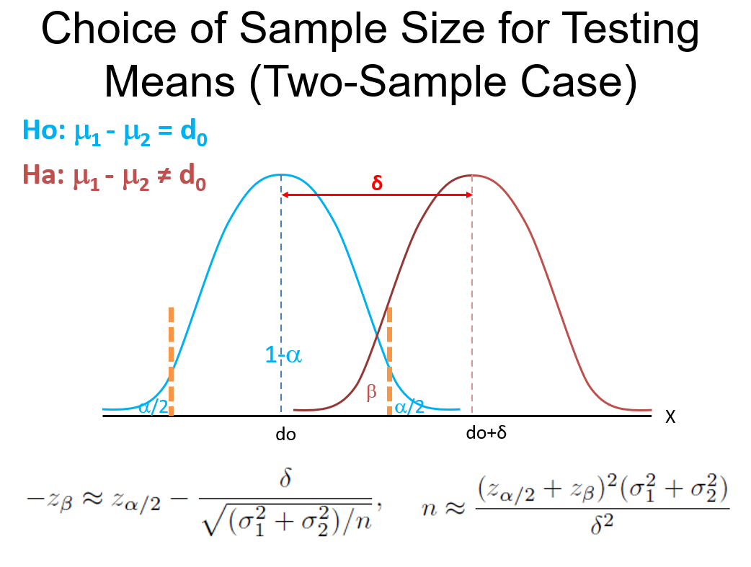

Slide 10
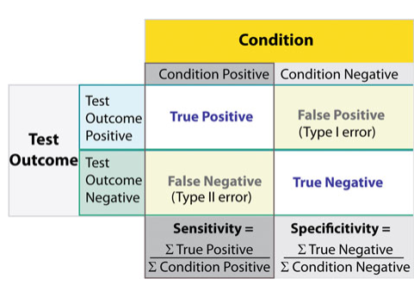
Sensitivity and Specificity
Sensitivity = proportion if positives that are correctly identified by a test (= probability of a positive test, given the patient is ill)
Specificity = proportion of negatives that are correctly identified by a test (=probability of a negative test, given that patient is well)

Slide 11
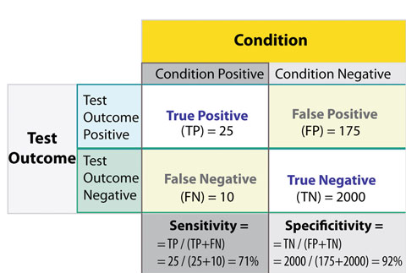
Worked Example

Slide 12

Positive/Negative likelihood ratio
Closely related to sensitivity and specificity
Used for determining whether a test result changes the probability that a condition exists

Slide 13
Receiver-Operating-Characteristic Curve
Graph displaying the relationship between the true positive rate (vertical axis) and false positive rate (horizontal axis)
True positive rate = sensitivity
False positive rate = 1-specificity
Used for discriminating between two given distributions

Slide 14
Worked Example
ROC first used during WW2 to analyze radar effectiveness
Example: Find a way to optimize the approach to rely on a radar that he is discriminating between birds and german planes correctly
We have two distributions: radar signal for Birds and radar signal for German planes and we want to determine a cut-off value for an indicator in order to assign a test result to either Birds or Planes

Slide 15
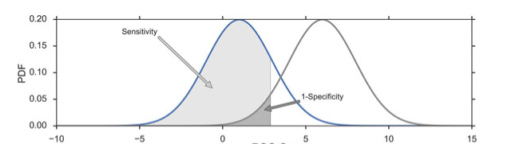
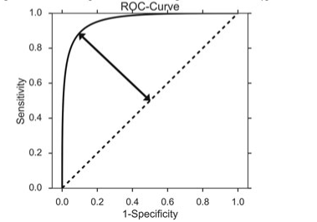
Worked Example: ROC Graph

