Slide 1
The Missing(ness) Piece
Louise Hadden presented at her first SAS conference in 1996 and has never looked back, presenting at multiple conferences across the continent over the years. She supports file building and analytic programming for life sciences organizations, most frequently government agencies such as CMS and CDC, and specializes in reporting and data visualization.

Slide 2
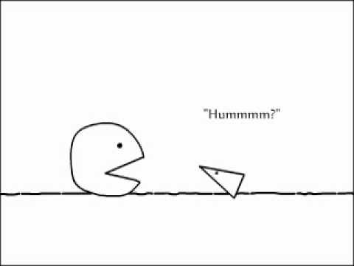
The Missing(ness) Piece
Louise S. Hadden, Independent Consultant

Slide 3
AGENDA
Introduction
The importance of missing data
Preparing to Analyze Missing Values
Special Missing Values
Missing Functions
PROC FREQ, ODS Output Objects, & NLEVELS
Arrays, NOBS, and PROC UNIVARIATE OUTTABLE
Assembling the Missing Piece(s)
Conclusion

Slide 4
INTRODUCTION
Reporting on missing and/or non-response data is vitally important, especially when working with survey, lab, and medical record data.
If you want a quick initial look at data files for problem areas, there are some quick and efficient techniques available to you
PROC FREQ NLEVELS and PROC UNIVARIATE OUTTABLE will help you find your missing(ness) piece
Notes:
Reporting on missing and/or non-response data is of paramount importance when working with longitudinal surveillance, laboratory and medical record data. Reshaping the data over time to produce such statistics is a tried and true technique, but for a quick initial look at data files for problem areas, there’s an easier way! will speed up your data cleaning reconnaissance and help you find your missing(ness) piece.

Slide 5
INTRODUCTION
Myriad ways to determine if you have missing data: PROC FREQ, PROC MEANS, PROC SUMMARY, PROC UNIVARIATE, etc.
Depending on procedure options in PROC FREQ, missing values can be included or not, in counts
PROC UNIVARIATE and other statistical procedures report out on the number of missing values as a matter of course
Notes:
There are myriad ways to determine if you have missing data (PROC FREQ, PROC MEANS, PROC SUMMARY, PROC UNIVARIATE, etc.). Most SAS® statistical procedures can report out on the number of missing values. Depending on procedure options in PROC FREQ, missing values can be included, or not, in counts of observations.

Slide 6
INTRODUCTION
Myriad ways to determine if you have missing data: PROC FREQ, PROC MEANS, PROC SUMMARY, PROC UNIVARIATE, etc.
Depending on procedure options in PROC FREQ, missing values can be included or not, in counts
PROC UNIVARIATE and other statistical procedures report out on the number of missing values as a matter of course
Notes:
Other statistical procedures simply drop records with missing values. Reporting on missing values can occur via “list” output, procedural output or ODS output objects. Most statistical procedures do not distinguish between different types of missing, but PROC FREQ and reporting procedures do. This paper explores using PROC FREQ and PROC UNIVARIATE to report on missing values by variable in a data set.

Slide 7
PREPARING MISSING VALUES
A common practice is to assign special codes for missing values, such as 95 for other specify, 96 for other, 97 for refused, 98 for not answered, and 99 for not applicable.
Unfortunately, to statistical procedures, they are just numbers and are treated as such.
SAS can assign up to 28 special missing value codes, ., ._., and .A through .Z.
Notes:
It is common in survey output to assign codes such as 95 for other specify, 96 for other, 97 for refused, 98 for not answered, and 99 for not applicable. These values represent different types of missing. Unfortunately, to statistical procedures, they are just numbers, and are treated as such. SAS can assign up to 28 special missing value codes, ., ._, and .A through .Z. These represent extremely small numbers that are greater than 0 – different extremely small numbers. SAS can and does distinguish between these special missing values in reporting procedures and PROC FREQ. It is recommended that analysts recode the 9x codes (and the like) to special missing values – for example, 95 (other) could be .O, and a valid skip (determined by looking at a survey instrument or data dictionary for skip patterns) could be coded .V. Knowing what is truly missing data is of the utmost importance. Note information on special missing value recodes in both variable and value labels. PROC FORMAT will report on the different missing values when used with reporting procedures and PROC FREQ. When the format below is applied to a variable, .O, .M, and .V are all reported out separately.

Slide 8
PREPARING MISSING VALUES
Special missing value codes represent extremely small numbers.
SAS can and does distinguish between these special missing values in reporting procedures and some statistical procedures such as PROC FREQ.
It is recommended that analysts recode the 9x codes to special missing values – for example, 95 (other) could be presented by .O.
Notes:
These represent extremely small numbers that are greater than 0 – different extremely small numbers. SAS can and does distinguish between these special missing values in reporting procedures and PROC FREQ. It is recommended that analysts recode the 9x codes (and the like) to special missing values – for example, 95 (other) could be .O, and a valid skip (determined by looking at a survey instrument or data dictionary for skip patterns) could be coded .V. Knowing what is truly missing data is of the utmost importance. Note information on special missing value recodes in both variable and value labels.

Slide 9
PREPARING MISSING VALUES
A common practice is to assign special codes for missing values, such as 95 for other specify, 96 for other, 97 for refused, 98 for not answered, and 99 for not applicable.
Unfortunately, to statistical procedures, they are just numbers and are treated as such.
SAS can assign up to 28 special missing value codes, ., ._., and .A through .Z.
Notes:
It is common in survey output to assign codes such as 95 for other specify, 96 for other, 97 for refused, 98 for not answered, and 99 for not applicable. These values represent different types of missing. Unfortunately, to statistical procedures, they are just numbers, and are treated as such. SAS can assign up to 28 special missing value codes, ., ._, and .A through .Z. These represent extremely small numbers that are greater than 0 – different extremely small numbers. SAS can and does distinguish between these special missing values in reporting procedures and PROC FREQ. It is recommended that analysts recode the 9x codes (and the like) to special missing values – for example, 95 (other) could be .O, and a valid skip (determined by looking at a survey instrument or data dictionary for skip patterns) could be coded .V. Knowing what is truly missing data is of the utmost importance. Note information on special missing value recodes in both variable and value labels. PROC FORMAT will report on the different missing values when used with reporting procedures and PROC FREQ. When the format below is applied to a variable, .O, .M, and .V are all reported out separately.

Slide 10
PREPARING MISSING VALUES
PROC FORMAT will report on the different missing values when used with reporting procedures and proc freq.
When the format below is applied to a variable, .O, .M, .V are all reported out separately
proc format;
value varx_f .O = '.O: Other Specify'
.M = '.M: Missing'
.V = '.V: Valid Skip'
other = 'Non-Missing’;
run;
Notes:
PROC FORMAT will report on the different missing values when used with reporting procedures and PROC FREQ. When the format below is applied to a variable, .O, .M, and .V are all reported out separately.
proc format;
value varx_f .O = 'Other Specify'
.M = 'Missing'
.V = 'Valid Skip'
other = 'Non-Missing';
run;

Slide 11
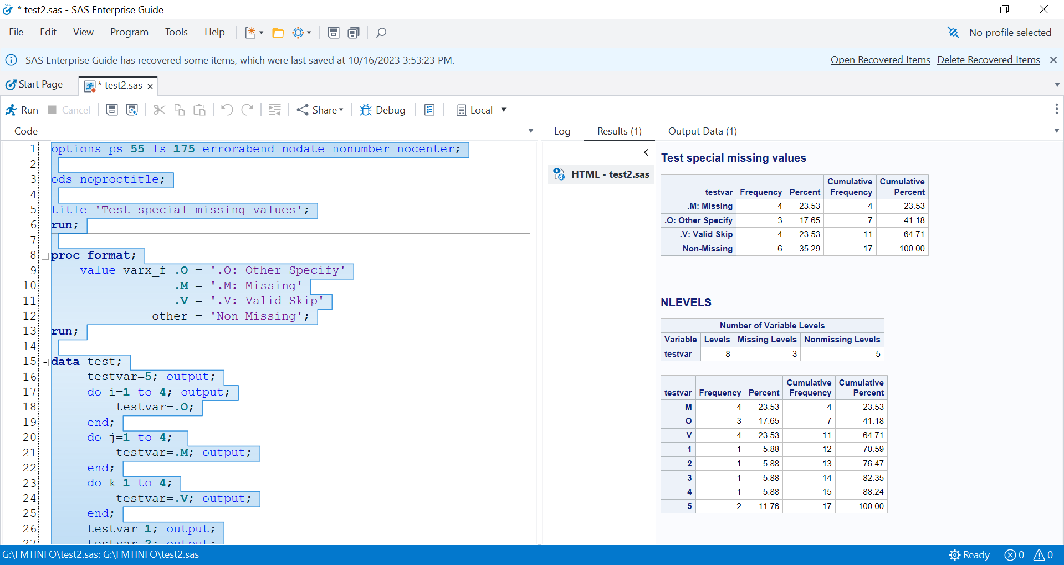
PREPARING MISSING VALUES
Notes:
As you can see, the special missing values are reported on, and will show up on proc freq nlevels.

Slide 12
PROC FREQ NLEVELS
SAS has an underutilized variant of PROC FREQ that allows you to produce a missingness report
The procedural option to use is NLEVELS
As we saw earlier, if your data has special missing NUMERIC values, these will be reported as “levels” of missing.
CHARACTER variables have a single “level” of missing
Notes:
Regardless of how your data was prepared with respect to missing values, SAS has a sadly underutilized variant of PROC FREQ that allows you to produce a missingness report with ease. This procedural option is NLEVELS. If your data set has special missing numeric values, these will be reported as “levels” of missing. Character variables have a single “level” of missing. The syntax for PROC FREQ NLEVELS is as follows:

Slide 13
PROC FREQ NLEVELS
Ods trace;
proc freq data=int.&infi. nlevels;
ods output nlevels=nlevels0;
tables _all_ / noprint;
run;
ods output close;
ods trace off;
proc print data=nlevels0 (obs=5) noobs;
title 'Test nlevels output';
run;
proc contents data=nlevels0 varnum;
run;
Notes:
Here is the syntax for PROC FREQ NLEVELS. ODS TRACE and ODS TRACE OFF lets us know what ODS OUTPUT objects are created by the procedural variant. The only ODS output object that PROC FREQ NLEVELS produces is NLEVELS. The NLEVELS0 data set contains 5 variables: TABLEVAR (variable name), TABLEVARLABEL (variable label), NLEVELS (number of different values, including missing), NMISSLEVELS (number of different missing values), and NNONMISSLEVELS (number of different non-missing values). Using _all_ in the tablue statement means that all variables are tabulated. Thus, you can generate a single line with missing value statistics for each variable in a single report.

Slide 14
PROC FREQ NLEVELS
Ods trace;
proc freq data=int.&infi. nlevels;
ods output nlevels=nlevels0;
tables _all_ / noprint;
run;
ods output close;
ods trace off;
proc print data=nlevels0 (obs=5) noobs;
title 'Test nlevels output';
run;
proc contents data=nlevels0 varnum;
run;
Notes:
PROC FREQ with the _ALL_ tables option will report on variables in the order in which they entered the PDV, so if a different order is desired, prepare your data set for reporting by reordering your variables. Additionally, ensure that all variables are labelled prior to reporting.
The listing output from PROC FREQ NLEVELS is not ideal for reporting. We use a PROC REPORT step, using the ODS OUTPUT object generated by the procedure.

Slide 15
PROC FREQ NLEVELS
data nlevels;
set nlevels0;
label TableVar = "Variable Name"
TableVarLabel = "Variable Description"
NLevels = "# of Variable values"
NMissLevels = "# of Missing Value Levels"
NNonMissLevels = "# of Non- Missing Value Levels";
shadeit=(nnonmisslevels=0);
run;
Notes:
We use PROC REPORT and ODS RTF to set up our Missingness report, highlighting a high degree of missingness using the shadeit variable created above. It is set as a non-printing variable in the DEFINE statement, but must be in the columns statement in order for the conditional shading of the row to work. Note that this shading can also be applied to single cells using options in the COMPUTE statement.

Slide 16
PROC FREQ NLEVELS
ods rtf file="Missingingness.rtf" path=odsout style=styles.pearl;
title2 "Missingness Report for &infi - N = &nobs";
proc report nowd data=nlevels
style(report)=[cellpadding=3pt vjust=b]
style(header)=[just=center font_face="Helvetica" font_weight=bold
font_size=8pt]
style(lines)=[just=left font_face="Helvetica"] split='|';
columns TableVar TableVarLabel NLevels NmissLevels NNonMissLevels
shadeit;
define shadeit / display ' ' noprint;
define TableVar / style(COLUMN)={just=l font_face="Helvetica"
font_size=8pt cellwidth=295 }
style(HEADER)={just=l font_face="Helvetica" font_weight=bold
font_size=8pt };
. . .
compute shadeit;
if (shadeit eq 1) then call
define(_row_,"STYLE","STYLE=[BACKGROUND=PINK]");
endcomp;
run;
ods rtf close;
Notes:
In preparation for reporting, we set the NLEVELS0 ODS output object, creating a temporary file for printing. We label the variables, and create a non-printing variable (shadeit) that allows us to flag any variables without any non-missing value levels.

Slide 17
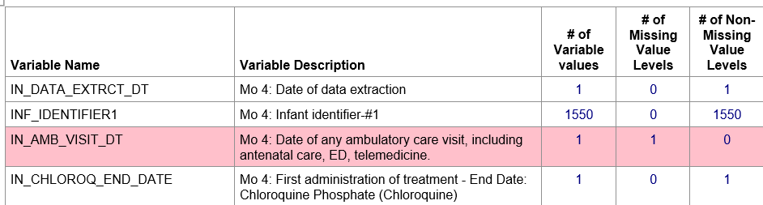
REPORT ON VARIABLE LEVELS
We are able to produce a report from a data set with thousands of variables with a few lines of PROC FREQ and PROC REPORT code, instantly highlighting records for variables which may have a missingness problem. Using the SHADEIT variable to screen, we could produce a report with variables with only missing values to research.
Notes:
We are able to produce a report from a data set with thousands of variables with a few lines of PROC FREQ and PROC REPORT code, instantly highlighting records for variables which may have a missingness problem. Using the SHADEIT variable to screen, we could produce a report with variables with only missing values to research.

Slide 18
BUT WAIT, THERE’S MORE!
%macro filecheck(inlib=out, inmem=recover_surveillance_&delivdate.);
proc sql noprint;
create table filelist0 as
select libname, memname, nobs
from dictionary.tables
where libname = upcase("&inlib");
quit;
data filelist;
set filelist0 (where=(memname = upcase("&inmem.")));
run;
%mend;
%filecheck(inlib=out,inmem=recover_surveillance_&delivdate.);
Notes:
The number of observations in a file is an important datum that can be used to calculate numerous useful statistics, for example, the cardinality ratio of each variable in a file. In order to obtain the N of a file, or a series of files, we use a macro to grab the NOBS. There are many ways to determine the number of observations. Since we analyze a number of different files, we use a macro driven solution to accommodate that need.

Slide 19
BUT WAIT, THERE’S MORE!
%macro filecheck(inlib=out, inmem=recover_surveillance_&delivdate.);
proc sql noprint;
create table filelist0 as
select libname, memname, nobs
from dictionary.tables
where libname = upcase("&inlib");
quit;
data filelist;
set filelist0 (where=(memname = upcase("&inmem.")));
run;
%mend;
%filecheck(inlib=out,inmem=recover_surveillance_&delivdate.);
Notes:
This macro is included in a larger program which calculates cardinality. This program has a few additions to the code snippet we saw above.

Slide 20
BUT WAIT, THERE’S MORE!
data nlevels out.nlevels_surveillance_&delivdate.;
length cr_type $ 12;
set nlevels0;
label TableVar = "Variable Name"
TableVarLabel = "Variable Description"
NLevels = "# of Variable values"
NMissLevels = "# of Missing Value Levels"
NNonMissLevels = "# of Non- Missing Value Levels";
shadeit=(nnonmisslevels=0);
/* shades variables with NO non missing values */
nobs=&fileobs;
cardinality=nobs/nlevels;
label nobs = "# of Observations"
cardinality = "Cardinality Ratio";
select;
when(nlevels eq 1 ) cr_type = '.unique';
when(nlevels gt 10) cr_type = 'many';
otherwise cr_type = 'few';
end;
label cr_type='Cardinality Type';
run;
Notes:
We then can produce a more robust missingness report.

Slide 21
BUT WAIT, THERE’S MORE!
ods rtf file="Missingness_Report_Surveillance_&delivdate..rtf" path=odsout style=styles.pearl;
title2 "Missingness Report for Deliverable Surveillance data set for &delivdate";
proc report nowd data=nlevels
style(report)=[cellpadding=3pt vjust=b]
style(header)=[just=center font_face="Helvetica" font_weight=bold font_size=8pt]
style(lines)=[just=left font_face="Helvetica"] split='|’;
columns TableVar TableVarLabel NLevels NmissLevels NNonMissLevels nobs cardinality
shadeit;
define shadeit / display ' ' noprint;
define TableVar / style(COLUMN)={just=l font_face="Helvetica"
font_size=8pt cellwidth=250 }
style(HEADER)={just=l font_face="Helvetica" font_weight=bold
font_size=8pt };
define Nobs / style(COLUMN)={just=c font_face="Helvetica" foreground=navy
font_size=8pt cellwidth=75 }
style(HEADER)={just=c font_face="Helvetica" font_weight=bold
font_size=8pt };
define Cardinality / style(COLUMN)={just=c font_face="Helvetica" foreground=navy
font_size=8pt cellwidth=110 }
style(HEADER)={just=c font_face="Helvetica" font_weight=bold
font_size=8pt };
compute shadeit;
if (shadeit eq 1) then call define(_row_,"STYLE","STYLE=[BACKGROUND=PINK]");
endcomp;
run;
ods _all_ close;
Notes:
We then can produce a more robust missingness report.

Slide 22
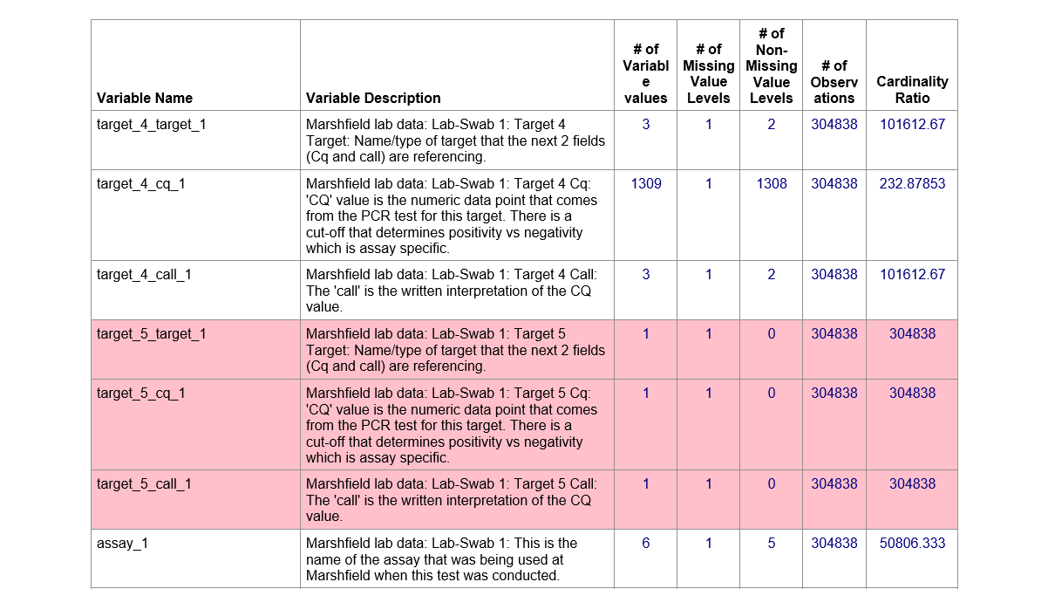
BUT WAIT, THERE’S MORE!
Notes:
What does the cardinality ratio give us? My company uses it to determine how to report on variables.

Slide 23
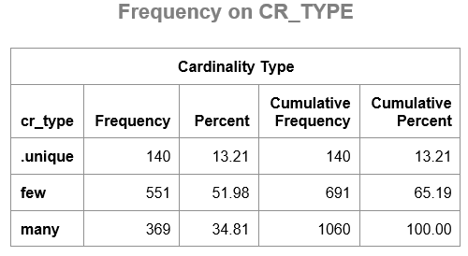
BUT WAIT, THERE’S MORE!
Notes:
A cr_type of .unique very likely is identifiable data, and won’t be reported on. A cr_type of few will be handled with a frequency table. A cr_type of many will likely be handled with a summary / means / univariate.
.

Slide 24
WHEN LESS IS MORE
PROC SQL NOPRINT;
CREATE TABLE CONTS_P AS
SELECT name format = $32. length = 32
, type format = $4. length = 4
, length format= 8. length = 8
, label format = $250. length = 250
, varnum format =8. length = 8
FROM DICTIONARY.COLUMNS
WHERE libname="INLIB" and memname=upcase("&infi.");
QUIT;
Notes:
Sometimes all that is required is a simple missing / presence report, maybe by site. Perhaps you have thousands of variables, of different types. SAS, the missing function, proc univariate outtable, and some clever macro coding can produce exactly what is needed. The code snippets here provide the answer with an informative table by site of missing and present variables, regardless of variable type.

Slide 25
WHEN LESS IS MORE
proc freq data=conts_p;
tables type / noprint out=max_type (keep=type count);
run;
data _null_;
set max_type;
if type='char' then do;
ccount=put(count,z4.);
CALL SYMPUTX("cmax",ccount);
end;
if type='num' then do;
ncount=put(count,z4.);
CALL SYMPUTX("nmax",ncount);
end;
run;
Notes:
*** get the maximum n of each type and create macro vars ***;
*** use &cmax for character and &nmax for numeric ***;

Slide 26
WHEN LESS IS MORE
proc sql noprint;
select name format = $32. length = 32 into :clist separated by ' '
from conts_p
where type='char';
quit;
proc sql noprint;
select name format = $32. length = 32 into :nlist separated by ' '
from conts_p
where type='num';
quit;
Notes:
*** List variable names by type and number ***;
****************************************************************************;
*** create macro variables to list character and numeric variables ***;

Slide 27
WHEN LESS IS MORE
proc sql noprint;
select name format = $32. length = 32 into :clist separated by ' '
from conts_p
where type='char';
quit;
proc sql noprint;
select name format = $32. length = 32 into :nlist separated by ' '
from conts_p
where type='num';
quit;
Notes:
*** use missing function to create numeric reps of char and num vars ***;

Slide 28
WHEN LESS IS MORE
data temp;
set inlib.&infi;
array clist (*) &clist;
array cton (*) cvar0001 - cvar&cmax. ;
array nlist (*) &nlist;
array nton (*) nvar0001 - nvar&nmax. ;
tempc=.;
tempn=.;
do i=1 to dim(clist);
tempc=missing(clist(i));
if tempc=0 then cton(i)=1;
else if tempc=1 then cton(i)=.;
end;
do j=1 to dim(nlist);
tempn=missing(nlist(j));
if tempn=0 then nton(j)=1;
else if tempn=1 then nton(j)=.;
end;
drop i j;
run;
Notes:
*** use missing function to create numeric reps of char and num vars ***;

Slide 29
WHEN LESS IS MORE
data temp;
set inlib.&infi;
array clist (*) &clist;
array cton (*) cvar0001 - cvar&cmax. ;
array nlist (*) &nlist;
array nton (*) nvar0001 - nvar&nmax. ;
tempc=.;
tempn=.;
do i=1 to dim(clist);
tempc=missing(clist(i));
if tempc=0 then cton(i)=1;
else if tempc=1 then cton(i)=.;
end;
do j=1 to dim(nlist);
tempn=missing(nlist(j));
if tempn=0 then nton(j)=1;
else if tempn=1 then nton(j)=.;
end; drop i j;
run;
Notes:
*** macro to process by site using univariate outtable ***;

Slide 30
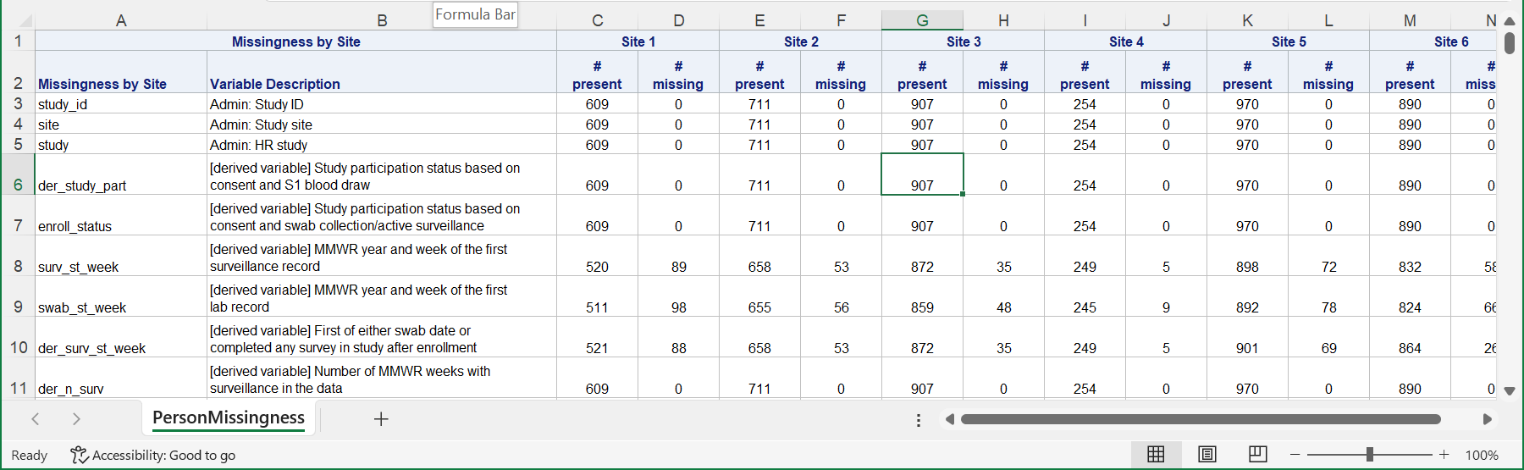
WHEN LESS IS MORE
Notes:
We use a proc report to produce a camera ready table with no editing required.

Slide 31
CONCLUSION
PROC FREQ with the NLEVELS option can provide an excellent broad stroke report on missingness in your data sets. PROC REPORT can generate a traffic-lighted report based on the number of total levels on each individual variable in the data set. Macro coding, the missing function, and PROC UNIVARIATE can produce a simple but effective table of presence and absence for an unlimited number of variables without user intervention. We have found the Missing(ness) Piece!

Slide 32

Contact Information
Louise S. Hadden
Girlwiththesastattoo@gmail.com

