Slide 1
ExCITE-ing! Build Your Paper’s Reference Section Programmatically Using Lex Jansen’s Website and SAS®
Louise S. Hadden, Owl & Otter Consulting
Abstract
One challenge in writing a SAS® White Paper is creating the perfect reference section, properly acknowledging those who have inspired and paved the way. Luckily, clever use of such tools as Lex Jansen’s website, SAS’s ability to read in and manipulate varied data sources, and tools such as Microsoft Word citation manager, every author can succeed in proper referencing in their SAS white papers. This paper and ePoster will demonstrate how to accomplish this goal.
Introduction
Citation Reqs
Addl Resources
LexJansen.Com
Construction
SAS Output
References
Click Headings Above to View Content

Slide 2
ExCITE-ing! Build Your Paper’s Reference Section Programmatically Using Lex Jansen’s Website and SAS®
Louise S. Hadden, Owl & Otter Consulting
Abstract
Citation serves a number of purposes:
Tells views where further information can be found
Gives appropriate credit to the persons whose words, concepts, and data you are using
Protects you from plagiarizing, and
Protects you from the risk of having your own research and projects being invalidated
SAS User Groups and other organizations require that all published work cited in your paper be contained in a references section.
ABSTRACT
Introduction
Citation Reqs
Addl Resources
LexJansen.Com
Construction
SAS Output
References
Click Headings Above to View Content

Slide 3
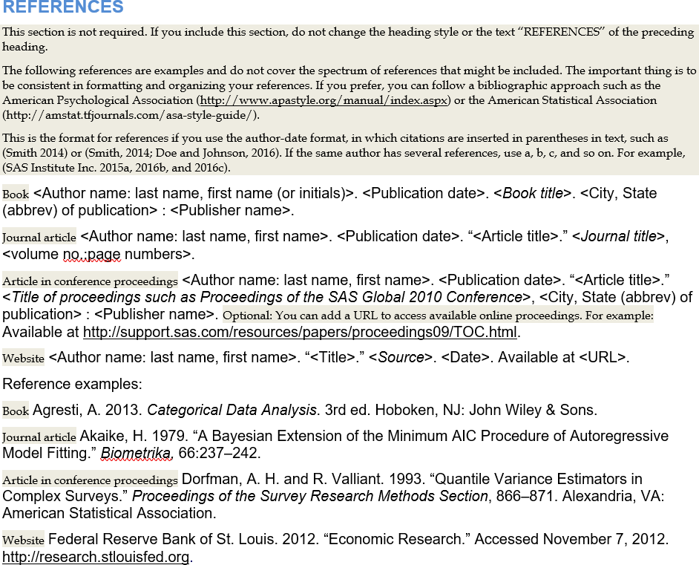
ExCITE-ing! Build Your Paper’s Reference Section Programmatically Using Lex Jansen’s Website and SAS®
Louise S. Hadden, Owl & Otter Consulting
What are the requirements for a reference section?
Abstract
ABSTRACT
Check out the PharmaSUG 2025 Word Template
For newer resources such as ChatGPT or OpenAI
Introduction
Citation Reqs
Addl Resources
In-text Example :APA guideline
When prompted with “How many SAS software papers published in 2024 mentioned ChatGPT?” the ChatGPT-generated text provided several detailed citations, primarily at PharmaSUG 2024 and 2025. (Open AI, 2025).
Reference: APA guideline
(Open AI, 2025). Response generated by ChatGPT (GPT-4.5-turbo) in response to user query about SAS software papers mentioning ChatGPT. Retrieved from https://chat.openai.com.
In-text Example: MLA format
When prompted with “How many SAS software papers published in 2024 mentioned ChatGPT?” the ChatGPT-generated text provided several detailed citations, primarily at PharmaSUG 2024 and 2025. (OpenAI).
Reference: MLA format
OpenAI. ChatGPT (GPT-4.5-turbo). Response to a query about SAS Software papers mentioning ChatGPT. 18 May 2025. ChatGPT, https://chat.openai.com/.
LexJansen.Com
Construction
SAS Output
References
Click Headings Above to View Content
Beige shading provides instructions;
On PharmaSUG website
Use the APA or MLS citation styles

Slide 4
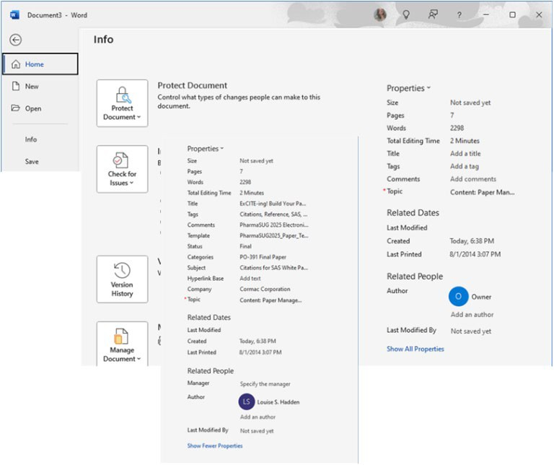
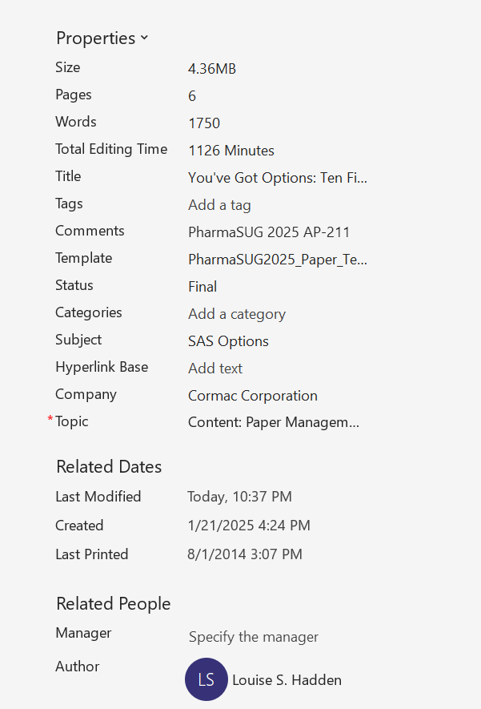
ExCITE-ing! Build Your Paper’s Reference Section Programmatically Using Lex Jansen’s Website and SAS®
Louise S. Hadden, Owl & Otter Consulting
Abstract
SAS User Group templates and advice on citing AI resources used are not inclusive of other types of writing and may be out of date due to ongoing changes in technology and what needs to be cited – the concept of digital copyrights is fluid at this point. Check out these other resources if you still have questions.
Introduction
Citation Reqs
SAS Editorial Guidelines
Anti-Plagiarism Tools
Addl Resources
Updated regularly
Cover how SAS’s copyrighted information should be treated
Always consult academic, employer, journal, etc. guidelines as well
https://www.sas.com/content/dam/SAS/documents/legal-employee-services/legal/editorial-guidelines.pdf
These tools and sites work by comparing text in your work with texts in large online data bases.
Popular options include Scribbr, Grammarly, Copyleasks, Quillbot, iThenticate, DupliCHeckr, and PlagScan
Word users can “Check for similarity to online sources”
LexJansen.Com
Construction
SAS Output
Common Instruction Sets
Microsoft / Adobe
References
APA (American Psychological Association)
MLA (Modern Language Association)
Chicago/Turabian
Covers both in-text citations and more complete references sections
PharmaSUG suggests APA or MLA
Protect your own work:
Secure your PDFs with Adobe
Add personalized properties (metadata) to your Word and PDF documents
Use Word Citation Management, which stores perfectly formatted citations
Click Headings Above to View Content

Slide 5
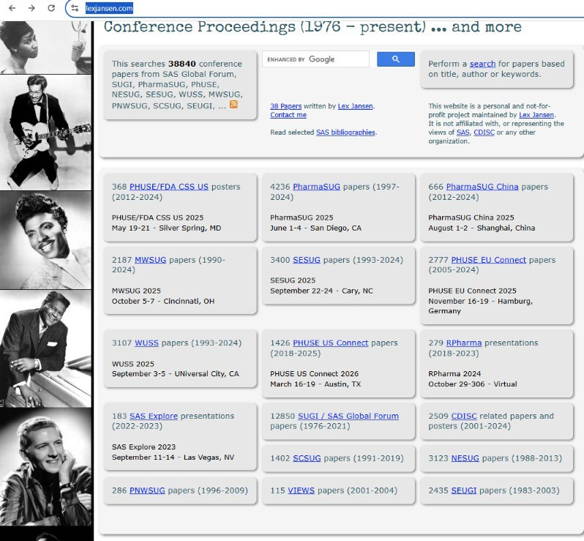
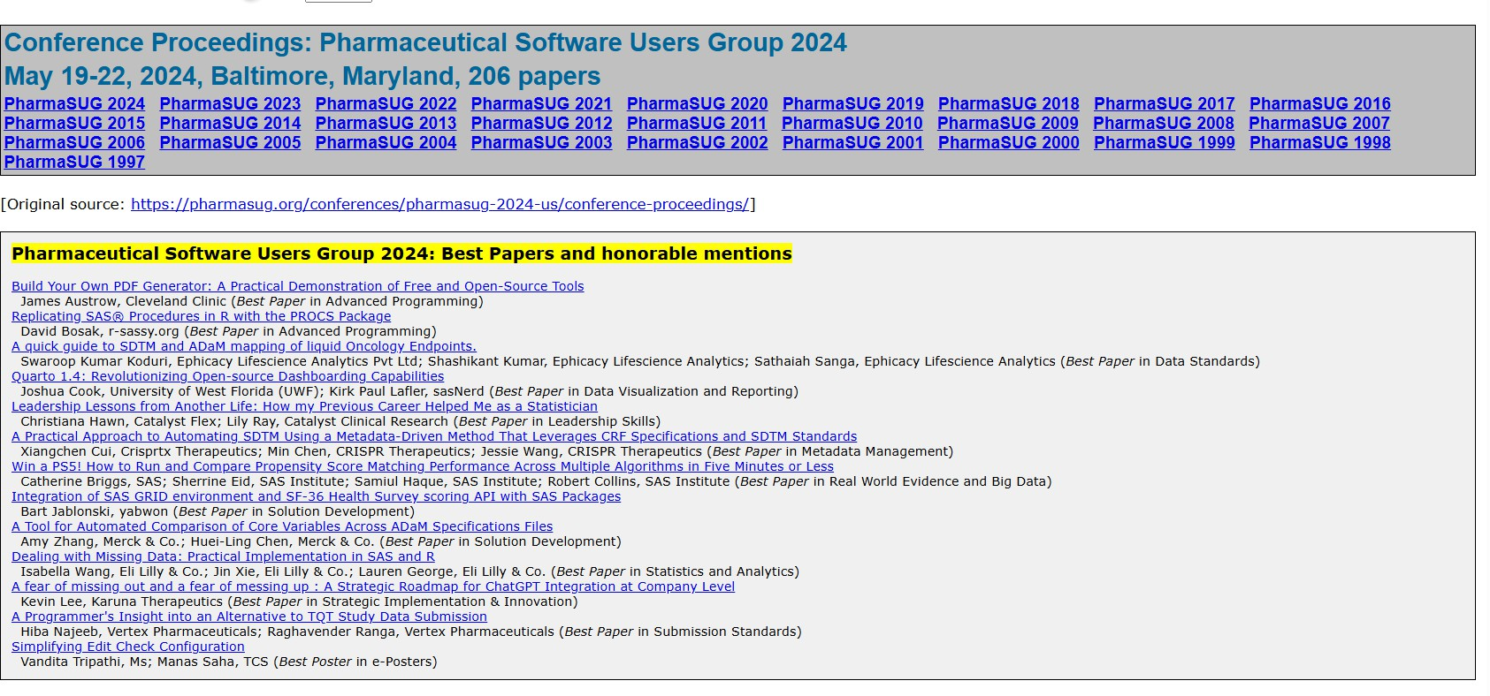

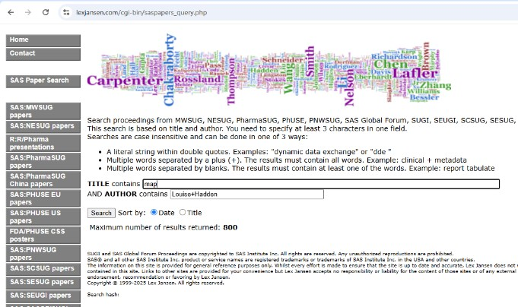
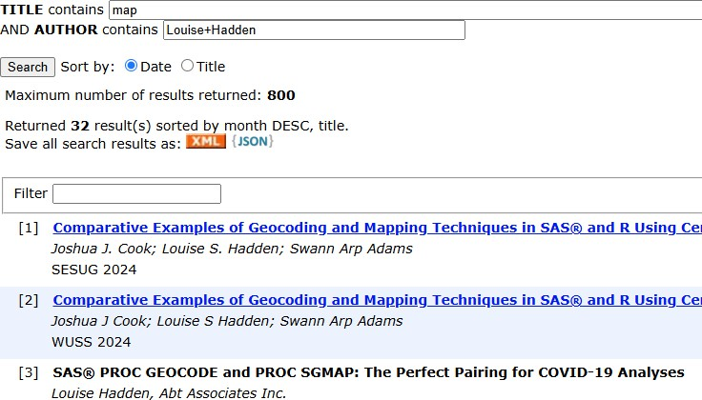
ExCITE-ing! Build Your Paper’s Reference Section Programmatically Using Lex Jansen’s Website and SAS®
Louise S. Hadden, Owl & Otter Consulting
Abstract
Top Level:
www.lexjansen.com/
On this level, you can find a hidden treasure: special SAS biographies created by the Macro Maven, Ron Fehd. This level is found by clicking on SAS Biographies on the main level. You can also find a selection of Lex Jansen’s papers and a link to Troy Martin Hughes’ paper.
https://www.lexjansen.com/sas-bibliographies/
https://www.lexjansen.com/sas-bibliographies/Hughes-2024_wuss-216_48-year-analysis.pdf https://www.lexjansen.com/papers/
User Group Level
(click on any user group on top level)
Introduction
Citation Reqs
Addl Resources
LexJansen.Com
Construction
SAS Paper Search:
https://www.lexjansen.com/cgi-bin/saspapers_query.php
The results of a search are shown to the left – I have 32 papers with the keyword maps in the title. You can save the search results as XML or JSON with a simple click. You can also click on any of the papers listed to download them individually or right click and save the link for later use.
Web scraping is an excellent choice for harvesting data from the site in either Python or SAS (see the references section for related work from Troy Martin Hughes and Bart Jablonksi)
SAS Output
References
Click Headings Above to View Content

Slide 6
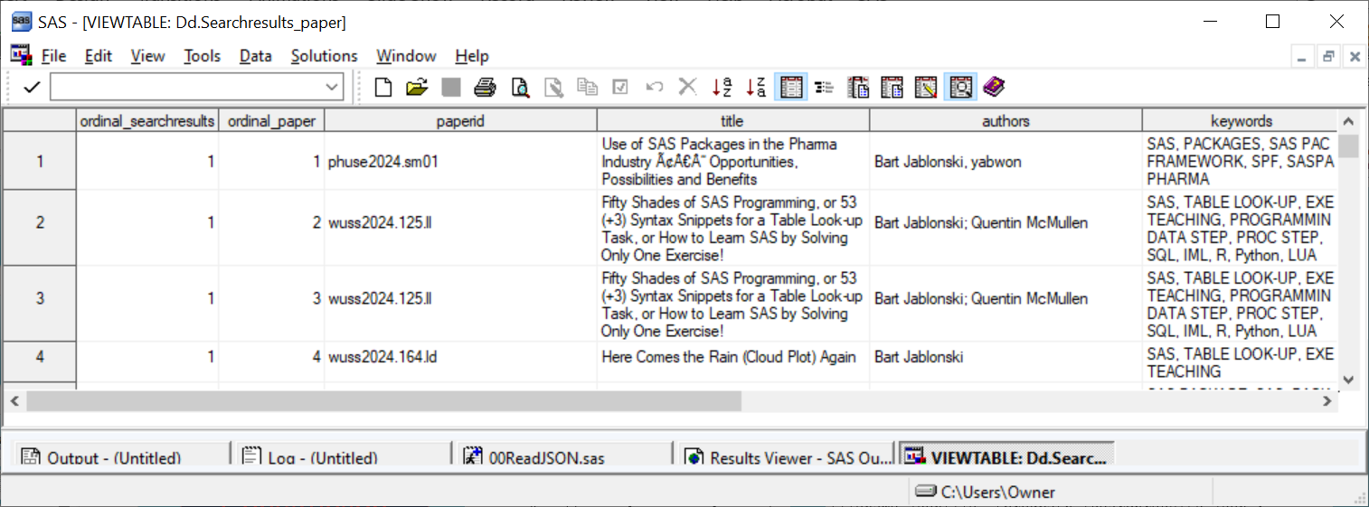
ExCITE-ing! Build Your Paper’s Reference Section Programmatically Using Lex Jansen’s Website and SAS®
Louise S. Hadden, Owl & Otter Consulting
Abstract
“
Article in conference proceedings <Author name: last name, first name>. <Publication date>. “<Article title>.”
<Title of proceedings such as Proceedings of the SAS Global 2010 Conference>, <City, State (abbrev) of publication> : <Publisher name>. Optional: You can add a URL to access available online proceedings. For example: Available at http://support.sas.com/resources/papers/proceedings09/TOC.html.”
Introduction
Citation Reqs
From the snippet above, we can determine that we need the following elements for this type of citation:
Author name, formatted as Last, First, followed by a period.
Publication Date, formatted as Year enclosed in parentheses, followed by a period.
Title, enclosed in double quotes, followed by a period. Optional italics.
Proceedings title or Conference name formatted as “Proceedings of” conference name and followed by “Conference” and a comma.
City and State of the Conference, followed by a period.
(Optional) “Retrieved from “ link to paper
The JSON method is demonstrated for this e-poster.
A search is performed on the SAS search page of Lex Jansen’s site, searching for author for Bart Jablonski. A JSON file is downloaded. The following extraction program is run:
Addl Resources
LexJansen.Com
libname dd "&progpath";
filename jsonfile "&progpath.\searchresults.json";
libname jsonfile json fileref=jsonfile noalldata;
run;
proc copy in=jsonfile out=dd;
run;
Construction
SAS Output
Three files are extracted, and one, the searchresults_paper table, is the file which has most of the desired elements. A second pass was done on the conference level data to obtain city and state of the conference, resulting in a locations table. Formats are created to obtain full conference names and city, state.
References
Click Headings Above to View Content

Slide 7
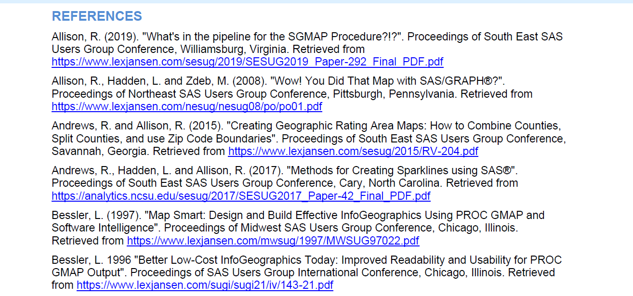
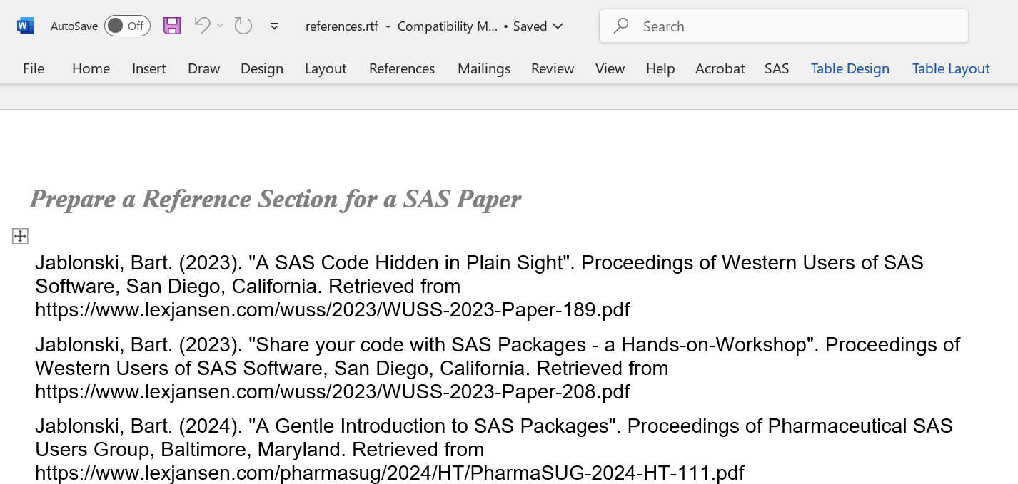
ExCITE-ing! Build Your Paper’s Reference Section Programmatically Using Lex Jansen’s Website and SAS®
Louise S. Hadden, Owl & Otter Consulting
Abstract
Features of the SAS program to create a reference section include:
Merge by conf_url (created in the search results table)
Precleaning (dirty Unicode data)
Preprocess all segments of the citation, particularly name, using SAS functions
Create an extraordinarily long string which includes all elements
Sort output by desired keys (last name of the first author, first name of first author, title)
Output to RTF for an easy drop into the reference section
The JSON method is demonstrated for this e-poster.
A search is performed on the SAS search page of Lex Jansen’s site, searching for author for Bart Jablonski. A JSON file is downloaded. The following extraction program is run:
Introduction
libname dd "&progpath";
filename jsonfile "&progpath.\searchresults.json";
libname jsonfile json fileref=jsonfile noalldata;
run;
proc copy in=jsonfile out=dd;
run;
Citation Reqs
Addl Resources
LexJansen.Com
Construction
SAS Output
References
Click Headings Above to View Content

Slide 8
ExCITE-ing! Build Your Paper’s Reference Section Programmatically Using Lex Jansen’s Website and SAS®
Louise S. Hadden, Owl & Otter Consulting
Abstract
References
Introduction
Hughes, Troy Martin. (2023). “Who’s Bringing That Big Data Energy? A 47-Year Longitudinal Analysis of 30,000 Presentations in the SAS® User Community To Elucidate Top Contributors and Rising Stars”.
Proceedings of the Western Users of SAS Software 2023 Conference, San Diego, California. Retrieved from https://www.lexjansen.com/wuss/2023/WUSS-2023-Paper-204.pdf
Hughes, Troy Martin. (2024).” Who’s Still Bringing That Big Data Energy? Leading a SAS® Conference by Leveraging a 48-Year Longitudinal Analysis of 30,498 Presentations in the SAS User Community”. Proceedings of the Western Users of SAS Software 2024 Conference, Sacramento, California. Retrieved from https://www.lexjansen.com/sas-bibliographies/Hughes-2024_wuss-216_48-year-analysis.pdf
Jablonski, Bart. (2023). "Share your code with SAS Packages - a Hands-on-Workshop". Proceedings of Western Users of SAS Software 2023 Conference, San Diego, California. Retrieved from https://www.lexjansen.com/wuss/2023/WUSS-2023-Paper-208.pdf
Citation Reqs
Addl Resources
LexJansen.Com
Construction
Acknowledgements
SAS Output
I dedicate this paper and ePoster to:
The unparalleled Lex Jansen, who sent me down this rabbit hole many years ago and enabled my first efforts to utilize the fantastic resource that is lexjansen.com. At my request, Lex added first the ability to save searches in the SAS paper search page to XML, and then later to JSON.
To my SAS-sy friends and co-conspirators, Troy Martin Hughes, who has been unfailingly supportive, wildly creative, inspirational, and so much fun; to Bart Jablonski, with his encyclopedia-like knowledge of SAS, his fantastic SAS packages, and the best slinger of American slang ever; to Ron Fehd, who has sparked so many of my own wildly creative ideas, and to Richann Watson, who keeps my feet on the ground and shares her incredible expertise with grace.
To Chris Hemedinger, his SAS Communities colleagues, and the SAS Blog writers, for providing a useful, and rich SAS communal resource.
To the many SAS tech support / R&D / Education staff who have helped me along the way – too many to name!
Long may we wave!
References
Click Headings Above to View Content

