Slide 1
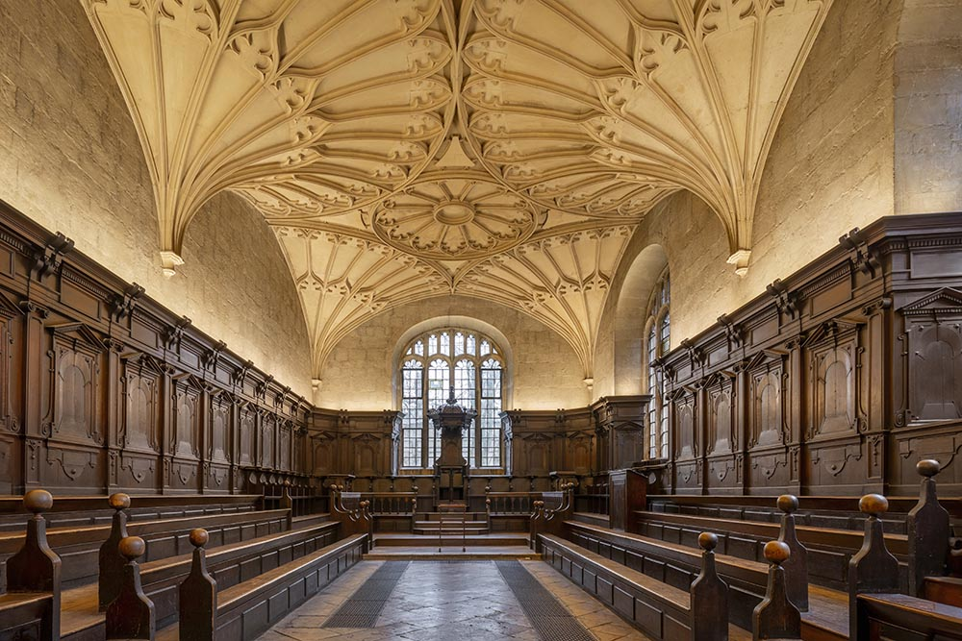
ExCITE-ing! Build Your Paper’s Reference Section Programmatically Using Lex Jansen’s Website and SAS®
Louise S. Hadden,
Independent Consultant

Slide 2

ExCITE-ing! Build Your Paper’s Reference Section Programmatically Using Lex Jansen’s Website and SAS®
Ms. Hadden supports analytics and data as Independent Contractor and an Analytic Lead / Programmer. Her current contract involves analytics and dashboards for the Network of Patient Safety Databases (NPSD). She specializes in reporting and visualization and loves a good SAS reporting challenge. She is also the girl with the SAS tattoo. When she isn’t busy wrangling incalcitrant data, she reads voraciously, volunteers at an animal shelter, and donates plasma and platelets to the American Red Cross.
Notes:
You may have noticed a “bookish” theme to the powerpoint slides and that isn’t accidental. The topic of today’s talk is SAS white paper reference sections: however, what we learn can be deployed can be used in other publishing scenarios such as journal articles, client reports, etc. For those of you are wondering, the photos in the template are from the famous Bodleian Library, in Oxford, England, which was thrilled to visit a few years ago.

Slide 3
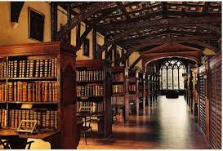
Introduction
Notes:
One challenge in writing a SAS® White Paper is creating the perfect reference section, properly acknowledging those who have inspired and paved the way. Luckily, clever use of such tools as Lex Jansen’s website, SAS’s ability to read in and manipulate varied data sources, and tools such as Microsoft Word citation manager, every author can succeed in proper referencing in their SAS white papers. This paper and presentation will demonstrate how to accomplish this goal.
We are going to be talking about publications, in this case SAS white papers, and most publications require that data sources and other written works be acknowledge in an official manner. The structure of citations differs with the circumstances surrounding your writing, but the basic concepts remain the same.

Slide 4

Introduction
Citation serves a number of purposes:
Tells viewers where further information can be found
Gives appropriate credit to the persons whose words, concepts, and data you are using
Protects you from plagiarizing, and
Protects you from the risk of having your own research and projects being invalidated
WUSS and other organizations require that all published work cited in your paper and/or used, even if paraphrased, even if your own work, be acknowledged in a references section.
Notes:
The importance of properly citing reference material in a publication cannot be understated. Citation serves a number of purposes: it tells viewers where information can be found and consulted for additional information; it gives appropriate credit to the persons whose words, concepts, and data you are using; and protects you from plagiarism and the risk of having your own research and products invalidated for misusing others’ works. WUSS and other groups require that all published work cited in your paper must be listed in a REFERENCES section. This includes both text and visuals (graphics). Special consideration needs to be employed for copyrighted materials in accordance with whether you have permission from the copyright or publisher to use the material, either by direct reprint or paraphrasing.

Slide 5
Introduction
This paper and presentation is specific to SAS White Papers.
If you are writing an article for a journal or another organization (APHA, ASA) there will be very specific instructions on preparing your works, with regard to:
How multiple authors are listed
Citations
Figure and table placements,
Fonts used, etc.
The research shown in this presentation will inform the creation of a tool set (or tool sets) for creating reference sections for other types of publications programmatically.
Luckily for us, most SAS user groups supply a paper template, with helpful instructions.
Notes:
Please note that this paper is specific to SAS White Papers. If you are writing an article for a journal or another organization (APHA, ASA, etc.) there will be very specific (and often conflicting from organization to organization) instructions on preparing your works, with regard to how multiple authors are listed (in some cases it will be last, first, middle initial, in other first, middle initial, last, and so on), citations, figure and table placements, fonts, and a wealth of other details. The research presented for this paper will inform creation of a tool set for creating reference sections for other types of publications programmatically.. Luckily for us, most SAS user groups supply a paper template, with helpful instructions.

Slide 6
Citation Requirements: SAS User Group Microsoft Word Templates
You do not need to look far for a SAS user group MS Word template! - detailed instructions can be located in the Word Template provided in Presenter Resources for this conference.
If you have not looked at the template recently, it is worth another look as it has been updated for newer versions of MS Word, and for different types of sources (can you say AI?)
It’s very tempting to use one of your old papers, or someone else’s as a model, but as the materials being cited evolve, it is worth at least pasting in the reference section of the more up-to-date templates.
An important exception is AI materials, also covered in this paper.
Notes:
There are thousands of SAS white papers published, and many of them have excellent reference sections that can be mined both for content and format. However, there are easier ways than Googling, reading, and copying relevant citations by hand. As far as a template goes, you need not search high and low to find some fantastic instructions for reference sections – detailed instructions can be located in the Word Template provided in Presenter Resources for this conference. If you have not looked at the template recently, it is worth a second look as it has been updated for newer versions of Microsoft Word, and for different data sources. It is very tempting to use one of your old papers, or someone else’s, as a model, but as the materials being cited evolve, it is worth at least pasting in the reference section of the Word template for up-to-date models. An important exception is the citation of AI materials, which is covered in this paper. A screenshot of the Reference Section of the Word template for this conference is provided below:

Slide 7
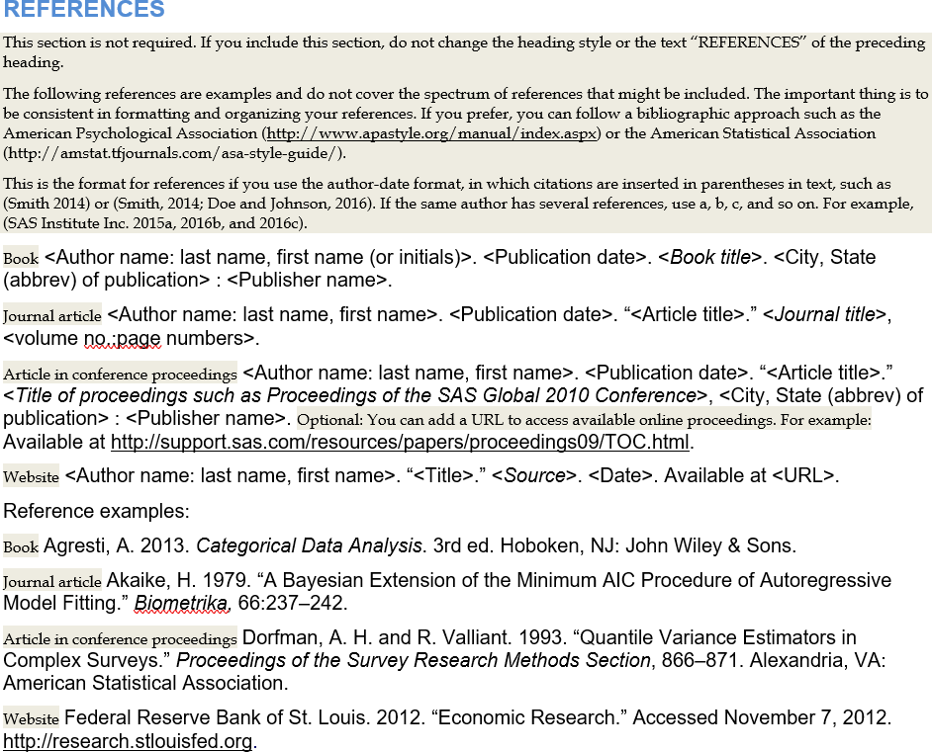
Citation Requirements: SAS User Group Microsoft Word Templates
Notes:
Items shaded in beige should be removed prior to paper submission. These notes provide the user with instructions for certain types of citations, except for AI Resources discussed below. It is not comprehensive but provides instructions for most types of documents.

Slide 8
Citation Requirements: Citing AI Resources
if you are using AI resources such as ChatGPT, you can use either APA or MLA style.
AI resources are not necessarily retrievable, so should be treated as personal communications which cannot be reproduced.
References to AI resources contained within the body of the paper should include the AI Provider (i.e., OpenAI) and the reference date. An important exception is AI materials, also covered in this paper.
Full citations in a reference list should also include a description of the prompt and the URL of the AI platform.
Notes:
In addition to the References Section from the Word template provided above, if you are using AI resources such as ChatGPT, you can use either APA or MLA style. AI resources are not necessarily retrievable, so should be treated as personal communications which cannot be reproduced. References to AI resources contained within the body of the paper should include the AI Provider (i.e., OpenAI) and the reference date. Full citations in a reference list should also include a description of the prompt and the URL of the AI platform. You can prompt the AI that you are using to provide you with a citation in the appropriate format to make it easy, but provided below are examples of two of the formats that SAS papers customarily accept based on the author’s query to Open AI.

Slide 9
Citation Requirements: Citing AI Resources
In-text Example :APA guideline
When prompted with “How many SAS software papers published in 2024 mentioned ChatGPT?” the ChatGPT-generated text provided several detailed citations, primarily at PharmaSUG 2024 and 2025. (Open AI, 2025).
Reference: APA guideline
(Open AI, 2025). Response generated by ChatGPT (GPT-4.5-turbo) in response to user query about SAS software papers mentioning ChatGPT. Retrieved from https://chat.openai.com.
In-text Example: MLA format
When prompted with “How many SAS software papers published in 2024 mentioned ChatGPT?” the ChatGPT-generated text provided several detailed citations, primarily at PharmaSUG 2024 and 2025. (OpenAI).
Reference: MLA format
OpenAI. ChatGPT (GPT-4.5-turbo). Response to a query about SAS Software papers mentioning ChatGPT. 18 May 2025. ChatGPT, https://chat.openai.com/.
Notes:
You can prompt the AI that you are using to provide you with a citation in the appropriate format to make it easy, but provided below are examples of two of the formats that SAS papers customarily accept based on the author’s query to Open AI.
In-text Example :APA guideline
When prompted with “How many SAS software papers published in 2024 mentioned ChatGPT?” the ChatGPT-generated text provided several detailed citations, primarily at PharmaSUG 2024 and 2025. (Open AI, 2025).
Reference: APA guideline
(Open AI, 2025). Response generated by ChatGPT (GPT-4.5-turbo) in response to user query about SAS software papers mentioning ChatGPT. Retrieved from https://chat.openai.com.
In-text Example: MLA format
When prompted with “How many SAS software papers published in 2024 mentioned ChatGPT?” the ChatGPT-generated text provided several detailed citations, primarily at PharmaSUG 2024 and 2025. (OpenAI).
Reference: MLA format
OpenAI. ChatGPT (GPT-4.5-turbo). Response to a query about SAS Software papers mentioning ChatGPT. 18 May 2025. ChatGPT, https://chat.openai.com/.

Slide 10
Citation Requirements: Additional Resources
SAS Editorial Guidelines
Updated regularly
Guidelines mostly cover how SAS’s copyrighted information should be treated, and do not comprise a full set of citation rules.
Note that the guidelines for the publishing entity must ALWAYS come first: Do not rely solely on the MS Word template and SAS’s editorial guidelines.
Common Instruction Sets
APA (American Psychological Association).
MLA (Modern Language Association).
Chicago/ Turabian.
Covers both in-text citations and more complete reference sections.
APA or MLA are recommended for SAS White papers.
Notes:
SAS User Group templates and advice on citing AI resources used are not inclusive of other types of writing and may be out of date due to ongoing changes in technology and what needs to be cited – the concept of digital copyrights is fluid at this point. Listed below are several other resources that may be helpful in writing your SAS white paper.
Citation guidelines in SAS white papers include both in-text citations (brief parenthetical mentions of the resource) within the paper and a stylized, more complete references section at the end, as noted above in the section on AI citations. Using these guidelines ensures that all resources are properly credited and viewers can find the details on cited information. Most used instruction sets are APA (American Psychological Association), MLA (Modern Language Association), and Chicago/Turabian (used in business, history, fine arts, etc. – not necessarily relevant for SAS White Papers.) The SAS User Group Word template states that SAS authors may use the APA or MLA systems.

Slide 11
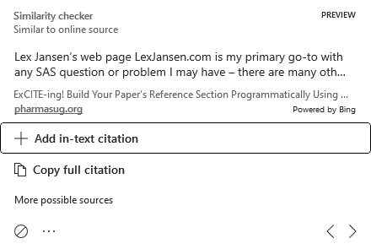
Citation Requirements: Additional Resources
Microsoft Word Citation Management
Easy Interface, links in-text and reference section citations,
Anti-Plagiarism Tools
Work by Comparing Text in your work with texts in large online data bases.
Popular options include Scribbr, Grammarly, CopyLeaks, Quillbot, iThenticate, DupliCHeckr, and PlagScan
MS Word Users can “Check for similarity to online sources” on the home screen click on Editing on the right (next to Copilot). The Editor will come up on the right, and toward the bottom, you will see a Similarity check. Click and it will flag similar text.
Notes:
Microsoft Word Citation Management
The process of writing SAS papers has evolved in strange and wonderful ways since my first SAS paper in two column format and just a few indications of the structured Word templates we have now. We have the editor, we have anti-plagiarism tools, we can edit document properties, etc.
ANTI-Plagiarism Tools
It may seem like all the citation rules are overkill, but having the framework in place does establish your credibility and reliability of your work. Another aspect of this is avoiding plagiarism – which is hard to do with SAS white papers, where we all learn from one another. There are number of anti-plagiarism tools available in both software and website forms. These tools and sites work by comparing texts in your work with texts in large online databases. Some popular options include: Scribbr, Grammarly, Copyleaks, Quillbot, iThenticate, DupliCheckr, and PlagScan. At the very least, Microsoft Word Users can access the built-in editor to “Check for similarity to online sources.”

Slide 12
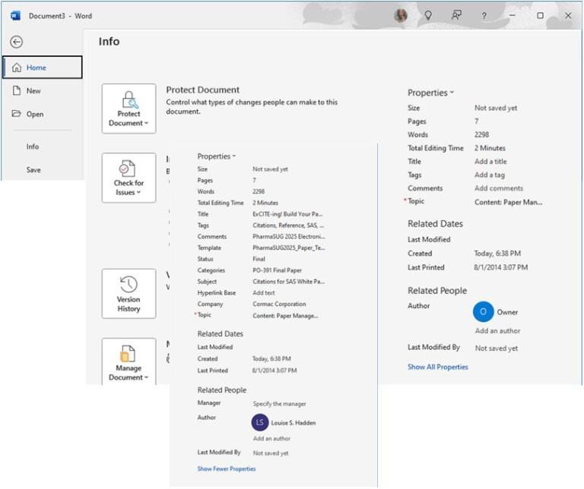
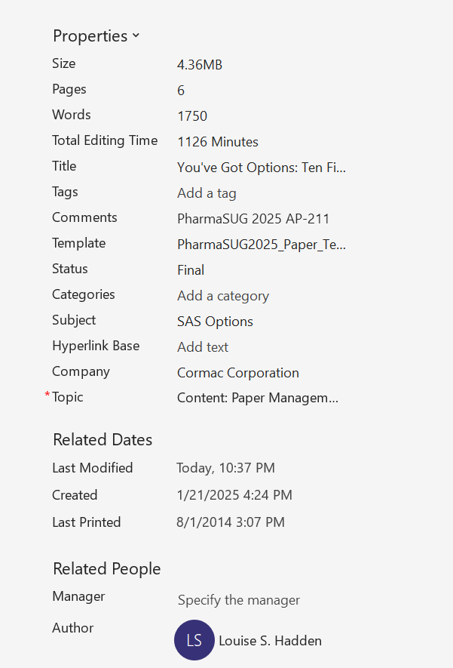
Citation Requirements: Additional Resources
Help Protect Your Own Work
Secure your papers and presentations by publishing with Adobe and using protection tools
As well as securing as a PDF, enter properties either in the MS word document before saving as a PDF, or as a native PDF.
Add keywords in the tag section so that your paper can be recognized
Search engines read the tags
As an example, Lex Jansen’s site pulls the tags in each publication (if applicable) and makes them available to users
Notes:
In addition to protecting yourself from inadvertently using others’ work, you can protect your own papers by securing your PDFs with Adobe, and/or opening your word document and editing your properties (metadata) of your Word or PDF documents. The important thing with metadata is to add keywords in the Tag section so that your paper can be recognized when people search for a given topic or element in papers, on Lex Jansen’s web site described below, or elsewhere. Search engines read the tags.
You’d be surprised how many of my own papers had metadata from other users or conferences who created or used the template!

Slide 13

LexJansen.com
Lex Jansen’s webpage is my primary go-to for any SAS question or problem
Introduced to Lex’s webpage and SASCOMMUNITY.ORG early in my career.
Lex has undertaken the collection of proceedings from SAS user Group and Other related conferences.
The data base is constantly being nurtured with the yearly influx of new SAS white papers.
Lex is very amenable to user requests – a decade ago I ask him if he could add XML as an output destination to save searches.
Some users have done topic frequency analyses (Hughes, Proceedings of WUSS 2023)
Notes:
Lex Jansen’s web page LexJansen.com is my primary go-to with any SAS question or problem I may have – there are many other resources, Google, listservs, SAS communities, friends – but Lex’s site is particularly convenient, with several different pages with different functionalities. Lex is a former SAS employee, and many years ago undertook the collection of proceedings from SAS User Group and other related conferences, including scanning by hand for earlier years. It is a mammoth undertaking and is constantly being nurtured with the yearly influx of new SAS white papers, some, including this paper, describing this history in the making.
Early in my SAS career, I was introduced to Lex and his efforts, and his website and sascommunity.org, a wiki-based website, and they became my primary sources of SAS information. A decade ago, I asked Lex if he would be willing to add XML as an output destination to save searches, et voila, XML happened, and JSON was not far behind. This paper and e-poster will discuss using saved search results and creating a reference section for SAS white papers electronically, but Lex’s site can entertain several other use cases, such as topic frequency analyses (Hughes, Proceedings of WUSS 2023).

Slide 14
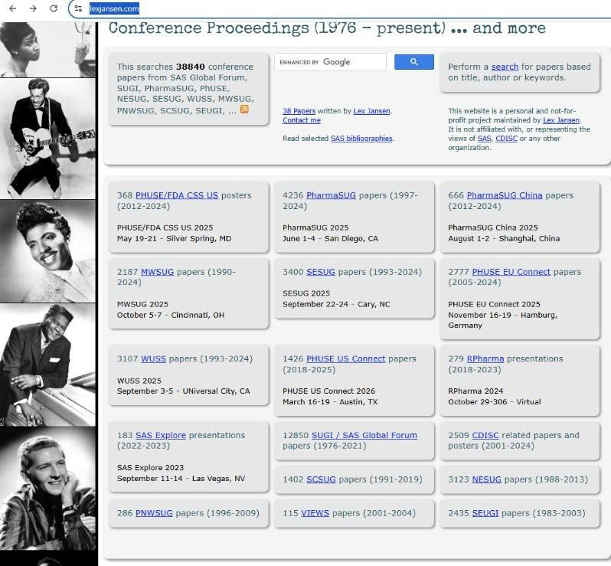
LexJansen.com – Top Level
The main page of Lex Jansen’s conference proceedings site provides you with:
A Google enhanced search field
User group level selections
Selected author biographies
And more!
https://www.lexjansen.com/

Slide 15
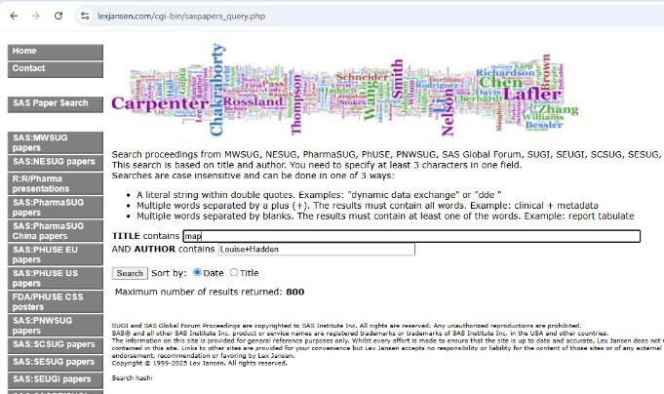
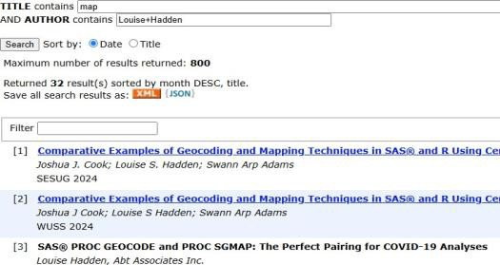
LexJansen.com – SAS Search
https://www.lexjansen.com/cgi-bin/saspapers_query.php
Notes:
At the top right of the main page, clicking on the “perform a search” link will bring you to the SAS search page.
Here, you can see individual user group pages on the left (also seen on the main page), and you can search by title/keywords and/or author(s).
The results of a search are shown above right – I have 32 papers with the keyword maps in the title.
Note that you can save the search results as XML or JSON with a simple click. You can also click on any of the papers
listed to download them individually or right click and save the link for later use.
XML and JSON downloads will be explored later. https://www.lexjansen.com/cgi-bin/saspapers_query.php

Slide 16
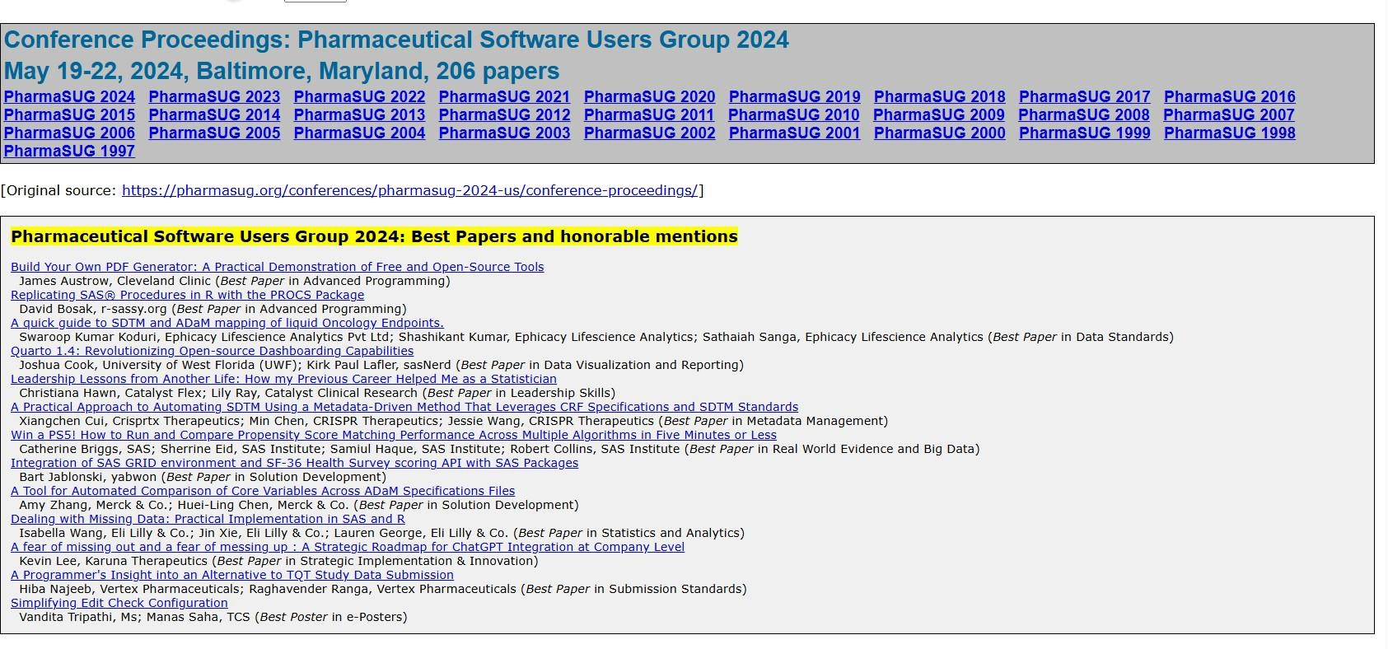
LexJansen.com – User Group Level
https://www.lexjansen.com/pharmasug/
Notes:
You can reach this level from the main page or the SAS search page by clicking on one of the User Group selections, in this case PharmaSUG. https://www.lexjansen.com/pharmasug/

Slide 17
LexJansen.com – Miscellaneous
Hidden treasures!
Special SAS biographies created by the Macro Maven, Ron Fehd. This level is found by clicking on SAS Biographies on the main level. https://www.lexjansen.com/sas-bibliographies/
In the Biographies section you can also find a 48 year analysis of SAS papers by Troy Martin Hughes
You can also find a selection of Lex Jansen’s papers
Extraction Tools
Lex’s XML and JSON tool
Python and Beautiful Soup (Troy Martin Hughes)
SAS Packages (Bart Jablonski)
Please see the reference section of the paper for more information on their related work.
Notes:
On this level, you can find a hidden treasure: special SAS biographies created by the Macro Maven, Ron Fehd. This level is found by clicking on SAS Biographies on the main level. You can also find a selection of Lex Jansen’s papers and a link to Troy Martin Hughes’ paper.
https://www.lexjansen.com/sas-bibliographies/
https://www.lexjansen.com/sas-bibliographies/Hughes-2024_wuss-216_48-year-analysis.pdf
https://www.lexjansen.com/papers/
It is possible to extract an amazing amount of data, papers, etc. in an instant from Lex Jansen’s site using the tools provided, and via web scraping. Troy Martin Hughes uses Python and Beautiful Soup to scrape the site and perform several analyses on SAS user group papers / presentations, and Bart Jablonski has Packages that automate the tasks using SAS. Please see the reference section for more information on their related work.
There are also myriad sources for literature searches and citations on the internet, including other search engines such as Google, sites such as Github, SAS Communities, Stackoverflow, etc. Most allow the copying or scraping of materials to create a reference section.

Slide 18
Additional Sources of Bibliographical Materials

Slide 19
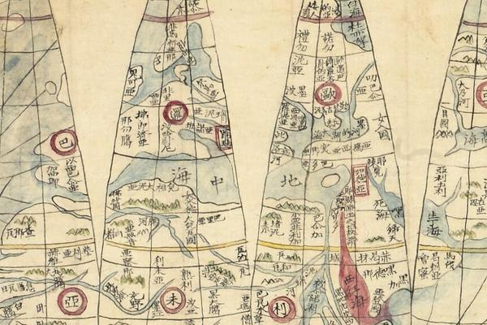
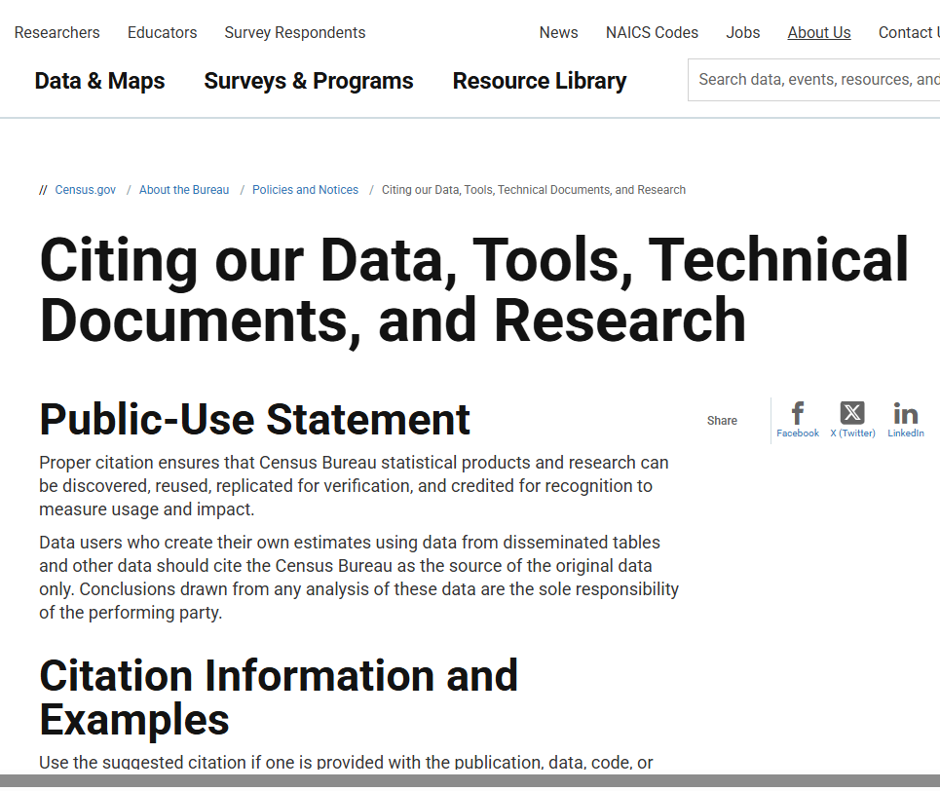
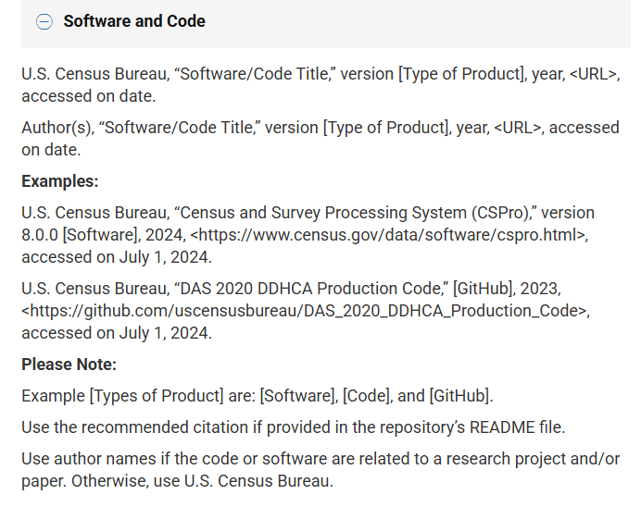
Additional Sources of Bibliographical Material
Myriad sources for literature searches and citations on the internet
Google,
Github
SAS Communities
Stackoverflow
Bureau of the Census
NHANES
Many provide specific instructions on citing their material
http://census.gov/about/policies/citation.html
Notes:
There are myriad sources for literature searches and citations on the internet, including other search engines such as Google, sites such as Github, SAS Communities, Stackoverflow, etc. Most allow the copying or scraping of materials to create a reference section. Some sites (such as US Bureau of the Census) provide explicit instructions on citing their materials, including for different publishing systems.

Slide 20
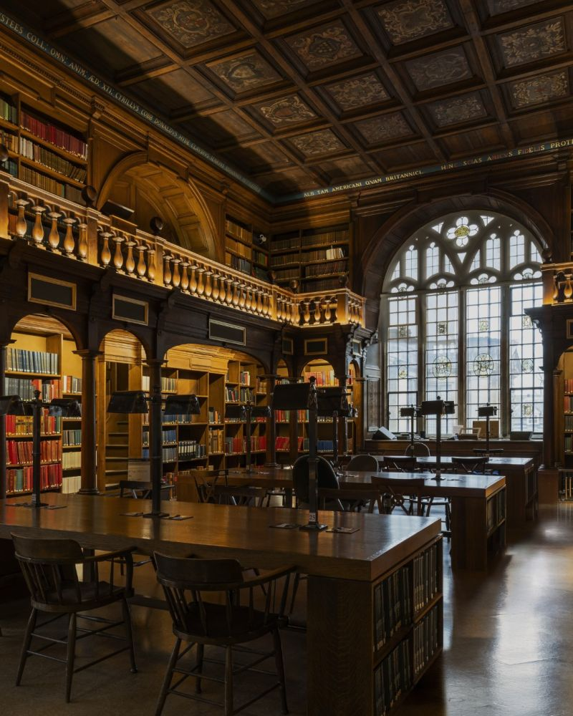
Reference Reporting Data Base Construction
Notes:
Finally, we are getting to the good part, which is how to build your reference section programmatically with SAS

Slide 21
Reference Reporting Data Base Construction
“<Author name: last name, first name>.
<Publication date>.
“<Article title>.
”<Title of proceedings such as Proceedings of the SAS Global 2010 Conference>,
<City, State (abbrev) of publication> :
<Publisher name>.
Optional: You can add a URL to access available online proceedings. For example: Available at http://support.sas.com/resources/papers/proceedings09/TOC.html.”
Notes:
Here’s a snippet for a simplistic example from the SAS Users Groups Paper Template which gives you an idea of what elements are required.

Slide 22
Reference Reporting Data Base Construction
Author name, formatted as Last, First, followed by a period.
Publication Date, formatted as Year enclosed in parentheses, followed by a period.
Title, enclosed in double quotes, followed by a period. Optional italics.
Proceedings title or Conference name formatted as “Proceedings of” conference name and followed by “Conference” and a comma.
City and State of the Conference, followed by a period.
(Optional) “Retrieved from “ link to paper
Notes:
From the snippet above, we can determine that we need these following elements formatted in this way for this type of citation:

Slide 23
Reference Reporting Data Base Construction
A search is performed on the SAS search page of Lex Jansen’s site, searching by author for Bart Jablonski. A JSON file is downloaded. The following program is run:
%let progpath=C:\Papers\391_ExCITE-ing!;
libname dd "&progpath";
filename jsonfile "&progpath.\searchresults.json encoding=wlatin1;
libname jsonfile json fileref=jsonfile noalldata; run;
proc copy in=jsonfile out=dd;
Notes:
So, how do we collect the data? There are three basic methods of obtaining data from Lex Jansen’s site: web scraping, a JSON download, and an XML download. All three result in multiple tables, and all three require post-processing to get the necessary elements of a reference section. In the interests of time, we will focus on the JSON method for the purposes of this paper, noting that all three methods are similar.
Depending on the encoding of your system, you may need to (a) make sure no special characters are in your folder name, and (b) add an optional encoding statement (shown in red above) to the filename statement.

Slide 24
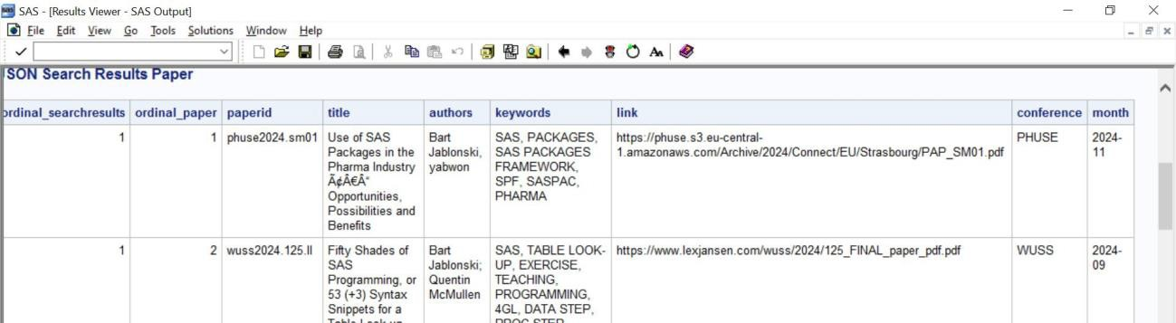
Reference Reporting Data Base Construction
The JSON import results in three tables:
Paper Download file
Search Result file
Search Result Paper file
Notes:
The process results in three separate tables: a paper download file, a search result file (this contains the search date, which you can store for reference), and a search result paper file. The search result paper file contains the bulk of the information we need. Conference and Month comprise part of “Proceedings of” and “Publication Date” ; and Title gives us Title; Authors gives us Authors; and Link will give us link

Slide 25
Reference Reporting Data Base Construction
The JSON import results in three tables:
Paper Download file
Search Result file
Search Result Paper file
Notes:
The process results in three separate tables: a paper download file, a search result file (this contains the search date, which you can store for reference), and a search result paper file. The search result paper file contains the bulk of the information we need.

Slide 26
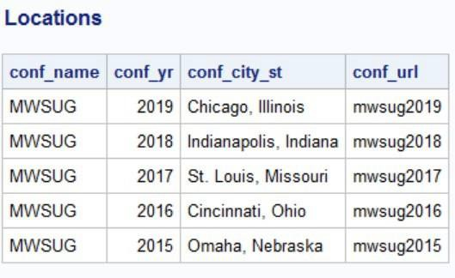
Reference Reporting Data Base Construction
Ways to get Conference Location:
Xml file available from LexJansen.com
Bart Jablon Jablonski’s BasePlus package (, 2023) - %downloadFilesTo macro
Enter by hand
Snippet of file available from LexJansen.com
Notes:
We still need location information for the conferences and we can obtain this information from Lex’s site as well, from an XML file available on the main page of Lex’s site. https://www.lexjansen.com/sasproceedings.xml Another possibility is to use Bart Jablonski’s BasePlus package, which has a tool (%downloadFilesTo() macro that automates the task. (Jablonski, 2023). You can also add additional citations and locations into the XLSX files by hand. Regardless of the method used, we now have all the elements needed. Locations can be added to the citation information via merging on conf_url in the location table and scanning the first chunk of paperid in the search results table.

Slide 27
Reference Reporting Data Base Construction
The JSON import results in three tables:
Paper Download file
Search Result file
Search Result Paper file
Notes:
The process results in three separate tables: a paper download file, a search result file (this contains the search date, which you can store for reference), and a search result paper file. The search result paper file contains the bulk of the information we need.

Slide 28
Output a Reference Section Using SAS
Notes:
One challenge in writing a SAS® White Paper is creating the perfect reference section, properly acknowledging those who have inspired and paved the way. Luckily, clever use of such tools as Lex Jansen’s website, SAS’s ability to read in and manipulate varied data sources, and tools such as Microsoft Word citation manager, every author can succeed in proper referencing in their SAS white papers. This paper and presentation will demonstrate how to accomplish this goal.
We are going to be talking about publications, in this case SAS white papers, and most publications require that data sources and other written works be acknowledge in an official manner. The structure of citations differs with the circumstances surrounding your writing, but the basic concepts remain the same.

Slide 29
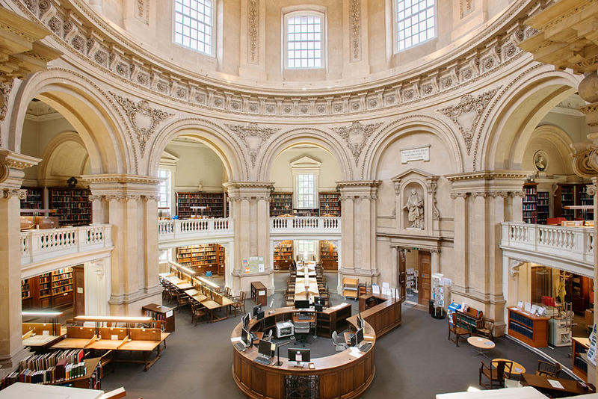
Output a Reference Section Using SAS
Features of the SAS program to create a reference section include:
Add a format for Conference Name abbreviations
Merge by conf_url (created in the search results table)
Precleaning (dirty Unicode data)
Preprocess all segments of the citation, particularly name, using SAS functions
Create an extraordinarily long string which includes all elements
Sort output by desired keys (last name of the first author, first name of first author, title)
Output to RTF for an easy drop into the reference section
Notes:
Features of the SAS program to create a reference section include:
Add a format for Conference Name abbreviations
Merge by conf_url (created in the search results table)
Precleaning (dirty Unicode data)
Preprocess all segments of the citation, particularly name, using SAS functions
Create an extraordinarily long string which includes all elements
Sort output by desired keys (last name of the first author, first name of first author, title)
Output to RTF for an easy drop into the reference section
Snippets are shown of the code sections below, full code available from me

Slide 30
Output a Reference Section Using SAS
proc format;
value $ conff "MWSUG"="Midwest SAS Users Group"
"WUSS"="Western Users of SAS Software"
"SCSUG"="South Central SAS Users Group"
"SESUG"="South East SAS Users Group"
"PNWSUG"="Pacific Northwest SAS Users Group"
"NESUG"="Northeast SAS Users Group"
"SEUGI"="SAS European Users Group International"
"SUGI"="SAS Users Group International"
"PHUSE"="Pharmaceutical Users Software Exchanage"
"PHARMASUG"="Pharmaceutical SAS Users Group"
;
run;
Notes:
Add a format for Conference Name abbreviations

Slide 31
Output a Reference Section Using SAS
data locations;
length conf_url $ 30;
set dd.locations (keep=conf_city_st conf_url);
run;
*** Some restrictions and data cleanings ***;
data citations;
length conf_url $ 30;
set dd.searchresults_paper (keep=paperid title authors link conference
where=(find(authors,"Jablonski")>0));
conf_url=scan(paperid,1,'.');
title=compress(title,"Ãƒâ€šÃ‚");
title=compress(title,"Â");
run;
Notes:
Pull in JSON data sets, clean and sort

Slide 32
Output a Reference Section Using SAS
*****************************************************************;
*** Create reference paragraphs for each citation ***;
*****************************************************************;
data references;
/* length statement to make sure paragraph and
contributing strings have enough space for everything */
set loc_cit;
/*routine for extracting year from conference url variable;
/*parse author names using scan, countw, and cat functions */
/* create proceedings string using cat and upcase functions */
/* create conf and link strings using the catx function */
/* create final blurb string using compbl and catx functions */
run;
Notes:
The program is too long with repetitive steps and is available from me – here are the steps laid out in comments. The end result is a data set called references which is sorted nodupkey by blurb, the very long paragraph string which holds all the necessary information for a citation.

Slide 33
Output a Reference Section Using SAS
ods listing close;
ods rtf file='references.rtf' path=odsout style=styles.noborder;
ods escapechar='^';
proc report nowd noheader data=references
style(report)=[cellpadding=3pt vjust=b]
style(header)=[just=center font_face=Helvetica font_weight=bold font_size=10pt]
style(lines)=[just=left font_face=Helvetica] ;
columns blurb ;
define blurb / style(COLUMN)={just=l font_face=Helvetica
font_size=10pt cellwidth=988}
style(HEADER)={just=l font_face=Helvetica
font_size=10pt};
run;
ods listing;
Notes:
You could simply export the references file to XLSX or LaTeX, but I find it convenient to “print” out to RTF and just drop into my Word Paper. I use PROC REPORT because it wraps long strings well. If you have trickily used an escapechar while building your blurb string (for example to add italics or bolding) make sure to include the ods escapechar statement, and always use ODS LISTING CLOSE (and ODS LISTING at the close of the procedure) or ODS SELECT / EXCLUDE statements to keep your log clean. Cellwidth=988 is the width of the column in TWIPS which I have found to be the most desirable with the fonts that I use. A twip is a tiny, screen-independent unit of measurement, equal to 1/1440th of an inch, which was primarily used in older computing systems like Microsoft Visual Basic and Rich Text Format for platform-independent display and print purposes. The name "twip" is an acronym for "twentieth of an Imperial Point"

Slide 34
Output a Reference Section Using SAS
Jablonski, Bart. (2023). "A SAS Code Hidden in Plain Sight". Proceedings of Western Users of SAS Software Conference, San Diego, California. Retrieved from https://www.lexjansen.com/wuss/2023/WUSS-2023-Paper-189.pdf
Jablonski, Bart. (2023). "Share your code with SAS Packages - a Hands-on-Workshop". Proceedings of Western Users of SAS Software Conference, San Diego, California. Retrieved from https://www.lexjansen.com/wuss/2023/WUSS-2023-Paper-208.pdf
Jablonski, Bart. (2024). "A Gentle Introduction to SAS Packages". Proceedings of Pharmaceutical SAS Users Group Conference, Baltimore, Maryland. Retrieved from https://www.lexjansen.com/pharmasug/2024/HT/PharmaSUG-2024-HT-111.pdf
. . .
Notes:
Snippet from the ODS RTF file generated by the program

Slide 35
Conclusion

Slide 36
Conclusion
Lex Jansen’s web site has been a wonderful resource for me for literature searches, troubleshooting, and writing my own reference sections for SAS white papers. I hope I inspire others to take advantage of the inspiration and convenience.
Acknowledgements to my Muses
Lex Jansen (of course!) – lexjansen.com
Ron Fehd, Macro Maven
Troy Martin Hughes
Bart Jablonski

Slide 37
Contact Information

Slide 38

Contact Information
Contact me!
Louise S. Hadden
louisesquibbhadden@gmail.com
saslouisehadden@gmail.com
www.linkedin.com/in/louisehadden
https://github.com/TheGirlWiththeSASTattoo

