Slide 1

You've Got Options: Ten Five-Star System Option Hacks
Louise S. Hadden:
Louise Hadden presented at her first SAS conference in 1996 and has never looked back, presenting at multiple conferences across the continent over the years. She supports file building and analytic programming for life sciences organizations, most frequently government agencies such as CMS and CDC, and specializes in reporting and data visualization.

Slide 2
Agenda
Introduction
Discovering your SAS system options
SAS documentation
PROC OPTIONS
SAS dictionary tables / SASHELP.VOPTION
SAS system options’ categories, groups, and subgroups
Top ten system option hacks
OPTSAVE and OPTLOAD procedures

Slide 3
Introduction
SAS® provides myriad opportunities for customizing programs and processes, including a wide variety of system options that can control and enhance SAS code from start to finish.
This paper and presentation demonstrates methods of obtaining information on SAS system options and moves on to fully explicate ten SAS system option hacks.
System options are dependent on platforms, security concerns, SAS versions and
This paper and presentation is the first part of a multi-part series: System Options, Data Set Options, Procedural Options, and SAS Functions.
A walk through of discovery follows, as well as an in-depth discussion of ten five-star System Options.
Notes:
SAS® provides myriad opportunities for customizing programs and processes, including a wide variety of system options that can control and enhance SAS code from start to finish. This paper and presentation demonstrates methods of obtaining information on SAS system options and moves on to fully explicate ten SAS system option hacks, from COMPRESS to XWAIT. System options are highly dependent on platforms, security concerns, SAS versions and products: dependencies and defaults will be discussed. SAS practitioners will gain a deeper understanding of the powerful SAS system options they have seen, used, and automatically included in their code. This presentation is suitable for all skill and experience levels; platform and implementation differences are part of the discussion
This paper and presentation is the first part of a multi-part series: System Options, Data Set Options, Procedural Options, and SAS Functions. A walk through of discovery (finding out as much information as possible about the System Options available in each SAS Session) follows, as well as an in-depth discussion of ten five-star System Options.

Slide 4
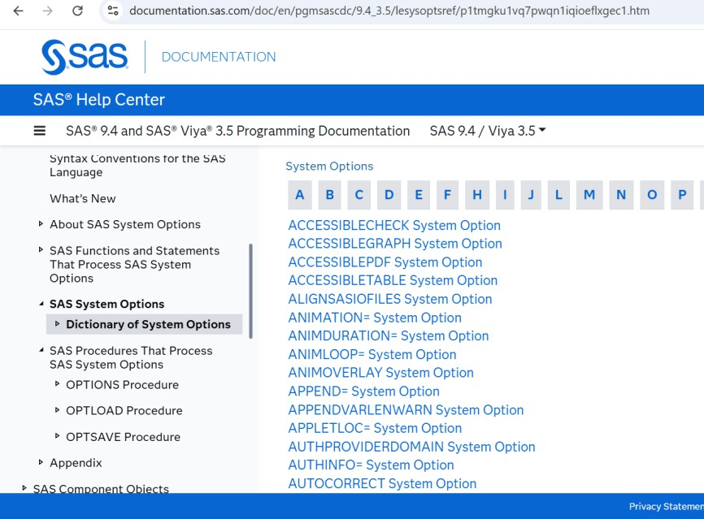
SAS DOCUMENTATION
SAS has robust documentation of SAS System Options, arranged in semi-alphabetical order, located at https://documentation.sas.com/doc/en/pgmsascdc/9.4_3.5/lesysoptsref/p1tmgku1vq7pwqn1iqioeflxgec1.h tm.
You can toggle SAS System Options by Category and view SAS System Options documented in other SAS publications.
Clicking on any of the system option links will get you to a short paragraph about the system option and you can view syntax with some details.

Slide 5
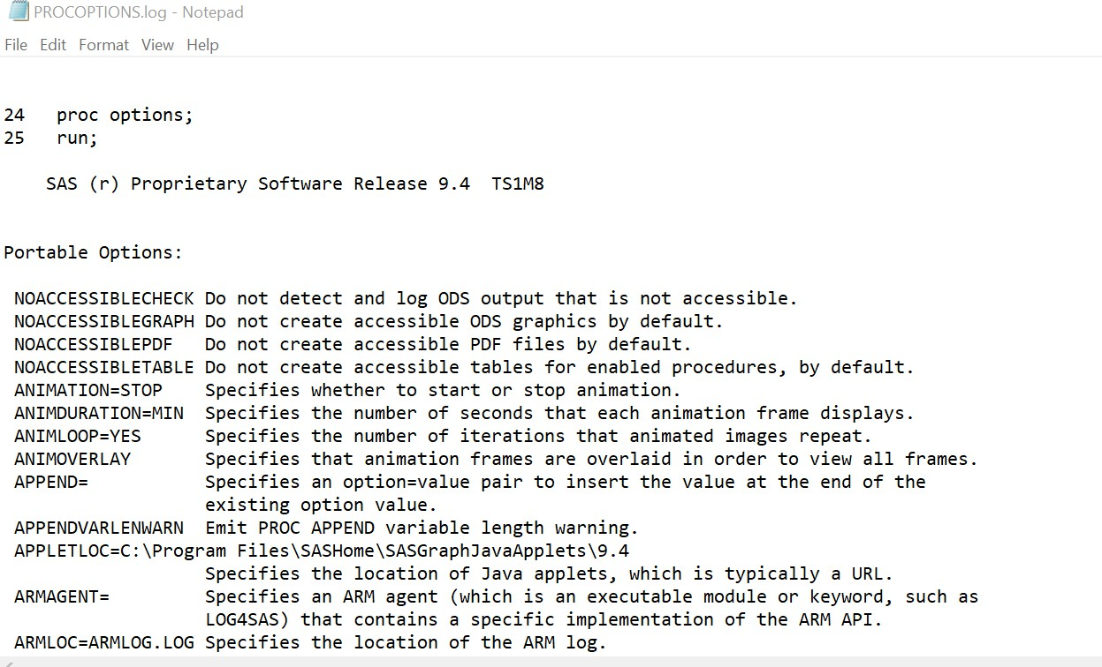
PROC OPTIONS
PROC OPTIONS writes a list of options currently in place during a SAS session to a SAS Log.
PROC OPTIONS reports on system options AS IS.
The listing in the log output does not offer a lot of information on each option.
proc options;
run;
Notes:
PROC OPTIONS provides a programmatic solution and writes a list of options currently in place during a SAS session to a SAS Log.
The listing in the log output snippet below is informative to an extent but does not really offer a lot of information on each option; additionally, the formatting is inutile. Note that PROC OPTIONS reports on system options AS IS; that is, it details the options that are in place at the current time, in the current session, the current implementation of SAS, and the current platform.

Slide 6
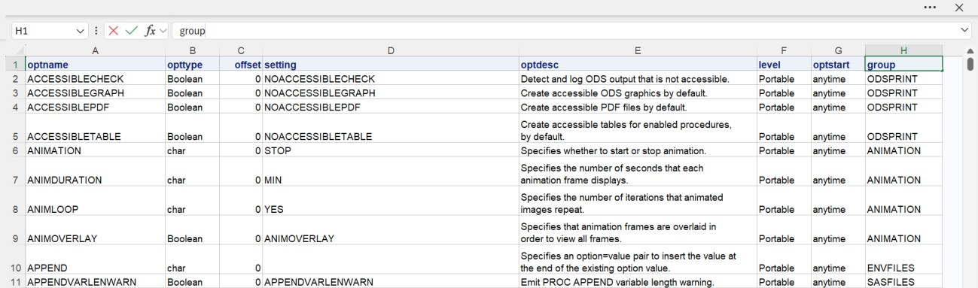
SAS Dictionary Tables / VOPTION
A second procedural option is to use SAS Dictionary Tables (yes, SAS has a Dictionary table and view for Options, as well as many other SAS structures).
ods excel file = “.\Options\voption_desc.xlsx";
proc print data=sashelp.voption noobs;
run;
ods excel close;
Columns available in the SASHELP.VOPTION table include: optname (Option Name), optype (Option type [char, num, boolean], offset (Offset into option value), setting (Option setting), optdesc (Option Description), level (Option Location), optstart (Option Set), and group (Option Group).
Notes:
A second procedural option is to use SAS Dictionary Tables (yes, SAS has a Dictionary table and view for Options, as well as many other SAS structures).
Columns available in the SASHELP.VOPTION table include: optname (Option Name), optype (Option type [char, num, boolean], offset (Offset into option value), setting (Option setting), optdesc (Option Description), level (Option Location), optstart (Option Set), and group (Option Group). Note that the setting column (D) shows the current setting of System Options, and not all setting possibilities. Both PROC OPTIONS and the Options Dictionary Table / SASHELP.Voptions will only inform you of the “current state” of both your program and/or system. Site administrators disallow some system options, and you will not even see those options in a listing. For example, one of the sites I work with does not allow the use of the DLCREATEDIR option, while the site I am testing this paper on does. If you find a system option you would like to use, you will need to consult your site administrators. Additionally, some options are SAS instance specific, for example, AZURETENANTID.

Slide 7
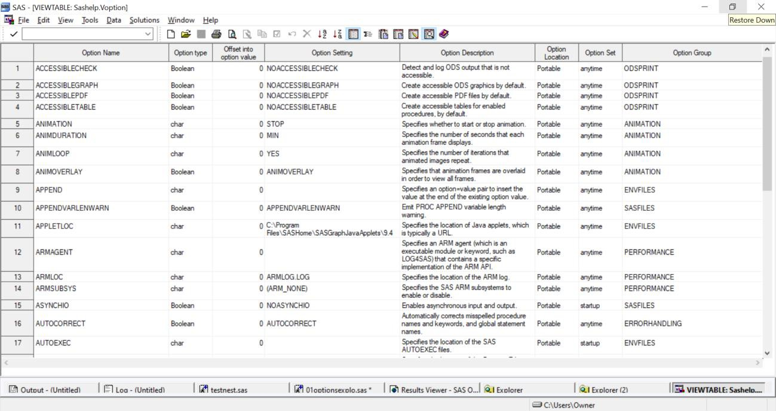
SAS Dictionary Tables / VOPTION
You can also see the SASHELP.VOPTION VIEWTABLE by going to the Explorer window in display manager and clicking on the SASHELP.VOPTION icon.
Column labels are displayed in this view, but the file is identical to the one explored above.
Notes:
You can also see the SASHELP.VOPTION VIEWTABLE by going to the Explorer window in display manager and clicking on the SASHELP.VOPTION icon. Column labels are displayed in this view, but the file is identical to the one explored above with the exception of column labels being used instead of column names. Personally I like having a spreadsheet to consult..

Slide 8
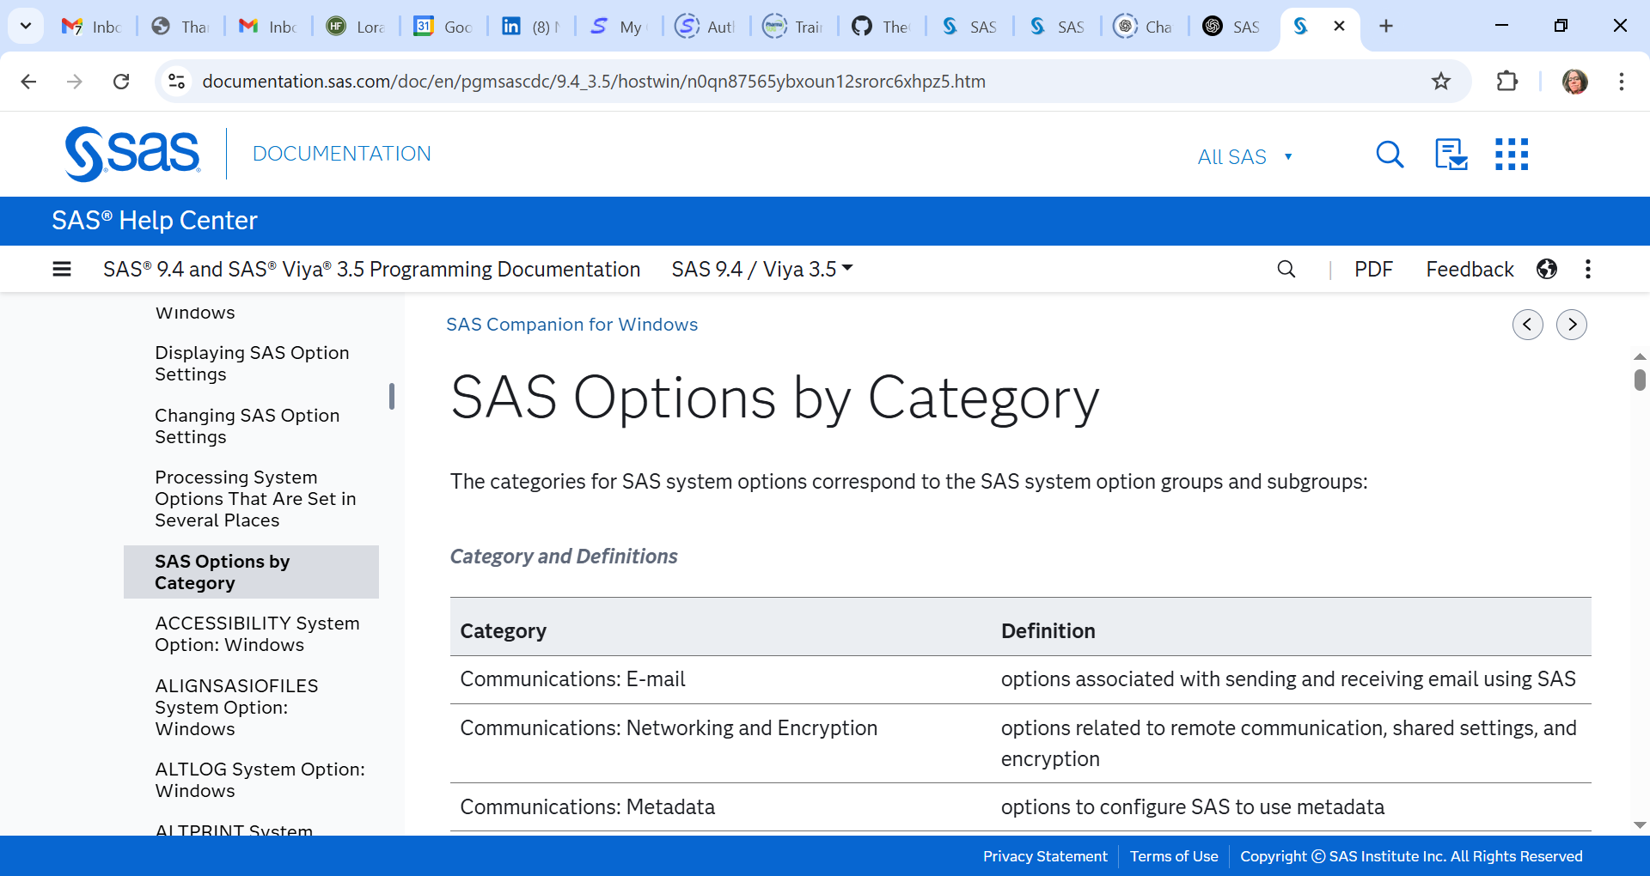
SAS system options’ categories, groups, and subgroups
A list of SAS system option categories, groups and subgroups can be found online at: https://documentation.sas.com/doc/en/pgmsascdc/9.4_3.5/hostwin/n0qn87565ybxoun12srorc6xhpz5.htm

Slide 9
Top Ten System Option Hacks
# | Option Name
1 | VALIDVARNAME
2 | VARLENCHK
3 | MERGENOBY
4 | DLCREATEDIR
5 | FMTERR
6 | COMPRESS
7 | SOURCE2, NOTES, LIMITPROCNOTES
8 | FIVE MACRO OPTIONS
9 | SEVEN ODSPRINT OPTIONS
10 | OPTSAVE and OPTLOAD PROCS
Here are my choices for a top ten of system options that are helpful to me.
Everyone is different: I hope you consult the information on PROC OPTIONS to find options that help you in your work.
Have a fun time finding the differences in defaults for options and/or new-to-you options and let me know!
Notes:
It was incredibly difficult to just choose ten incredible system options from all the choices available. I am going to cheat just a little bit by grouping options that naturally go together in my programming work. Here are my choices with an explanation of what they do for me, and hopefully for you. If you are running in a non-windowing environment, I hope you run PROC OPTIONS and have a fun time finding the differences in defaults for options and/or new-to-you options and let me know.

Slide 10
VALIDVARNAME
Many workplaces use XLS, XLSX, and CSV files as a primary transfer format.
The VALIDVARNAME= system option can have several values,“V7”, “UPCASE”, and “ANY”.
Invalid characters, in particular blanks or nulls, are replaced with underscores, and SAS automatically adds a counter to variable names that are not unique.
Syntax: OPTIONS VALIDVARNAME=V7;
“V7” is often the default, but not in every system.
“UPCASE” converts all variable names to uppercase.
“ANY” which may require the use of a name literal.
Notes:
I use this option every programming day, as the main transfer formats for data in my workplace are XLS, XLSX, and CSV. The VALIDVARNAME= system option can have several values, each controlling how SAS handles column names from different systems. “V7” is often the default, but not in every system.
Invalid characters, in particular blanks or nulls, are replaced with underscores, and SAS automatically adds a counter to variable names that are not unique. Other options include “UPCASE” which converts all variables to uppercase, and “ANY” which may require the use of a name literal.
My client receives data with spaces and special characters in column names, making it impossible to import XLS, XLSX, or CSV files without this option.
Syntax: OPTIONS VALIDVARNAME=V7;

Slide 11
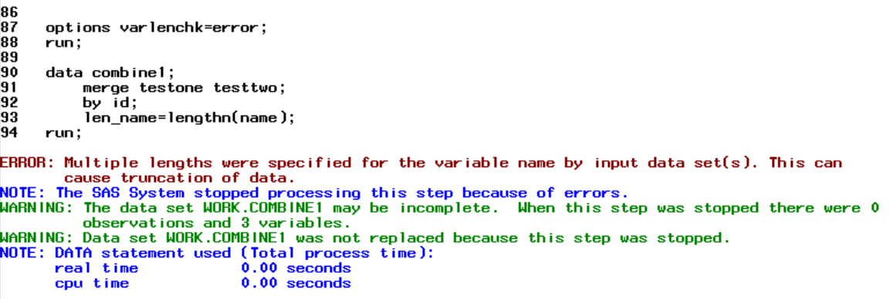
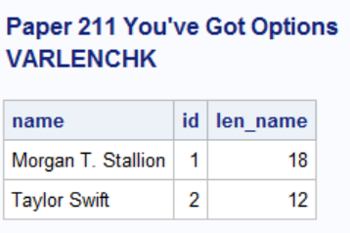
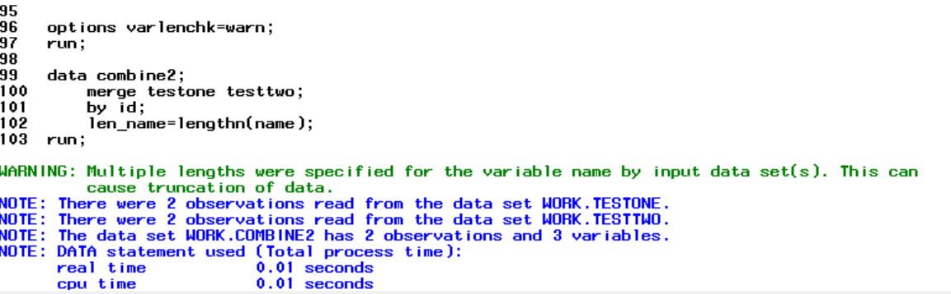
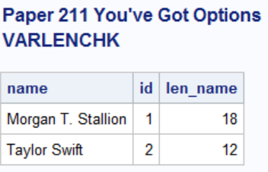
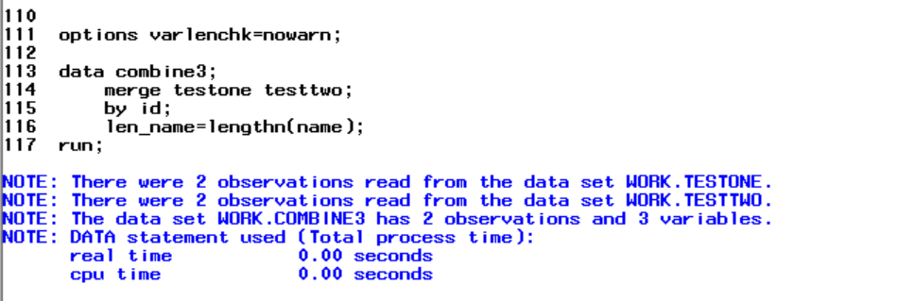
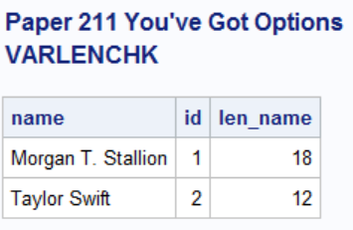
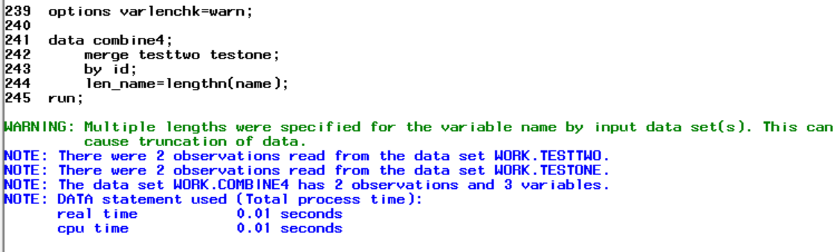
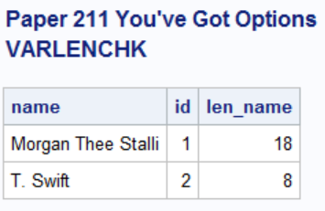
VARLENCHK
The value options for VARLENCHK are NOWARN, WARN, or ERROR.
The default on my system is WARN.
ERROR or WARNING conditions are generated if there is a mismatch between the length of a variable being read in, and the length setting of a variable already present in the PDV.
SET, MERGE, etc. lengths are considered.
SYNTAX: OPTIONS VARLENCHK=ERROR
Notes:
If I had a dime for every time I have seen this warning in the thousands of logs I have reviewed I would be a rich woman. It is common to receive a warning from this option when there is a mismatch between the length of a variable being read in and either a length statement for that variable or another data set being read in in the same data step. The value options are NOWARN, WARN, or ERROR; that is, you can receive no warning in the log, a warning, or an error for the respective option values. For development, I like to use ERROR, so I can fix the problem. For production, I leave it on WARN which is the default.
Syntax: OPTIONS VARLENCHK=ERROR

Slide 12
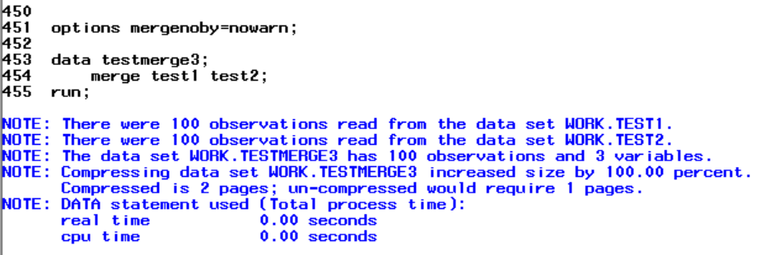
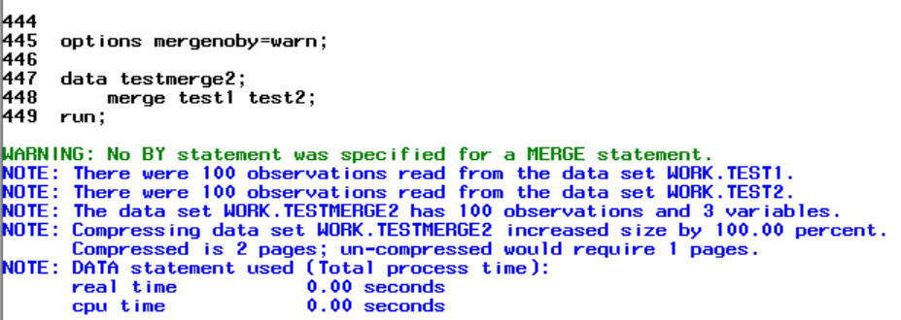
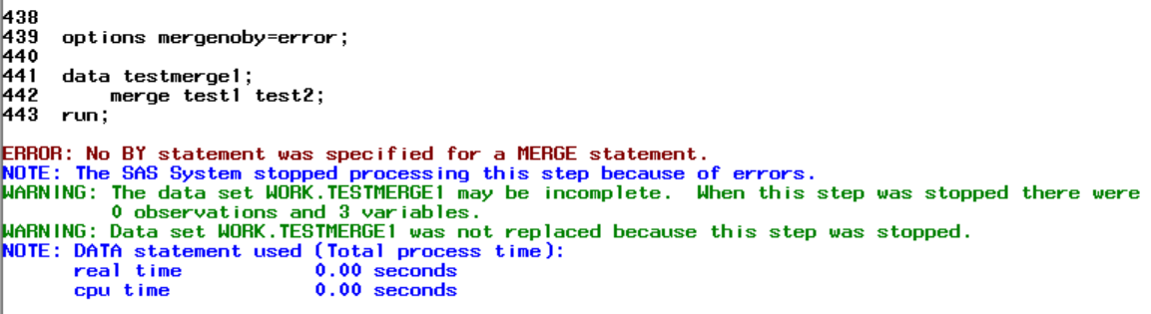
MERGENOBY
SAS determines whether a MERGE statement is occurring without a BY statement, and will ignore (i.e., NOWARN), warn (WARN), or trigger an error (ERROR).
The default on my system is NOWARN, so I need to reset this option for my development runs. It is rare that you would not want to be warned regarding a missing by statement.
For runs that will be reviewed by an auditor, the default will work (no warnings or errors generated).
Syntax: OPTIONS MERGENOBY=ERROR;
Notes:
This option is exactly what it sounds like; SAS determines whether a MERGE statement is occurring without a BY statement, and will ignore (i.e., NOWARN), warn (WARN), or trigger an error in the log (ERROR). For development I like to use ERROR, and for production put it on WARN. The default on my system is NOWARN, so I need to reset this option for my runs. There are occasions (when I am merging a one-line summary with a one-line summary) where I willfully ignore the warning. For runs that will be reviewed by an auditor, the default will work (no warnings or errors generated).
Syntax: OPTIONS MERGENOBY=ERROR;

Slide 13
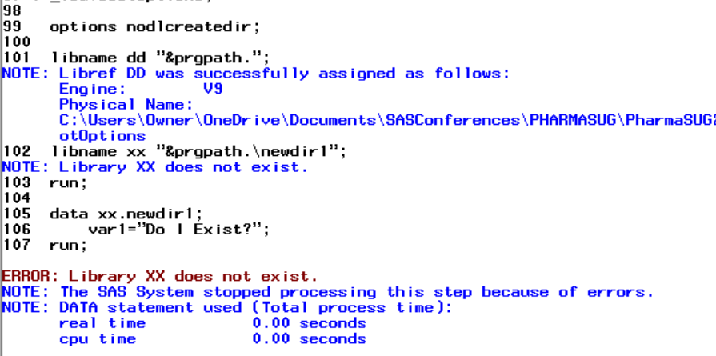
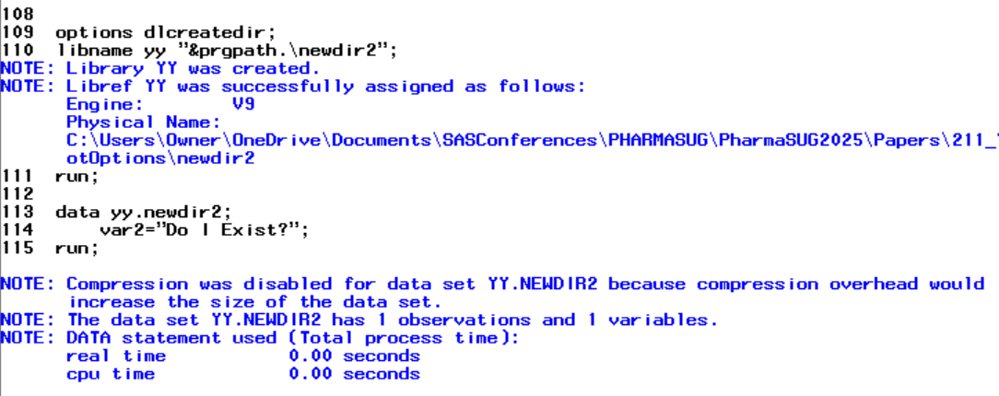
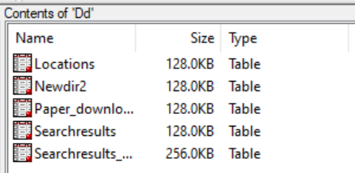
DLCREATEDIR
This option allows the automatic creation of subdirectories where one does not exist.
The default is different depending on what system you are using: under UNIX, Windows, and SAS Viya, the shipped default is NODLCREATEDIR. Under z/OS the shipped default is DLCREATEDIR.
This option is frequently restricted by site admins as it poses risks.
This option will not overwrite existing data in place.
Syntax: OPTIONS DLCREATEDIR;
Notes:
This is a fantastic option which allows the automatic creation of subdirectories where one does not exist. The default is different depending on what system you are using: under UNIX, Windows, and SAS Viya, the shipped default is NODLCREATEDIR. Under z/OS the shipped default is DLCREATEDIR. However, with good reason, this option is frequently restricted by site admins. While this option will not overwrite existing data in place, if it is used in conjunction with a macro, it could spawn hundreds of subdirectories accidentally. Nonetheless, it is one of my favorite options, and I have used it monthly to create a complicated directory structure for processing (Hadden, “Get Smart”, 2017).
Syntax: OPTIONS DLCREATEDIR;

Slide 14
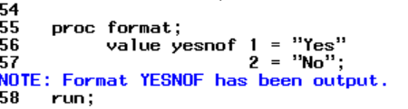
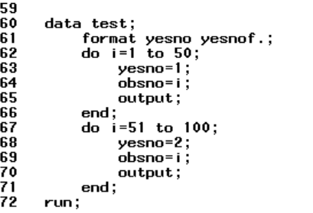
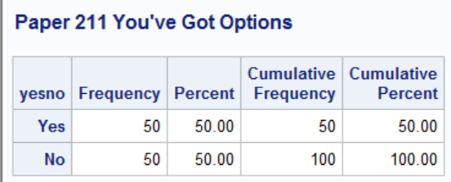

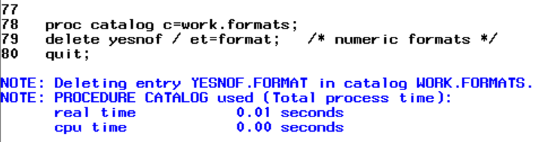
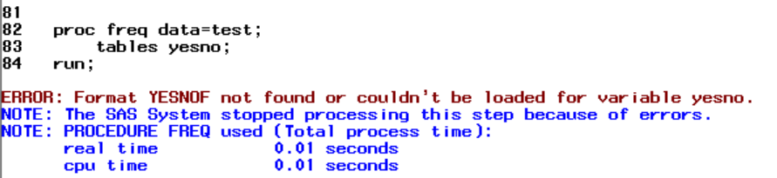
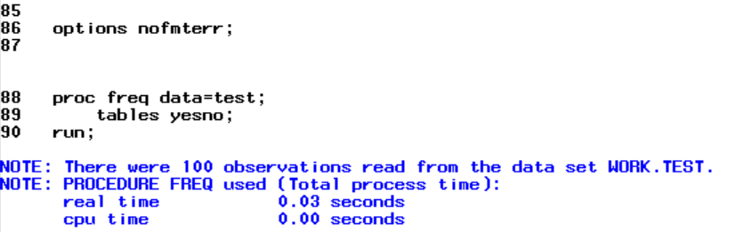
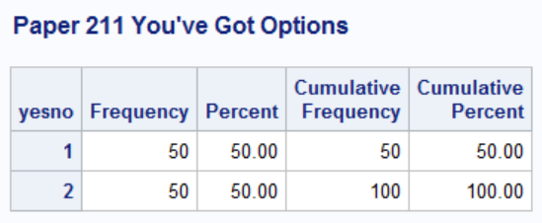
FMTERR
This option has two values, FMTERR or NOFMTERR.
This is invaluable if you are working with a formatted data set and did not receive an accompanying format catalog that is available on your platform, CNTLIN SAS data set, or program to generate a format catalog.
The default value is FMTERR on my system.
Syntax: OPTIONS NOFMTERR; or OPTIONS FMTERR;
Notes:
This option has two values, FMTERR (generate an error message if a specified format is not found for a variable), or NOFMTERR (allow processing to continue, replacing the specified format with the default w. or $w. format and putting a note in the log.) This is invaluable if you are working with a formatted data set and did not receive an accompanying format catalog that is available on your platform, CNTLIN SAS data set, or program to generate a format catalog. Format catalogs are notoriously difficult to transfer across systems and platforms, as well. This is a case where I wish there were a warning level because the lack of appropriate format is a serious concern, but often, we are under the gun to get data processed so we can clean and address problems. For example, during the pandemic we received data from a text-based survey system (REDCAP) from multiple sites, and if one site collected a data element and another did not, the formats would often mismatch. (Hadden, “Putting the Meta”, 2022). We often had two to three days to turn around incoming data for the CDC and White House briefings, so time was of the essence and the head start from NOFMTERR facilitated on time delivery.
Syntax: OPTIONS NOFMTERR; or OPTIONS FMTERR;

Slide 15
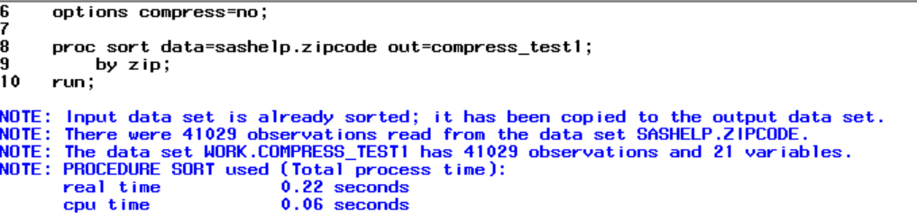
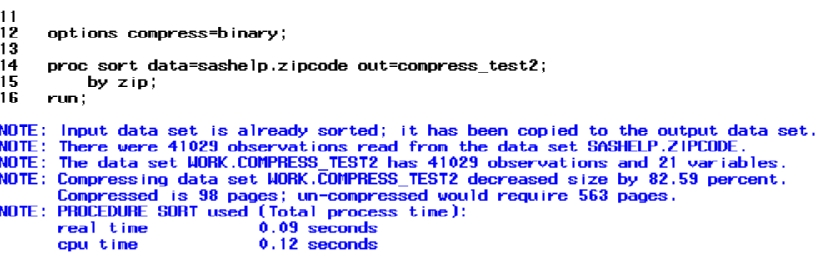
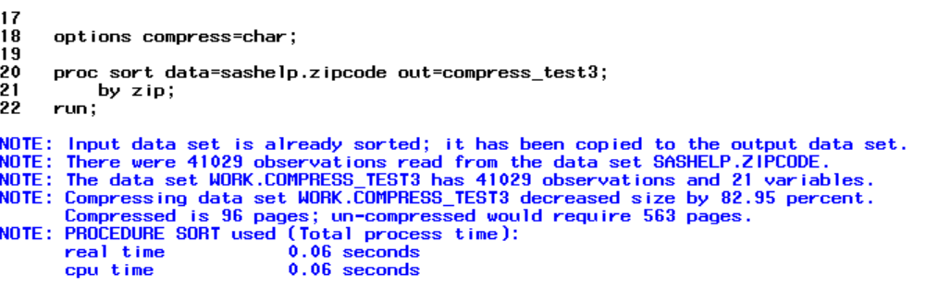
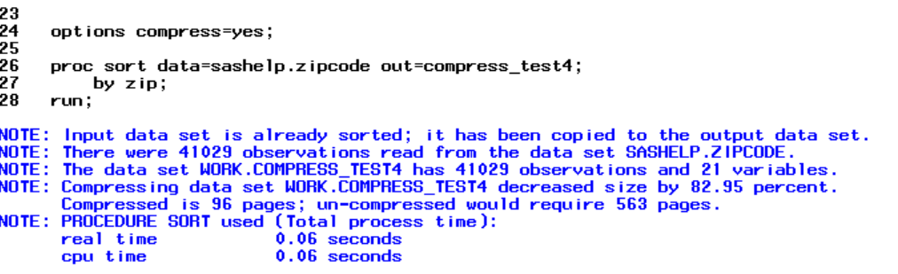
COMPRESS
The COMPRESS option has four values: NO, YES, CHAR, and BINARY.
NO indicates no compression, YES, CHAR, and BINARY enables compression.
YES and BINARY use run-length encoding (RLE): this compression type reduces repeated characters to two- or three-byte representations.
BINARY uses Ross Data Compression which is more efficient for mostly numeric data sets. The shipped default is NO.
For our test, we chose SASHELP.ZIPCODE, which has 41,209 observations and a 62%/38% split between character and numeric variables respectively.
Notes:
The COMPRESS option has four values: NO, YES, CHAR, and BINARY. NO indicates no compression, YES, CHAR, and BINARY enables compression. YES and BINARY use run-length encoding (RLE): this compression type reduces repeated characters to two- or three-byte representations. BINARY uses Ross Data Compression which is more efficient for mostly numeric data sets. The shipped default is NO. Compression comes with a cost, and you need to consider the hit from compression on processing.
There are times when you get notes in the log saying that compression increases the size of the data set (mostly when the data sets are small.) On the other hand, if you are dealing with billions of records such as Medicare claims, which often have a large amount of character data, compression can make an enormous difference in data set size. Because of the potential for a hit on processing, this option may be restricted by your site SAS admins. For clinical trials work, where the data sets are small, COMPRESS=NO (the default) is appropriate. For claims work, COMPRESS=CHAR can make a substantial difference in storage and efficiency. For numeric data (such as banking or insurance) that is large to medium sized COMPRESS=BINARY could be utile, but compression in general should be avoided for smaller data sets.
Syntax: OPTIONS COMPRESS=NO;

Slide 16
SOURCE2, NOTES, LIMITPROCNOTES
For programmers who are using or reviewing programs that have one or more %include statements, the SOURCE2 system option is a lifesaver, providing the source code from the include file(s) in the log.
The NOTES system option allows you to turn NOTES off in the log, reducing the burden of review in production
LIMITPROCNOTES (new in M6) limits the number of notes that can be written to the SAS log by a SAS procedure. You can set a min (100 or more) and max (up to 2147483647) and specify note-count, so that you know how many notes were suppressed.
Syntax: OPTIONS SOURCE2;
Syntax: OPTIONS NONOTES;
Syntax: OPTIONS LIMITPROCNOTES=nnnn;
Notes:
For programmers who are using or reviewing programs that have one or more %include statements, the SOURCE2 system option is a lifesaver, providing the source code from the include file(s) in the log. The default is NOSOURCE2, which is appropriate in production – for example, a lengthy routine creating formats and style templates adds to the log. In development, seeing the log for the code that is spawning an error is essential.
The NOTES system option allows you to turn NOTES off in the log, reducing the burden of review in production. It is never appropriate to turn the NOTES system option off (NONOTES) in development and testing. LIMITPROCNOTES (new in M6) limits the number of notes that can be written to the SAS log by a SAS procedure. You can set a min (100 or more) and max (up to 2147483647) and specify note-count, so that you know how many notes were suppressed. LIMITPROCNOTES can be useful in that it does not “count” notes generated by titles and footnotes, because they are not created by procedures. I ran programs monthly to generate 15,000+ individual multi-page PDFs and the log had so many notes in it that it was almost impossible to review. Options NONOTES for the section generating the PDFs was a great space and time saver. (Hadden, “Programming the Provider Previews”, 2012).

Slide 17
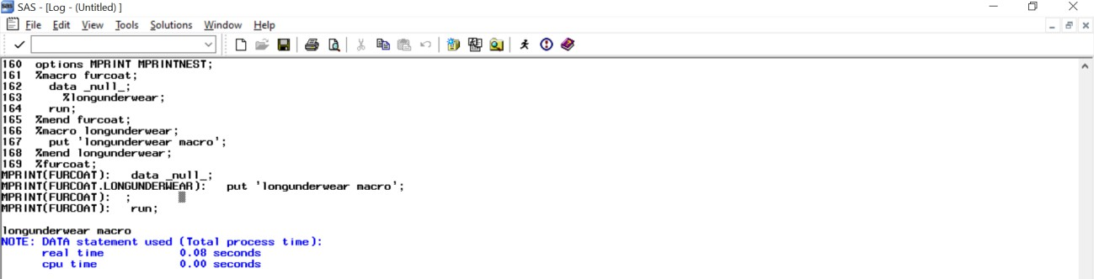
MFILE, MPRINT, MPRINTNEST
The MFILE system option is used in conjunction with MPRINT and determines whether or not the log information saved with MPRINT is written to an external file for review.
The default is NOMFILE, and MPRINT must be specified in the system options.
Both MPRINT and MFILE can bog down processing, so it is appropriate for debugging purposes at the development and review stages, but not production.
If you have not encountered MPRINTNEST yet, you are in for a treat.
Macro nesting information (i.e., the call stack) is displayed in MPRINT output.
options MPRINT MPRINTNEST;
%macro furcoat; data _null_;
%longunderwear; run;
%mend furcoat;
%macro longunderwear;
put 'longunderwear macro';
%mend longunderwear;
%furcoat;
Notes:
Macro options are my very favorite. I could easily have chosen the top ten macro functions! The MFILE system option is used in conjunction with MPRINT and determines whether or not the log information saved with MPRINT is written to an external file for review. The default is NOMFILE, and MPRINT must be specified in the system options. Both MPRINT and MFILE can bog down processing, so it is appropriate for debugging purposes at the development and review stages, but not production. If you have not encountered MPRINTNEST yet, you are in for a treat. Macro nesting information (i.e., the call stack) is displayed in MPRINT output.

Slide 18
MLOGIC, MLOGICNEST
The MLOGIC and MLOGICNEST options work in a similar fashion.
MLOGIC must be specified in the system options for MLOGICNEST to work.
MLOGIC causes the macro processor to trace its execution and to write the trace information to the log, which is immensely helpful in debugging complex macros.
The downside is the log becomes very verbose.
%macro furcoat;
%put THIS IS FURCOAT;
%sweatshirt;
%mend furcoat;
%macro sweatshirt;
%put THIS IS SWEATSHIRT;
%longunderwear;
%mend sweatshirt;
%macro longunderwear;
%put THIS IS LONG UNDERWEAR;
%mend;
options mlogic mlogicnest;
%furcoat
Notes:
The MLOGIC and MLOGICNEST options work in a similar fashion. MLOGIC must be specified in the system options for MLOGICNEST to work. MLOGIC causes the macro processor to trace its execution and to write the trace information to the log, which is immensely helpful in debugging complex macros. The downside is the log becomes very verbose.

Slide 19
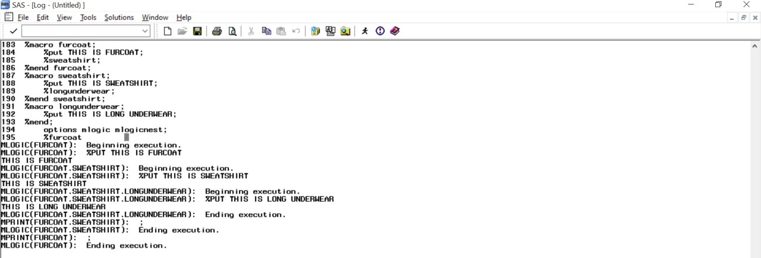
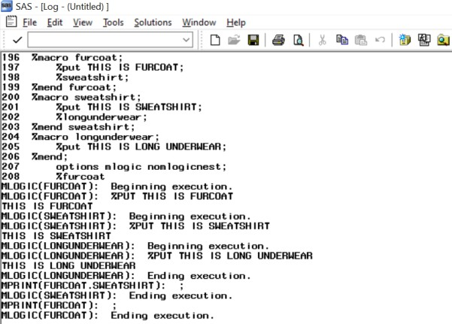
MLOGIC, MLOGICNEST
MLOGICNEST goes a step further by enabling the macro nesting information to be displayed in the MLOGIC output in the log.
If we rerun the code above replacing MLOGICNEST with NOMLOGICNEST, we get the following output in the log:
Notes:
MLOGICNEST goes a step further by enabling the macro nesting information to be displayed in the MLOGIC output in the log. If we rerun the code above replacing MLOGICNEST with NOMLOGICNEST, we get the following output in the log:
While these system options increase the size and complexity of the log, they are extremely worthwhile for debugging.

Slide 20
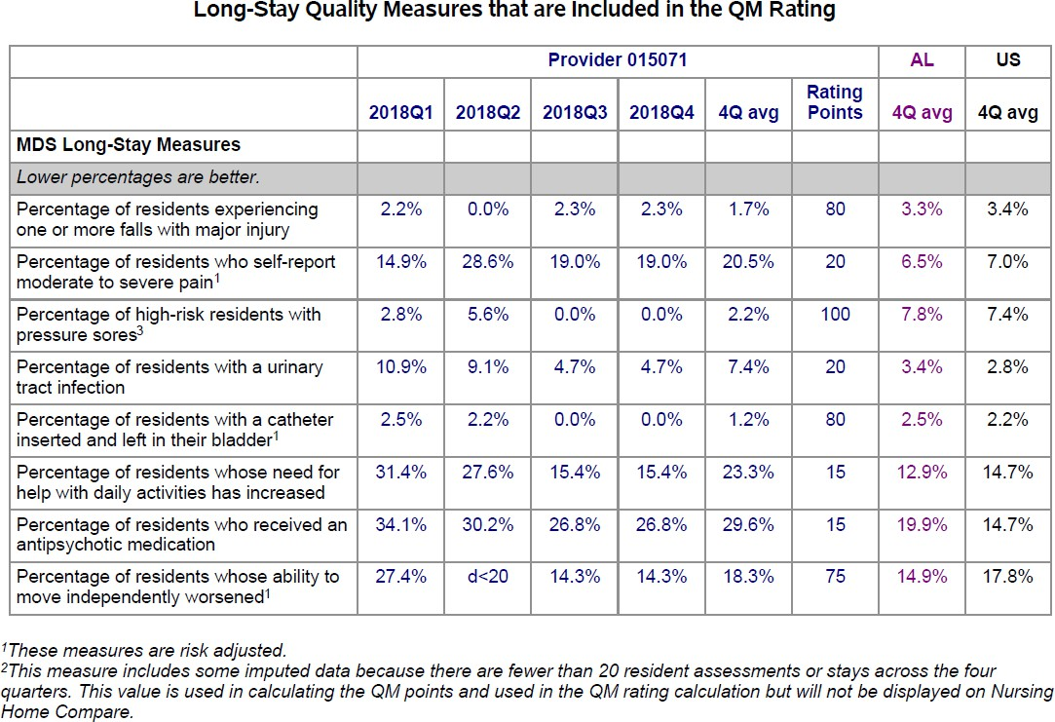
Top ten system option hacks
These system options are part of the ODSPRINT group.
The default for output is to have the page NUMBER and DATE on the top right.
The default for orientation is portrait.
The default margins vary with the destination and style template being used.
You can override all these defaults.
Many production reports have extremely strict reporting requirements as to margins, dates, and page numbers and it is important to be able to control these items in output.
Notes:
These system options are all a part of the ODSPRINT group and affect how ODS outputs are formatted. The default for output is to have the page NUMBER and DATE on the top right, the default for orientation is portrait, and the default margins vary with the destination and style template being used. You can override these defaults using the LEFTMARGIN, RIGHTMARGIN, TOPMARGIN, and BOTTOMMARGIN options. Many production reports have extremely strict reporting requirements as to margins, dates, and page numbers and it is important to be able to control these items in output. For the PDFs mentioned above, we needed to have narrow margins and control over where titles and footnotes were placed, as well as needing to switch orientation for wide tables within the PDF. All this could be accomplished with these system options. (Hadden, “Programming the Provider Previews”, 2012).

Slide 21
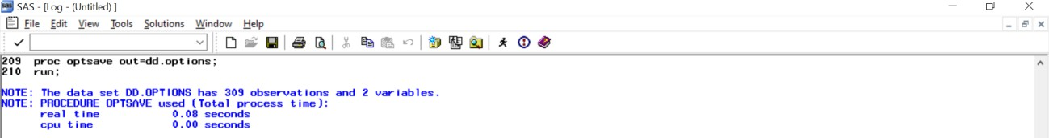

OPTSAVE and OPTLOAD Procedures
proc optsave out=dd.options; run;
proc optload data=dd.options; run;
options dlcreatedir;
proc options; run;
PROC OPTSAVE
PROC OPTLOAD
Notes:
SAS provides two procedures for saving and loading specific sets of SAS System Options. This way, you can save production, validation, and debugging option sets and easily recall them for specific tasks.

Slide 22
Conclusion
SAS provides a vast number of useful system options, as well as tools to exploit these resources. From descriptive tools to examples to tools to manage the saving and loading of system option settings on the fly, SAS system options are an integral part of the SAS programmer’s toolbox.
Please consult the paper’s reference section for some excellent papers on SAS options.

Slide 23
Acknowledgements
To three of my muses:
John King (aka Data _Null_), who reminded me years ago of the nesting data set option to debug data set loops;
Bart Jablonski (aka Yabwon), who got me onto the MPRINTNEST and MLOGICNEST options for debugging macro loops;
Troy Martin Hughes, who introduced me to DLCREATEDIR and more;
Heartfelt thanks for the information and ongoing dialogue about the religion of SAS.

Slide 24

Contact me!
Name: Louise S. Hadden
Phone: 617-513-2646
E-mail: louisesquibbhadden@gmail.com
Github: TheGirlwiththeSASTattoo

