Slide 1
The (ODS) Output of Your Desires: Creating Designer Reports and Data Sets
Louise S. Hadden:
Louise Hadden presented at her first SAS conference in 1996 and has never looked back, presenting at multiple conferences across the continent over the years. She supports file building and analytic programming for life sciences organizations, most frequently government agencies such as CMS and CDC, and specializes in reporting and data visualization.
Paper Number HT-187

Slide 2
ODS Output Objects
https://github.com/TheGirlWiththeSASTattoo/PharmaSUG2025
Paper Number HT-187

Slide 3
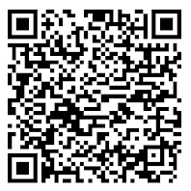
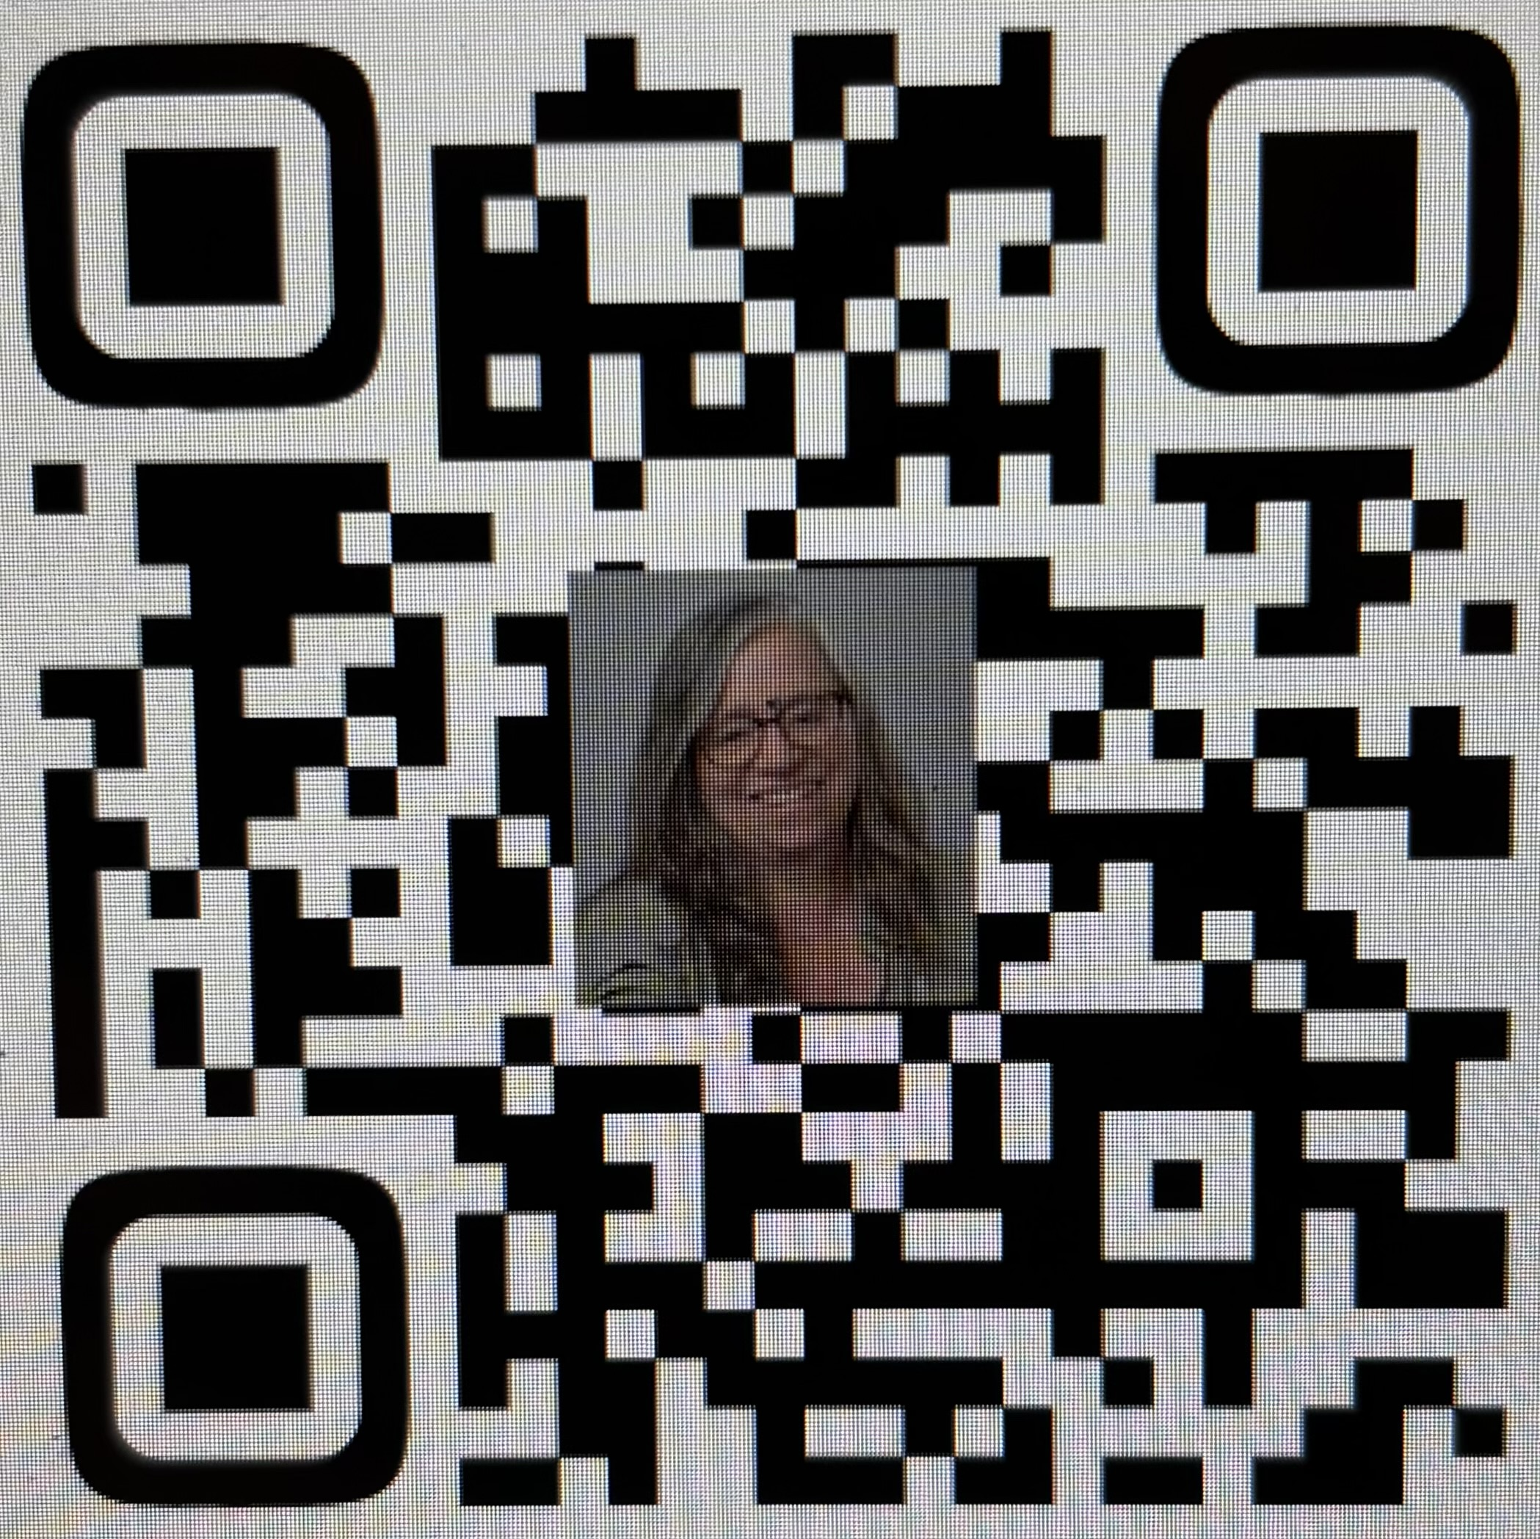
Contact me!
Name: Louise S. Hadden
Organization: Cormac Corporation
Work Phone: 617-513-2646
E-mail: louisesquibbhadden@gmail.com
Blinq
GitHub

