Slide 1
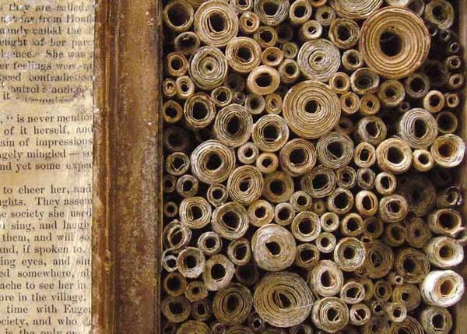
The (ODS) Output of Your Desires:
a Tool-kit for Creating Designer Reports and Data Sets
Louise S. Hadden
Independent Consultant

Slide 2
Author Biography
Louise Hadden presented at her first SAS conference in 1996 and has never looked back, presenting at multiple conferences across the continent over the years. She supports file building and analytic programming for life sciences organizations, most frequently as a contractor for government agencies such as CMS and CDC, and specializes in reporting and data visualization.
The Great Library of Alexandria

Slide 3
Introduction
ODS delivers what used to be printed output in many convenient forms.
SAS® packages a collection of items that come out of a procedure that most people want to see in a predefined order (aka template.)
ODS TRACE, ODS TRACE DOM, ODS OUTPUT, ODS SELECT, ODS EXCLUDE, ODS destinations, ODS print system options, and SAS metadata can help.
The Great Library of Alexandria
Notes:
The Output Delivery System (ODS) delivers what used to be printed output in many convenient forms. What many of us don't realize is that "printed output" from procedures (whether the destination is PDF, RTF, or HTML) is the result of SAS® packaging a collection of items that come out of a procedure that most people want to see in a predefined order (aka template.) With tools such as ODS TRACE, ODS TRACE DOM, ODS OUTPUT, ODS SELECT, ODS EXCLUDE, ODS destinations, SAS metadata, SAS Graphics Editor, and reporting procedures, this presentation explores the many buried treasures of procedural output and ODS output objects and demonstrates how to use these objects to get exactly the information that is needed, in exactly the format wanted. In this presentation, we’ll cover ODS TRACE and ODS OUTPUT in detail.

Slide 4
Session Agenda
Address the opportunity to harness the power of SAS's Output Delivery System (ODS) and ODS Output Objects to create highly customized reports and data sets.
Learn how to trace, manipulate, and repurpose ODS output objects using tools like ODS TRACE, ODS OUTPUT, and SAS reporting.
Go for a deep dive into some less known capabilities of ODS, providing tools and concepts to easily transform procedural output into designer-quality reports.
The Great Library of Alexandria
Notes:
This session addresses the opportunity to harness the power of SAS's Output Delivery System (ODS) and ODS Output Objects to create highly customized reports and data sets tailored to specific needs, saving time and enhancing clarity. Attendees will learn how to trace, manipulate, and repurpose ODS output objects using tools like ODS TRACE, ODS OUTPUT, and SAS reporting procedures to extract precise information, coalesce data, and present it in visually appealing formats across multiple ODS destinations. In an era of data-driven decision-making, the ability to streamline and customize reporting is critical for efficiency and accuracy. This session offers a deep dive into some less known capabilities of ODS, providing attendees with a birds-eye view of how SAS transforms information, and tools and concepts to transform procedural output into designer-quality reports.

Slide 5
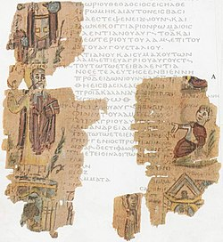
Creating a Test Data Set
The Great Library of Alexandria

Slide 6
Creating a Test SAS Data Set
Based on the SASHELP.HEART data set
Data set contains demographics, medical data, and common risk factors for cardiovascular disease (CVD).
Additional elements added include a group variable (HeartID), an ID variable (seqnum), Sample Weight, BMI, BMI Category, binaries for female and male, and Obesity Category.
Missing variable labels are also added.
The Great Library of Alexandria
Notes:
SAS provides numerous data sets in the SASHELP folder that are available with 9.4 installations and elsewhere. The SASHELP.HEART data set, based on the Framingham Heart Study, started in 1948 in Framingham, MA, was selected to demonstrate the capabilities of ODS OUTPUT. The data set contains both demographic and medical data. Additional elements added include a group variable (HeartID), an ID variable (seqnum), Sample Weight, BMI, BMI Category, binaries for female and male, and Obesity Category. Missing variable labels were also added.

Slide 7
Creating a Test SAS Data Set
data out1.heart (label="Enhanced version of SASHELP.HEART");
set sashelp.heart;
*** create missing variable labels;
label status="Status"
sex="Sex"
height="Height"
weight="Weight"
Diastolic="Diastolic Blood Pressure"
Systolic="Systolic Blood Pressure"
Smoking="Smoking Status"
Cholesterol="Cholesterol Status";
The Great Library of Alexandria
Notes:
Sample data sets are extremely valuable for demonstration purposes, and here, we use a readily available SASHELP.HEART data set as a starting point.

Slide 8
Creating a Test SAS Data Set
*** create a faux group variable;
HeartID=modz(_n_,4);
*** create a faux id;
SeqNum=_n_;
*** create a faux weight;
SampleWeight=1+mod(_n_,10);
The Great Library of Alexandria
Notes:
Here we create a “group” variable, a faux id, and a faux weight for demonstration purposes.

Slide 9
Creating a Test SAS Data Set
*** create BMI variables;
bmi= weight / height**2 * 703;
select;
when (1 le bmi lt 18.5) bmi_cat = 1; . . .
otherwise bmi_cat = .;
end;
select;
when (1 le bmi lt 30) obesity_cat = 1; . . .
otherwise obesity_cat = .;
end;
The Great Library of Alexandria
Notes:
Create simple BMI from height and weight, variables, and then derive bmi and obesity category variables.

Slide 10
Creating a Test SAS Data Set
select;
when (sex='Female') female = 1;
otherwise female = 0;
end;
select;
when (sex='Male') male = 1;
otherwise male = 0;
end;
The Great Library of Alexandria
Notes:
Create female and male binaries for regression purposes

Slide 11
Creating a Test SAS Data Set
label HeartID="Heart Group Variable"
SeqNum="Sequence Number"
bmi="BMI"
bmi_cat="BMI Category"
obesity_cat="Obesity Category"
SampleWeight="Sample Weight"
male="Binary: Male"
female="Binary: Female";
run;
The Great Library of Alexandria
Notes:
And label variables

Slide 12
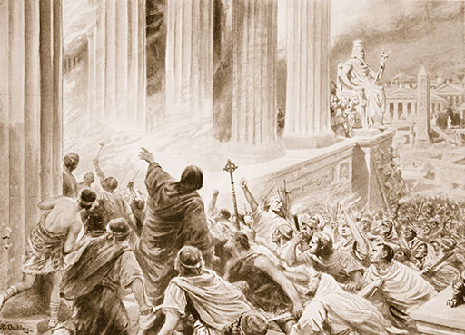
Identifying ODS Output Objects:
ODS TRACE
The Great Library of Alexandria
Notes:
Next up we will discuss the ODS TRACE statement aka the Apericium Spell, which forces SAS to reveal its deepest darkest secrets… well not really, but ODS TRACE is illuminating!

Slide 13
How to train your ODS Output Objects
1. Identify / locate your ODS output object(s) using ODS TRACE or output data set(s) .
2. Analyze your ODS output object(s) or output data set(s) using basic SAS procedures and review.
3. Manipulate your ODS output object(s) or output data set(s) using SAS data steps, ODS options, and/or procedures.
4. Report on your final data set(s).
The Great Library of Alexandria
Notes:
There are four basic concepts involved in re-tooling ODS output objects to produce custom reports:
1. Identify / locate your ODS output object(s) using ODS TRACE or output data set(s) .
2. Analyze your ODS output object(s) or output data set(s) using basic SAS procedures and review.
3. Manipulate your ODS output object(s) or output data set(s) using SAS data steps, ODS options, and/or procedures.
4. Report on your final data set(s).

Slide 14
How to train your ODS Output Objects
ods trace on / label listing;
ods rtf file=yourfilename.rtf’ path=odsout style=styles.journal2;
ods graphics on;
. . . your procedures here . . .
ods rtf close;
ods graphics off;
ods trace off;
The Great Library of Alexandria
Notes:
The next step is to identify ODS OUTPUT objects created via SAS procedures. Most SAS procedures generate ODS objects behind the scenes. SAS uses these objects in conjunction with style templates that have custom “buckets” for certain types of output to produce the output we see in all destinations (including the SAS listing).
Use the ODS TRACE command to identify ODS output objects. Note that objects can include graphs and plots as well as “print” data files. Choose the procedure that you are using, and “surround” the procedure (including any ODS GRAPHICS calls, ODS SELECT and ODS EXCLUDE statements, etc. you may be using) with ODS TRACE and ODS TRACE OFF commands. The optional “/ label” below includes the label path for the output object in the record. You can use a label path anywhere that you can use a path.

Slide 15
How to train your ODS Output Objects
ods trace on / listing;
proc contents data=out1.heart order=collate;
title2 "Contents of modified Heart db - Order=Collate - ODS TRACE";
run;
ods trace off;
The Great Library of Alexandria
Notes:
Here we show how ODS TRACE shows us what ODS OUTPUT OBJECTS are created for the PROC CONTENTS procedure with the COLLATE option (this is the default contents, which shows variables in alphabetic order)

Slide 16
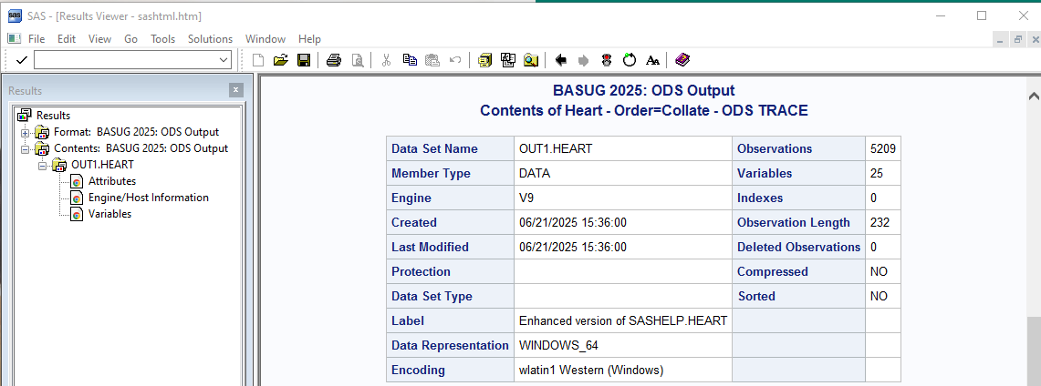
How to train your ODS Output Objects
The Great Library of Alexandria
Notes:
First, we show the Results window aka ODS output window showing the 3 outputs, and then the three print outputs created by the procedure, attributes, engine host, and variables.

Slide 17
How to train your ODS Output Objects
The Great Library of Alexandria
Notes:
First, we show the Results window aka ODS output window showing the 3 outputs, and then the three print outputs created by the procedure, attributes, engine host, and variables.

Slide 18
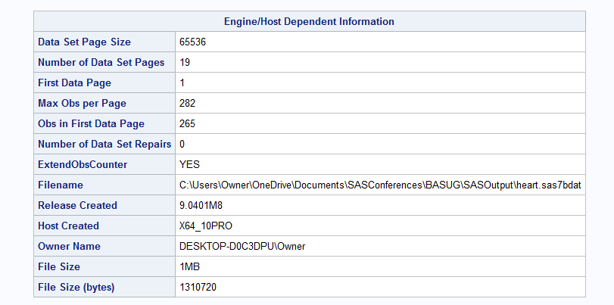
How to train your ODS Output Objects
The Great Library of Alexandria
Notes:
First, we show the Results window aka ODS output window showing the 3 outputs, and then the three print outputs created by the procedure, attributes, engine host, and variables.

Slide 19
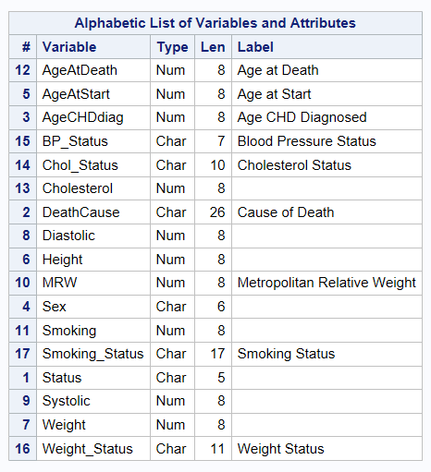
How to train your ODS Output Objects
The Great Library of Alexandria
Notes:
First, we show the Results window aka ODS output window showing the 3 outputs, and then the three print outputs created by the procedure, attributes, engine host, and variables.

Slide 20
How to train your ODS Output Objects
ods trace on / listing;
proc contents data=out1.heart order=varnum;
title2 "Contents of modified Heart db - Order=Varnum - ODS TRACE";
run;
ods trace off;
The Great Library of Alexandria
Notes:
Now, we repeat the process for the contents procedure with order=Varnum.

Slide 21
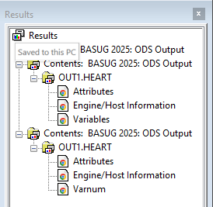
How to train your ODS Output Objects
The Great Library of Alexandria
Notes:
Again, we see the results window – but hey, what’s up? The ODS output objects are different – from the same procedure. Options can affect ODS output objects, just as the printed output changes.

Slide 22
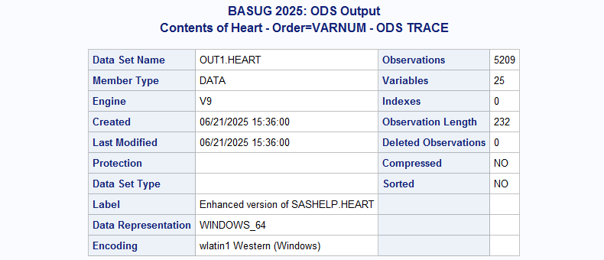
How to train your ODS Output Objects
The Great Library of Alexandria
Notes:
Again, we see the results window – but hey, what’s up? The ODS output objects are different – from the same procedure. Options can affect ODS output objects, just as the printed output changes.

Slide 23
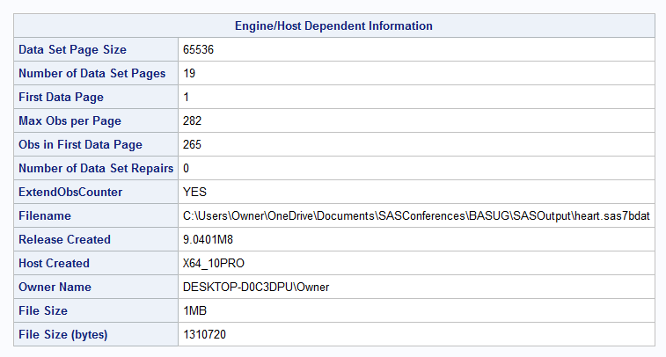
How to train your ODS Output Objects
The Great Library of Alexandria
Notes:
Again, we see the results window – but hey, what’s up? The ODS output objects are different – from the same procedure. Options can affect ODS output objects, just as the printed output changes.

Slide 24
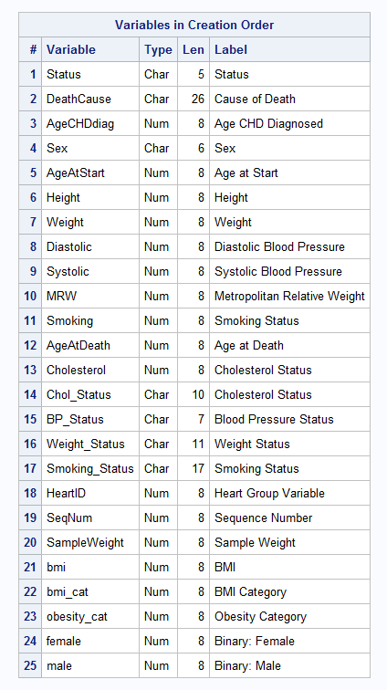
How to train your ODS Output Objects
The Great Library of Alexandria
Notes:
Again, we see the results window – but hey, what’s up? The ODS output objects are different – from the same procedure. Options can affect ODS output objects, just as the printed output changes.

Slide 25
How to train your ODS Output Objects
proc sort data=out1.heart out=out1.heart_sorted;
by seqnum;
run;
ods trace on;
proc contents data=out1.heart_sorted varnum;
title2 "Contents on Sorted Data Set";
run;
ods trace off;
The Great Library of Alexandria
Notes:
Sometimes, external processes affect ODS output objects, for example, running proc contents on a sorted data set.

Slide 26
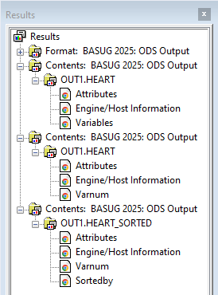
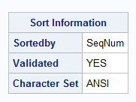
How to train your ODS Output Objects
The Great Library of Alexandria
Notes:
This time, a new ODS object is created, the sortedby object. You can use this to display how your data set is sorted – and, you don’t get this information in PROC CONTENTS Out=. (It is present in the printed output).

Slide 27
How to train your ODS Output Objects
proc datasets library=out1 nolist;
modify heart;
index create id=(seqnum heartid) / nomiss unique;
quit;
ods trace on;
proc contents data=out1.heart varnum;
title2 "Contents - Add Index";
run;
ods trace off;
The Great Library of Alexandria
Notes:
Similarly, if a file is indexed, a new ODS output object is created

Slide 28
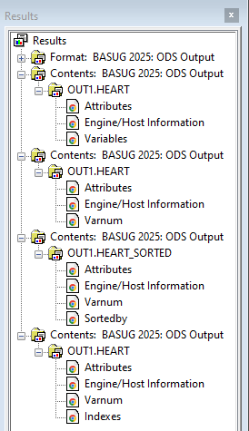
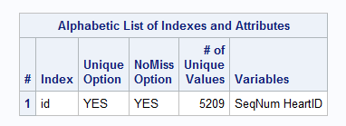
How to train your ODS Output Objects
The Great Library of Alexandria
Notes:
Again, our results window shows an index OOO with info on the indexing.

Slide 29
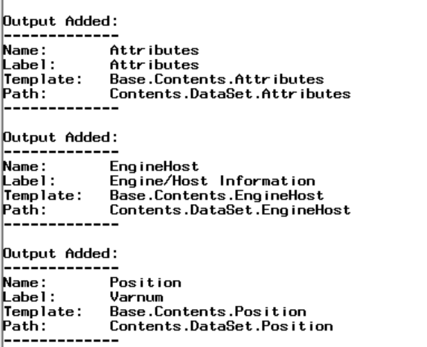
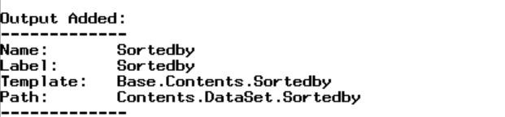
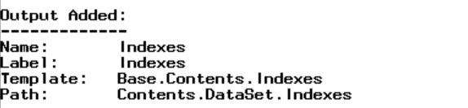
How to train your ODS Output Objects
The Great Library of Alexandria
Notes:
We’ve seen the results window, and now we are going to look at the log equivalents. Note that in some cases, the output name is different (like Varnum and position). When you “harvest” your OOOs, you need to use the name in the log. The log also gives you some additional information, like label, template and path. You can also use the full path provided to access the OOOs.

Slide 30
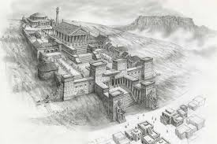
ODS SHOW, SELECT, EXCLUDE
The Great Library of Alexandria

Slide 31
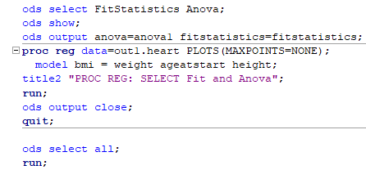
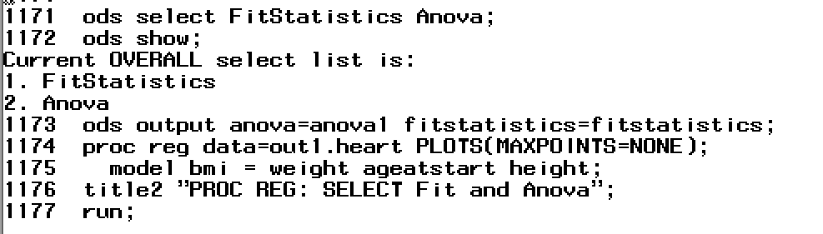
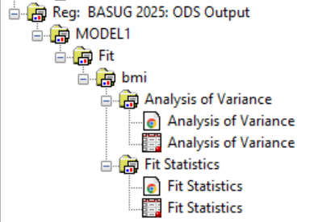
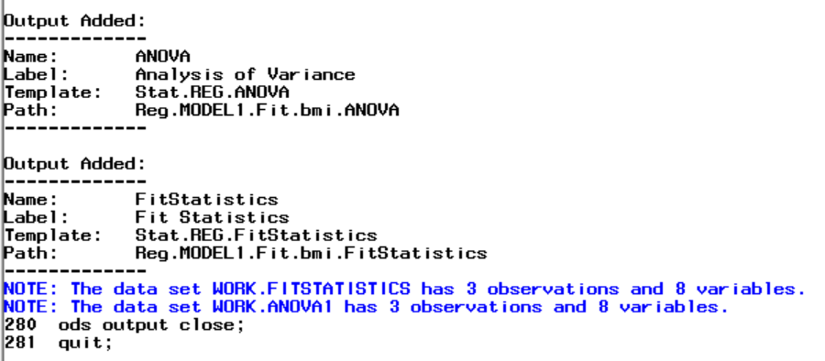
ODS SELECT, SHOW
The Great Library of Alexandria
Notes:
There are ODS commands to control what you see, or don’t see in terms of ODS Output Objects. This is very powerful, but you also need to be very careful, because you may suppress information that you need to see. Here, of the many outputs produced by PROC REQ, we use ODS SELECT to cherry pick our OOOs, choosing only ANOVA and FIT Stats. Similarly, there’s an ODS Exclude statement to prevent ODS output objects from being created, and an ODS SHOW statement to show what OOOs are in effect.

Slide 32
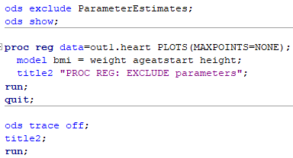
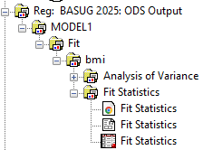
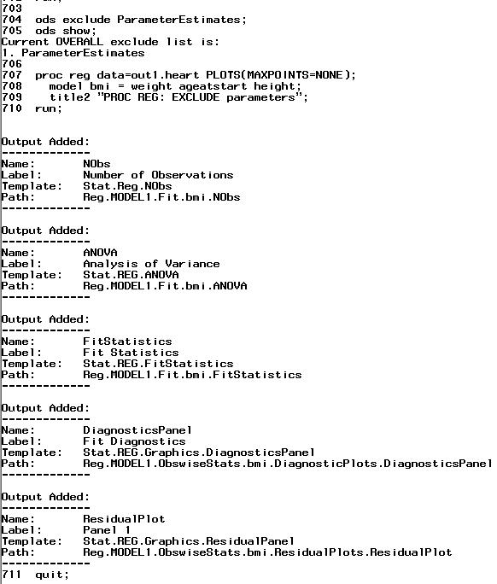
ODS EXCLUDE, SHOW
The Great Library of Alexandria
Notes:
Similarly, we can prevent a OOO from getting created by using an ODS Exclude statement, (in this case Parameter Estimates) and an ODS SHOW statement to show what SELECT and EXCLUDE statements are in effect. In case you haven’t noticed, there’s a LOT of ODS Output Objects created automatically – and maybe you don’t want all of them. This is a way of managing results directory creep. As I said before, be careful though – it’s important to know what’s going on under the hood and automatic exclusion can leave you unaware.

Slide 33
Harvesting your ODS Output Objects
The Great Library of Alexandria
Notes:
Speaking of OOOs… Once we know what ODS OUTPUT OBJECTS (or OOOs) have been created by our programs, we can explore them. We have seen that in Display Manager it is possible to click on objects in the results window to the left, which opens the object, and get some idea of what has been created, and even save those temporary ODS Output objects from the results window, but in order to do some adaptive reuse on the OOOs you need more. That is where ODS OUTPUT comes in. Going back to PROC CONTENTS, we generate work or permanent data sets from the temporary ODS OUTPUT OBJECTS. Using the object names gleaned from ODS TRACE for PROC CONTENTS COLLATE, we can write an ODS OUTPUT statement, outputting attributes, enginehost, and variables.

Slide 34
Harvesting ODS Output Objects
ods output
attributes=attributes1 enginehost=enginehost1 variables=variables1;
proc contents data=out1.heart order=collate;
title2 "Collate contents with ODS OUTPUT objects";
run;
ods output close;
The Great Library of Alexandria
Notes:
We have already determined that the ODS output objects for PROC CONTENTS COLLATE are Attributes, Enginehost, and Variables. These data sets are ephemeral and only exist during a SAS session, whether it is batch or interactive. Therefore, we need to preserve them as either work or permanent data sets. The way to do this is to use an ODS OUTPUT sandwich. The code in red at the top saves our three ODS Output data sets as work data sets with the same name with 1 added. Although you CAN name the work files to be the same name as the ODS output object names, that isn’t advisable due to the potential for ods output objects. Once you have assigned your output objects to work data sets, close ODS OUTPUT at the bottom of your ODS sandwich.

Slide 35
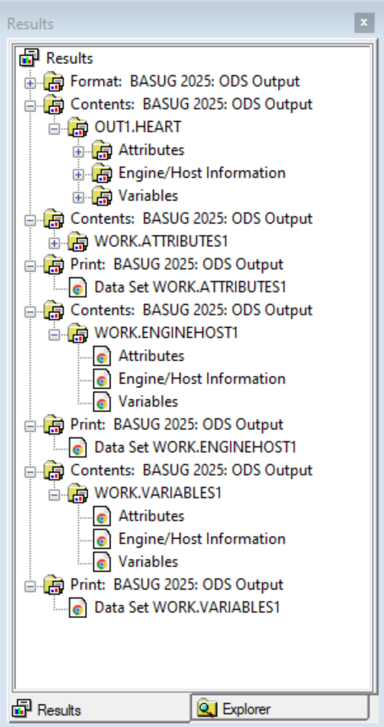
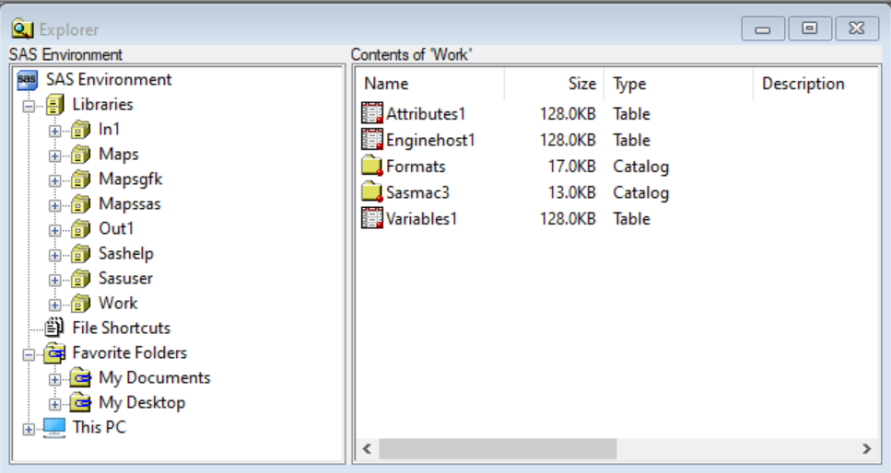
Harvesting ODS Output Objects
What you see in the Results Window
(ODS outputs) and SAS libraries
(for example WORK) is NOT the same.
The Great Library of Alexandria
Notes:
Now, let’s the result of the operation. After running the code above, we see to the left DM explorer the SAS environment (libraries, folders, etc.) and clicking on the Work library allows us to see the created work SAS data sets along with work formats and macros for the session – and to the right, we see the ods output objects created by the procedures. It’s important to note that although the names are similar, the files and ODS objects are not the same.

Slide 36
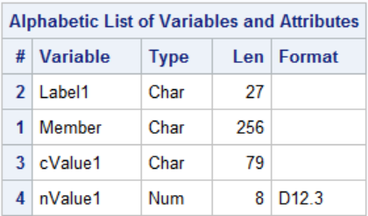
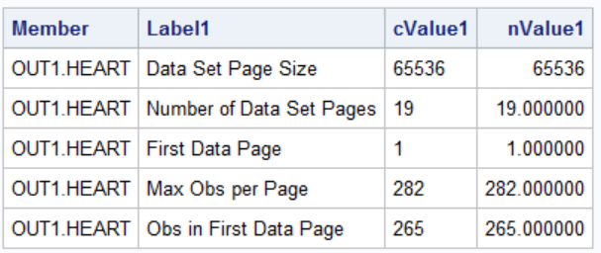
Harvesting ODS Output Objects
Contents
Test Print 5 Observations
The Great Library of Alexandria
Notes:
Next, we are going to investigate our WORK files generated by ODS Output Objects by using PROC CONTENTS and PROC PRINT. Shown on this slide is the Engine Host work data set. Note that SAS provides both a character and numeric version of variables – character is generally what SAS puts in their listing output, numeric allows you to do any special formatting that may be required in your reports.

Slide 37
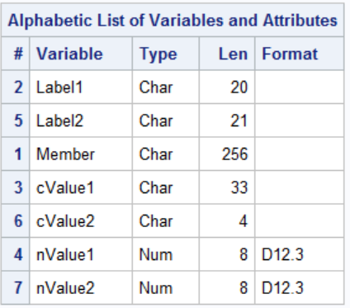
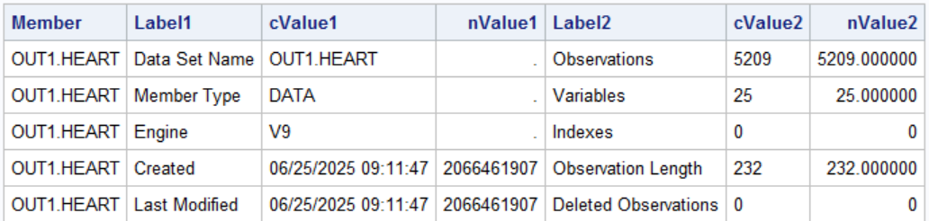
Harvesting ODS Output Objects
Contents
Test Print 5 Observations
The Great Library of Alexandria
Notes:
Next is the work attributes data set. Note that there are multiple values and labels on the same line, as well as cvalues and nvalues.

Slide 38
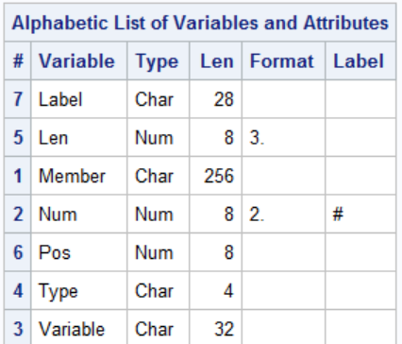
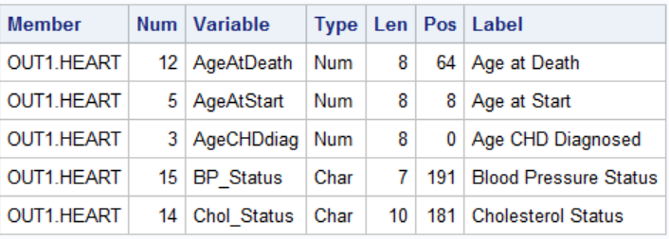
Harvesting ODS Output Objects
Contents
Test Print 5 Observations
The Great Library of Alexandria
Notes:
And finally the variables, which speak for themselves.

Slide 39
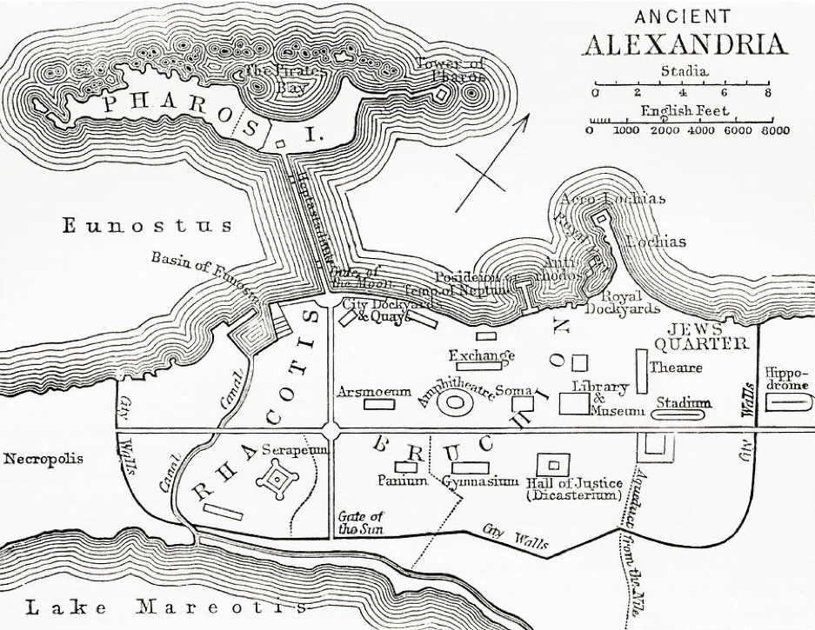
ODS Output Use Case: ODS GRAPHICS and PROC UNIVARIATE
The Great Library of Alexandria
Notes:
Plots are ODS Output Objects too!

Slide 40
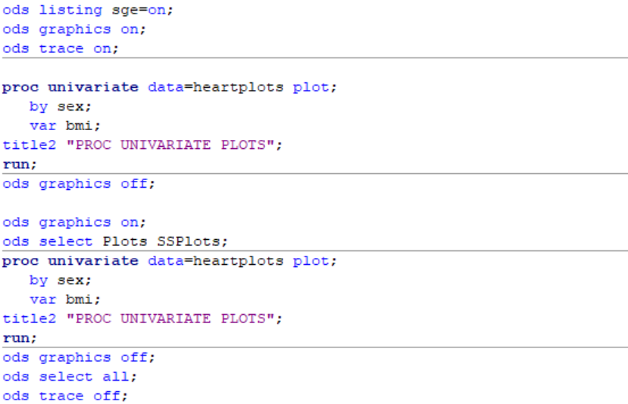
PROC UNIVARIATE ODS Output Objects
Plots are ODS Output Objects Too!
The Great Library of Alexandria
Notes:
ODS listing SGE=on turns on the SAS Graphics editor
ODS graphics turns graphics on – remember to turn on ODS SELECT ALL when you are done!
Second set restricts output
And of course, turn everything off again

Slide 41
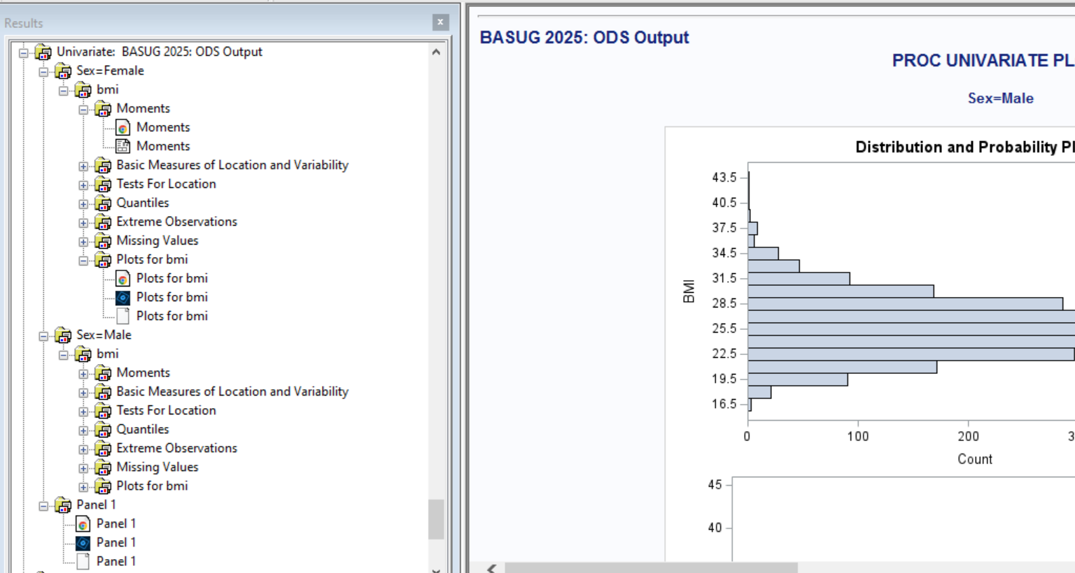
PROC UNIVARIATE ODS Output Objects
Plots are ODS Output Objects Too!
The Great Library of Alexandria
Notes:
On the left side, you see the results window from proc univariate with plots and SGE on. You can see that plots have been created and if you click on the three different plot images, you will get (a) redirected to results window print, (b) open png file in image editor, or c – if you have the SAS Graphics Editor – open in SGE. SGE allows you to actually edit an image, and to output the template code resulting from your edits. Pretty cool.

Slide 42
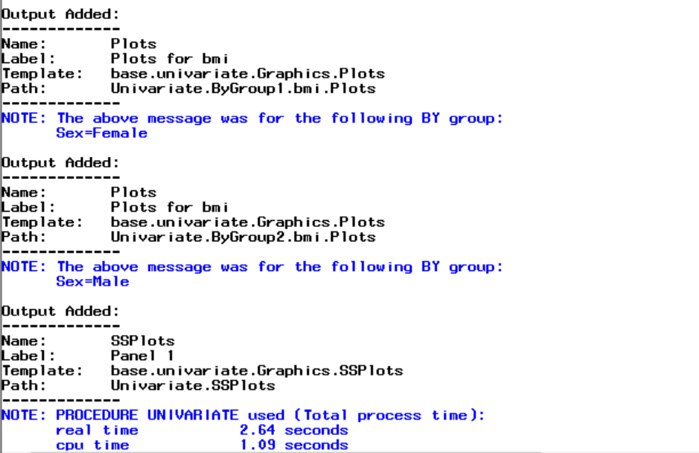
PROC UNIVARIATE ODS Output Objects
Plots are ODS Output Objects Too!
The Great Library of Alexandria
Notes:
And here is the log trace showing the information on the plots created.

Slide 43
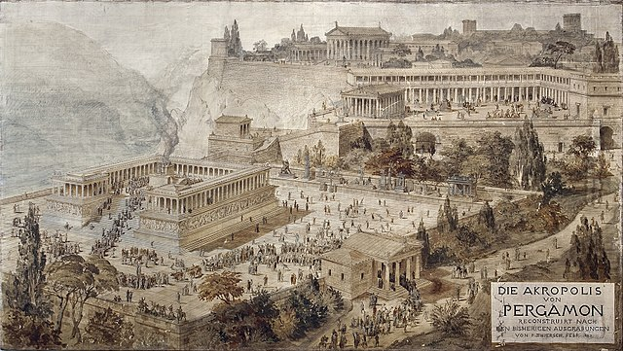
ODS Output Use Case: PROC SURVEYFREQ
The Great Library of Alexandria
Notes:
Let’s put what we’ve learned about ODS output objects in action. In my professional life, I spend a lot of time manipulating data to create files for analytic research and dashboards. There may be standards to meet, and templates for reporting. OOOs can help! First up, we will look at PROC SURVEYFREQ OOOs and see what we can make of them.

Slide 44
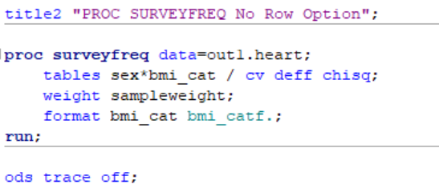
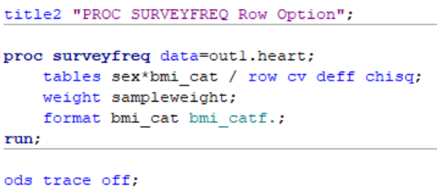
PROC SURVEYFREQ ODS Output Objects
What a Difference an Option Makes
The Great Library of Alexandria
Notes:
Procedural options make a difference! We’ve seen different ODS objects created by different options – but the ODS objects themselves can change with options as well. Just a reminder to always check your log AND the analysis of your ODS objects (contents / test print). Here, we see that adding the row option to PROC SURVEYFREQ add 3 new variables to the CrossTabs ODS object.

Slide 45
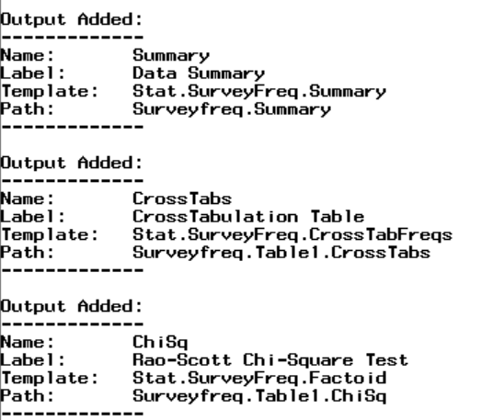
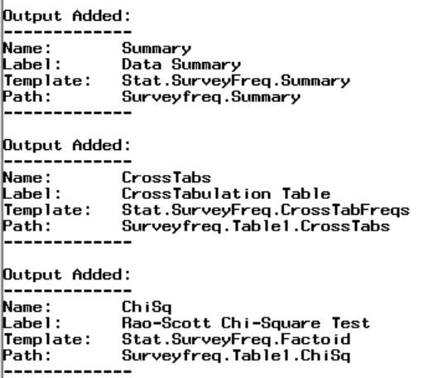
PROC SURVEYFREQ ODS Output Objects
What a Difference an Option Makes
The Great Library of Alexandria
Notes:
Procedural options make a difference! We’ve seen different ODS objects created by different options – but the ODS objects themselves can change with options as well. Just a reminder to always check your log AND the analysis of your ODS objects (contents / test print). Here, we see that adding the row option to PROC SURVEYFREQ add 3 new variables to the CrossTabs ODS object.

Slide 46
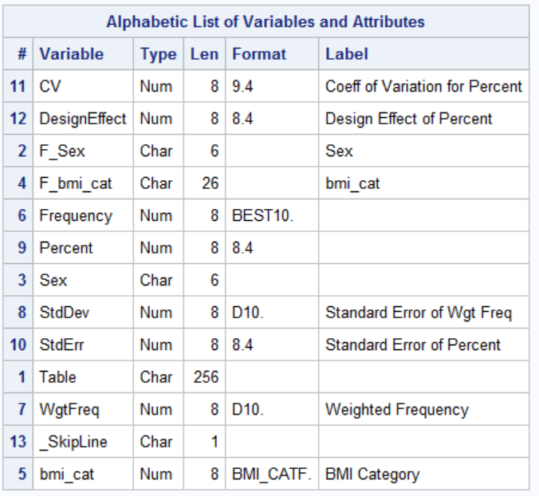
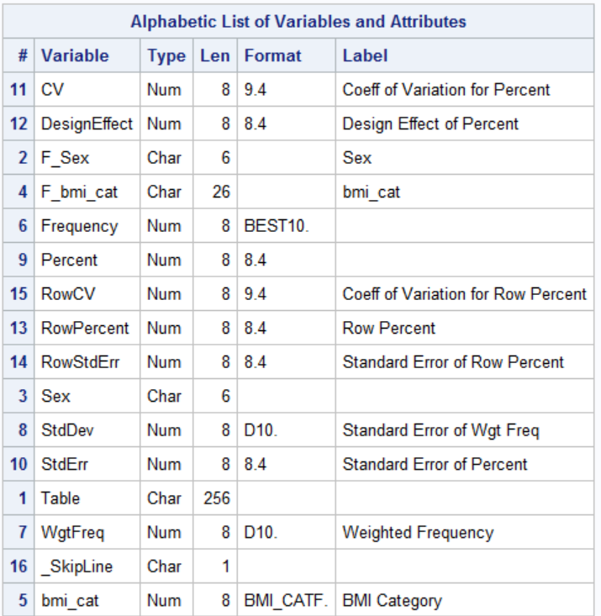
PROC SURVEYFREQ ODS Output Objects
What a Difference an Option Makes
The Great Library of Alexandria
Notes:
Procedural options make a difference! We’ve seen different ODS objects created by different options – but the ODS objects themselves can change with options as well. Just a reminder to always check your log AND the analysis of your ODS objects (contents / test print). Here, we see that adding the row option to PROC SURVEYFREQ add 3 new variables to the CrossTabs ODS object.

Slide 47
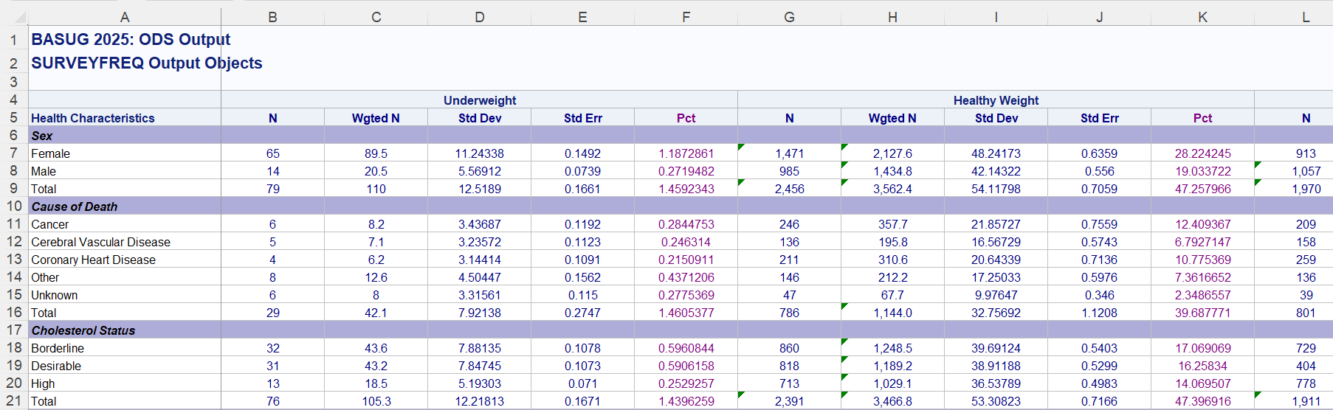
PROC SURVEYFREQ ODS Output Objects
The Great Library of Alexandria
Notes:
So, how do we get from the objects above to this, without cutting and pasting or post formatting the spreadsheet?

Slide 48
PROC SURVEYFREQ ODS Output Objects
Write a macro to run PROC SURVEYFREQ on LHS variables by BMI category, outputting OOOS
Create LHS data set for row headers; do some formatting; split into 5 files (4 BMI categories and Total)
Second macro to format split files; merge 5 files to transpose bmi category and total column sets, output to ODS Excel and format
The Great Library of Alexandria
Notes:
Three fairly major steps. There’s a lot packed into these steps, but I promise it’s worth it. You’ll be able to make changes to variables, formatting, etc., pretty easily with minor modifications of the code.

Slide 49
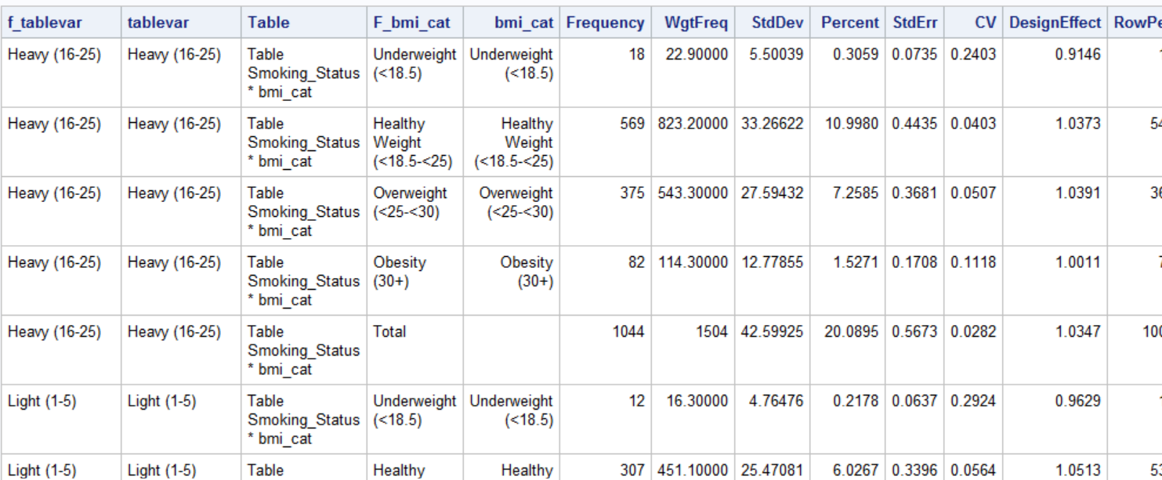
PROC SURVEYFREQ ODS Output Objects
The Great Library of Alexandria
Notes:
First animation: combining ods output objects for bmi categories and setting different tablevars into a single DB – this is on LHS and BMI_CAT level

Slide 50
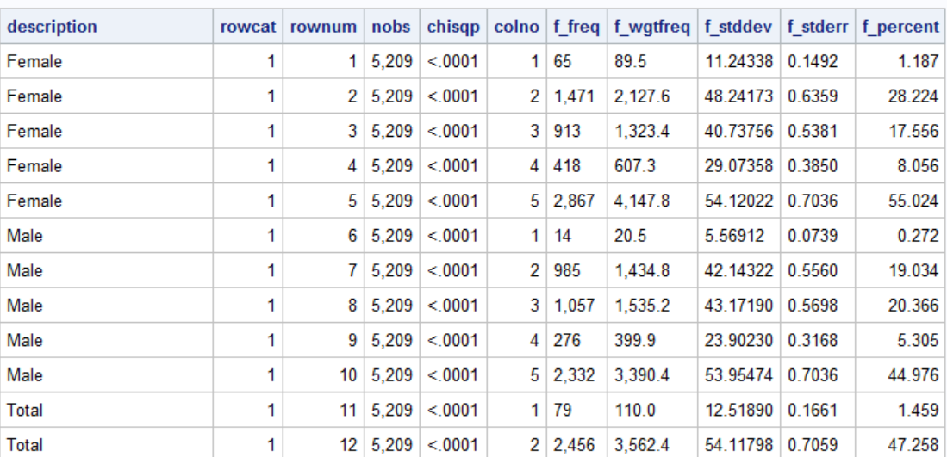
PROC SURVEYFREQ ODS Output Objects
The Great Library of Alexandria
Notes:
Second animation: Next, we split the data set into different bmi categories and total

Slide 51
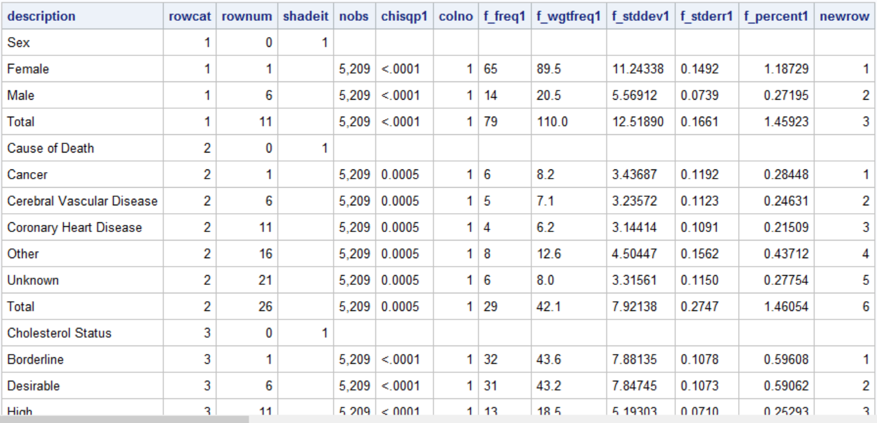
PROC SURVEYFREQ ODS Output Objects
The Great Library of Alexandria
Notes:
Third animation: Massage the 5 different data sets, rename variables, etc.

Slide 52
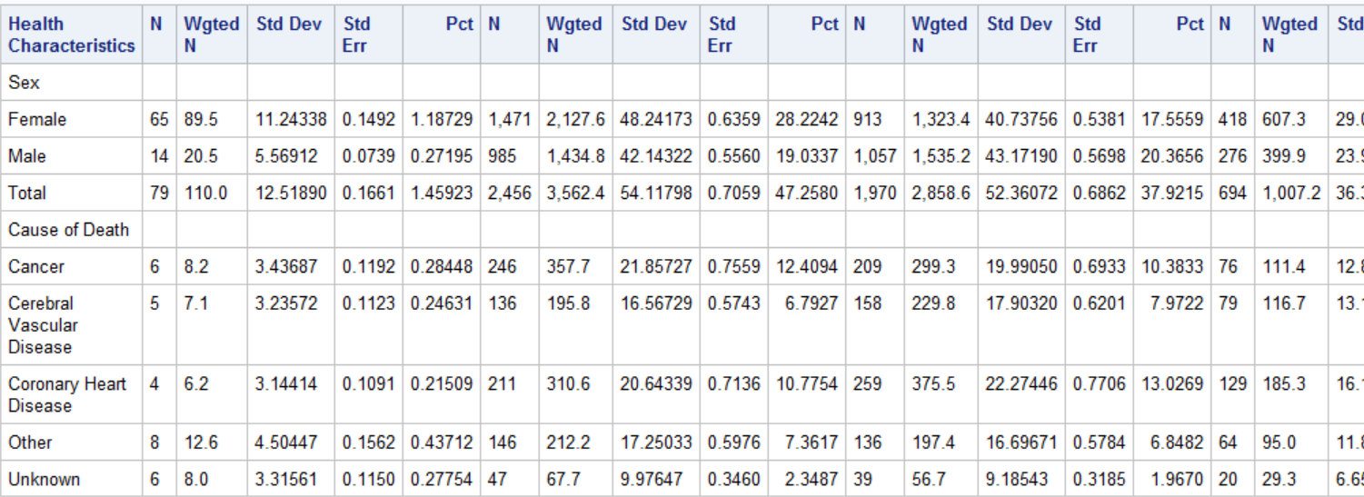
PROC SURVEYFREQ ODS Output Objects
The Great Library of Alexandria
Notes:
Fourth animation: Prepare for final ODS Excel output, add reporting dummies, etc.

Slide 53
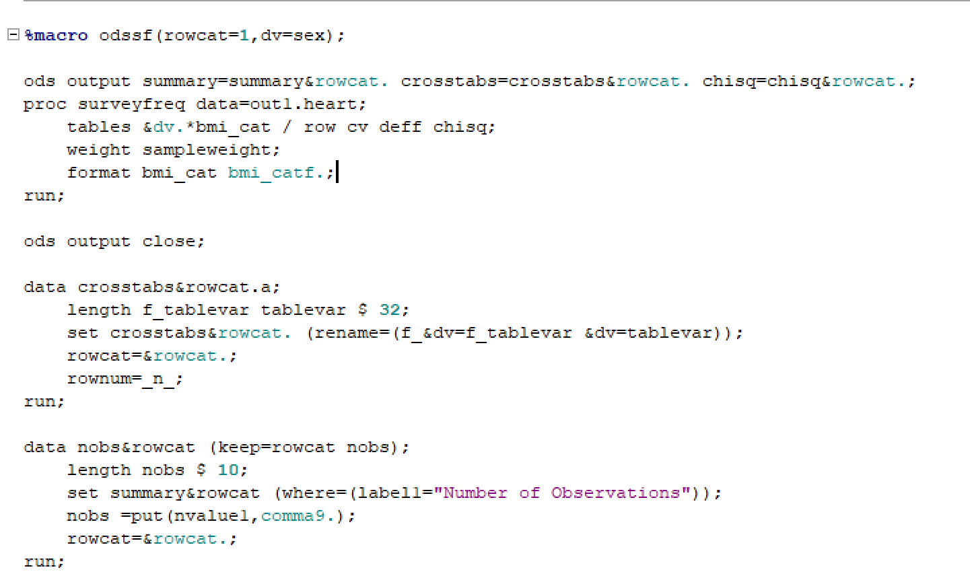
PROC SURVEYFREQ ODS Output Objects
The Great Library of Alexandria
Notes:
I’m providing the full code for this example on Github, feel free to make it your own. You don’t need to take screenshots and I might be moving too fast for that to work for you. I’m just publishing code snippets here so that you understand the process. Animations: Create a macro which puts together three OOOs for 6 different lhs/dependent variables, renames variables accordingly, run macros. Highlight the nonexistent chisq routine, cherry picking, _n_=1

Slide 54

PROC SURVEYFREQ ODS Output Objects
The Great Library of Alexandria
Notes:
Highlight the nonexistent chisq routine, cherry picking, _n_=1

Slide 55

PROC SURVEYFREQ ODS Output Objects
The Great Library of Alexandria
Notes:
, run macros. Highlight the nonexistent chisq routine, cherry picking, _n_=1

Slide 56

PROC SURVEYFREQ ODS Output Objects
The Great Library of Alexandria
Notes:
Animations: set in the different LHS data sets, format, and re-output into separate groups.

Slide 57

PROC SURVEYFREQ ODS Output Objects
The Great Library of Alexandria
Notes:
Animations: creates a macro which Mainly renames variables to reflect the new column groupings, and resets the row variable.

Slide 58

PROC SURVEYFREQ ODS Output Objects
The Great Library of Alexandria
Notes:
Run the macro, reorder variables using retain, remerge the different column sets, and label for final output

Slide 59

PROC SURVEYFREQ ODS Output Objects
The Great Library of Alexandria
Notes:
Finally, we output to ODS excel. Note the options – ODS Excel has tons of them, and they are so cool. Here, I’m embedding titles (you can do footnotes too), coloring the tab (purple), freezing the first column (weirdly, it says ROWHEADERS for columns!), naming the tab (reportreg because apparently I can’t seem to remember it is surveyfreq and not surveyreg). I’m using the default style here, but you can use your own corporate style or another style template.

Slide 60

PROC SURVEYFREQ ODS Output Objects
The Great Library of Alexandria
Notes:
Finally, we output to ODS excel. Note the options – ODS Excel has tons of them, and they are so cool. Here, I’m embedding titles (you can do footnotes too), coloring the tab (purple), freezing the first column (weirdly, it says ROWHEADERS for columns!), naming the tab (reportreg because apparently I can’t seem to remember it is surveyfreq and not surveyreg). I’m using the default style here, but you can use your own corporate style or another style template.

Slide 61
PROC SURVEYFREQ ODS Output Objects
Embedded Titles
Spannimg Headers
Define statement in PROC REPORT to Color Columns
Non-Printing Variable
to color rows
The Great Library of Alexandria
Notes:
I’m embedding titles (you can do footnotes too), define statement for column shading, using spanning headers for the column groups, and a non-printing variable to do traffic lighting at the row level.

Slide 62

Conclusion
I hope you will agree that SAS ODS Output Objects offer many opportunities to enhance and customize your SAS reporting, along with saving valuable time. The basic concepts surrounding the use of ODS Output Objects remain the same whether you are doing a complex weighted multivariate analysis or a simple PROC FREQ. With ODS Output Objects, the sky is the limit!
The Great Library of Alexandria

Slide 63
Contact me at: saslouisehadden@gmail.com Paper, Training Programs, and Presentation available
https://github.com/TheGirlWiththeSASTattoo

