Slide 1
LifeLine
Smart City Disaster Response & Evacuation Simulator
A DSA-driven full-stack project — every data structure and algorithm written from scratch in C++17
Team: Ishaan Sandhwar · Harsh Sharma · Piyush Priyanshu · Deepak Kumar Behera · Aditya Shukla
Speaker 1

Slide 2
The Problem
▪ When disaster strikes a city, minutes decide lives
– Floods, fires, gas leaks spread outward — roads close in real time
▪ Emergency response raises hard computational questions:
– Fastest route for an ambulance when half the roads are blocked?
– How many people per hour can actually evacuate a zone?
– Which rescue unit goes to which emergency first?
– Which single road or junction, if lost, splits the city apart?
▪ Every one of these is a classic graph problem in disguise
Speaker 1

Slide 3
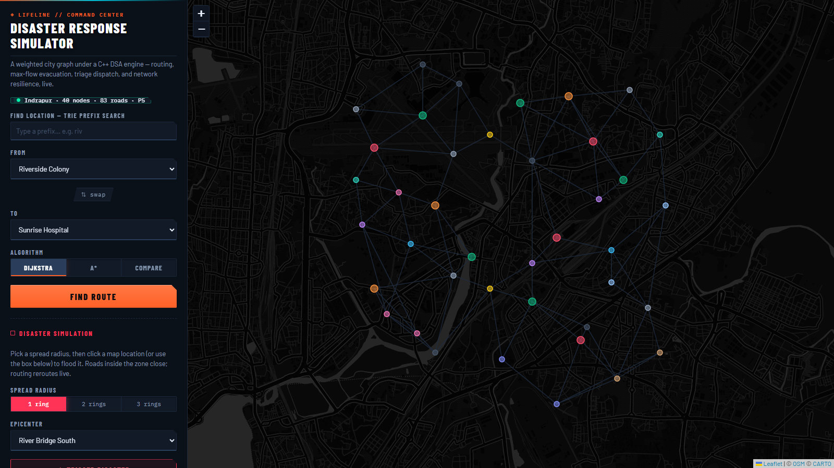
LifeLine — The Solution
▪ Fictional smart city “Indrapur” modelled as a weighted graph
▪ C++17 engine answers every question with classic algorithms
▪ Single static binary — REST API + React command center
▪ Zero external dependencies, runs anywhere
▪ 10+ algorithms, 4 custom data structures, 96 automated checks
Speaker 1

Slide 4
Modelling the City: Indrapur
▪ 40 locations, 83 roads → weighted undirected graph
– Nodes: hospitals, shelters, fire stations, residential zones
– Edges: distance, travel time, and road capacity as weights
▪ City lives in city_graph.json — engine is city-agnostic
▪ Python generator tool rebuilds the city, keeps A* heuristic admissible
▪ Adjacency list representation — O(V + E) memory
Speaker 2

Slide 5
Custom Data Structures — No STL Shortcuts
▪ Binary min-heap — priority queue driving Dijkstra & A*
– insert / extract-min in O(log n)
▪ Binary max-heap — emergency triage by severity
▪ Hash map — separate chaining with djb2 hash
– O(1) average lookup for location names → node IDs
▪ Trie — prefix search / autocomplete over location names
▪ Union-Find — path compression + union by rank
– near-O(1) connectivity checks, powers Kruskal
Speaker 2

Slide 6
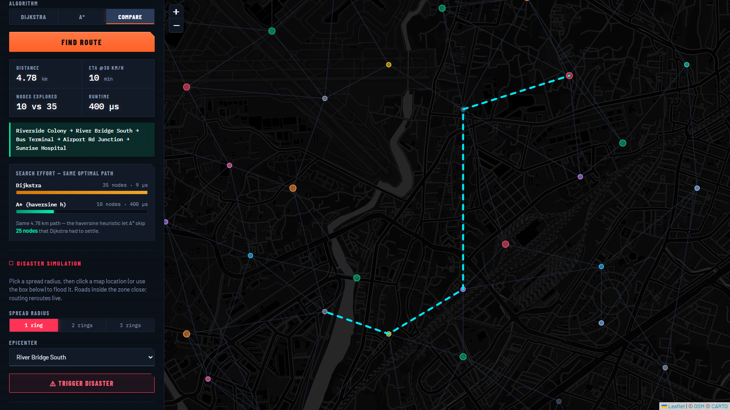
Routing Engine — 4 Algorithms, Compared Live
▪ Dijkstra — O((V+E) log V) on our custom min-heap
▪ A* — admissible straight-line heuristic, fewer nodes expanded
▪ Bellman-Ford — handles risk-adjusted (negative-safe) weights
▪ Floyd-Warshall — all-pairs, O(V³), precomputed matrix
▪ UI races all four on the same query — paths + nodes explored
Speaker 3

Slide 7
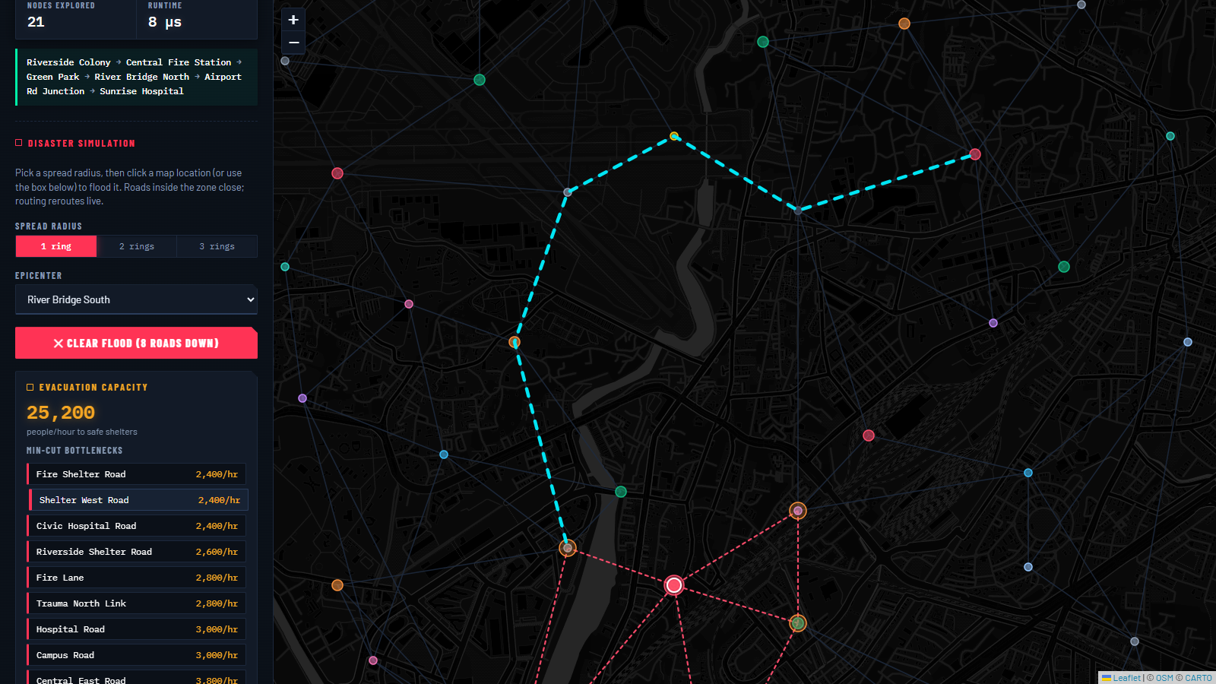
Disaster Simulation — BFS Spread
▪ Disaster starts at one node, spreads level-by-level via BFS
▪ Each BFS ring = one time step of the spreading hazard
▪ Affected roads get blocked or heavily re-weighted
▪ Routing engine instantly reroutes around the danger zone
▪ Map shows live disaster zones and detour paths
Speaker 3

Slide 8
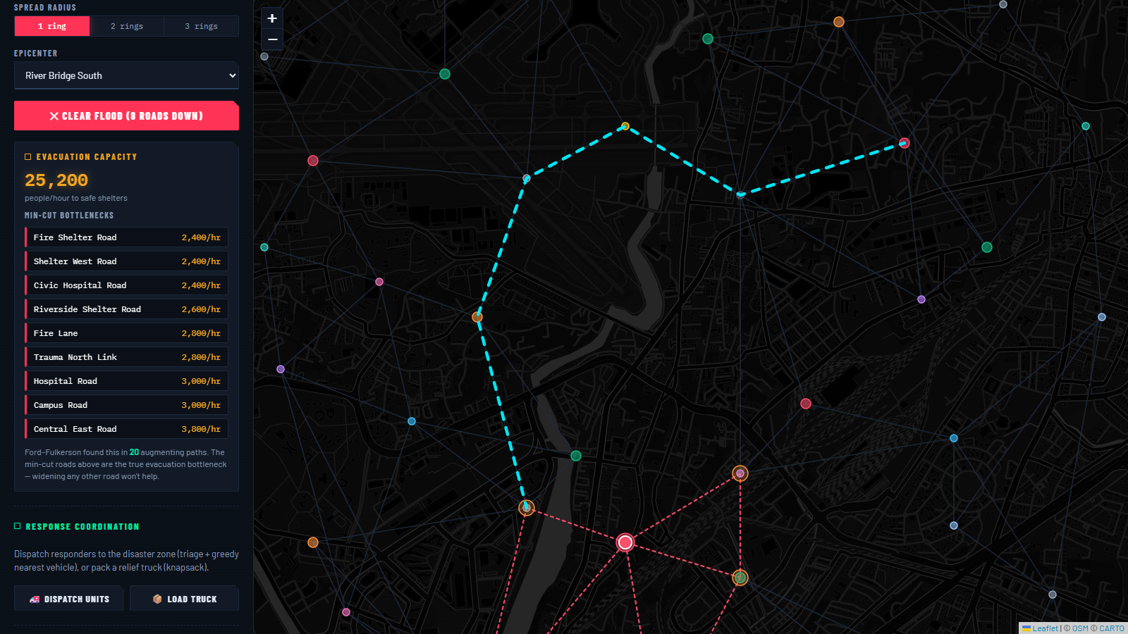
Evacuation Capacity — Max-Flow / Min-Cut
▪ Question: how many people/hour can escape zone → shelters?
▪ Edmonds-Karp max-flow — BFS augmenting paths, O(V E²)
▪ Road capacities become edge capacities in the flow network
▪ Max-flow value = true evacuation throughput
▪ Min-cut exposes the exact bottleneck roads
– widen these roads first — direct planning insight
Speaker 4

Slide 9
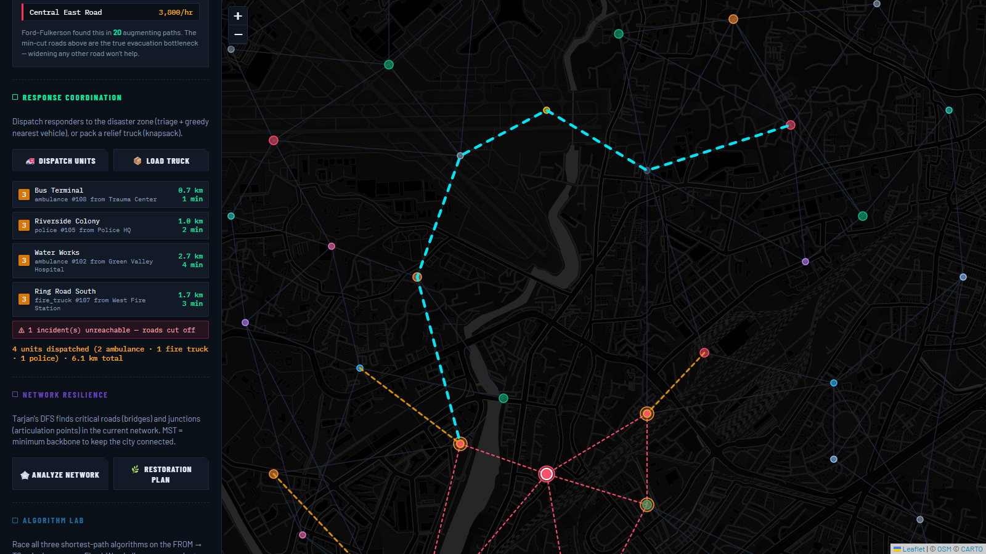
Dispatch & Supply Loading
▪ Emergencies ranked by severity in the custom max-heap (triage)
▪ Greedy dispatch — nearest available unit via Dijkstra distances
▪ Supply truck loading = 0/1 knapsack, solved with DP
– maximize utility of medicine/food/equipment under weight limit
▪ Every dispatched unit drawn with its actual route on the map
Speaker 4

Slide 10
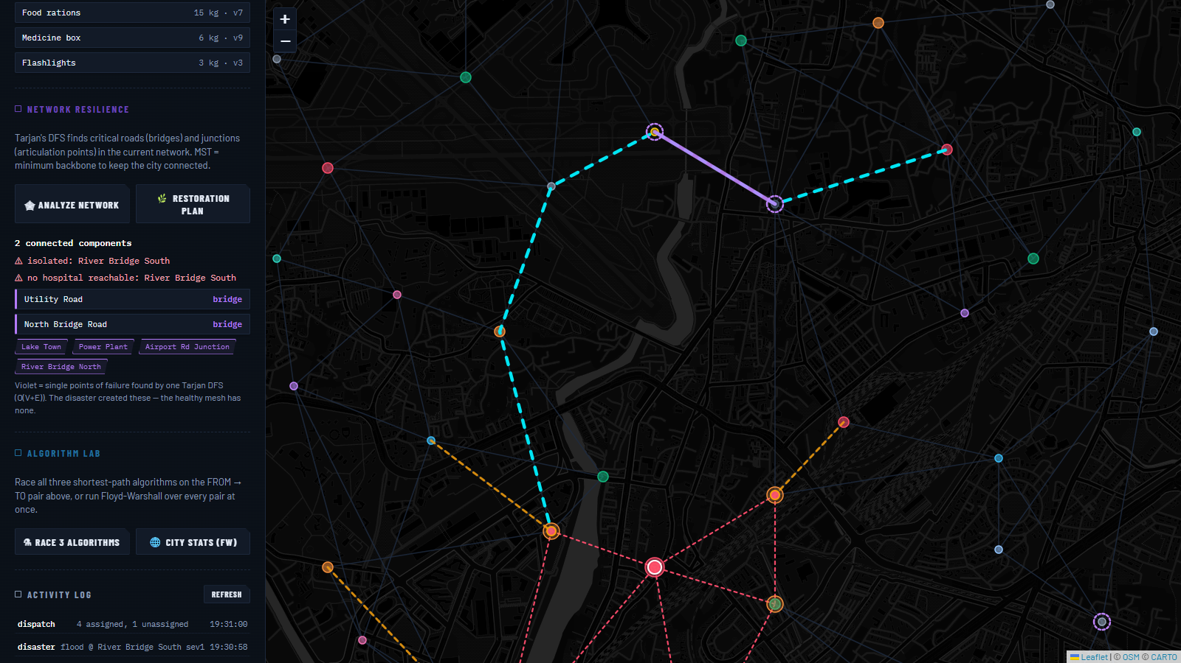
Network Resilience — Finding Weak Points
▪ Tarjan’s algorithm in one O(V+E) DFS pass:
– bridges — roads whose loss disconnects the city
– articulation points — critical junctions
▪ Prim & Kruskal — minimum spanning tree
– the minimal road backbone to keep every zone reachable
▪ Union-Find verifies connectivity after simulated failures
Speaker 5

Slide 11
Engineering & Testing
▪ Zero-dependency C++17 — one static binary serves API + React UI
▪ REST API via header-only cpp-httplib; JSON via nlohmann
▪ React (Vite) command center — dark interactive map
▪ History log: SQLite (optional) with JSONL fallback
▪ 96 automated checks across 5 test suites
– every algorithm cross-verified against an independent Python implementation on the real city graph
▪ Builds on Linux, macOS, Windows (MSYS2) — also runs in Docker
Speaker 5

Slide 12
Future Scope & Takeaway
▪ Real city graphs from OpenStreetMap (10k+ nodes)
▪ Time-varying road capacities as the disaster spreads
▪ Multi-objective dispatch — time vs coverage vs supplies
▪ Real hazard models: flood zones, historical disaster data
▪ Takeaway: textbook DSA is not just for exams —
– every algorithm here runs in a production path with a purpose
Speaker 5

Slide 13
Thank You
github.com/TheGodVishnu21/lifeline · live demo available
Team

