Slide 1


SMART INDIA HACKATHON 2024
DoJ Chatbot
Problem Statement ID– SIH1700
Problem Statement Title- Developing an AI based interactive Chatbot or virtual assistant for the Department of Justice’s Website.
Theme-Smart Automation
PS Category- Software
Team ID- 44138
Team Name- JarOfSand

Slide 2
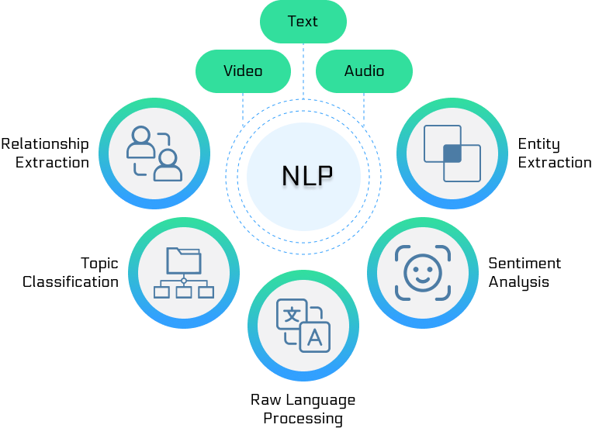





EquiAI
JarOfSand
AI-powered chatbot for the Department of Justice (DoJ) website to enhance user interactions and provide quick access to judiciary-related information
Unique Features
Multilingual support
NJDG
Scalable
Password hashing
E-courts support

Slide 3
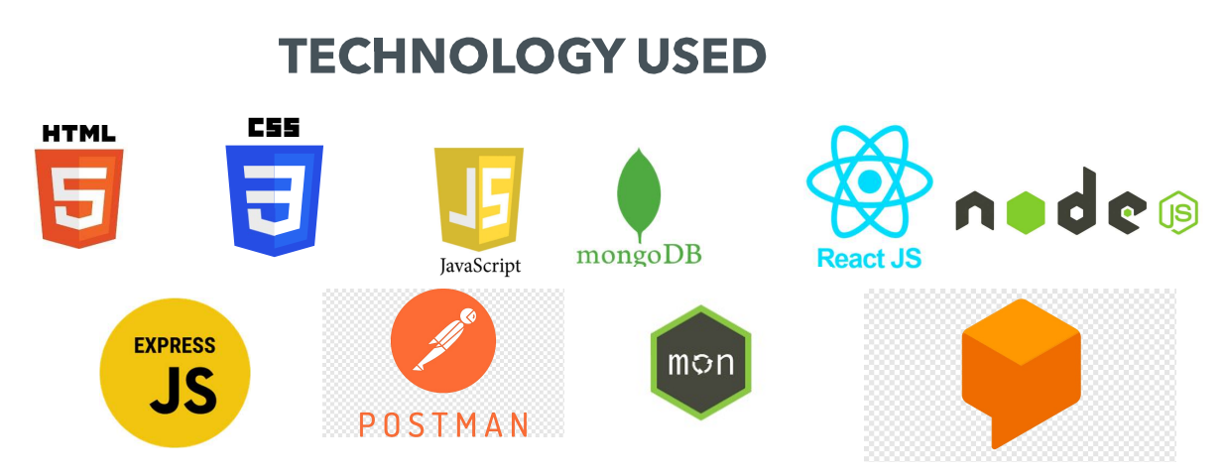
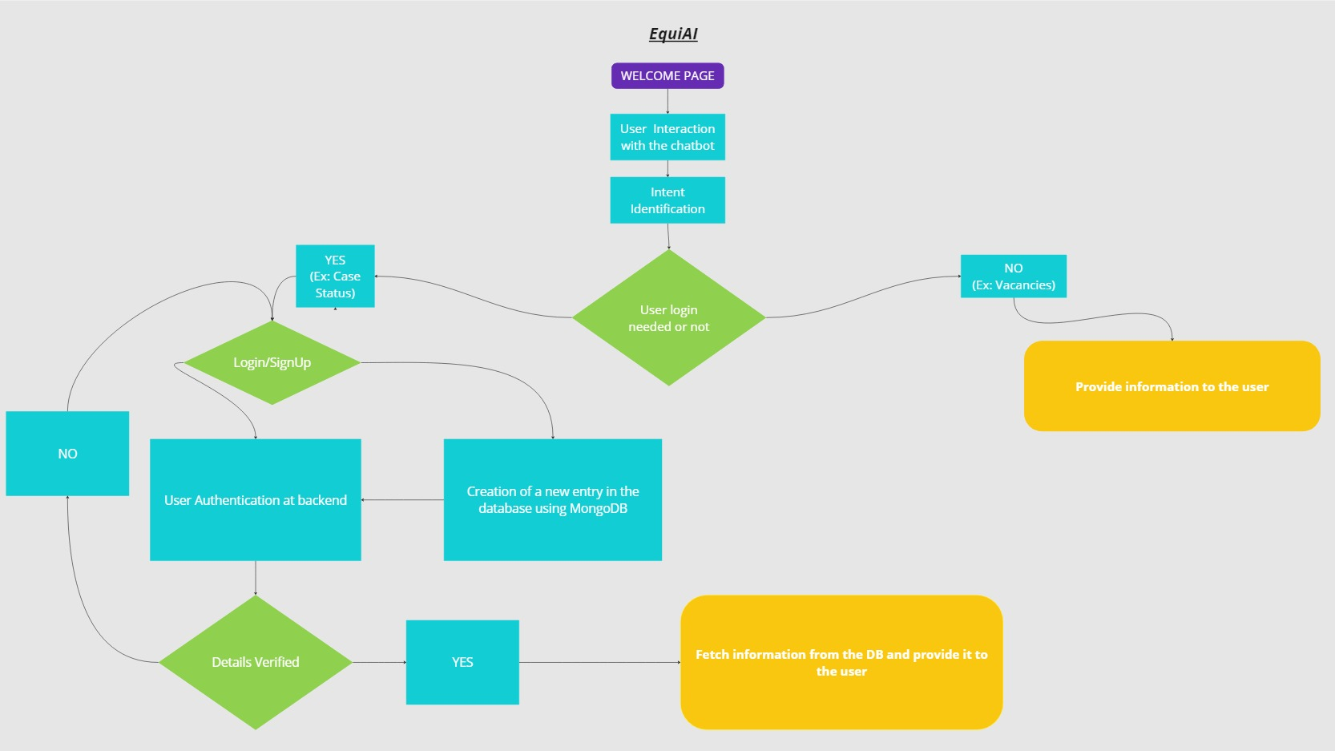
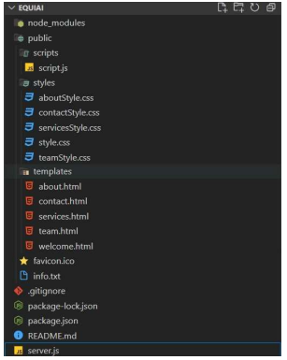
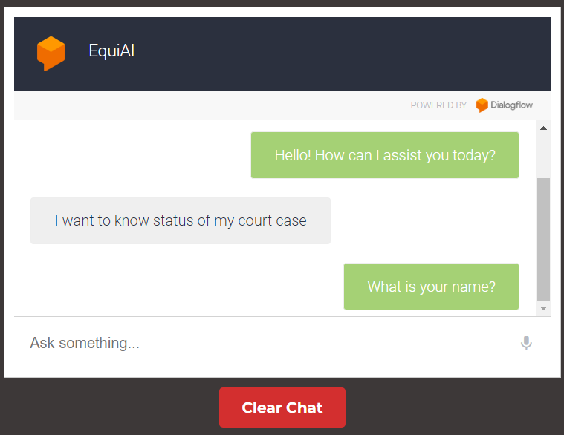
TECHNICAL APPROACH
JarOfSand
Tech Stack:
PROGRESS

Slide 4
FEASIBILITY AND VIABILITY
JarOfSand
Potential Challenges and Risks:
Managing high data volumes
Secure data transmission
Multilingual NLP
GDPR compliance for user data security
Feasibility Analysis:
Highly feasible given the availability of advanced NLP, machine learning, and AI technologies. Integration with DoJ systems like NJDG, eCourts, and other judiciary platforms is achievable with existing APIs and data access protocols.
Strategies for Overcoming Challenges :
Robust machine learning models
Secure hashing for sensitive user data,
End-to-end encryption
Regular system audits, load testing, and data security protocols

Slide 5
IMPACT AND BENEFITS
JarOfSand
Benefits of the Solution:
Social: Improves access to justice, legal services, and transparency in the judiciary system.
Economic: Reduces administrative costs and manual effort by automating queries and processes.
Environmental: Supports digital processes, reducing paper usage and promoting eco-friendly practices.
Technological: Increases efficiency with AI-driven interactions, multilingual support, and real-time data integration with judiciary platforms.
Potential Impact on Target Audience:
The chatbot will greatly enhance user experience by providing quick, accurate access to judiciary-related information. It will assist citizens, legal professionals, and government agencies by simplifying processes like eFiling, case tracking, and legal queries.

Slide 6
RESEARCH AND REFERENCES
JarOfSand
Links of Reference and Research Work:
https://arxiv.org/abs/2004.1
https://ieeexplore.ieee.org/abstract/document/9200315/2158
https://doj.gov.in/
https://lawmin.gov.in/

