Slide 1
CMP3103M – Robotics Assessment
Graeme Hutchison
14470469

Slide 2
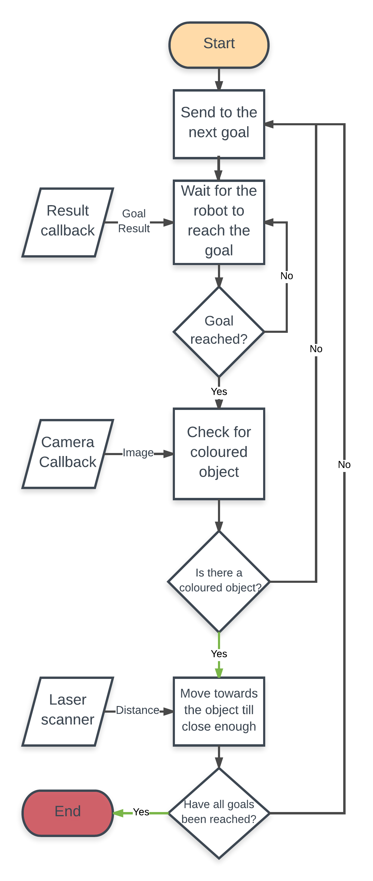
System Architecture and Features
The robot makes use of 2D navigation goals consisting of X and Y coordinates for position and quaternions for orientation. It uses these goals to move around the pre-acquired map of the environment, while using 3 different callbacks to perceive the relevant information around it.
The 3 subscriber callbacks featured within the system are the RGBD camera feed, the laser scanner and the result topic found within the navigation stack. Information is constantly received from these topics while the robot’s behaviour is in effect.
The navigation stack that the robot uses to get to the goals assumes that the robot is circular and operates on a costmap. It uses the costmap to find a minimum cost plan from its current position to the goal computed with Dijkstra’s algorithm.
After the robot reaches each goal, it will use the image callback data to find traces of the chosen colour ranges. Each image received from the camera is converted to an HSV image as the colours that are required to find in the task generally have high saturation compared to the rest of the environment. This made creating masks for each colour range using HSV easier and more effective.
If any of the colours are present it will proceed to centre the object in its vision while moving towards it. Once it gets within a specified distance judged by the laser scanner, it will confirm that it has found that specific object and no longer look for it.
The robot will continue the behaviour of moving to a goal then checking for colour till all of the goals have been reached.

Slide 3
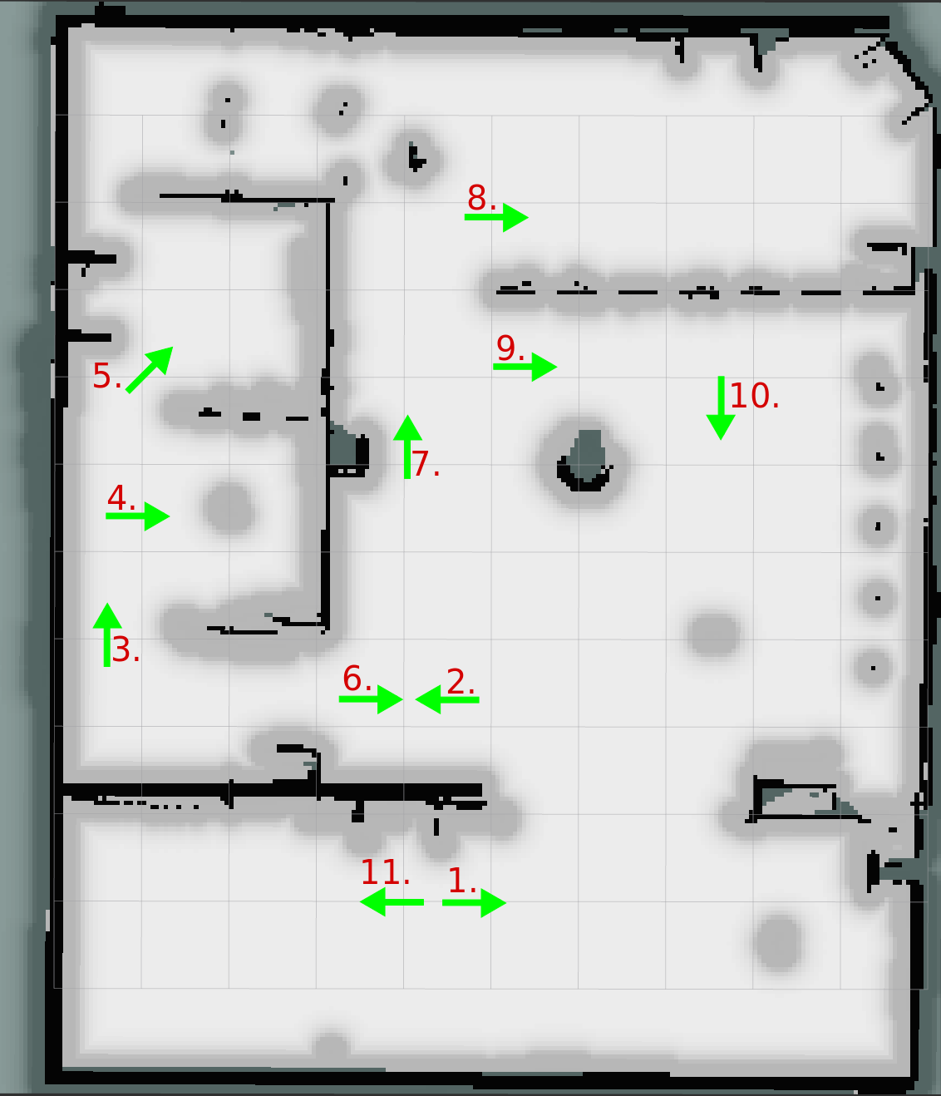
Evaluation
Using the map and 2D coordinates provided a huge performance and reliability boost over using a reactive naive behaviour to navigate the room.
Compared to using navigation goals, the naive behaviour moves around quicker, but often has trouble reaching certain areas of the map that are enclosed, thus making it an ineffective solution to the problem.
To ensure that the whole room has been searched, a total of 11 goals have been set around to try and search all possible locations that the objects may be.
Optimisation of the goals is definitely a possibility as a lot of the robots vision at each goal overlaps, so it is possible that the amount of goals can be lowered to reduce the amount of time the robot is slowly moving around.
The time for the robot to search the whole room was roughly 4 minutes and 24 seconds. Having better goal placement could help reduce search time as well as reducing the amount of goals required to search the whole room.
Goal 1 | Goal 2 | Goal 3 | Goal 4 | Goal 5 | Goal 6 | Goal 7 | Goal 8 | Goal 9 | Goal 10 | Goal 11 | Total
22.8 | 25.2 | 22.6 | 27.4 | 10.8 | 20.4 | 40.9 | 33.6 | 22.0 | 21.0 | 16.5 | 4:24

