Slide 1
Developing self-driving car app
Required configuration steps:
parsing
Synchronization
Hardware
inter-process communication
Etc..
Or just use PolySync!
freeing you to focus on your application!
making your work simpler, faster, and more stable.

Slide 2
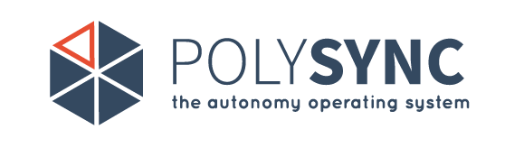
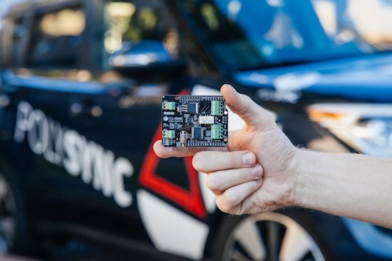
Dor Indivo
Valentin Boonder
Ron Bentolila

Slide 3
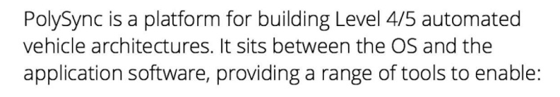

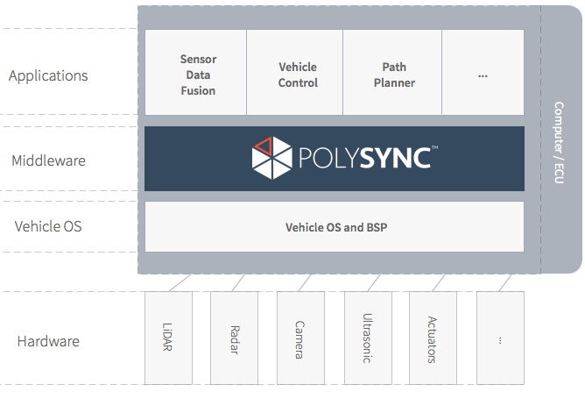
The platform

Slide 4
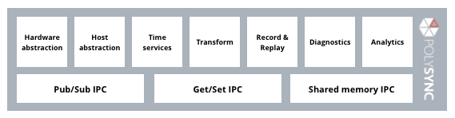
PolySync Functionalities

Slide 5
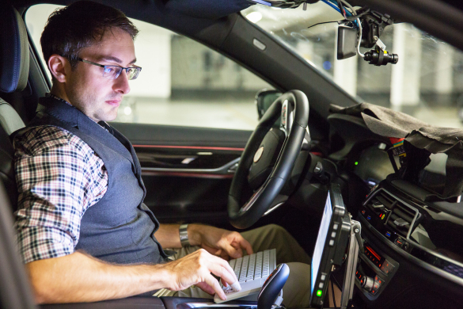
Audience
autonomous driving development teams.
Education
Freelancers
Everyone

Slide 6
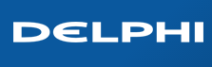
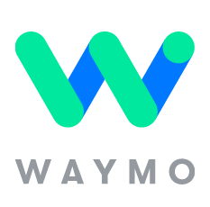
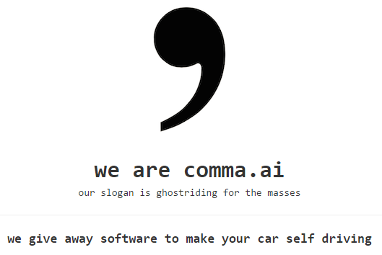
Competition

Slide 7
Architecture
Application nodes: All applications that run on each system and communicate over the middleware.
Dynamic Driver Nodes: are responsible for interfacing with supported hardware and often include support for diagnostics, parameters, and special data types.
The PolySync bus: exists on the Ethernet wire. On a distributed system, all hosts would be connected to the same Gigabit Ethernet switch.

Slide 8
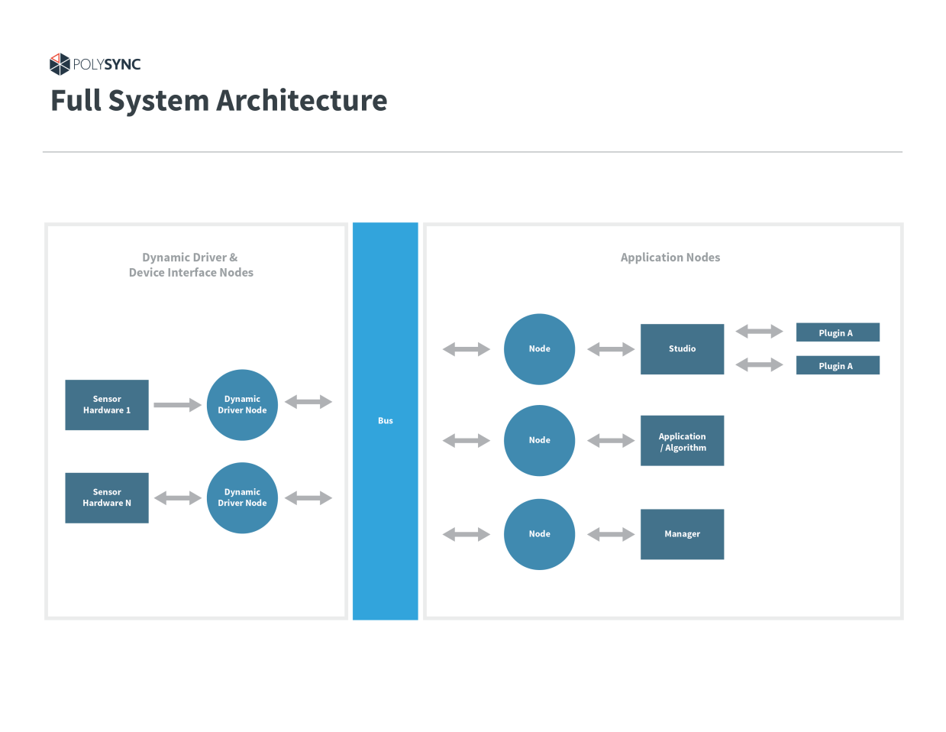

Slide 9
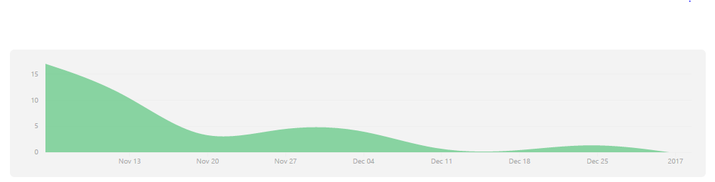

Schedule diagram
First commit
Pedal thresh
Steering rate control
brake actuator

Slide 10
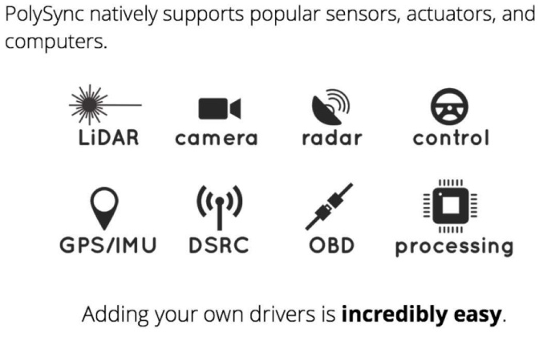
Develop

Slide 11
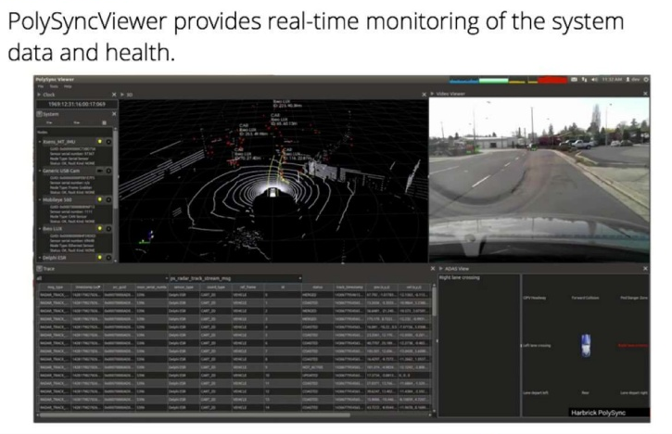

Slide 12
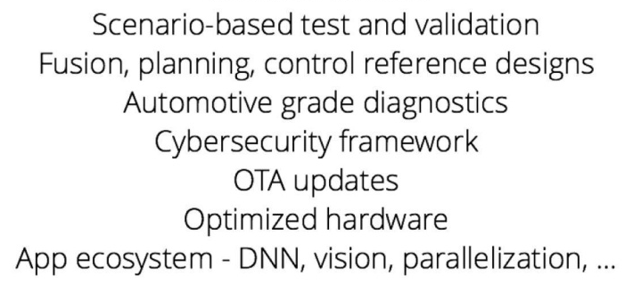
Future Plans

Slide 13
