Slide 1
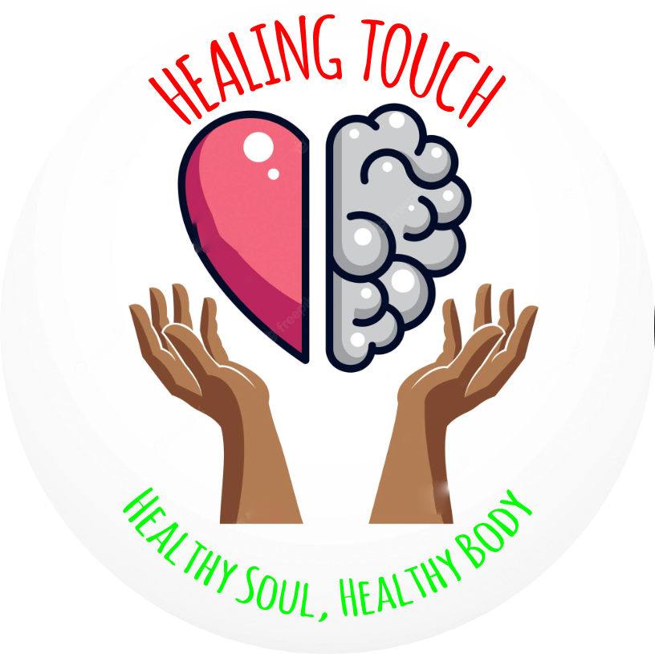
HEALING TOUCH
Healthy Soul, Healthy Body

Slide 2
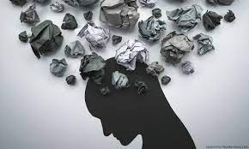
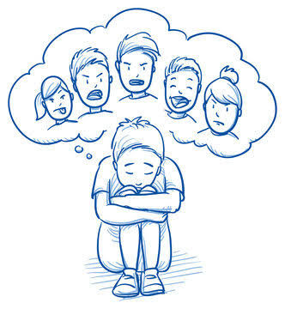
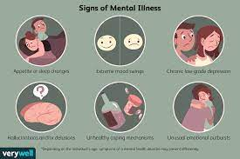
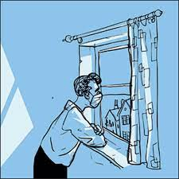
PROBLEM STATEMENT
In this, we are discussing about improving the mental health of a being, especially in the Teenagers.
They face a problem that they don’t even know the real cause of , why they are not able to give their 100% in academic performance.
We are targeting about improving their mental health as seeking professional help is also difficult for being expensive and inaccessible due to family views as well.
We aim to aid in making a safe space for teenagers in need of a secure and understanding community, and provide mental health guidance and professional help.

Slide 3
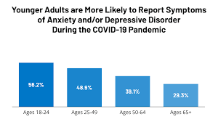
COVID IMPACT ON CHILDREN’S MENTAL HEALTH
COVID-19 Pandemic heads into its third year, the impact on children and young people’s mental health continues to weigh heavily. Through the pandemic, children have had limited access to support from social services due to lockdown measures. The disruption to routines, education, recreation, as well as concern for family income and health, is leaving many young people feeling afraid, angry, and concerned for their future.
According to data from UNESCO, over 286 million children up to grade 6 were out of school in India between 2020-2021. UNICEF’s rapid assessment in 2021 found that only 60 per cent could access digital classrooms. Many would not be able to continue their education.
The impact on children’s lives is incalculable, according to the World Health Organization, the economic loss due to mental health conditions between 2012-2030 is estimated to be USD 1.03 trillion in India, according to WHO 2020.

Slide 4

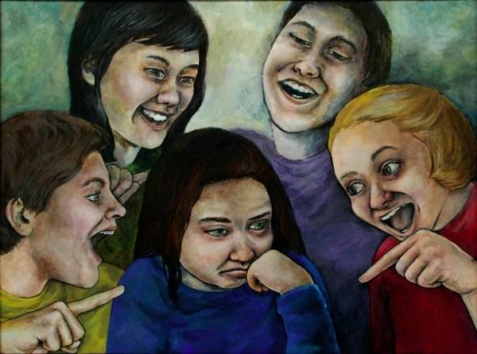
TEEENAGERS MENTAL HEALTH
Globally, one in seven 10-19-year-olds experiences a mental disorder, accounting for 13% of the global burden of disease in this age group.
Depression, anxiety and behavioural disorders are among the leading causes of illness and disability among adolescents. Suicide is the fourth leading cause of death among 15-19 year-olds.
The consequences of failing to address adolescent mental health conditions extend to adulthood, impairing both physical and mental health and limiting opportunities to lead fulfilling lives as adults.

Slide 5
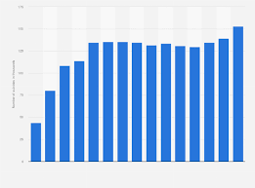
SUICIDE IN INDIA
There has been an increase in the rates of suicide in India over the years, although trends of both increases and decline in suicide rates have been present. Distinct from global demographic risk factors.
In India, marital status is not necessarily protective and the female: male ratio in the rate of suicide is higher. The motives and modes of suicide are also distinct from western countries.
Preventive strategies implemented at a community level and identifying vulnerable individuals maybe more effective than global strategies.

Slide 6
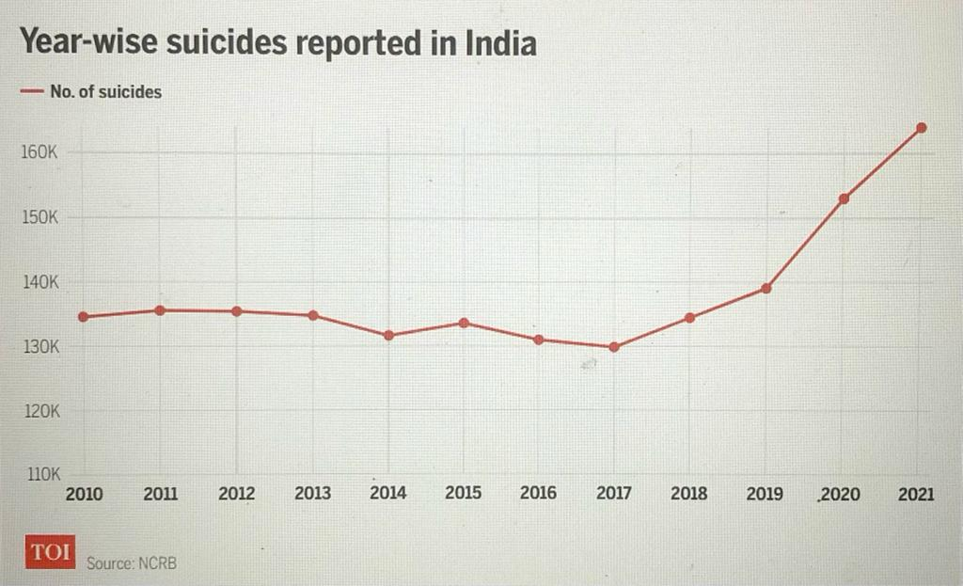

Slide 7
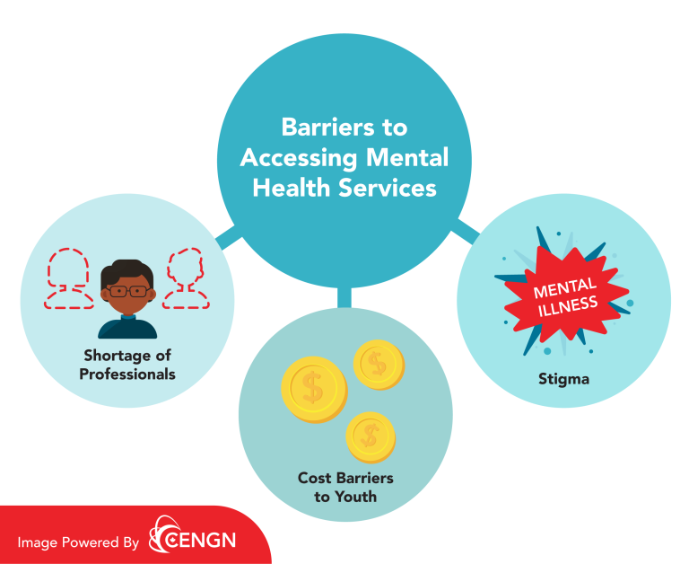
BARRIERS OF YOUTH
Youth have difficulty accessing mental health services and are at the center of the mental health crisis in India.
The risk of mental illness and substance use problems is highest among young people aged 15 to 24 . Cost is a significant barrier to youth accessing mental health services, with privatized care fees ranging from around $100 to $225 per hour
Stereotypes surrounding those with mental illnesses prevent patients from seeking the help they need. According to a World Health Organization study, 30 to 80 percent of those with mental health issues don’t seek treatment. It’s common to hear stereotypes about people with mental health issues like they’re dangerous, incompetent, or responsible for their illness.

Slide 8
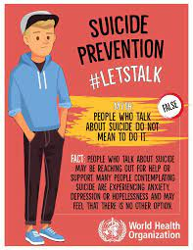
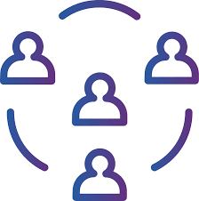
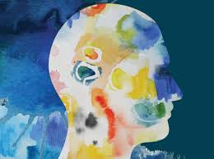
SUICIDAL TENDENCY IS AVOIDABLE
◦ Maintain Meaningful Social Connections
◦ Know the Warning Signs
◦ Identify Whether You or Someone Else Has Specific Mental Health Needs
◦ Reducing Access to Lethal Means of Suicide
◦ Seek Help for Yourself or Someone Else

Slide 9
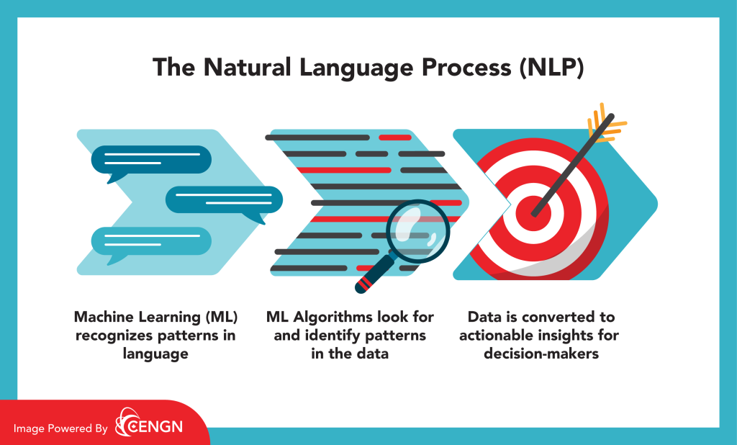
IMPORTANCE OF AI
Because of the issues listed above, mental health professionals have started to introduce AI in their practice, and the results are already proving to be very promising.
Here’s how AI is leveraged at each step of mental health services today.
Custom Care
Monitoring Symptoms & Tracking Progress:
Reducing Wait Times and Combatting Misdiagnosis

Slide 10
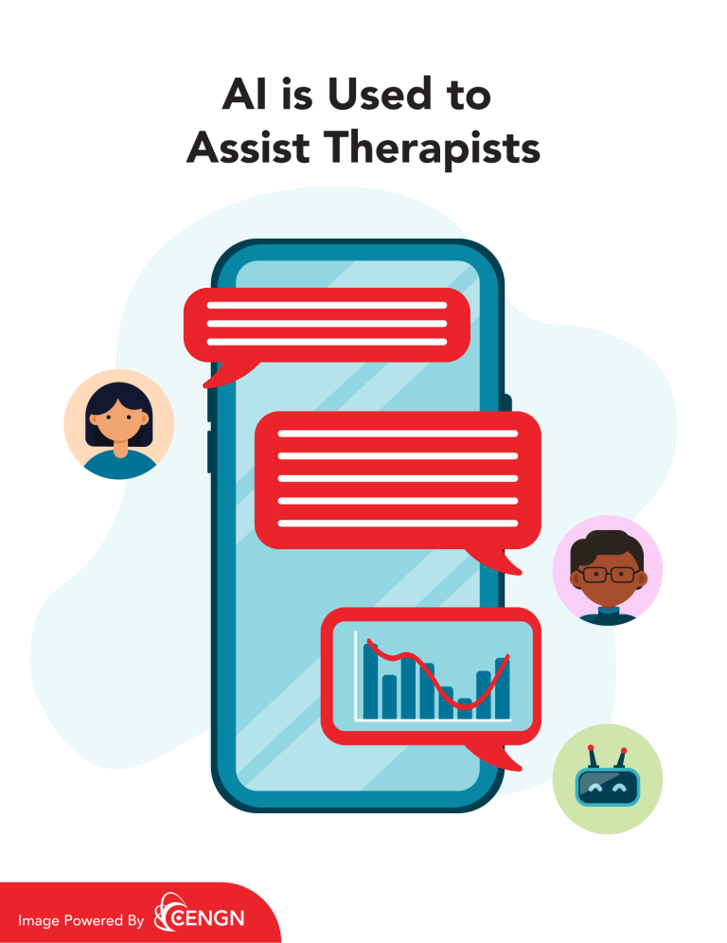
AI’s Role in Treating Different Mental Health Issues
In the model of emotionally focused therapy, a person who is emotionally safe is accessible, responsive, and engaging. These are the qualities researchers and programmers in the field of AI hope to bring to technology-based mental health care.
The University of Illinois Chicago is currently conducting a 5-year study where researchers combine AI voice technology with problem-solving therapy (PST). This will be a systematic approach to helping individuals focus on improving their cognitive and behavioural abilities through AI-delivered mental health treatment.

Slide 11
HEALING TOUCH
Teenage is a stage in which children think a lot and undergo many changes and frequently move into negative thoughts.
Our App Prevents the user to think negative and encourages the user to stay positive and happy.
During interaction, the bot will motivate the user to get engaged into music, yoga, meditation etc.
When needed, it will give information to contact mental health therapists.
We highly recommend this app to teenagers, specially when they feel lonely.

Slide 12
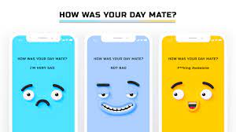
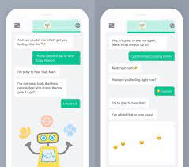
APP FEATURES
Healthy Touch app is made while focusing on Tenagers’ mental health. The app helps the user to overcome depression, anxiety, low self-esteem etc.
Features such as virtual AI friend, soothing and pleasing music are added to the app
to give a positive impression on the user and motivate them to stay happy and healthy.
This app engages the user in their free time to avoid negative thoughts.

Slide 13
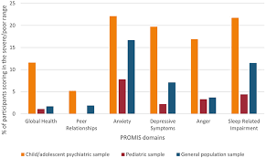
COMPETITION ANALYSIS
Access and Stigma-AI-based depression resources also hope to address other barriers to mental health treatment, such as a lack of providers in rural areas, the stigma associated with mental illness, and feelings of fear, guilt, or shame that may stop someone with depression from reaching out to others.
Privacy and Anonymity-Many people value their privacy and enjoy the anonymity technology can provide. Considering the sensitive and personal nature of the content shared in counseling and therapy, programs using AI that can be used anonymously by users can be an appealing asset.
Accessibility and Responsiveness-AI apps can provide unprecedented accessibility by being available 24/7 at little to no cost. The programs collect data that allow them to create a level of therapeutic rapport with users and offer relevant responses.

Slide 14
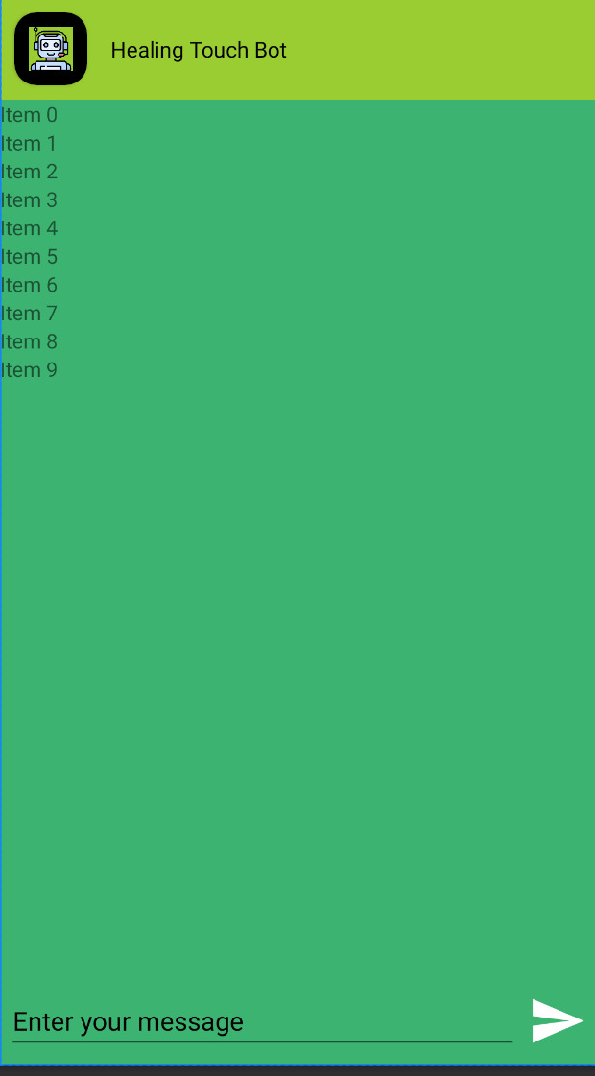
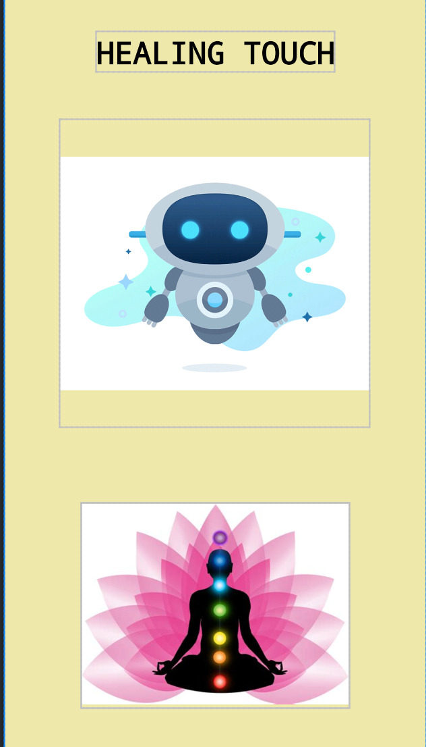
TECHNOLOGIES USED
Healing Touch is made using and AI application which is trained to create a positive mindset for the user.
The app is made on Android Studio using Java and XML languages.
AI helps the chatbot to respond the user.

Slide 15
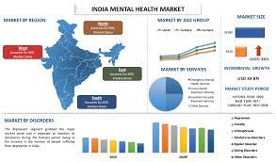
MARKET ANALYSIS
The global health market is valued at 381.31 Billion $ and is estimated to be valued at 537.97 Billion $ growing at a CAGR of 3.5% from 2021 to 2030
India mental health market is expected to grow significantly by 2028 expanding at a reasonable CAGR during the forecast period (2022-2028).
In India, there were 3 Psychiatrists per 10 lakh population and around 5 psychologist per 1 crore population. This makes availability of professionals limited to most demanding and high paying locations
On the other hand the mental-health providers are overworked
Government of india has already launched National mental health policy to provide universal psychiatric care available to all
This has proved to be a boon for mental-health industry and opened a lot of growing opportunities in the sector.

Slide 16
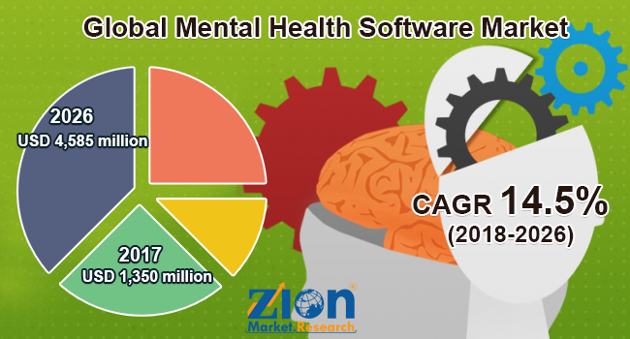

Slide 17
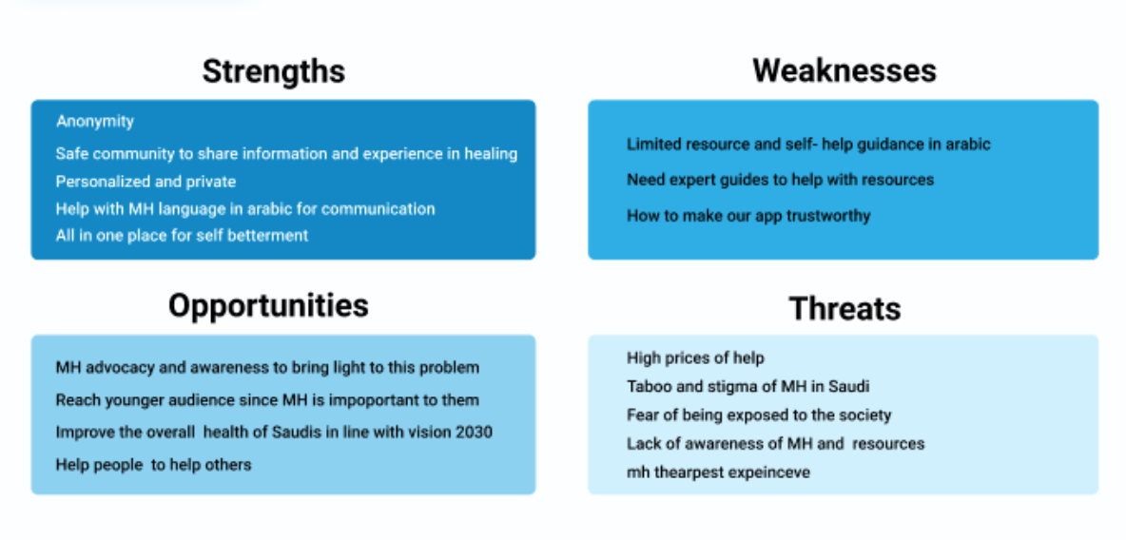
SWOT ANALYSIS

Slide 18
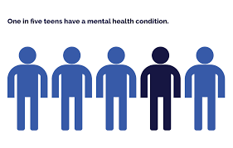
TARGET GROUPS
THE TARGET GROUPS WILL BE
Mental illness is the third leading cause of death among young adults worldwide.
Issues such as peer pressure, academic expectations and changing bodies can bring a lot of ups and downs for teens. But for some teens, the lows are more than just temporary feelings — they're a symptom of depression.
Teen depression isn't a weakness or something that can be overcome with willpower — it can have serious consequences and requires long-term treatment. For most teens, depression symptoms ease with treatment such as medication and psychological counseling.

Slide 19
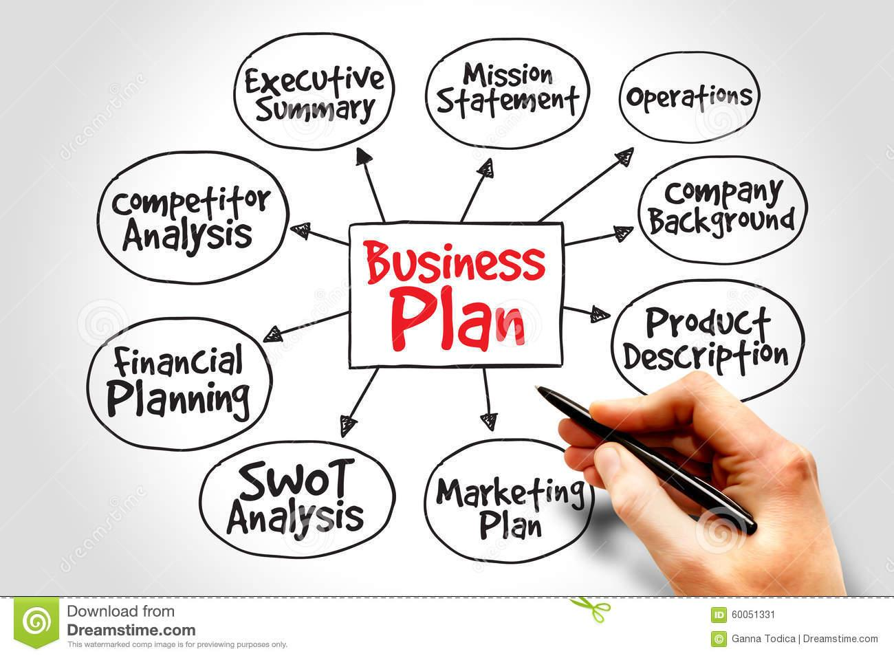
BUSINESS PLAN
First we will upload the chatbot on our web page and then the app will be upload on the google play store and apple store
The app will be current available to the users for no cost
MARKETING STRATEGY
The marketing of the app will be done through web site and word of mouth
We will also conduct mental health awareness campaigns and counselling in the school

Slide 20


Slide 21
BIBLOGRAPHY
https://www.unicef.org
https://www.cengn.ca
https://www.verywellmind.com/
https://timesofindia.indiatimes.com/
https://childmind.org/
https://save.org/
https://www.ncbi.nlm.nih.gov/pmc/articles/PMC3554961/
https://economictimes.indiatimes.com/
https://www.who.int/
(Source: CAMH)
(Source: The Conversation)
(Source: High Watch Recovery)
(Source: Progress in Mind)
(Source: University of Illinois Chicago).
https://www.mayoclinic.org/

