Slide 1
Ayan Guha
Derrik Dennis
Matthew Elenniss
Odill Rodrigues
Sarah Parzyck
HurriPy
A group of world-renowned data scientists took upon themselves to analyze the correlations between cyclones and impacting factors.
Notes:
Title Slide

Slide 2

Understanding cyclones patterns over the past few years:

Slide 3
Demographics of top 3 costliest cyclone hit areas on the mainland in the past 10 years:

Slide 4
Tracking a Storm:

Slide 5
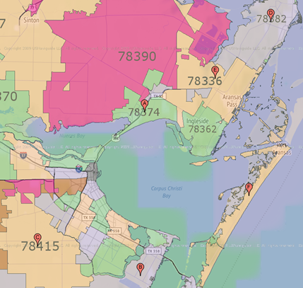
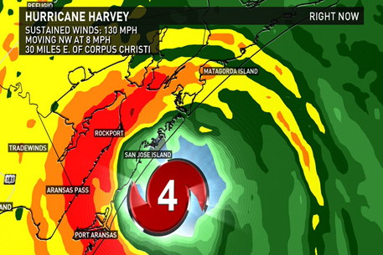
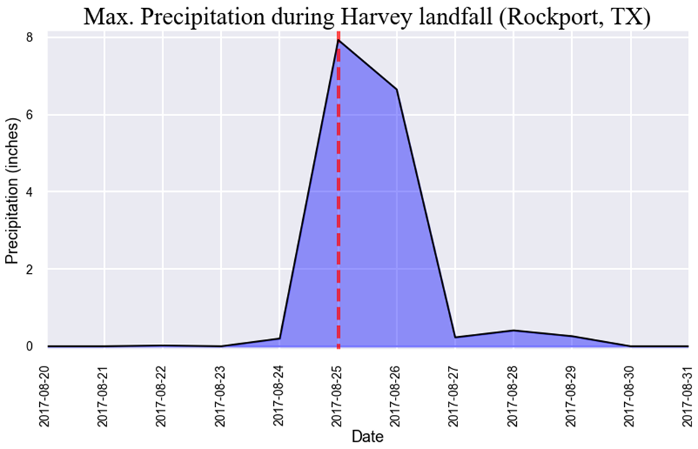
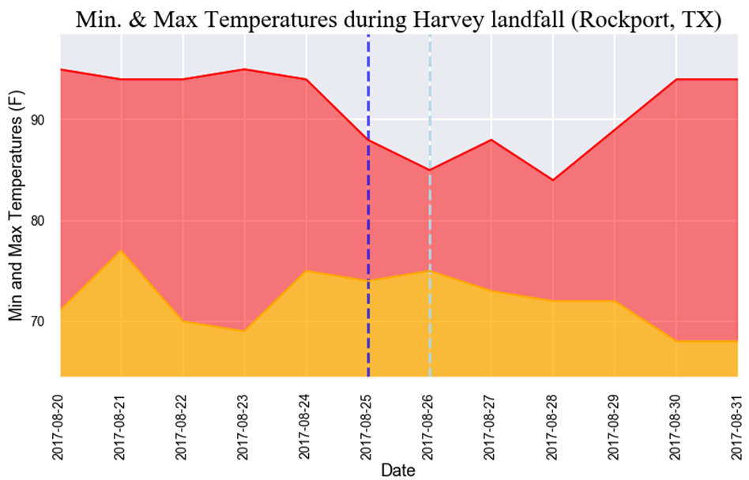
Predictive Data Modeling: Harvey (2017)

Slide 6
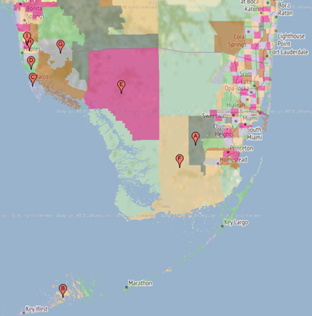
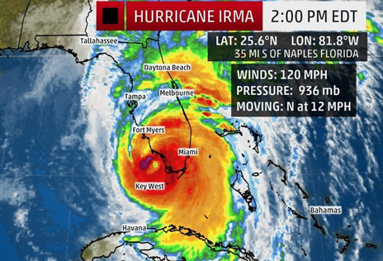
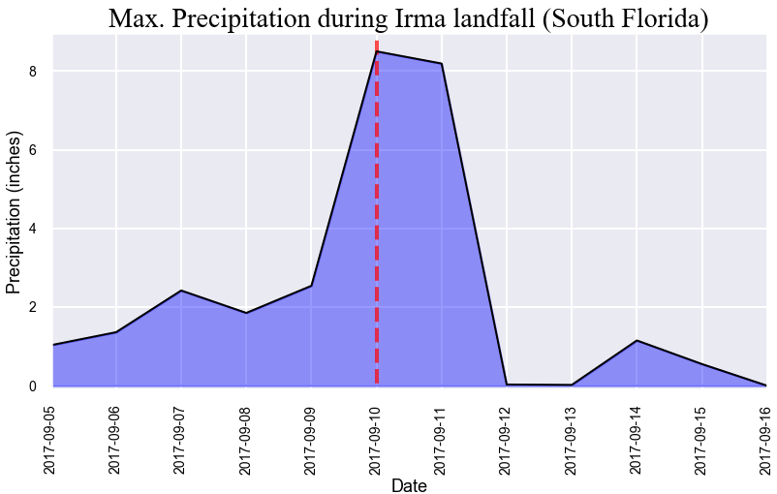
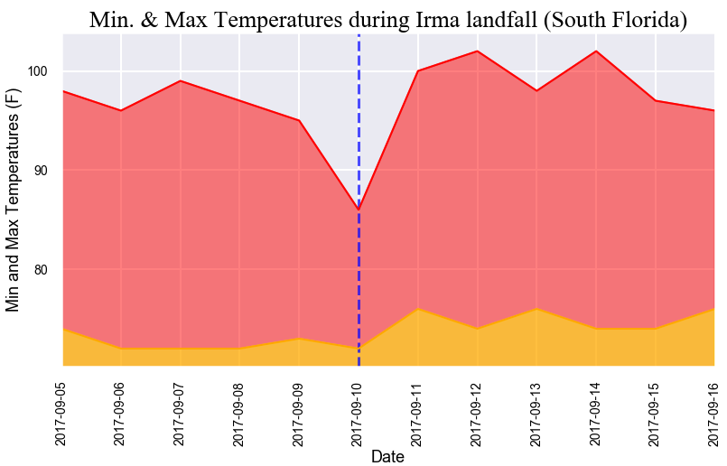
Predictive Data Modeling: Irma (2017)

Slide 7
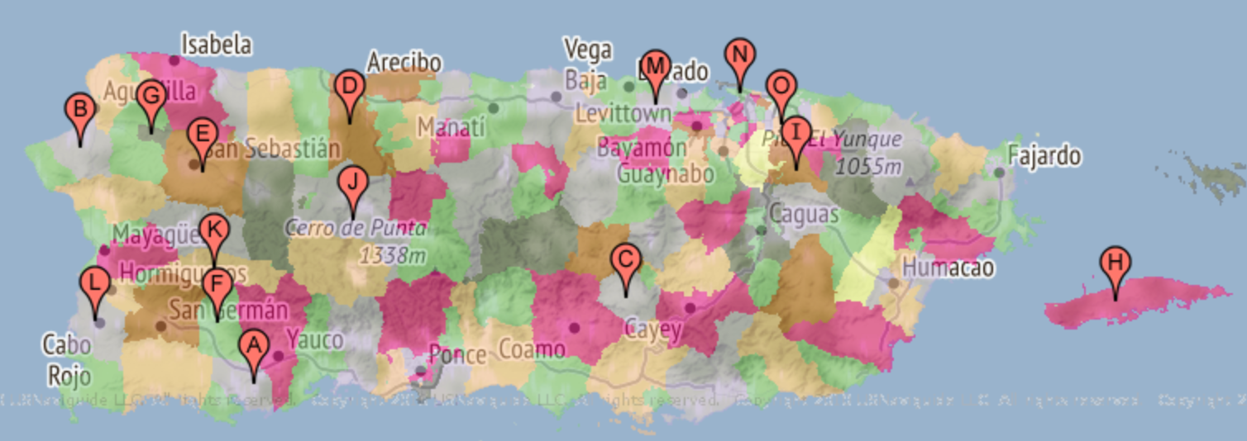
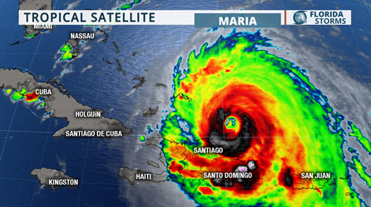
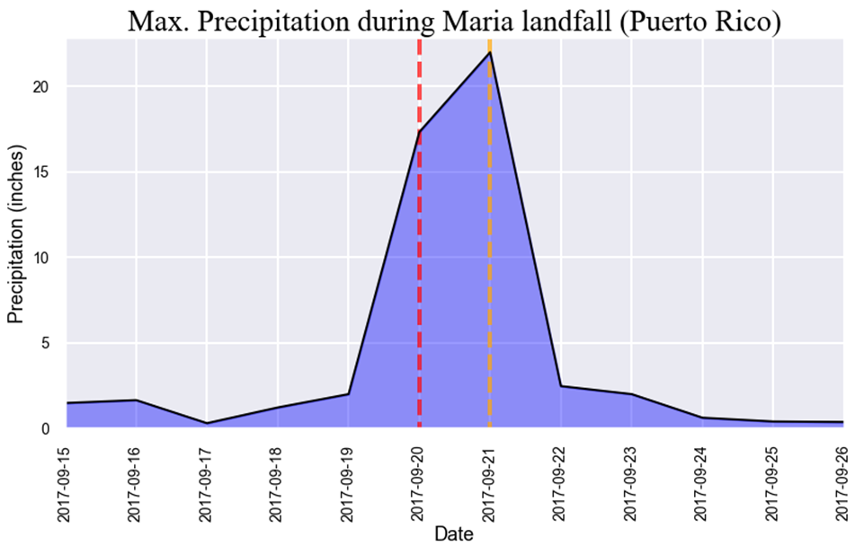
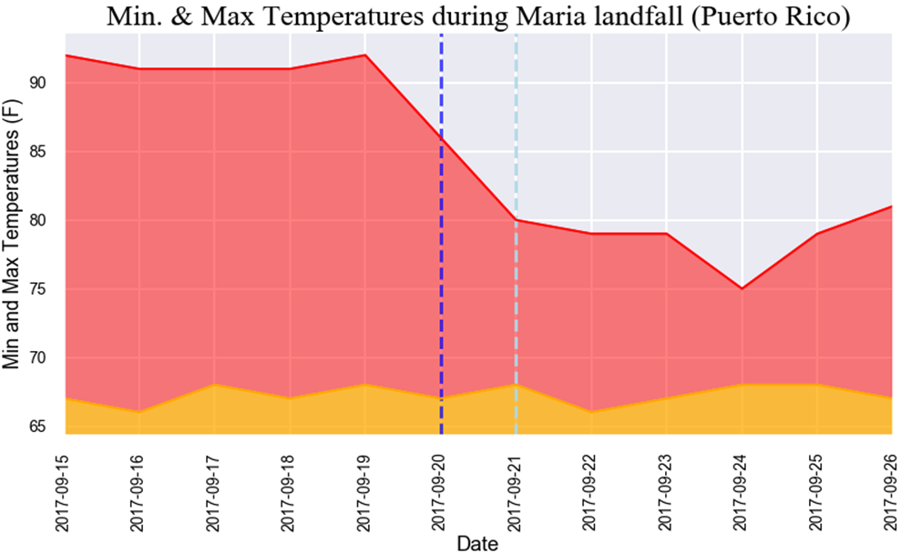
Predictive Data Modeling: Maria (2017)

Slide 8



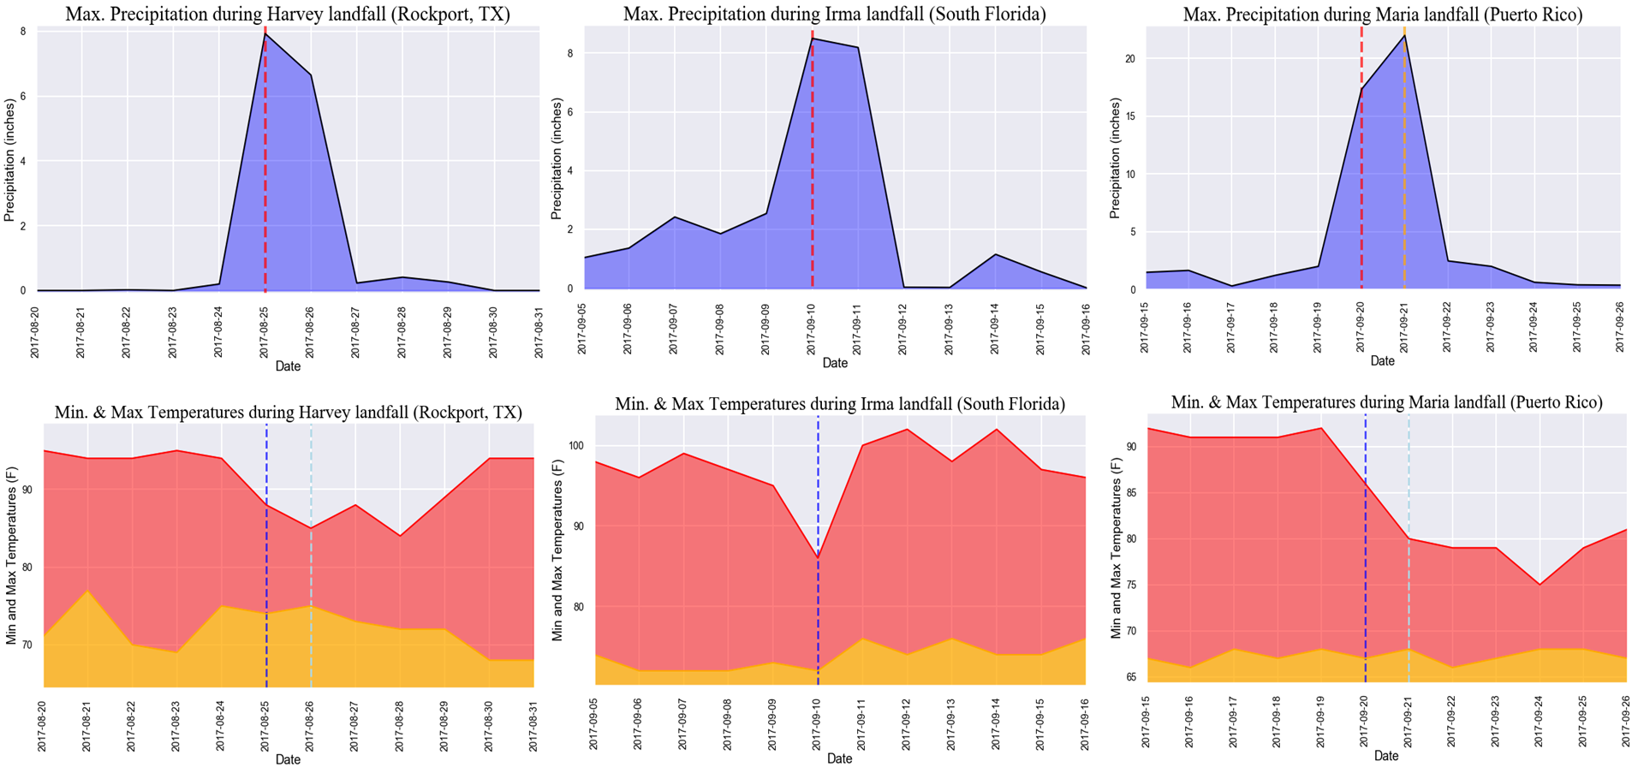

Slide 9

Resources:
Data sets used:
https://www.census.gov/
https://www.ncei.noaa.gov
https://www.nhc.noaa.gov/
https://www.weather.gov/
https://www.usgs.gov
TA:
https://www.census.gov/data/developers/data-sets/business-dynamics.html
API keys requested from:
https://towardsdatascience.com/getting-weather-data-in-3-easy-steps-8dc10cc5c859
https://www.nhc.noaa.gov/data/hurdat/hurdat2-1851-2019-052520.txt
https://www.nhc.noaa.gov/data/hurdat/hurdat2-format-nov2019.pdf

Slide 10
Everything past this slide is just “place holders” and notes for me. None of it (including this slide) will be included in the final project.
Viewer Discretion is Advised.

Slide 11
Who did what?
Understanding cyclones patterns over the past few years (Odille)
Demographics of top 3 costliest cyclone hit areas on the mainland in the past 10 years (Sarah)
Tracking a Storm (Derrik)
Predictive Data Modeling (Ayan)

Slide 12
The study hopes to provide information regarding:
Understanding the cyclone patterns over the past few years – Data collection (DD), Data cleaning (OR)
The onset of cyclone season as it pertains to the time of the year – Box plot for each decade (AG)
Named vs. unnamed - Stacked bar chart (OR)
When do we usually see named cyclone with the letter “C” – Line graph (OR)
Cyclone by category level and year – Stacked bar chart (OR)
The time it takes to go from a tropical storm to a cyclone – Bar graph with line graph (OR)
Demographics of top 3 costliest cyclone hit areas on the mainland in the past 10 years – Data collection (SP)
Cyclones: Harvey, Irma, and Sandy that all hit in the past decade - Line graph ( )
Have damage costs increased or decreased over the past 10 years - Line graph ( )
Top 3 biggest for a year and their line graph - Line graph ( )
Population: Year before and year after – Line graph for YOY% change ( )
Median home values: Year before and year after – Line graph for YOY% change ( )
Poverty rates: Year before and year after – Line graph for YOY% change ( )
Tracking a storm
The path of Cristobal and top 3 (DD & ME)
Predictive data modeling based on land weather station historical data (AG)
Rough breakdown of tasks:
Agree on methodology
Data sources and collection
Data cleaning
Data visualization
Conclusions and summary

