Slide 1
Ayan Guha
Derrik Dennis
Matthew Elenniss
Odill Rodrigues
Sarah Parzyck
HurriPy
A group of world-renowned data scientists took upon themselves to analyze the correlations between cyclones and impacting factors.
Notes:
Title Slide

Slide 2
The study hopes to provide information regarding:
Understanding the cyclone patterns over the past few years – Data collection (DD), Data cleaning (OR)
The onset of cyclone season as it pertains to the time of the year – Box plot for each decade (AG)
Named vs. unnamed - Stacked bar chart (OR)
When do we usually see named cyclone with the letter “C” – Line graph (OR)
Cyclone by category level and year – Stacked bar chart (OR)
The time it takes to go from a tropical storm to a cyclone – Bar graph with line graph (OR)
Demographics of top 3 costliest cyclone hit areas on the mainland in the past 10 years – Data collection (SP)
Cyclones: Harvey, Irma, and Sandy that all hit in the past decade - Line graph ( )
Have damage costs increased or decreased over the past 10 years - Line graph ( )
Top 3 biggest for a year and their line graph - Line graph ( )
Population: Year before and year after – Line graph for YOY% change ( )
Median home values: Year before and year after – Line graph for YOY% change ( )
Poverty rates: Year before and year after – Line graph for YOY% change ( )
Tracking a storm
The path of Cristobal and top 3 (DD & ME)
Predictive data modeling based on land weather station historical data (AG)
Rough breakdown of tasks:
Agree on methodology
Data sources and collection
Data cleaning
Data visualization
Conclusions and summary

Slide 3
Data sets used:
https://www.census.gov/
https://www.ncei.noaa.gov
https://www.nhc.noaa.gov/
https://www.weather.gov/
https://www.usgs.gov
TA:
https://www.census.gov/data/developers/data-sets/business-dynamics.html
API keys requested from:
https://towardsdatascience.com/getting-weather-data-in-3-easy-steps-8dc10cc5c859
https://www.nhc.noaa.gov/data/hurdat/hurdat2-1851-2019-052520.txt
https://www.nhc.noaa.gov/data/hurdat/hurdat2-format-nov2019.pdf
Unofficial motivational partners:
Alamo HurriPy
Siena HurriPy
Vital HurriPy

Slide 4
Motivation & Summary
Analyze the correlations between cyclones and impacting factors.
Question 1 – do hurricanes affect population rates, poverty rates, and property value?
We asked this question as we were curious of the impact hurricanes made to small and large cities.
We were able to answer these question to our satisfaction and found that hurricanes don’t necessarily affect those three. We expected there to be a negative impact across all three but found most improved or increased.
Notes:
Motivation & Summary Slide
* Define the core message or hypothesis of your project.
* Describe the questions you asked, and _why_ you asked them
* Describe whether you were able to answer these questions to your satisfaction, and briefly summarize your findings

Slide 5
Questions & Data
Question 1 – do hurricanes affect population rates, poverty rates, and property value?
To analyze this data we used the Census API to pull Population, Poverty Count, and Median Home Value.
We narrowed our Hurricane Search to three 2017 Hurricanes that were part of the the top ten hurricanes that created the most damage in the past ten years – Irma, Maria, Harvey.
We then used three zip codes that were hit hardest by each hurricane to analyze their population, poverty count, and median home value in 2016 vs. 2018.
Notes:
Questions & Data
* Elaborate on the questions you asked, describing what kinds of data you needed to answer them, and where you found it

Slide 6
Data Cleanup & Exploration
Notes:
Data Cleanup & Exploration
* Describe the exploration and cleanup process
* Discuss insights you had while exploring the data that you didn't anticipate
* Discuss any problems that arose after exploring the data, and how you resolved them
* Present and discuss interesting figures developed during exploration, ideally with the help of Jupyter Notebook

Slide 7
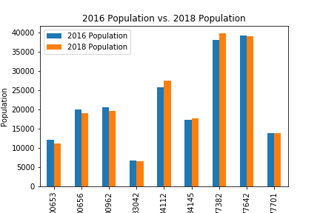
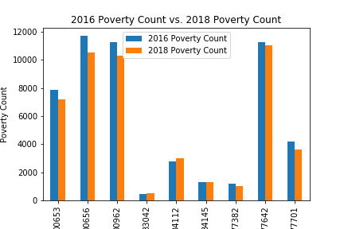
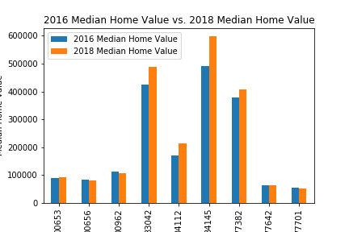
Data Analysis
Analyzed Population Bar Graph – found that population decreased after Hurricane Maria but for other storms it either dipped slightly, stayed the same or increased
Analyzed Poverty Count Bar Graph – Except for two zip codes in Florida, overall Poverty Count decreased. It could be assumed though with the drop in Population in PR the Poverty Count also decreased as there is a correlation.
Analyzed Median Home Value and found it interesting that home value increased significantly in Florida after Hurricane Irma. Expected the Texas zip codes to have a drop in Home Values in 2018 since they had heavy flooding.
Notes:
* Data Analysis
* Discuss the steps you took to analyze the data and answer each question you asked in your proposal
* Present and discuss interesting figures developed during analysis, ideally with the help of Jupyter Notebook

Slide 8
Discussion of Findings
Census data:
Expected to find that hurricanes negatively affected population, median home value and poverty count based on the destruction and damage they cause.
Found, overall across the board, they didn’t have a huge impact on those three items. Generally population still went up, median home value went up or stayed the same, and poverty count decreased in the zip codes we analyzed.
Notes:
* Discussion
* Discuss your findings. Did you find what you expected to find? If not, why not? What inferences or general conclusions can you draw from your analysis?

Slide 9
Postmortem
Difficulties that arose:
Difficult to find accessible hurricane data
Difficult to find the correct data that supported our questions
Additional questions/research if we had two weeks:
Expand the hurricanes we researched for census data
Notes:
* Postmortem
* Discuss any difficulties that arose, and how you dealt with them
* Discuss any additional questions that came up, but which you didn't have time to answer: What would you research next, if you had two more weeks?

Slide 10
Q&A
Notes:
* Questions
* Open-floor Q&A with the audience

