Slide 1
Overtemperature Protection System (independent of Arduino)
Thermal Regulator board
(repurposed from old solar hot water controller)
Overtemp Cutout board
Plug B
Pin3=grn=thermistor1
Pin5=blk=thermistor2
Red +5V
Blk Gnd
Yellow = thermistor reading
Green = cutoff (0 = latched)
Y+G maybe swapped
To pump relay
240VAC(L)
B
1
5
2
4
3
View from outside

Slide 2
A
B
1
5
1
5
2
4
2
4
3
3
View from outside
View from outside
Pinout:
1=+5V Arduino
2=Gnd Arduino
3=Surgetank Level Switch
4=Onewire temp sensors
5= NC
Shell= NC
Pinout:
1=NC
2=Gnd
3=Overtemp sensor1
4=Solar sensor
5=Overtemp sensor2
Shell=NC

Slide 3
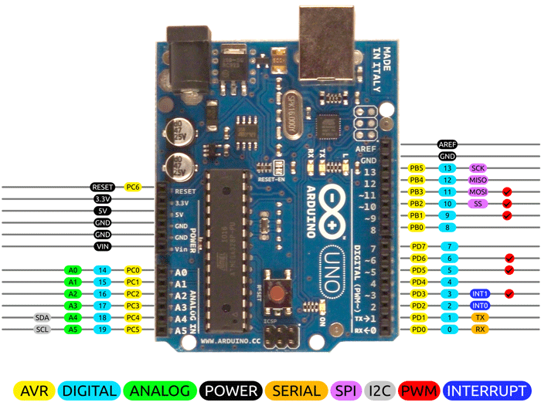


+12VDC plugpack in
Relay Board
#define DIGPIN_TEMP_PROBES_ONE_WIRE_BUS 2
#define DIGPIN_PUMP 3
#define DIGPIN_CHIPSELECT_SDCARD 4
#define DIGPIN_SURGE_TANK_LEVEL 5
#define DIGPIN_CHIPSELECT_ETHERNET 10
#define DIGPIN_STATUS_LED LED_BUILTIN // expect 13
#define ANLGPIN_SOLAR_INTENSITY_PIN A4
8V
GND
From pin3 pump control
Realtime clock
Status LED
on case
plugA1(+5V)
520
plugA2(Gnd)
Ethernet
Shield
B=GND from Relayboard
8V from Relayboard
3k3
plugA3
plugB4
(solar sensor)
plugA4
relayboard
7R2
GND
Arduino UNO

