Slide 1
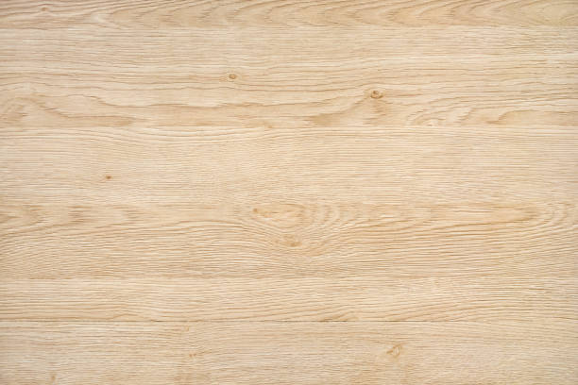
1
Hours
Remaining
Lock
Open
8
4
12
2
16
1
24
Lock Duration (hours)
Push Open. Put stuff in box. Close lid till it clicks.
Turn dial to the desired lock duration, push Lock.
When lock duration expires, box opens itself.
(Optional): to see remaining hours, push Open. Each blink = 1 hour (rounded up)

