Slide 1
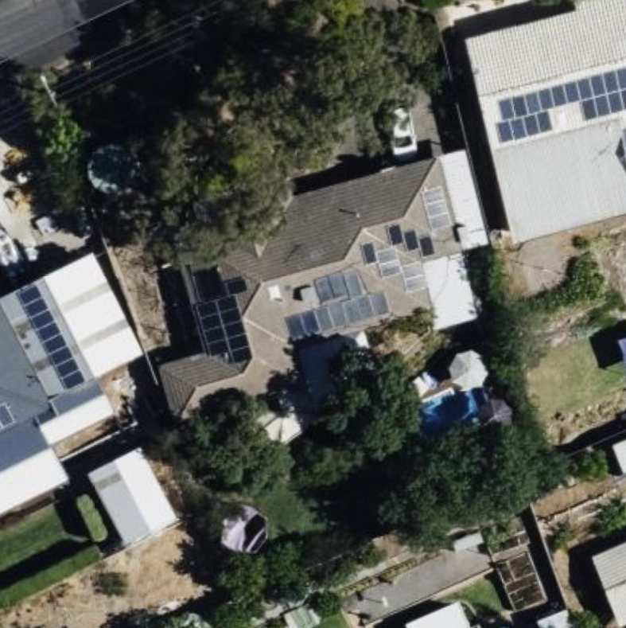
E
24VAC for solenoids
RS485 comms loop
5V for chips
5V for power
D
C
J1
J3
J2
A
B

Slide 2
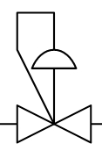

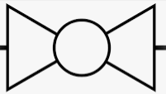


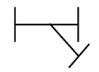

Current
E
Veg garden
VA2
P1
Lawn upper right
VA1
C
mains
Lawn lower
B
Lawn upper left
A

Slide 3
New
E
Veg garden
VA4
P1
Lawn upper right
VA1
C
mains
VA2
VA3
Lawn lower
B
Lawn upper left
A

Slide 4
Blue
brown
10A
E
D
0.5mm2
4 A
Red
White
Black
Blue
Green
J1
J3
C
Telecom
Red in+
Blue in-
White out+
Black out-
J2
A
B

Slide 5
RS485 comms loop example
Blue = in
Black = out
Analagous for
Red = in
White = out

Slide 6
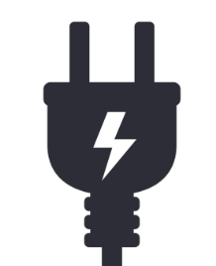

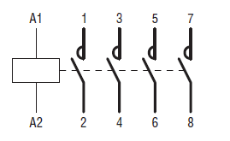

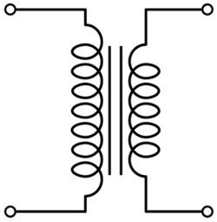
Current
1A
VA1
24VAC
0.85A
VA2

Slide 7

New
Tortech 24 VAC 12.5 A
VA2,VA3,VA4: Toro micro 20mm
1012316B
24VAC Inrush 0.5A Holding 0.3 A
Pump or mains
5A
VA1: Holman 25mm VHF5125T
24VAC inrush 0.4A holding 0.25A
1A
Lawn
switch
VA1 (mains)
24VAC
0.85A
VA2
VA3
24VAC
0.85A
5A
Red irrigation cable:
Red = 24VAC pilot(A)
Black = 24VAC pilot(N)
White = Lawn switch return
Green = 24VAC main (A)
Blue = 24VAC main(N)
VA4

