Slide 1
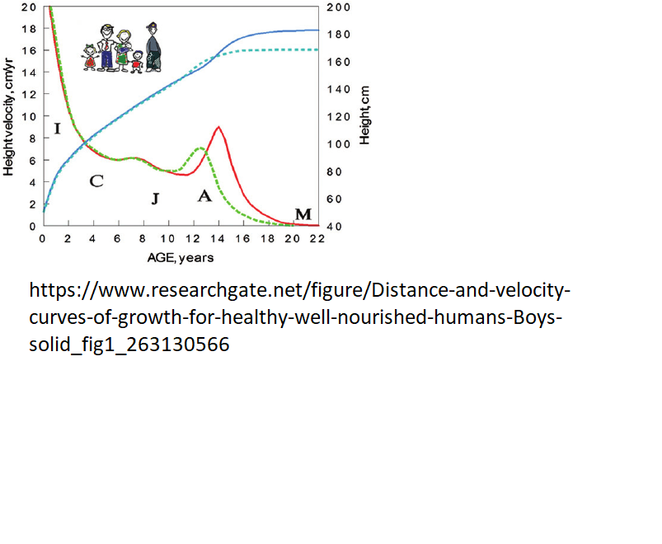
20 years Fully grown adult: body = eye height = 2m roughly
0 years Baby = tiny, say 0.1 m
5 years A child 0.5 m
12 Teenager 1 m
Orange growthrate curve – size per year
Initial slow growth
Plateau growth during child
Peak growth during juvenile
Zero growth once adult
Peak growth
child
young
hatchling
infant
adult

Slide 2
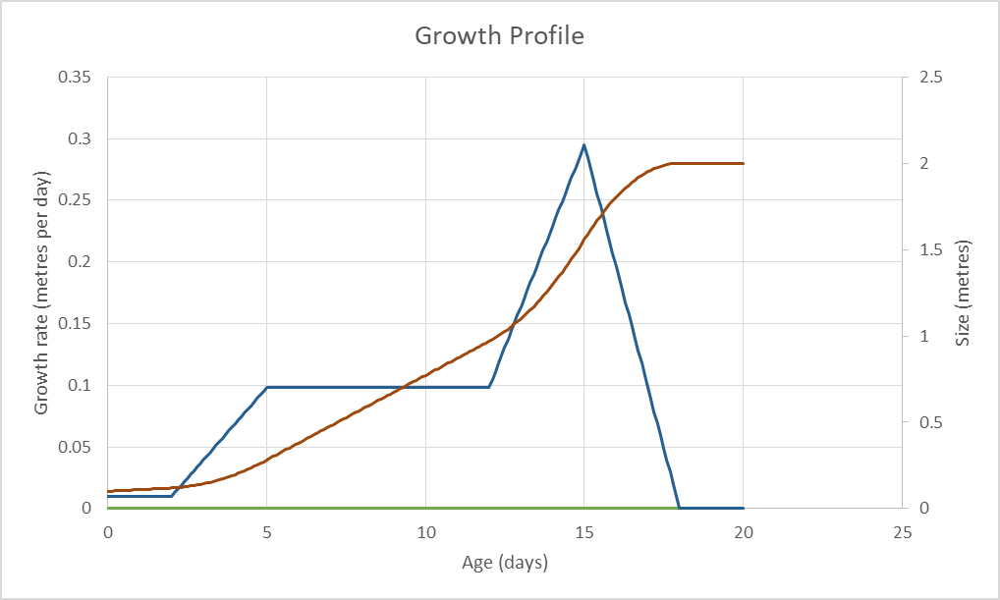
PeakTeenGrowthRate
ChildGrowthRate
HatchlingGrowthRate
Child
Adult
Infant
Hatchling
LateTeen
Early Teen
PhysicalSize follows a growthrate profile

Slide 3
Physical Maturity
Emotional Maturity
Breath Weapon Maturity
EmotionalMaturityLateTeen
EmotionalMaturityEarlyTeen
These follow a defined curve,
Not a growth rate
EmotionalMaturityChild
EmotionalMaturityInfant
Child
Adult
Infant
Hatchling
LateTeen
Early Teen

