Slide 1
[-8,0,+8]
Z
[-0.5, 1.5, -0.5]
Y
[-1, 3, -1]
Y
X
X
X
Z
Z
[8,16,-8]
groundY = 24
[0.5,0.5, 0.5]
[1,1, 1]
Entity position
Y
Entity position
Entity position
ModelSpace
coordinates
BaseSpace coordinates
WorldSpace coordinates
(scale = 2 for
GLStateManager.scale()
In PreRenderCallback)

Slide 2
Rotation point
for body pitch
[-0.5, 1.5, -0.5]
Y
[-1, 3, -1]
Y
4
X
X
X
Z
Z
Z
[8,16,8]
groundY = 24
[0.5,0.5, 0.5]
[1,1, 1]
Entity position
Y
Entity position
Entity position
BaseSpace coordinates
WorldSpace coordinates
(scale = 2 for
GLStateManager.scale()
In PreRenderCallback)
rotationPos for body
And offsetXYZ

Slide 3
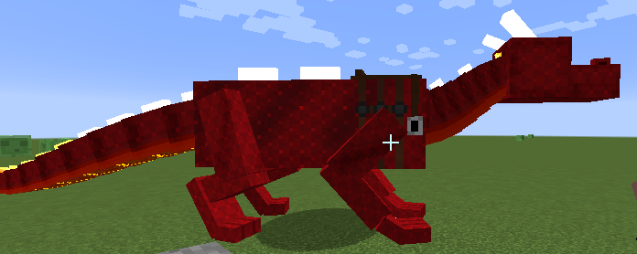
Rotation point for pitch
Body origin
Positive pitch
head
Entity [posX, posY, posZ]
a
Pitch θ
Rotation point
b
Body origin
a
c
head
d
e
Want e. Know a, c, d.
Calc b = c – a.
Rotate b by θ.
e = d + a + b{rotated}

Slide 4
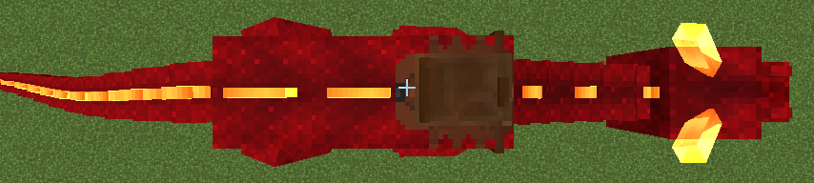
Rotation point
Body origin (BC)
head

Slide 5
Body pitch rotation point: offsetXYZ [0, -1.5, -1.5] plus vanilla offset of y=-1.5 places the origin here, i.e. 24 body + 24 vanilla offset above the ground and 24 forward of the entity zpos
Rotation point for
Body pitch [0, -4, -8]
The body.setRotationPoint(0, 4, 8) is the translation of the model origin relative to the body pitch rotation point, i.e. from [0,-4,-8] of the rotation point to the [0,0,0] of the body model origin
Body model origin[0,0,0]
z
Y=0
Y=12
head
y
Y=24
Y=44
While standing
Origin of first neck segment
Y = 10, Z=-16
But the code rotationPoint=[0,14,-8]
Z =48
Z =16
Z =-16
Entity
Origin
(posXYZ)
This is relative to the
Main body pitch rotation point which is
[0, -4, -8]
Relative to the body model origin it is [0, 10, -16]
private void buildBody() { body = new ModelPart(this, "body"); body.setRotationPoint(0, 4, 8); body.addBox("body", -12, 0, -16, 24, 24, 64);

Slide 6
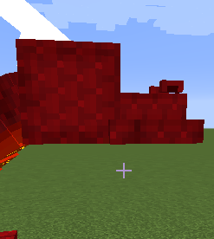
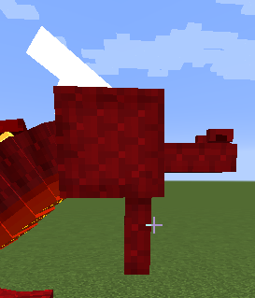
z
Y=-8
Head origin
(rotation pt)
y
Y=+8
Throat position [y=6, z=-12]
to be just beyond main head
rotationPoint (actually this is translation of the origin)
y=4, z=-8
Z =6
Z =-10
Y=0,z=0
head = new ModelPart(this, "head"); head.addBox("upperjaw", -6, -1, -24, 12, 5, 16); head.addBox("mainhead", -8, -8, -10, 16, 16, 16); head.addBox("nostril", -5, -3, -22, 2, 2, 4); head.mirror = true; head.addBox("nostril", 3, -3, -22, 2, 2, 4); buildHorn(false); buildHorn(true); jaw = head.addChildBox("lowerjaw", -6, 0, -16, 12, 4, 16); jaw.setRotationPoint(0, 4, -8);
jaw
Y=4,z=-16
Jaw rotates about its origin

Slide 7
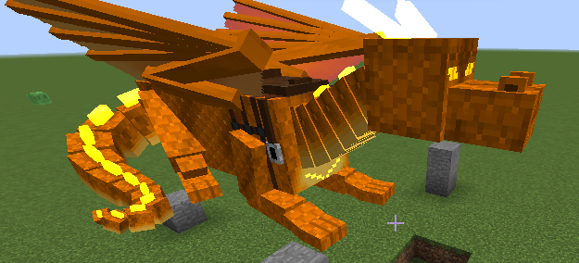
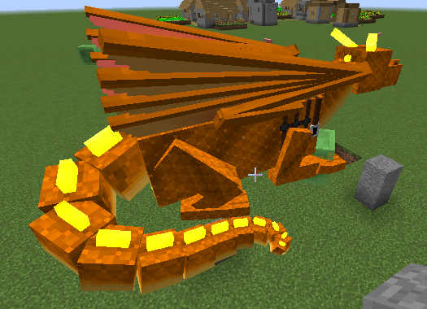
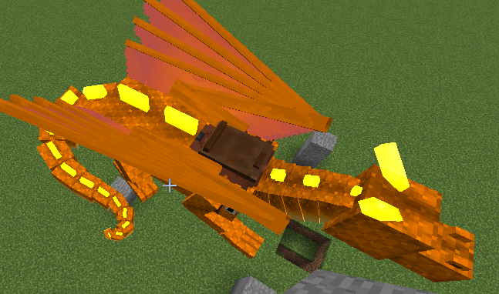
head:
upperjaw, mainhead, 2xnostril
body.ridgeplate
tailRidgePlateXXX:
Single plate
Or two (angled)
bodyRidgePlateFrontmost hidden when saddled

Slide 8
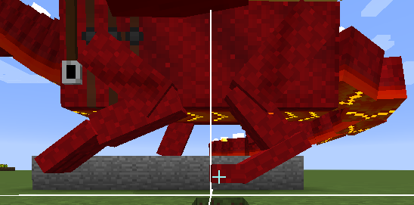
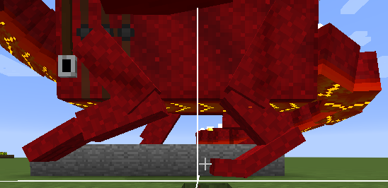
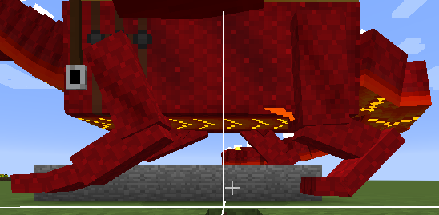
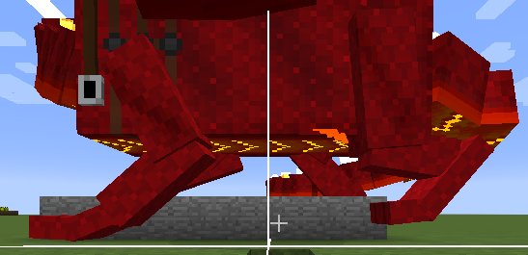
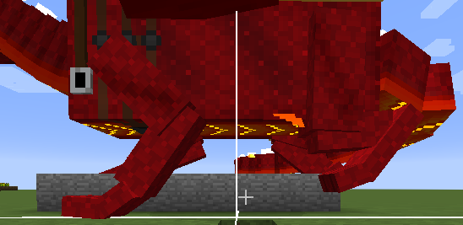
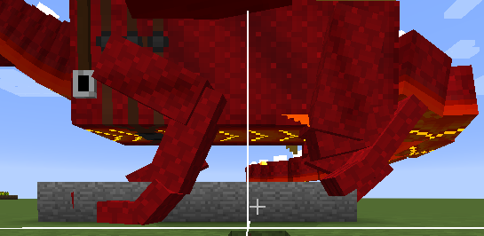
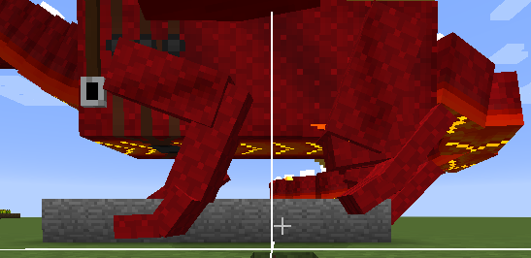

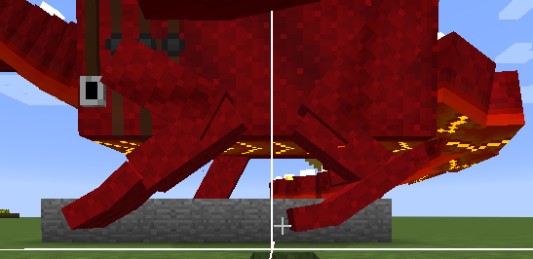
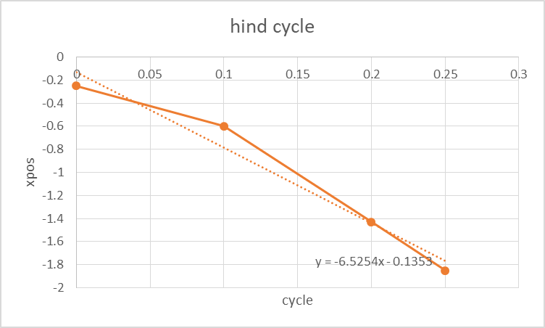
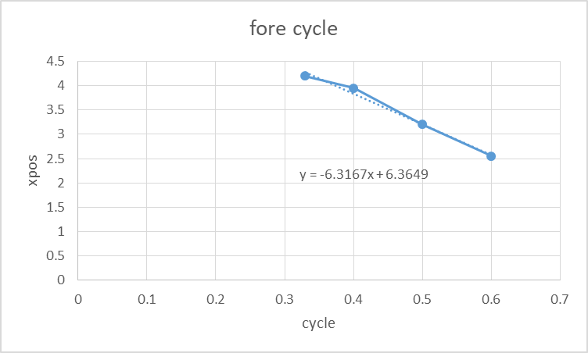
0
0.1
0.2
0.3
0.4
0.5
0.6
0.7
0.8
0.9
For a full-size dragon, render factor is
1.6x i.e. WC = 1.6BC:
Speed = ~6.4WC blocks per cycle
= 4.0 BC blocks per cycle
But each paw is only in contact with the ground for ~0.33 of a cycle
May have to tweak it. 6.8 looks a bit better = about 4.2 BC

