Slide 1
[-8,0,-8]
[-0.5, 1.5, -0.5]
Y
[-1, 3, -1]
Y
X
X
X
Z
Z
Z
[8,16,8]
groundY = 24
[0.5,0.5, 0.5]
[1,1, 1]
Entity position
Y
Entity position
Entity position
ModelSpace
coordinates
BaseSpace coordinates
WorldSpace coordinates
(scale = 2 for
GLStateManager.scale()
In PreRenderCallback)

Slide 2
Rotation point
for body pitch
[-0.5, 1.5, -0.5]
Y
[-1, 3, -1]
Y
4
X
X
X
Z
Z
Z
[8,16,8]
groundY = 24
[0.5,0.5, 0.5]
[1,1, 1]
Entity position
Y
Entity position
Entity position
BaseSpace coordinates
WorldSpace coordinates
(scale = 2 for
GLStateManager.scale()
In PreRenderCallback)
rotationPos for body
And offsetXYZ

Slide 3
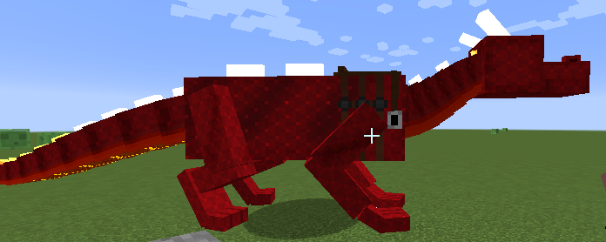
Rotation point for pitch
Body origin
Positive pitch
head
Entity [posX, posY, posZ]
a
Pitch θ
Rotation point
b
Body origin
a
c
head
d
e
Want e. Know a, c, d.
Calc b = c – a.
Rotate b by θ.
e = d + a + b{rotated}

Slide 4
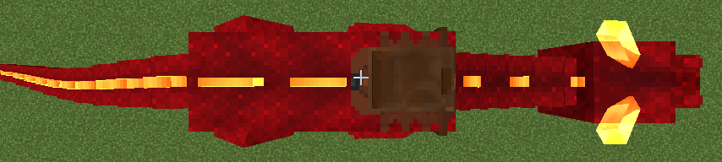
Rotation point
Rotation point
Body origin
Body origin
head
head

Slide 5
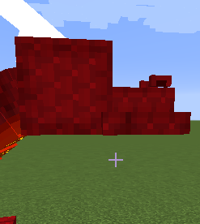
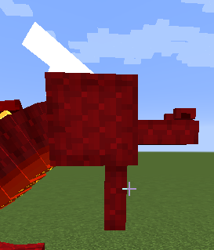
z
Y=-8
Head origin
(rotation pt)
y
Y=+8
rotationPoint (actually this is translation of the origin)
y=4, z=-8
Z =6
Z =-10
Y=0,z=0
head = new ModelPart(this, "head"); head.addBox("upperjaw", -6, -1, -8 + HEAD_OFFSET_Z_MC, 12, 5, 16); head.addBox("mainhead", -8, -8, 6 + HEAD_OFFSET_Z_MC, 16, 16, 16); head.addBox("nostril", -5, -3, -6 + HEAD_OFFSET_Z_MC, 2, 2, 4); head.mirror = true; head.addBox("nostril", 3, -3, -6 + HEAD_OFFSET_Z_MC, 2, 2, 4); buildHorn(false); buildHorn(true); jaw = head.addChildBox("lowerjaw", -6, 0, -16, 12, 4, 16); jaw.setRotationPoint(0, 4, 8 + HEAD_OFFSET_Z_MC);
jaw
Y=4,z=-16
Jaw rotates about its origin
HEAD_OFFSET_Z_MC = -16

Slide 6
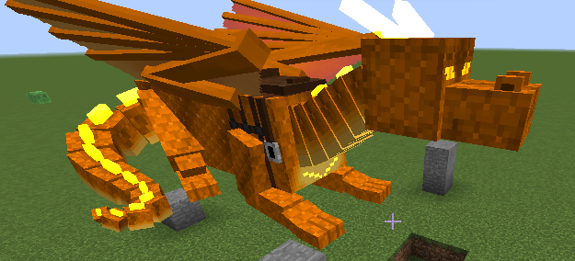
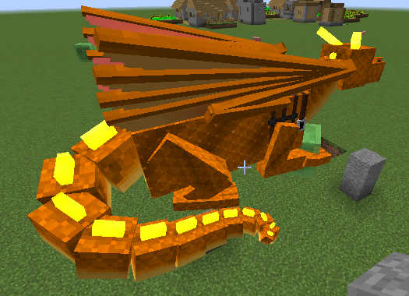
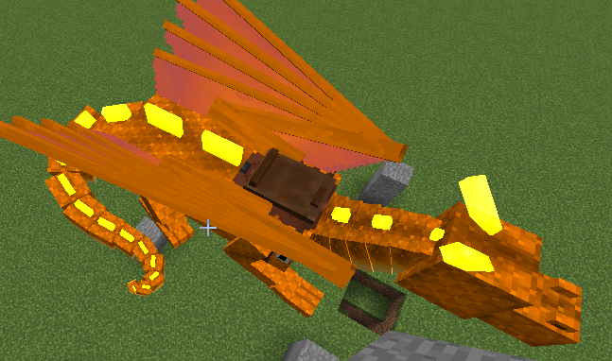
head:
upperjaw, mainhead, 2xnostril
body.ridgeplate
tailRidgePlateXXX:
Single plate
Or two (angled)
bodyRidgePlateFrontmost hidden when saddled

