Slide 1

Simply5 A Text Simplification System
Domain
Natural Language Processing
Paper ID : 1479

Slide 2


“ How can we tackle the problem of
Understanding complex text and simplify Jargons that make reading difficult ? ”

Slide 3
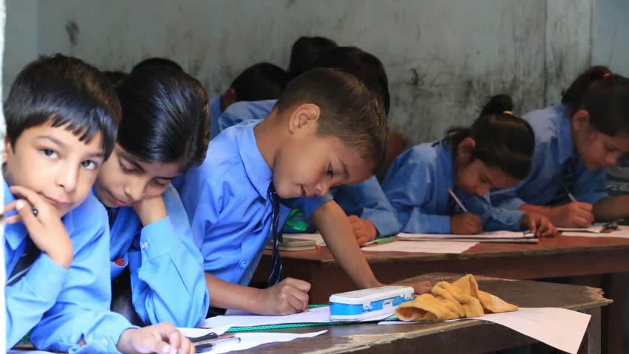
Complex Sentences.
Jargon Barriers.
Motivation
Simplify
Overcome

Slide 4
Text Simplification
Text simplification is an operation used in NLP to modify, enhance, classify or otherwise process an existing corpus of human-readable text in such a way that the grammar and structure of the prose is greatly simplified, while the underlying meaning and information remains the same.

Slide 5
Methodology
Complex Sentence
Syntactic Simplification
Lexical
Simplification
Sentence Generation
Simplified Text

Slide 6
Syntactic Simplification
Syntactic simplification is the process of reducing the grammatical complexity of a text, while retaining its information content and meaning.
The man who Sarah loved walked by.
The man walked by.
Sarah loved the man

Slide 7
Analysis
The man who Sarah loved walked by.
who Sarah loved
walked by.
The man

Slide 8
Transformation
who Sarah loved
walked by.
The man
walked
by
Sarah
loved
The man
The man

Slide 9
Generation
The man walked by.
Sarah loved the man.
The man
walked
by
Sarah
loved
The man

Slide 10
Lexical Simplification
Lexical Simplification is a sub-task of text simplification. It can be defined as any lexical substitution task that reduce text complexity, by substituting a simpler word or a set of words.
The cat perched on the mat.
The cat sat on the mat.

Slide 11
Lexical Simplification Pipeline
Input Text
1
Identification of
Complex Words
2
The cat perched on the mat.
Substitution Generation
The cat perched on the mat.
3

Slide 12
Word Sense
Disambiguation
Perched
rested, sat, roosted, settled
4
Perched
rested, sat, roosted, settled
Synonym Ranking
5
OUTPUT
#1) sat #2) rested
#3) settled
6
The cat perched on the mat.

Slide 13
Sentence Regeneration
The process of fitting the lexically simplified meaning of the difficult word into the sentence such that it fits the context and is grammatically and semantically correct.

Slide 14
In today’s world, a floppy disk is an anachronism.
Original Sentence
In today’s world, a floppy disk is an something located in a time
where it should not have been placed.
Lexical Simplification
In today’s world, a floppy disk is an something located in a time
where it should not have been placed.
Rule Base
In today’s world, a floppy disk is something located in a time
where it should not have been placed.
Output

Slide 15



Target Audience

Slide 16


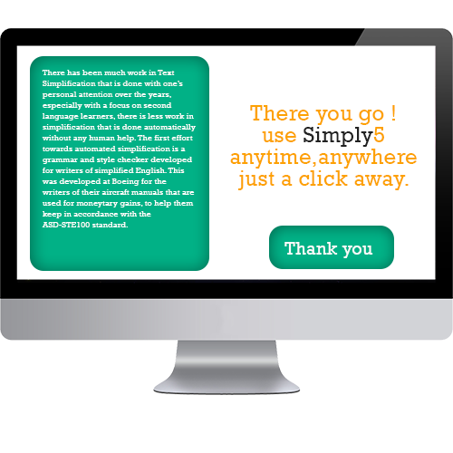
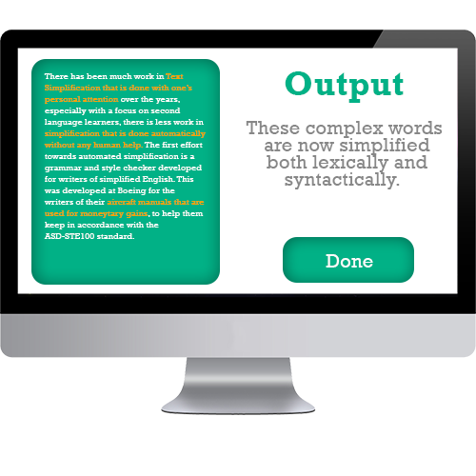


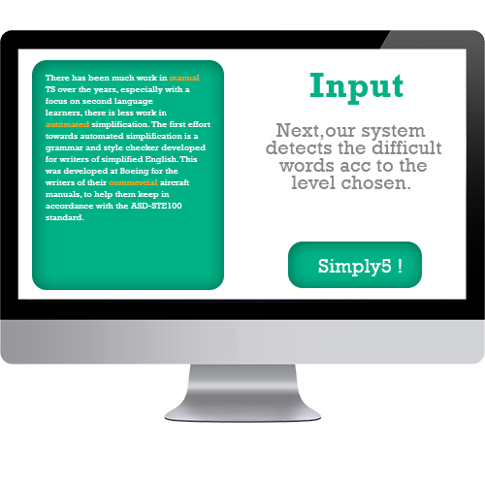

Slide 17
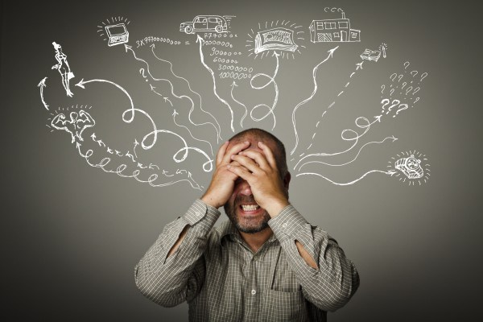
Simply5

