Slide 1
What Is Data Science?
Allen Grimm
Grimm Science Consulting
TheGrimmScientist@gmail.com
June 30th, 2014

Slide 2
“The study of the generalizable extraction of knowledge from data” - Wikipedia
“A combination of computer hacking skills, contextual expertise,
and stats knowledge” - Revelytix
“Making data work” - Strata Conference
“Almost like a Renaissance individual who really wants to learn and bring change to an organization.” - IBM
“Delivering on the promise of big data.” - Predictive Analytics World
“Have a deep passion for applying advanced analytic approaches, an eagerness to dig into the data, and a vision for turning disparate data streams into a cohesive view of our global consumers” - Nike job description

Slide 3
Data is Potential Knowledge

Slide 4
Data is Potential Knowledge
Knowledge Empowers Better Decisions

Slide 5
Buzzwords, and Where Data Helps
Data
Data
Business Intelligence
Analytics
Data Mining
Reporting
Machine Learning
Computational Intelligence
Artificial Intelligence
Predictive Analytics
Predictive Modeling
Content to help
human decision making
Content to help
computer decision making

Slide 6
Data Science Roles
Liaison between machine learners and business people
Integrate and use disparate data sources
Manage / manipulate big data
Data savvy product manager

Slide 7
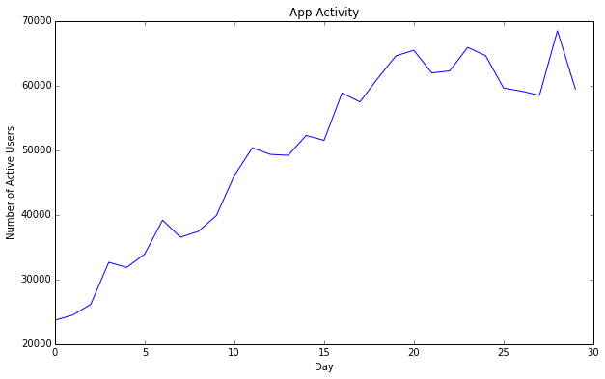
Example: Membership
Raw data:
user | date
1 | 5/1
1 | 5/1
1 | 5/1
1 | 5/4
1 | 5/5
1 | 5/6
2 | 5/3
2 | 5/3
3 | 5/2
3 | 5/3
… | …

Slide 8
Churn Prediction
Based on patterns in past behavior, learn model:
f
Activity two weeks ago
Activity last week
[known]
[known]
[unknown]
Model
Generate predictions on future behavior:
Model
Activity last week
Predictions for this week
[known]
[unknown]
[known]
Predictions

Slide 9
AB Testing
Determine the best action to take for a specific group:
Looking only at users likely to leave:
Treatment: | Original Population: | Population Remaining
Control | 4000 | 756
Email | 4000 | 642
Gift | 4000 | 1108

Slide 10
Other Examples (More Buzzwords)
Behavior Prediction
Ad Optimization
Response Modeling
Your credit score
Cohort Analysis
Clustering
Time Series Forecasting
Virality Modeling
Natural Language Processing
Fraud / Outlier Detection
Failure Prediction

Slide 11
Size of Data Needed
Size of data
Size of sensible decision
N=10
“Does my app work?”
N=10k
“What's the conversion rate for different images in an ad?”
N=10MM
“Should the open button be blue or teal?”

Slide 12
Thanks!
Data is potential knowledge
Knowledge empowers decisions
Data Science is the new word for the old problem of using data to help with decision making
Allen Grimm
Grimm Science Consulting
TheGrimmScientist@gmail.com

