Slide 1
The Data Science Process
- Or how I contextualize all the work I do.
Allen Grimm
Grimm Science
allen@GrimmScience.com
#GrimmScientist

Slide 2
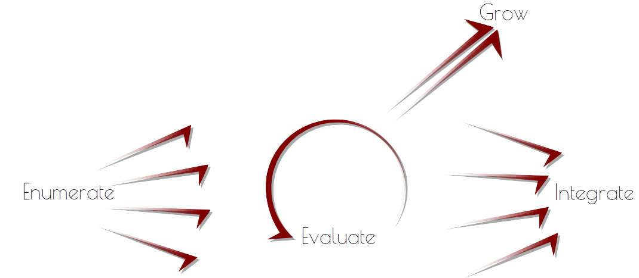

Slide 3


Slide 4
Enumerate Points of Leverage
This is a business problem.
“Where does decision making and data intersect?”
Examples:
  Made-up bank: Fraud detection
  UpSight: Churn Prediction
  U.S. Bank: Uplift Modeling

Slide 5
Example: Fraud Detection
Data Available:
  Historic monthly sales data.
  1M Customers
Business Problem:
  Identity theft happens to 0.1% of users yearly
  Avearge $5k in losses per attack
  Results in annual damages of $500M damages
Goal:
  Early fraud detection

Slide 6
Example: Churn Prediction
Data:
  5k integrated games
  130M unique users
  2.5B game sessions
Business Problem:
  User acquisition is expensive
Goal:
  Retain more of the current users by detecting and taking action on users likely to leave

Slide 7
Example: Uplift Modeling
Data Available:
  Banking data for all users
    (currently) Over 15MM customers
    (currently) Process 4B checks annually
    (at the time) Held $282B in assets
Business Problem:
  Failing Marketing Campaigns
Goal:
  Better targeting of users

Slide 8


Slide 9
Evaluate Points of Leverage
This is a machine learning problem
Questions:
  “How should the data be modeled?”
  “What expected return can I expect on model application?”
Deliverables:
  Estimated model accuracy
  Projected value of initiative

Slide 10
Example: Fraud Detection
Fraud detection is usually done by first learning “normal behavior” then looking for deviations from normal.
70% fraud detection within first 3 days
Projected savings of 500M * .7 = 350M

Slide 11
Example: Churn Prediction
Historic time series in, expected future time series out
Technique: Discrete Multivariate Modeling
Toolset:
  Raw data pre-aggregated by Redshift
  Model initially built and ran in pure python
  Eventually started writing bottlenecks in hadoop streaming
Model had over 75% accuracy

Slide 12
Example: Uplift Modeling
Uplift Modeling Algorithm:
  Take sample of users
  Try various content on sampled users
  Apply most successful content to rest of users
(Case study didn't give Evaluate details beyond their model being sufficient to Integrate)

Slide 13


Slide 14
Integrate Initiative Into Product
This is an engineering problem.
Highest commitment, but also the point.
“How can the prescribed model best be integrated into our system?”
Deliverable:
  Automated re-training and application of the model, as applied to the chosen business problem.

Slide 15
Example: Fraud Detection
30% attacks not caught averaging $5k in damages
70% attacks caught early averaging $1k in damages
Say, 5MM expense of bulding infrastructure to freeze accounts.
Net damages now 225M (down 50%)

Slide 16
Example: Churn Prediction
Last I heard, not actually integrated.
Intended to mark certain users as most likely to leave, allowing for a highly-targeted uplift modeling initiative. End goal was to increase user engagement.

Slide 17
Example: Uplift Modeling
300% increase to cross-sell revenue
Over 1MM in increased revenue from initial campaigns
73% increase in direct deposit usage
40% less mail sent
Model reported to be used elsewhere in the business, too

Slide 18


Slide 19
Grow Your Data Science Team
This is a management problem.
Enumerate:
  Need to speak both business and data at the basic level
  Experience with data structures and basic modeling techniques.
Evaluate:
  The broader the machine learning experience, the better for enabling the enumerate step.
  The deeper the machine learning experience, the faster you'll generate nice, niche, models.
Integrate:
  Engineers with enough math to understand the Evaluate Reports?
  Machine learners the programming chops to write product code? Your choice.

Slide 21
Takehomes:
Enumerate – Evaluate – Integrate – Grow
Keep data science grounded in business
Iterating on an already Evaluated problem is done at the expense of Iterating on a new problem
For the new data scientist:
  Find an interesting dataset (from your work?)
  Install Anaconda (specialized Python dist.)
  Play with your data and SKLearn
PortlandDataScience.com

Slide 22
References
Churn Prediction Presentation at PyData:
  http://vimeo.com/79533999
U.S. Bank Case Study:
  Current stats: en.wikipedia.org/wiki/U.S._Bancorp
  Case study: bit.ly/US_bank_uplift_modeling
Anaconda:
  http://continuum.io/downloads

