Slide 1




ELECTRONIC ARTS BUSINESS ANALYSIS
Zhanuzak Raiymbek
220107020
Kanat Nuradil
220107097

Slide 2
INTRODUCTION
This analysis delves into Electronic Arts (EA) and its operations, examining customer demographics, financial performance, game portfolio, and market positioning. By leveraging diverse datasets, the study uncovers patterns in EA's consumer base, scrutinizes its fiscal health, and provides actionable insights, aiming to deepen understanding of EA and the evolving landscape of interactive entertainment.

Slide 3
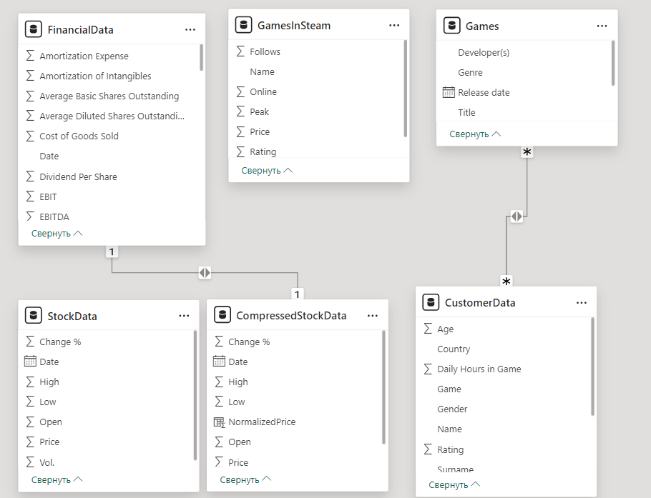
DATA COLLECTION

Slide 4

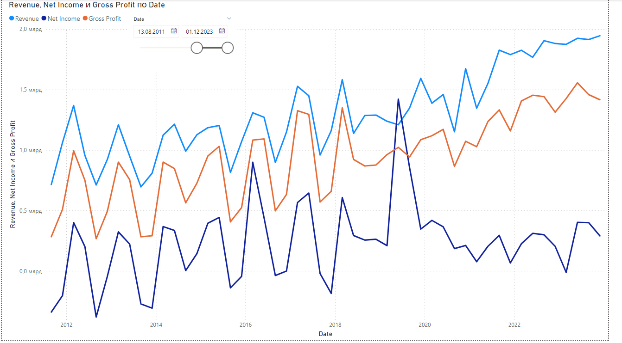
VISIO.1
Financial data

Slide 5
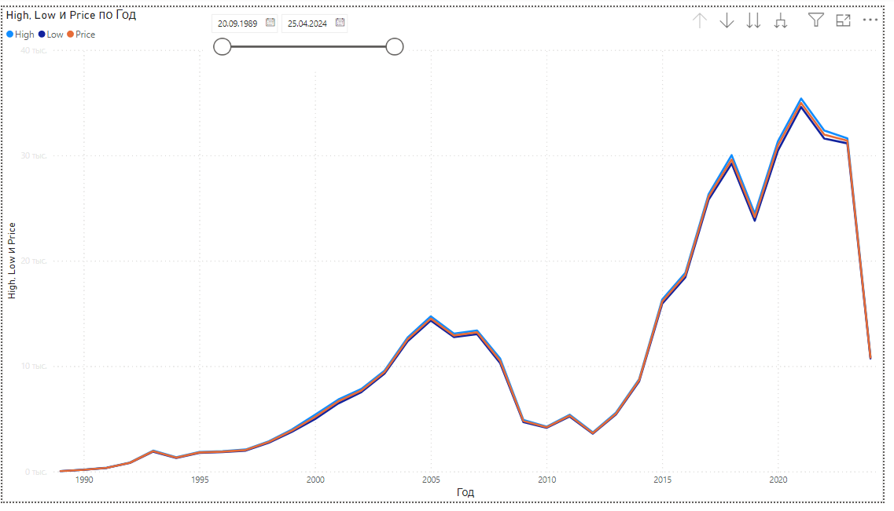
VISIO.2
Stock price

Slide 6
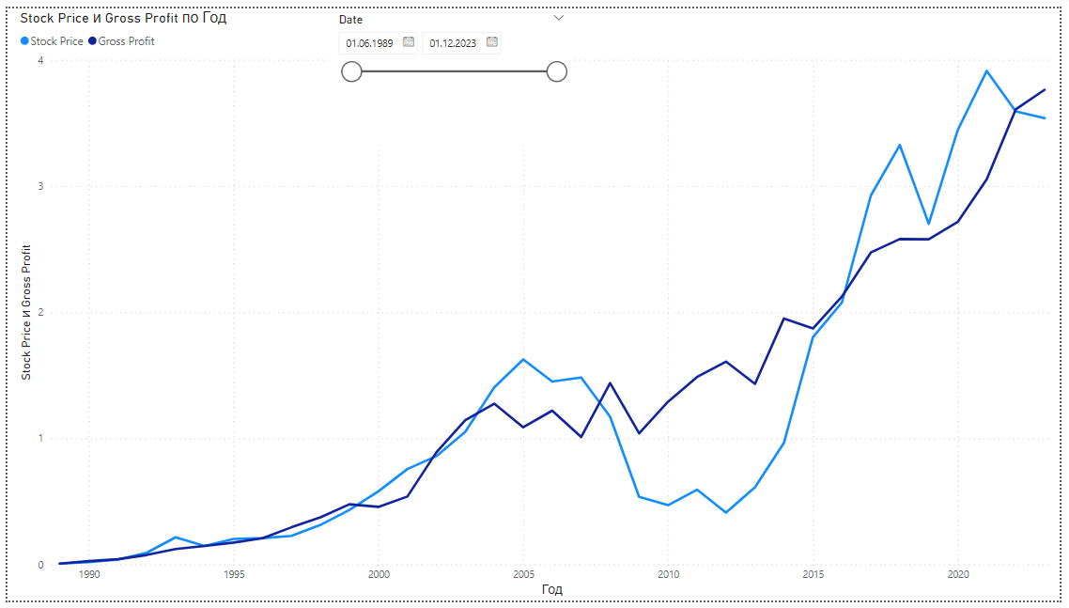
VISIO.3
Stock Price and Gross Profit comparing

Slide 7
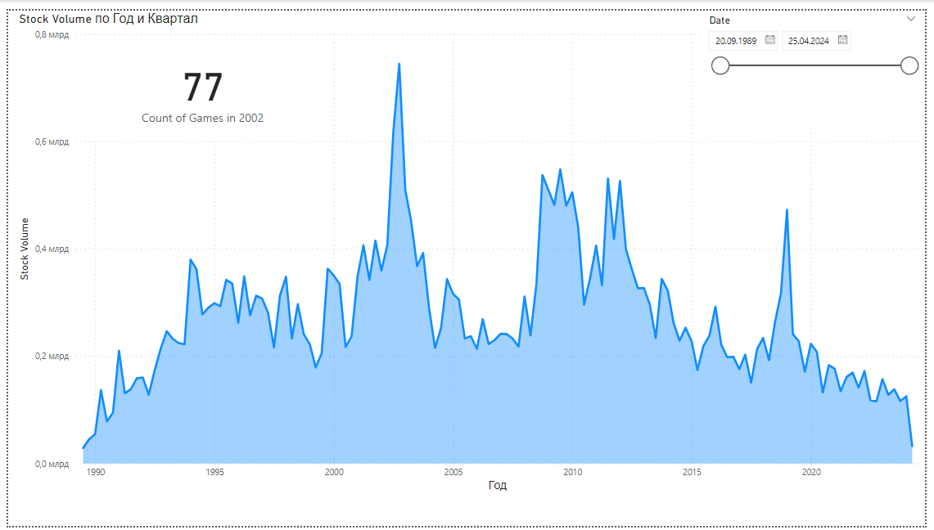
VISIO.4
Stock sales volume

Slide 8
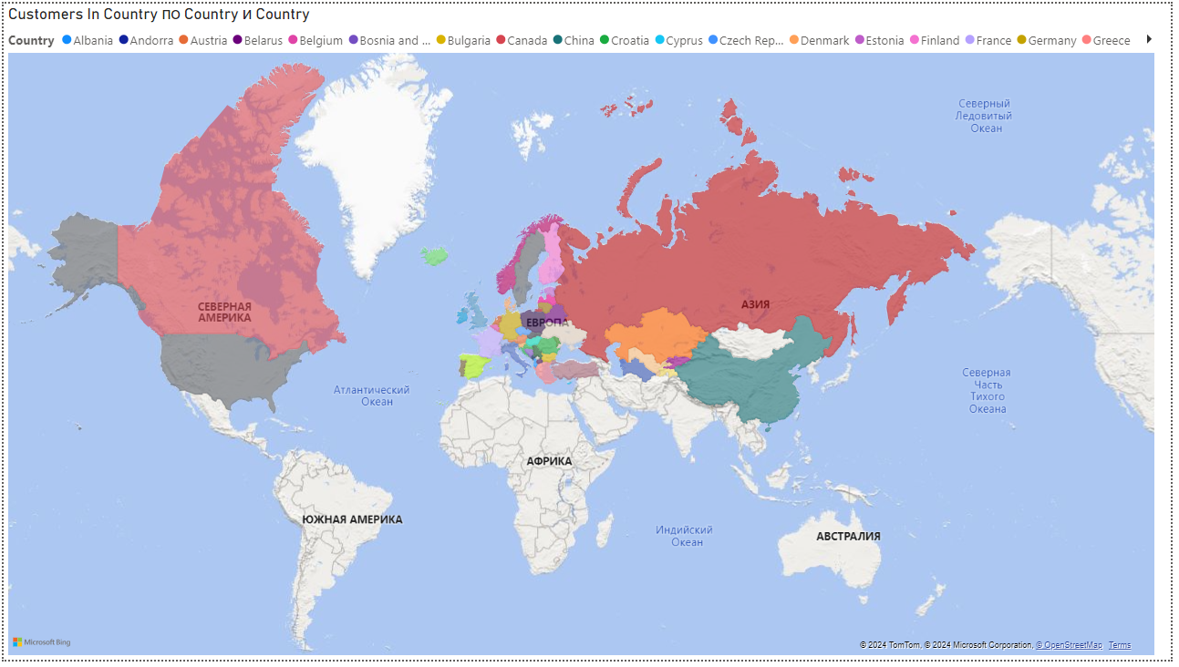
VISIO.5
Customers around World

Slide 9
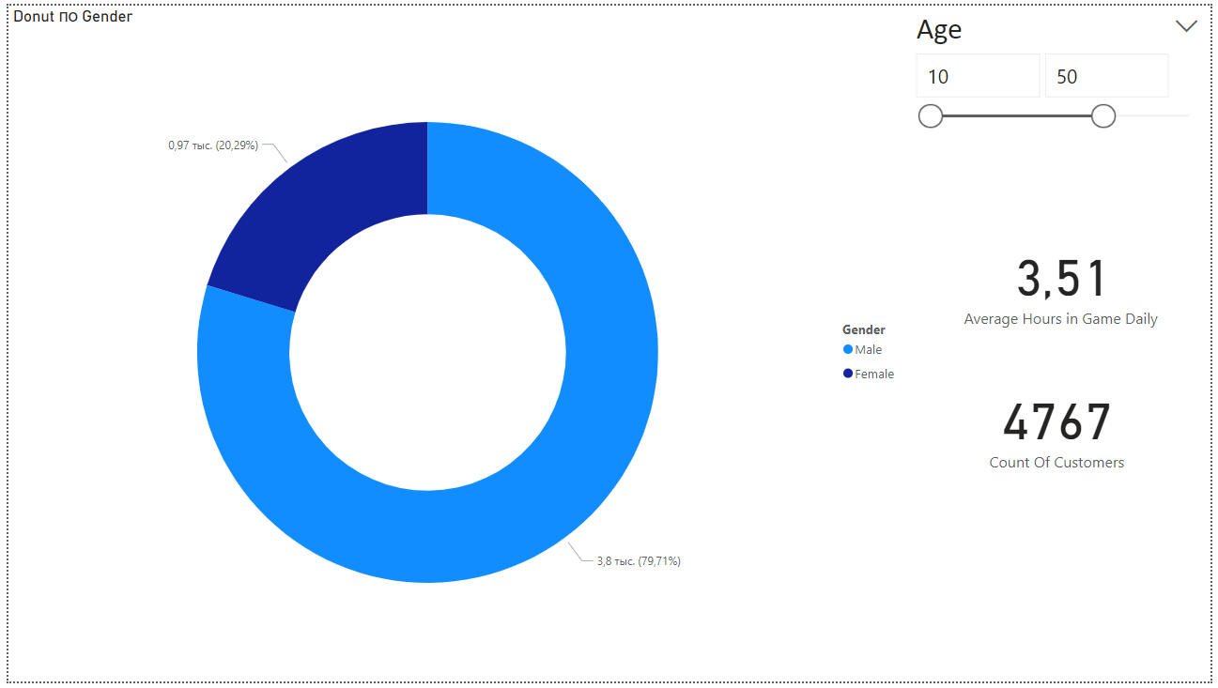
VISIO.6
Customers Statistics

Slide 10
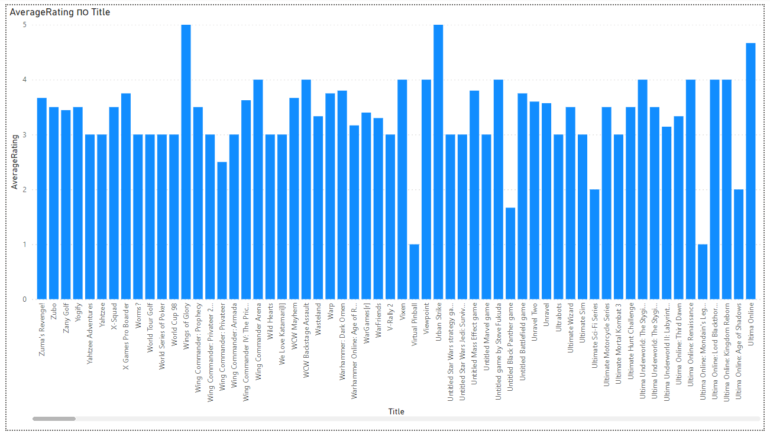
VISIO.7
Average Rating of all Games by customer data

Slide 11
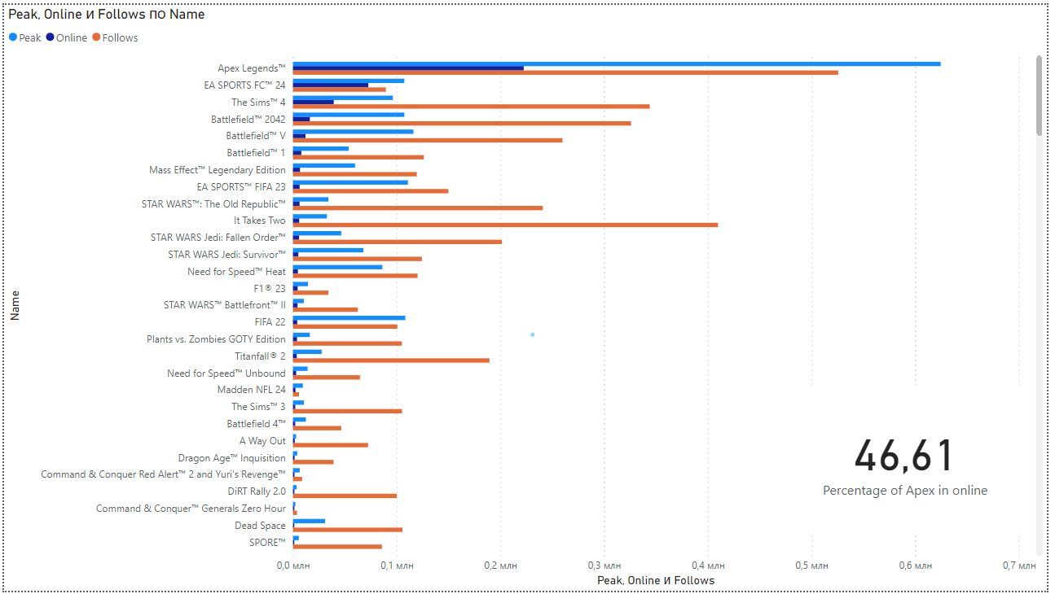
VISIO.8
Electronic Arts games in Steam

Slide 12
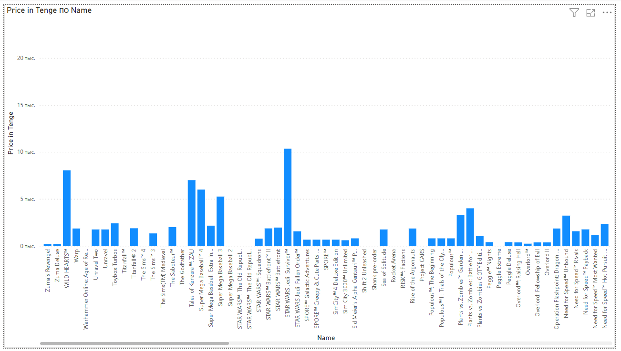
VISIO.9
Visualization of Price of Games

Slide 13
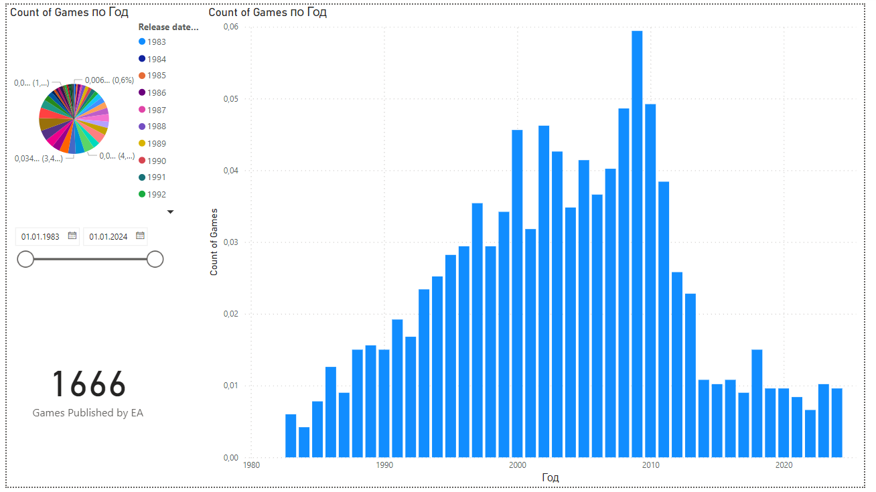
VISIO.10
Dynamics of game releases by year

Slide 14
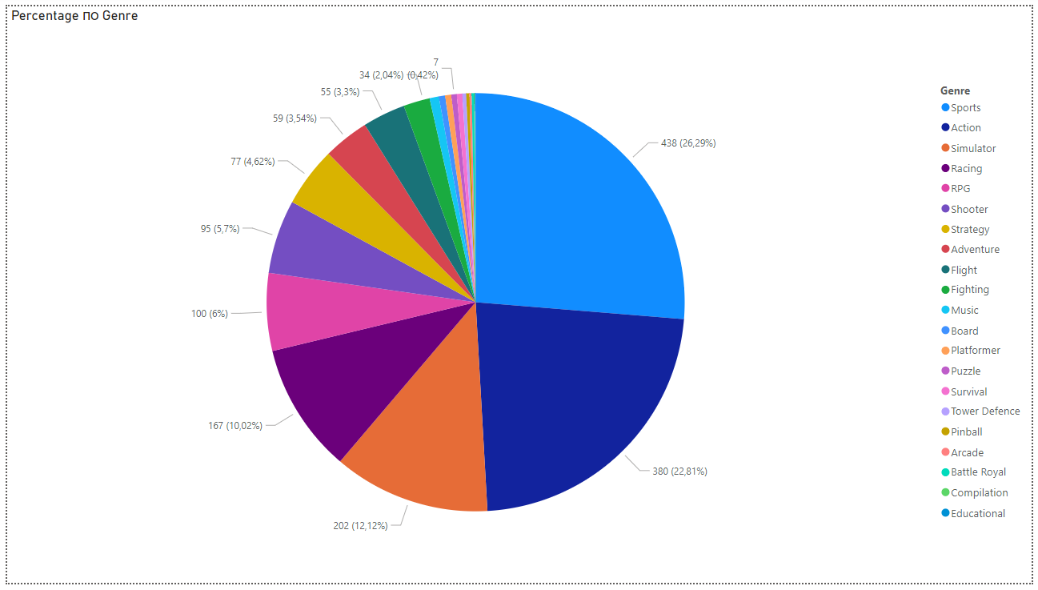
VISIO.11
Genre of Games

Slide 15
CONCLUSION
The analysis of Electronic Arts (EA) provides insights into its market performance, financial resilience, and customer behavior. Despite economic challenges, EA maintained strong finances and experienced income growth during the pandemic. Varied customer demographics and genre preferences highlight opportunities for targeted marketing and innovation in the gaming industry.

Slide 16
THANK'S FOR WATCHING

