Slide 1

Data Analysis
Xiaomi vs Samsung
Zhanuzak Raiymbek

Slide 2

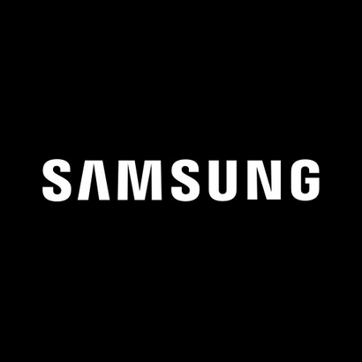
Introduction
Chinese corporation founded by Lei Jun in 2010. In 2021, it became the leader in smartphone production volume. It also produces household appliances, tablets, smart watches, software, electric scooters, electric bicycles and much more.
South Korean group of companies, one of the largest chaebols, founded by Lee Byung-chul in 1938. It produces electronics, machinery, chemical products, and is also involved in heavy manufacturing, construction, etc.
Both of them are mainly known for the production of smartphones and they are both eastern companies and I was interested in comparing them.

Slide 3

Research and scraping
I took data from two websites, www.technodom.kz to compare products, ratings and reviews and www.investing.com to compare stocks and sales volume. To answer I used python code with pandas and numpy libraries. Then I maked plots and charts by using matplotlib library.

Slide 4
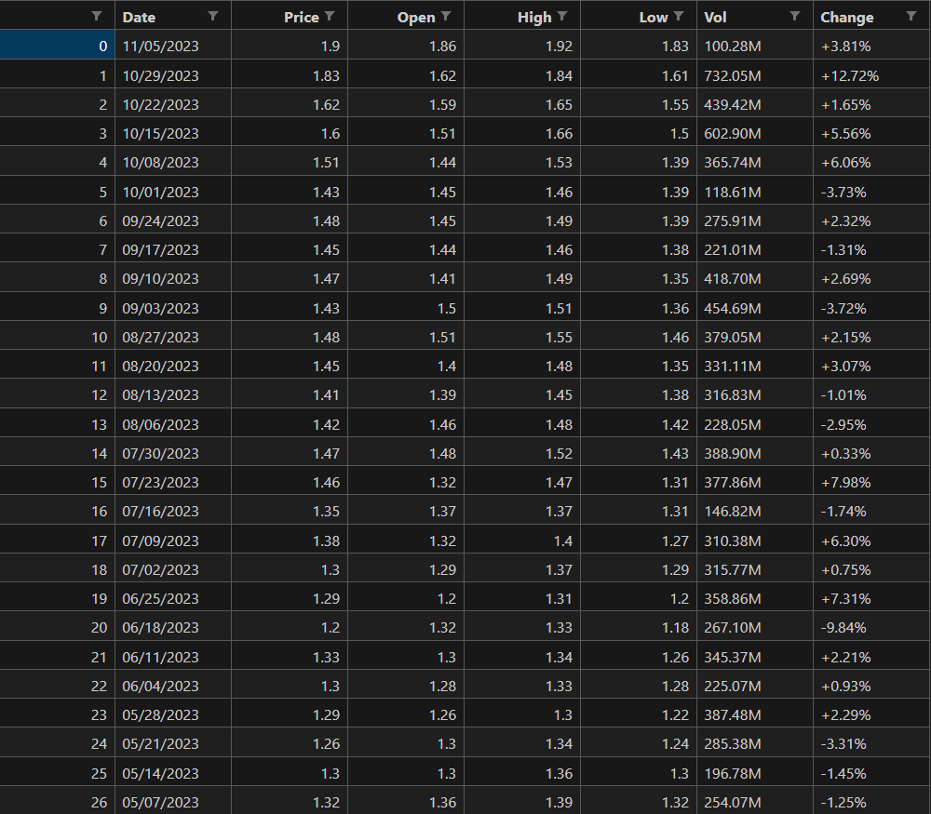
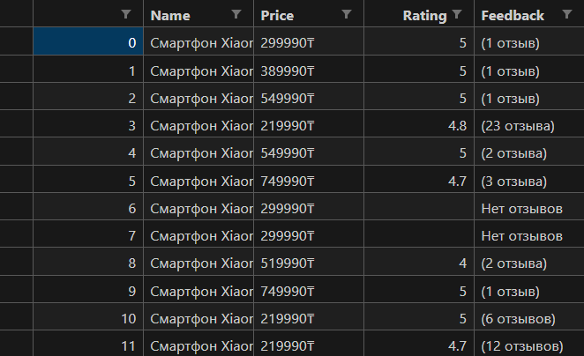
Websites and tables
For my project, I chose technodom to compare products and investing to compare shares of both companies and I came up with four tables.
Example of tables of Xiaomi:

Slide 5

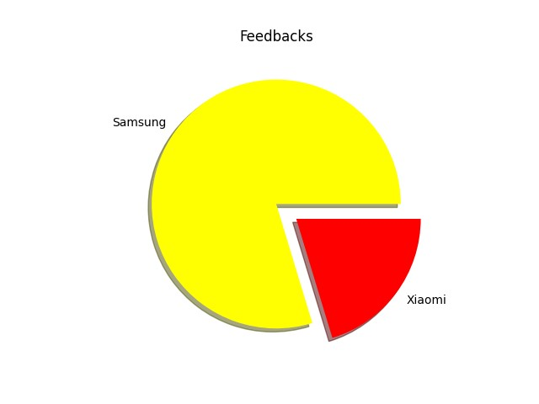
Data Visualization
For visualizing them i used matplotlin library in python and made 4 plots. 10 questions with answers are in the pdf file.
Feedbacks:

Slide 6
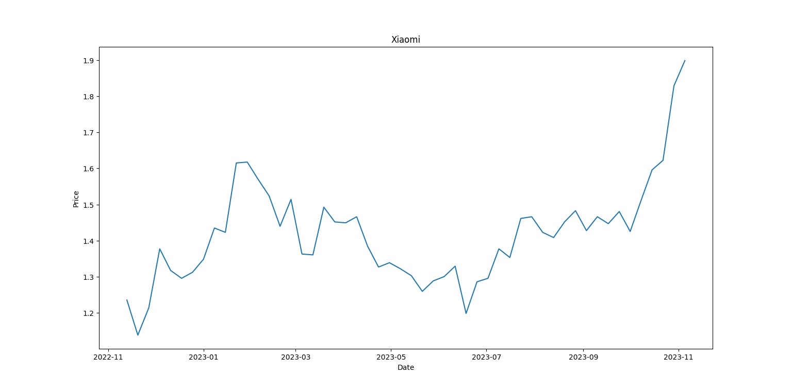
Xiaomi’s shares chart

Slide 7
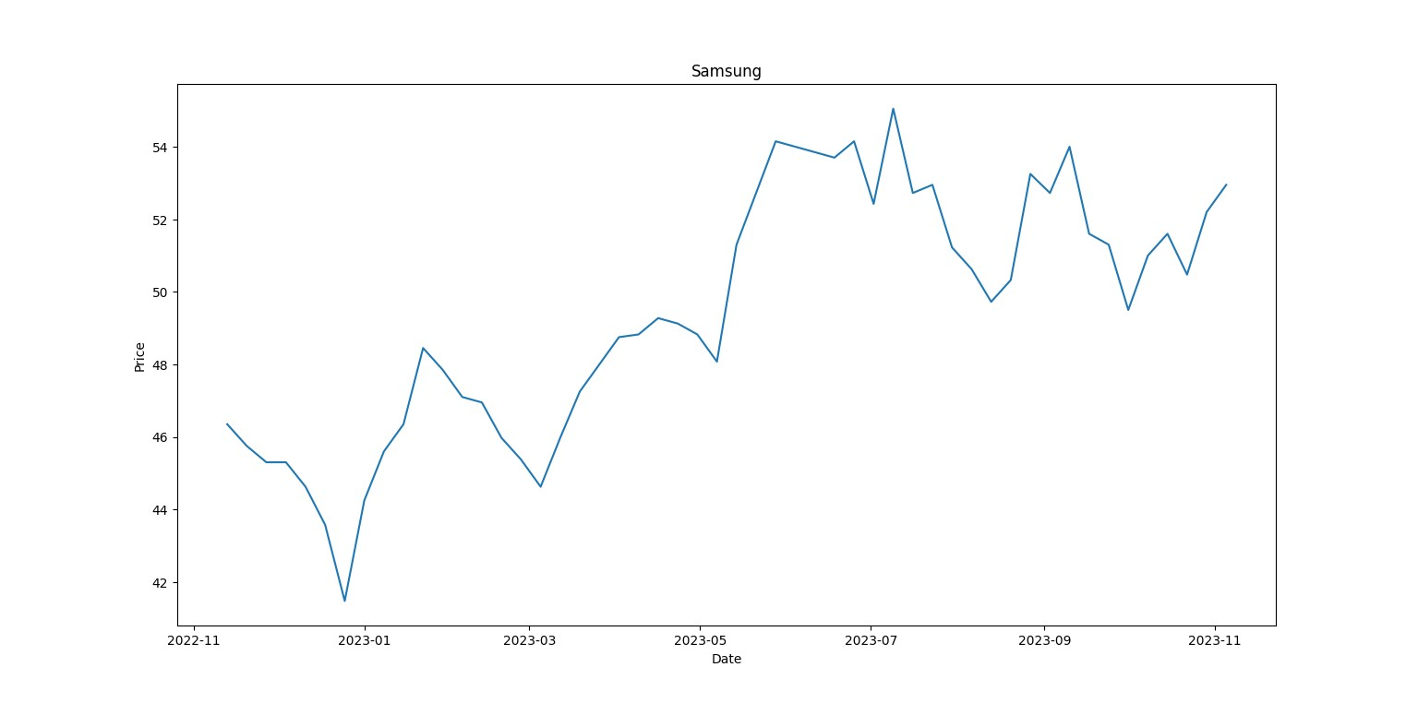
Samsung’s shares chart

Slide 8
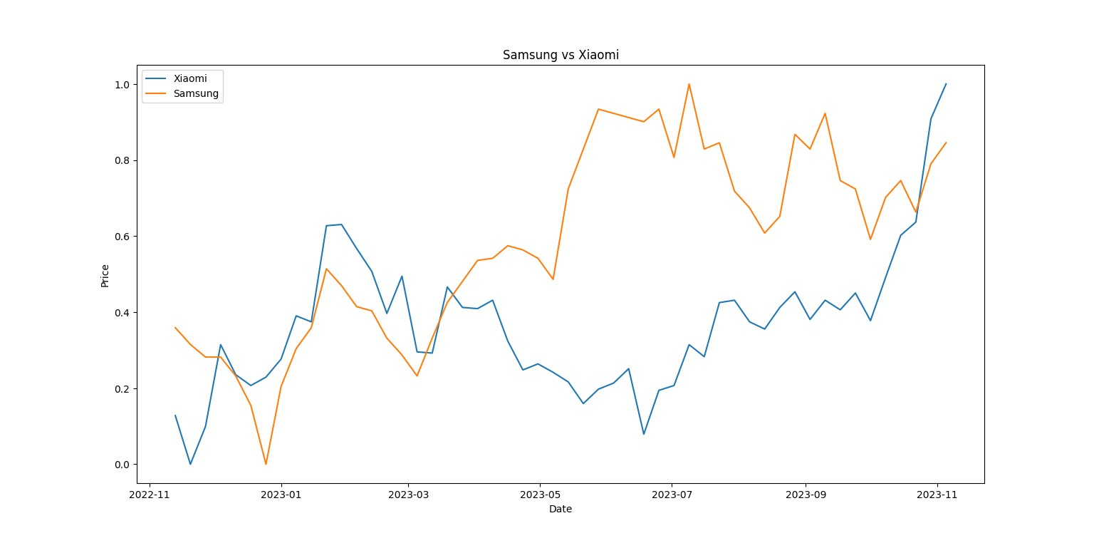
Comparing chart

