Slide 1
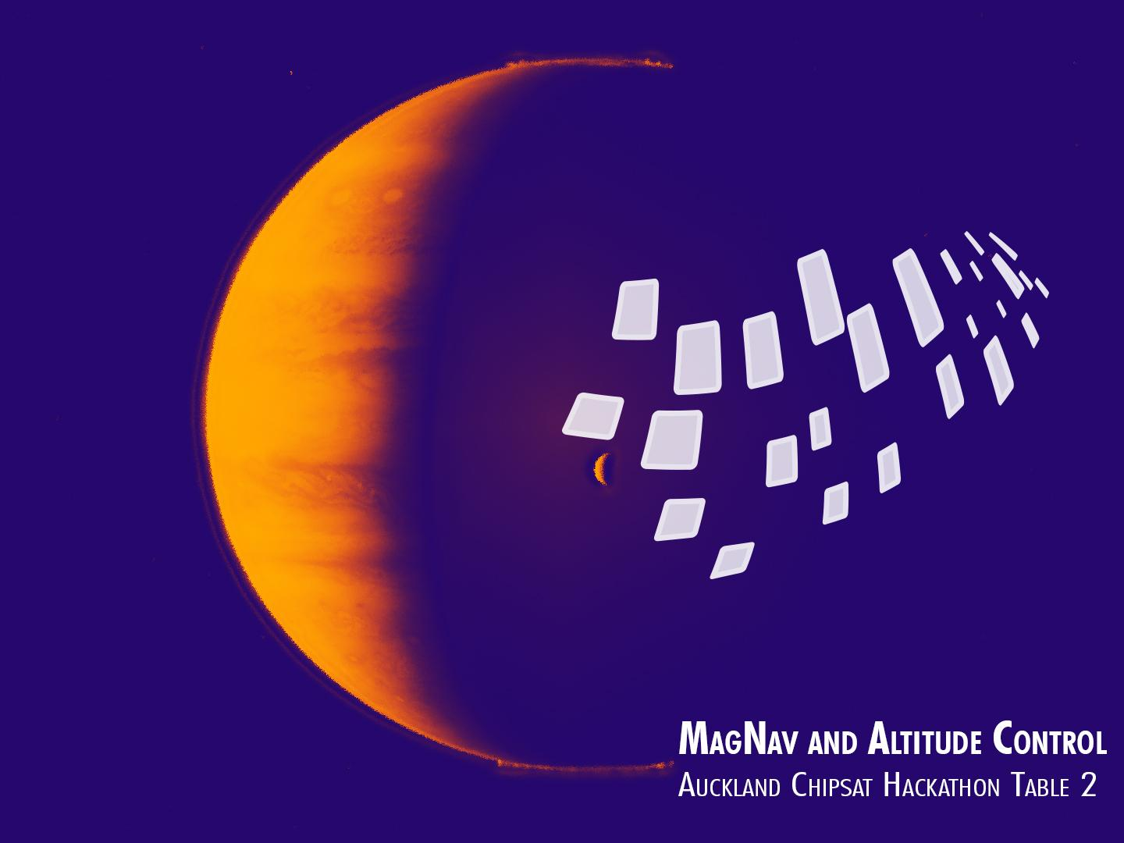

Team Members
(Alphabetical)
Petr Dobias
Jerry Fan
Dom Kay
Francis Moynihan Lavey
Nathan Pages
Jon Pearce
Mikhael Sayat
Frank Wang

Slide 2


Goal
Attitude control of ChipSats
Specific use case:
Unknown magnetic field pattern
Radio or Infrared emission from body
Unknown orbit
Example application: Jupiter orbit mission

Slide 3
Test Scenario
Simplifications:
Light sensor instead of radio or infrared sensor
One degree of freedom
Assumed ChipSat spins faster than orbit
Assumed many ChipSats are launched, some failures acceptable

Slide 4
Attitude Determination
Hardware used:
Light Sensor (LDR)
Gyroscope
Algorithm:
Integrate gyroscope output for continuous measurement
Fuse with light sensor measurements to correct for drift

Slide 5
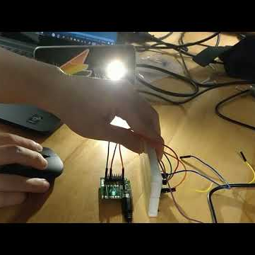
Test Results

Slide 6
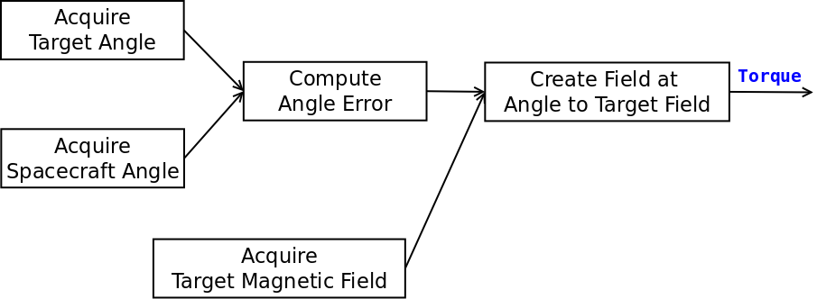
Attitude Control
Generate a magnetic field at an angle to the target’s field
Torque generated will pull fields into alignment

Slide 7
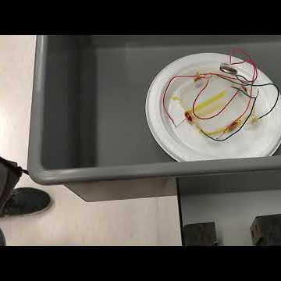
Test Results

Slide 8
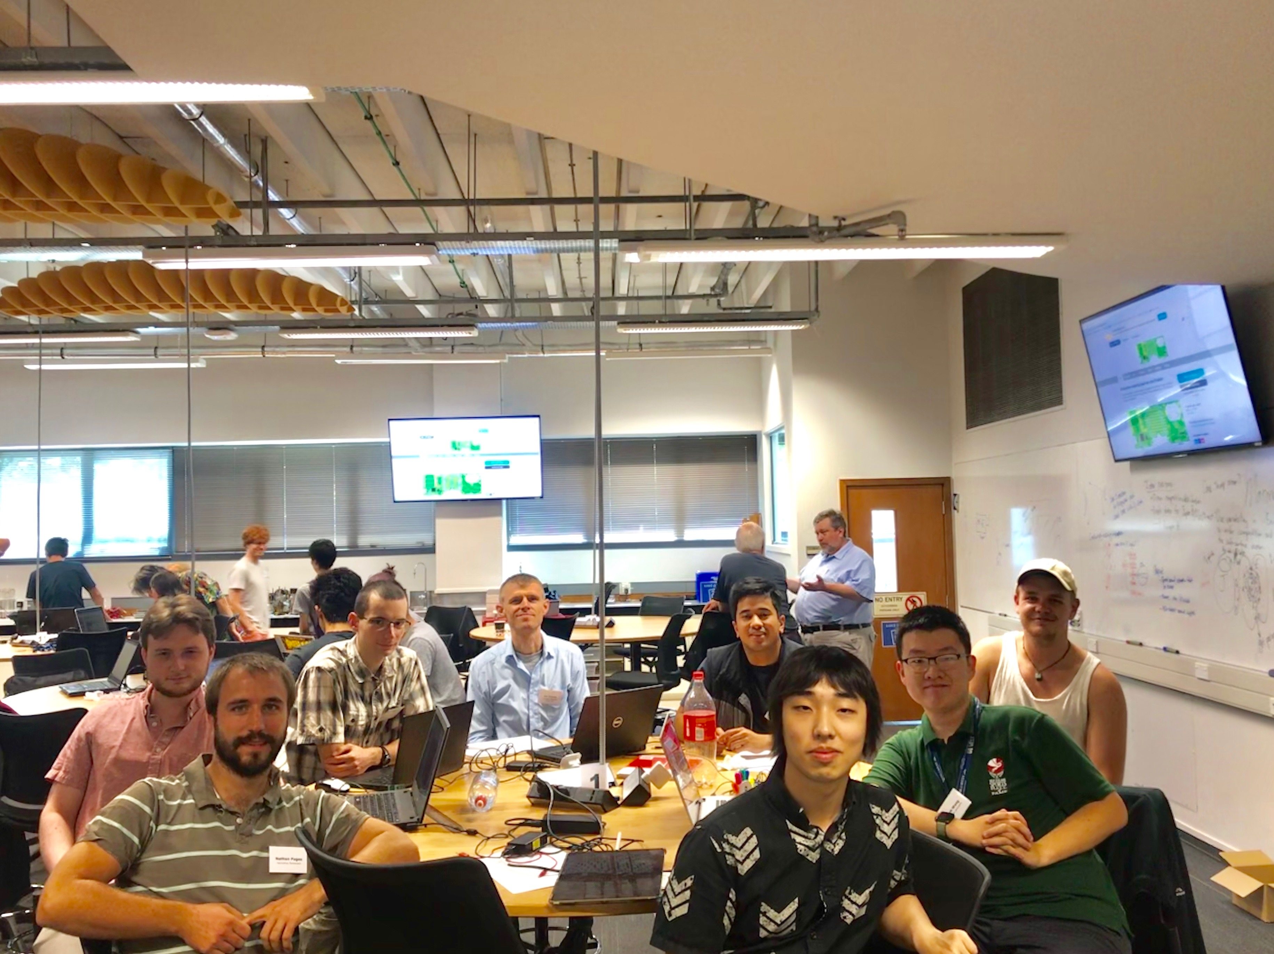
Thank you

Slide 9
