Slide 1

Flame Chat
P2P Chat Application

Slide 2
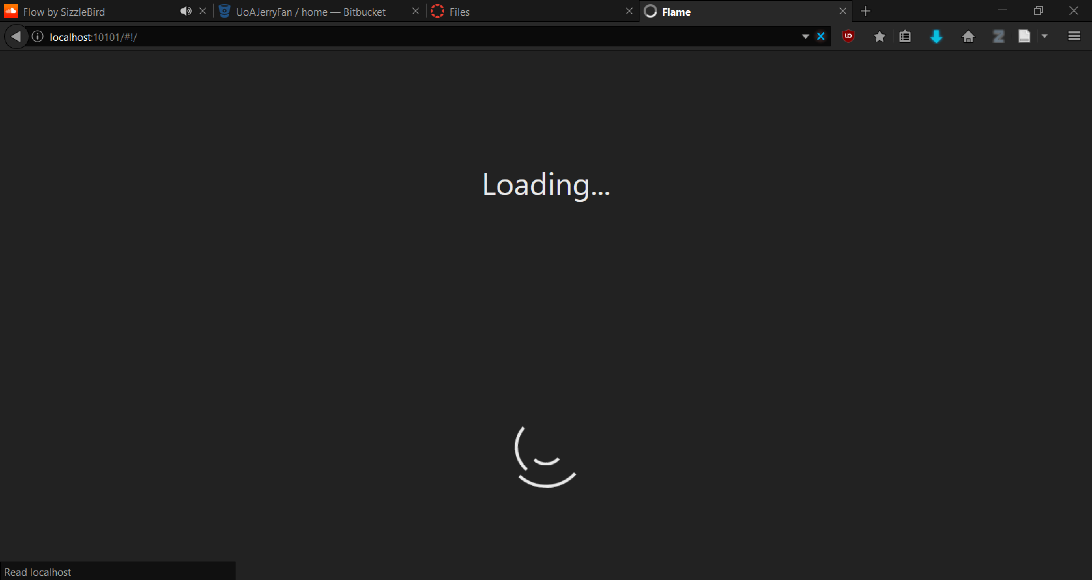

Slide 3
Project Requirements
Client requested a secure communication system for use by executives.
Peer to peer social network proposed by the manager, and accepted by the client.

Slide 4
Network Model
Login Server – Provides benefits of P2P networking security
End to end encrypted messages
Provides way of synchronizing user list
Distribute keys for securing messages
Easily implemented for prototyping

Slide 5
Technologies
Python Server
Browser Stack

Slide 6

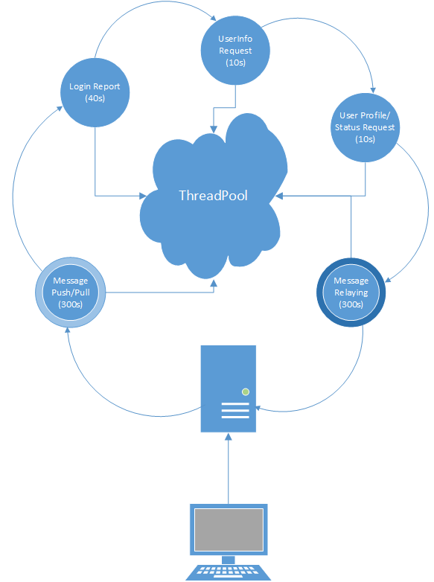
Relay Server Model
Server acts as a relay
Upkeep loop maintains network synchronization
Independently gathers from and sends data to other users
Other users can communicate with the server outside of the loop to inject data (such as messages)

Slide 7
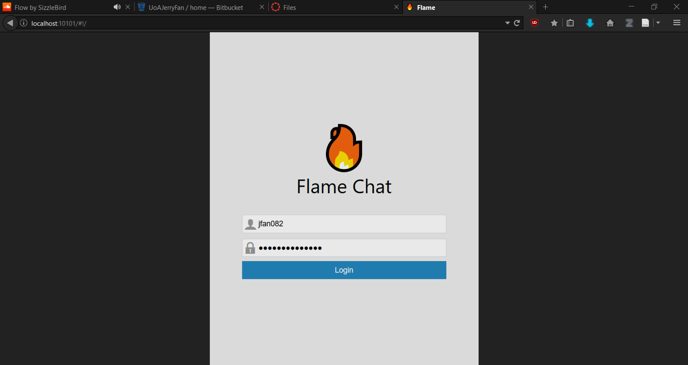

Slide 8
Front End
Using AngularJS 1 for data binding and reactive UI
Status notifications provided by angular presence
Browser upload provided by angular file upload – Drag n Drop support
Sticky chat conversations
Polling UI updates
Loading bar
Media player
Page routing with templates

Slide 9
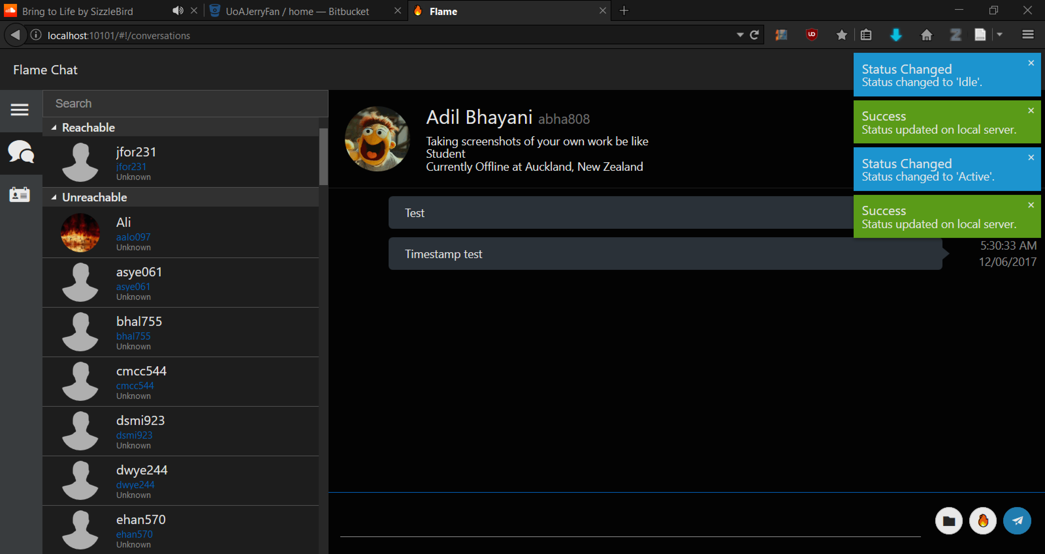
Conversations and Status

Slide 10
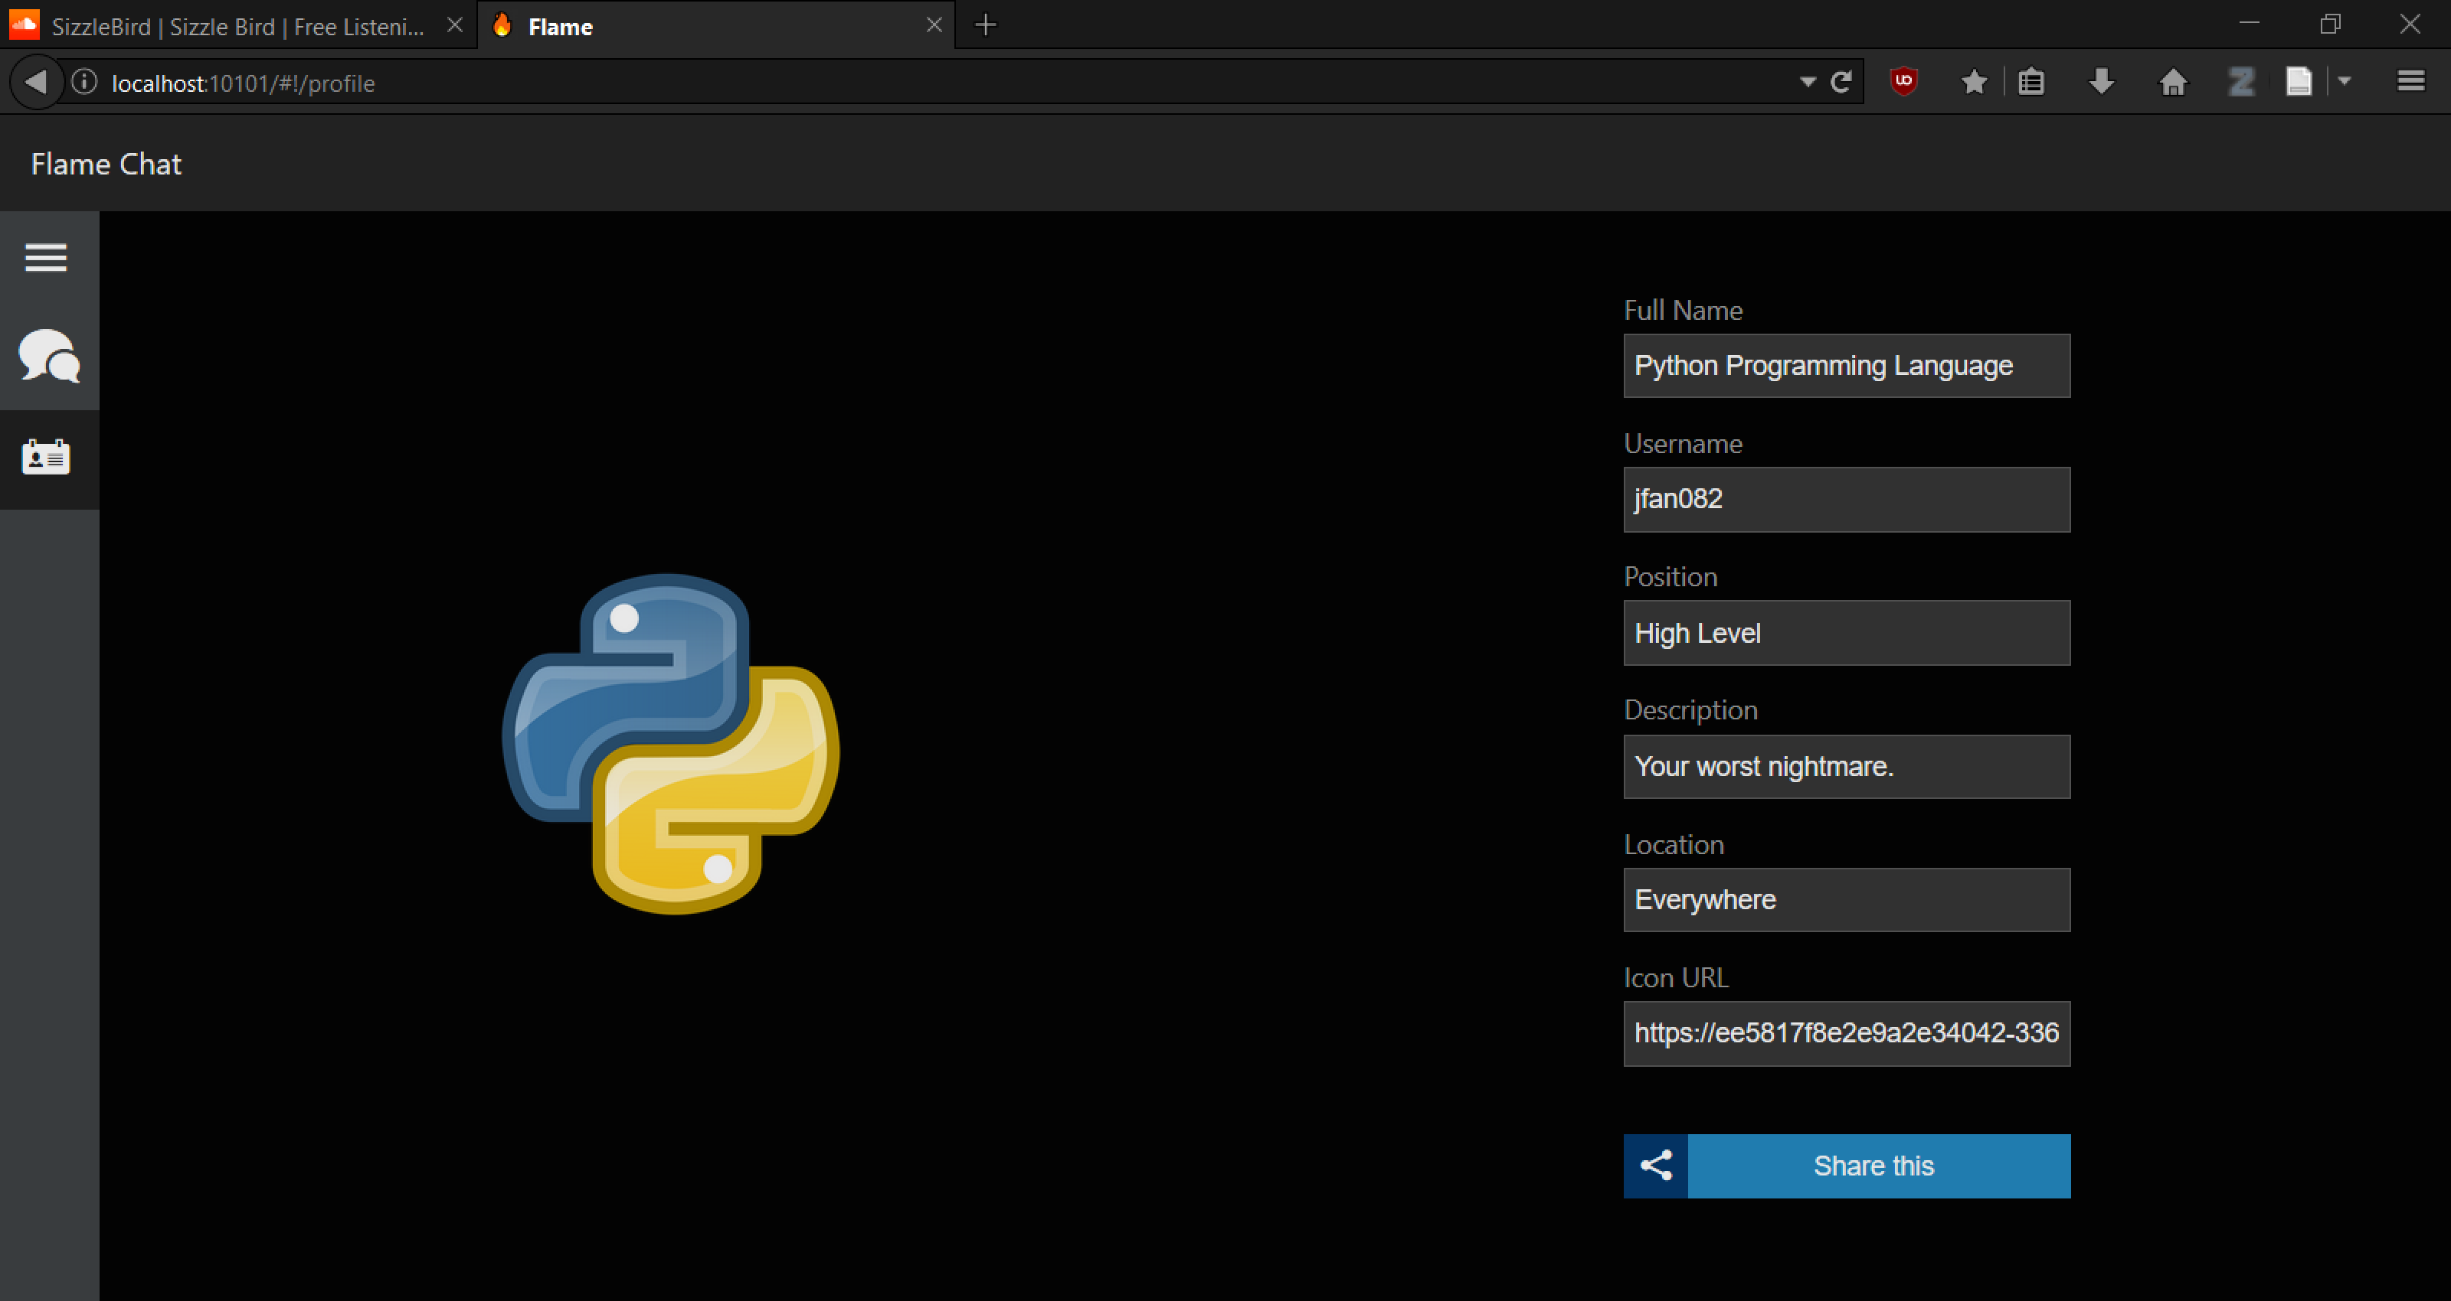
Profile

Slide 11
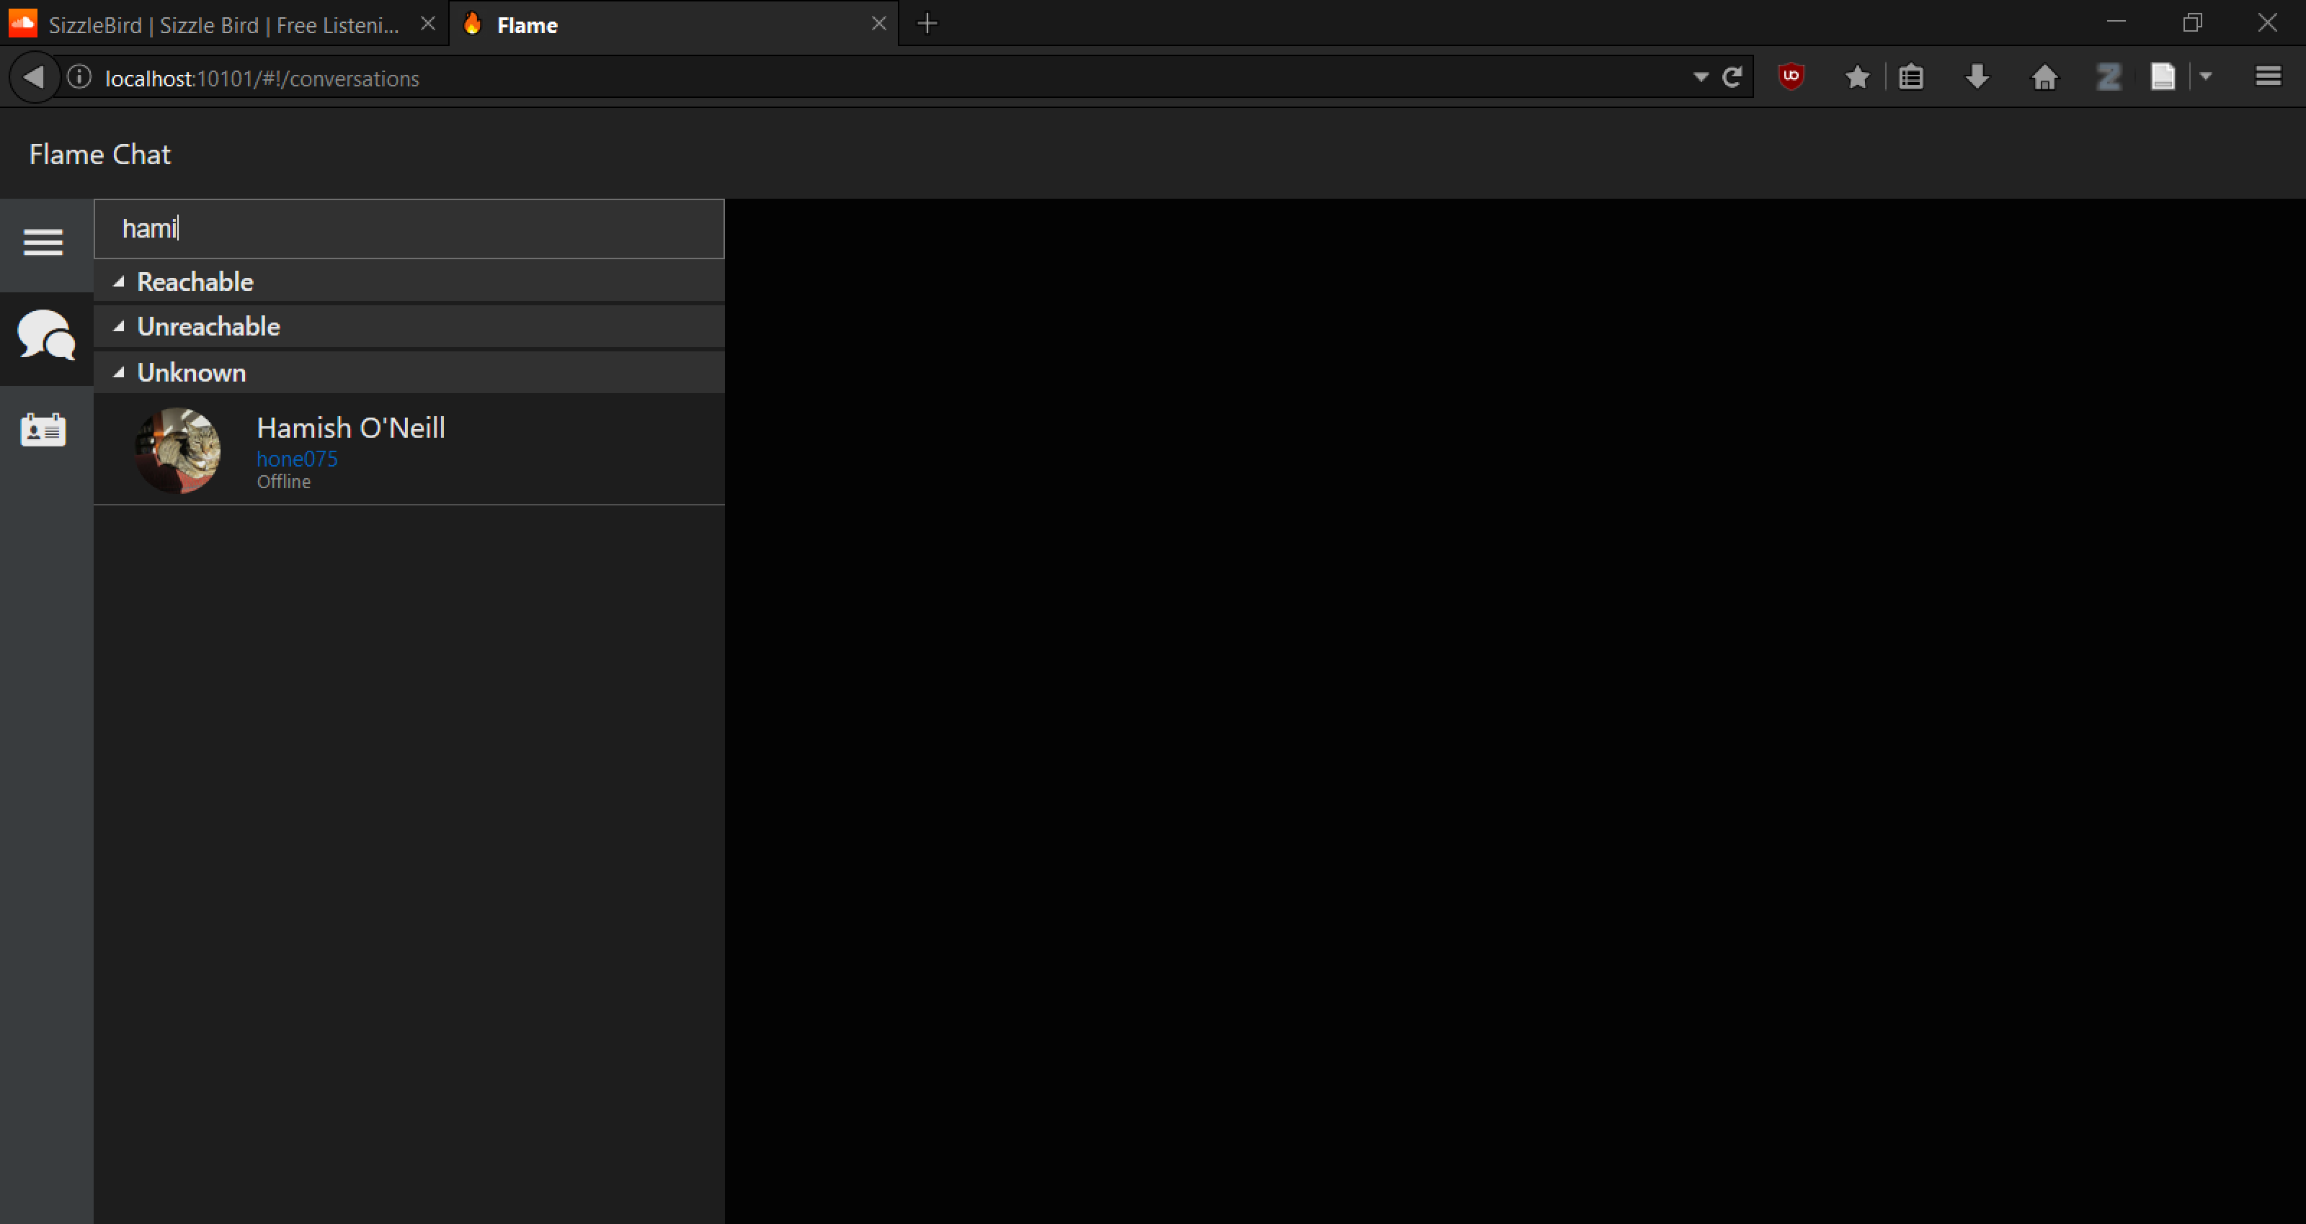
Search

Slide 12
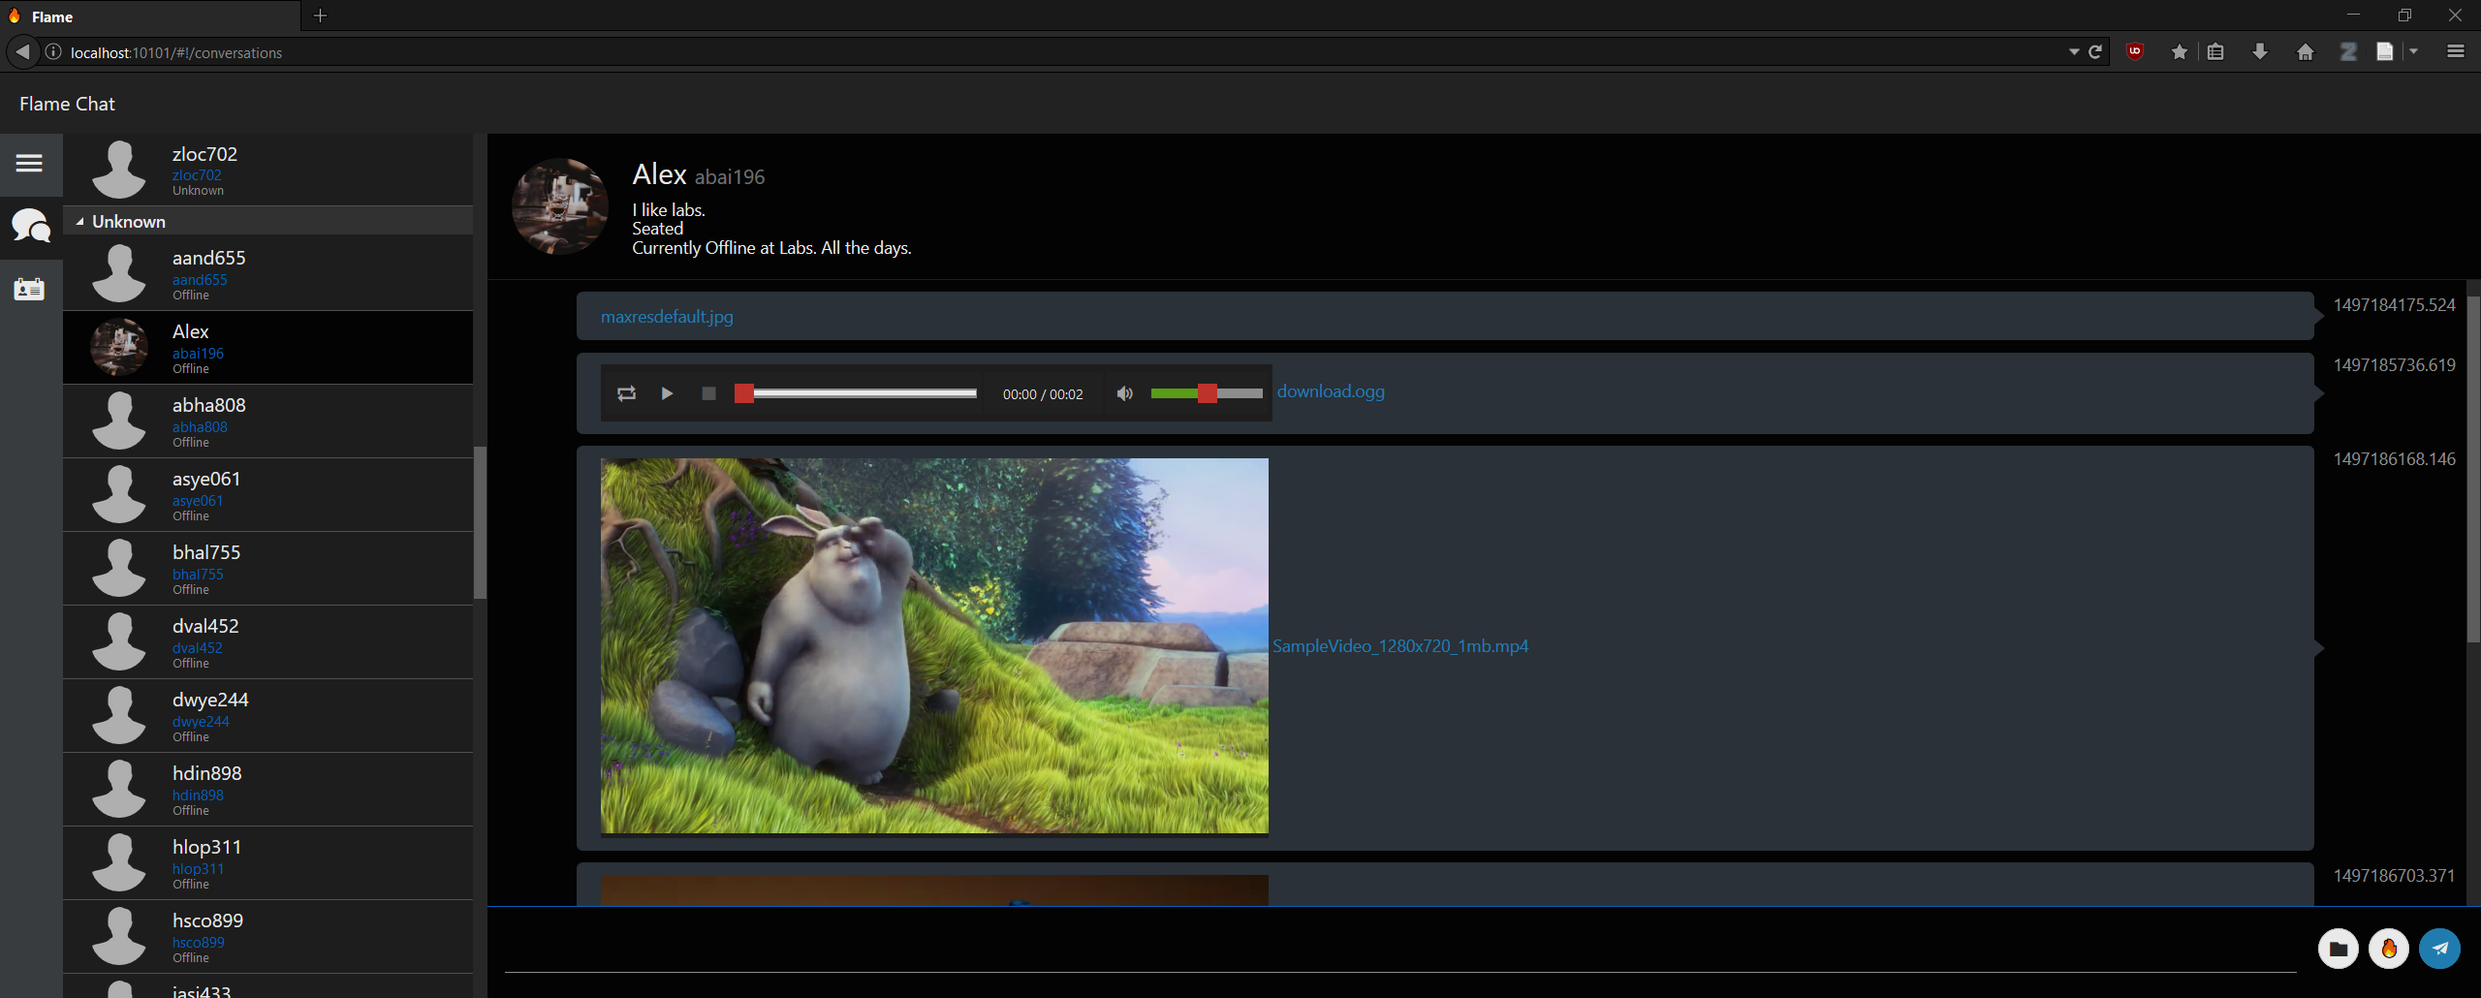
Embedded Media

Slide 13
Everything Can Work
Application prototype designed with extensibility in mind
Modular, able to adapt to changing requirements
Demonstrated meeting requirements

