Slide 1
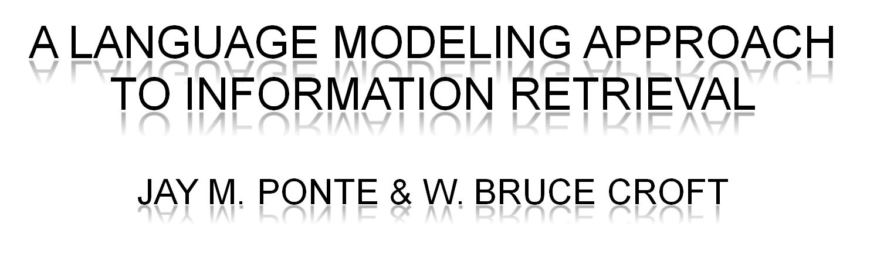
Murat Açar - Zeynep Çipiloğlu Yıldız

Slide 2

  The problem is:
    the integration of document indexing and retrieval models
    the lack of an adequate indexing model
    parametric assumptions
    prior assumptions about the similarity of documents
  The novel approach is:
    non-parametric
    based on probabilistic language modeling
    to integrate document indexing and document retrieval models into a single model
    inspired by speech recognition

Slide 3

  2-Poisson model [Harter]
    probabilistic indexing model
    a subset of terms in a document is useful for indexing
    identify words by distribution and assign indexing words
  Robertson and Spark Jones model
    estimates the probability of relevance of each document to the query
  INQUERY inference network model [Turtle and Croft]
    integrate indexing and retrieval by making inferences of concepts from features
    features: words, phrases, or more complex structures
    Bayesian network (for multiple feature sets/queries)

Slide 4




  Method:
    infer a language model for each document individually
    estimate the probability of producing the query
    rank the documents with respect to probabilities
  Estimate the prob. of the query, given the LM of doc. d
  MLE of the prob. of term t under term distribution of doc. d
  Problem: only document sized sample

Slide 5




  Risk function (geometric distribution):
  Probability of producing the query for a given document model
  Compute for each candidate document and rank

Slide 6

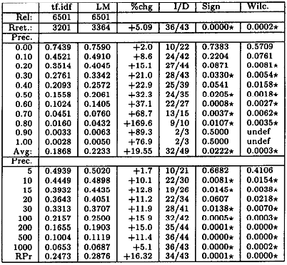
  11 point recall/precision experiments on TREC data
  Labrador(a research prototype retrieval engine)
  Wilcoxon test
  LM:
    has better precision
at all levels
    significantly better
    at several levels

Slide 7

  Text retrieval based on probabilistic language modeling
  It is both conceptually simple and explanatory
  The improvement in the performance is not the main point
  More significant is that a different approach to retrieval was shown to be effective
  It can be improved:
    Additional knowledge about the language generation process will yield better estimates
    Textual/graphical tools to sense the distribution of terms

Slide 8

[1] Harter, S. P. "A Probabilistic Approach to Automatic
Keyword Indexing” Journal of the American Society for Information Science, July-August, 1975.
[2] Robertson, S. E. and K. Sparck Jones. “Relevance Weighting Of Search Terms,” Journal of the American Society for Information Science, vol. 27, 1977.
[3] Turtle H. and W. B. Croft. “Efficient Probabilistic
Inference for Text Retrieval,” Proceedings of RIAO 3, 1991.

Slide 9


