Slide 1
Merge Sort and Quick Sort
Notes:
5/12/2018

Slide 2
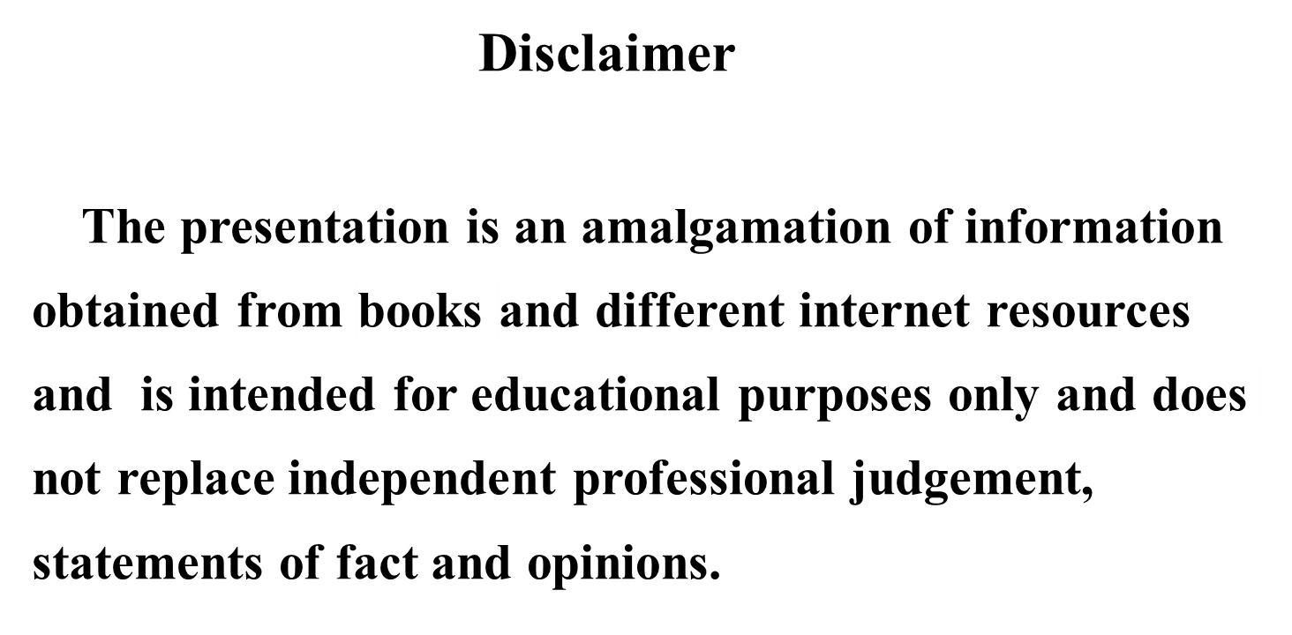
DISCLAIMER

Slide 3
Major Resource(s)
https://www.cse.unr.edu/~bebis/CS477/

Slide 4
Sorting
Insertion sort
  Design approach:
  Sorts in place:
  Best case:
  Worst case:
Bubble Sort
  Design approach:
  Sorts in place:
  Running time:
incremental
Yes
Θ(n)
Θ(n²)
incremental
Yes
Θ(n²)

Slide 5
Sorting
Selection sort
  Design approach:
  Sorts in place:
  Running time:
Merge Sort
  Design approach:
  Sorts in place:
  Running time:
incremental
Yes
Θ(n²)
divide and conquer
No
Let’s see!!

Slide 6
Divide-and-Conquer
Divide the problem into a number of sub-problems
  Similar sub-problems of smaller size
Conquer the sub-problems
  Solve the sub-problems recursively
  Sub-problem size small enough ⇒ solve the problems in straightforward manner
Combine the solutions of the sub-problems
  Obtain the solution for the original problem

Slide 7
Merge Sort Approach
To sort an array A[p . . r]:
Divide
  Divide the n-element sequence to be sorted into two subsequences of n/2 elements each
Conquer
  Sort the subsequences recursively using merge sort
  When the size of the sequences is 1 there is nothing more to do
Combine
  Merge the two sorted subsequences

Slide 8
Merge Sort
p
q
r
1
2
3
4
5
6
7
8
Alg.: MERGE-SORT(A, p, r)
if p < r Check for base case
then q ← ⎣(p + r)/2⎦ Divide
MERGE-SORT(A, p, q) Conquer
MERGE-SORT(A, q + 1, r) Conquer
MERGE(A, p, q, r) Combine
Initial call: MERGE-SORT(A, 1, n)
5
2
4
7
1
3
2
6

Slide 9
Example – n Power of 2
Divide
1
2
3
4
5
6
7
8
5
2
4
7
1
3
2
6
q = 4
1
2
3
4
5
6
7
8
5
2
4
7
1
3
2
6
1
2
3
4
5
6
7
8
5
2
4
7
1
3
2
6
1
2
3
4
5
6
7
8
5
2
4
7
1
3
2
6

Slide 10
Example – n Power of 2
Conquer
and
Merge
1
2
3
4
5
6
7
8
1
2
2
3
4
5
6
7
1
2
3
4
5
6
7
8
2
4
5
7
1
2
3
6
1
2
3
4
5
6
7
8
2
5
4
7
1
3
2
6
1
2
3
4
5
6
7
8
5
2
4
7
1
3
2
6

Slide 11
Example – n Not a Power of 2
1
2
3
4
5
6
7
8
9
10
11
Divide
4
7
2
6
1
4
7
3
5
2
6
q = 6
1
2
3
4
5
6
7
8
9
10
11
q = 3
4
7
2
6
1
4
7
3
5
2
6
q = 9
1
2
3
4
5
6
7
8
9
10
11
4
7
2
6
1
4
7
3
5
2
6
1
2
3
4
5
6
7
8
9
10
11
4
7
2
6
1
4
7
3
5
2
6
1
2
4
5
7
8
4
7
6
1
7
3

Slide 12
Example – n Not a Power of 2
Conquer
and
Merge
1
2
3
4
5
6
7
8
9
10
11
1
2
2
3
4
4
5
6
6
7
7
1
2
3
4
5
6
7
8
9
10
11
1
2
4
4
6
7
2
3
5
6
7
1
2
3
4
5
6
7
8
9
10
11
2
4
7
1
4
6
3
5
7
2
6
1
2
3
4
5
6
7
8
9
10
11
4
7
2
1
6
4
3
7
5
2
6
1
2
4
5
7
8
4
7
6
1
7
3

Slide 13
Merging
p
q
r
1
2
3
4
5
6
7
8
2
4
5
7
1
2
3
6
Input: Array A and indices p, q, r such that p ≤ q < r
  Subarrays A[p . . q] and A[q + 1 . . r] are sorted
Output: One single sorted subarray A[p . . r]

Slide 14
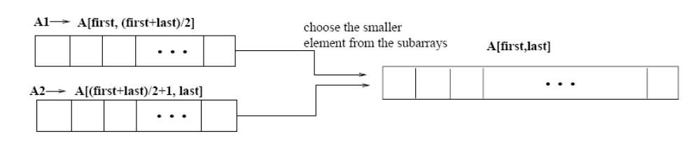
Merging
p
q
r
Idea for merging:
  Two piles of sorted cards
    Choose the smaller of the two top cards
    Remove it and place it in the output pile
  Repeat the process until one pile is empty
  Take the remaining input pile and place it face-down onto the output pile
1
2
3
4
5
6
7
8
2
4
5
7
1
2
3
6
A1← A[p, q]
A[p, r]
A2← A[q+1, r]

Slide 15
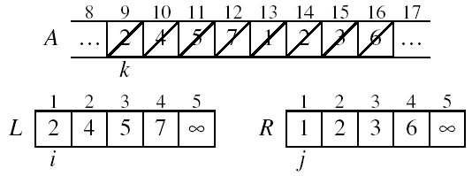
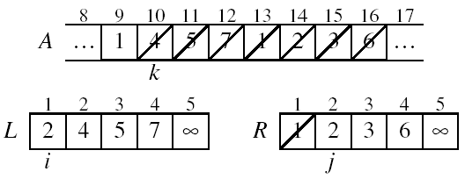
Example: MERGE(A, 9, 12, 16)
p
q
r

Slide 16
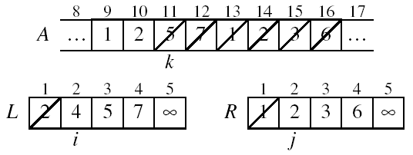
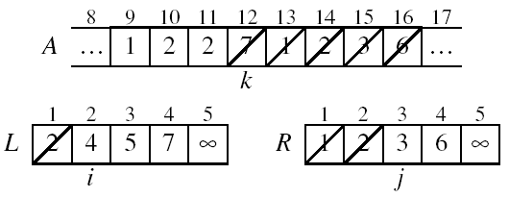
Example: MERGE(A, 9, 12, 16)

Slide 17
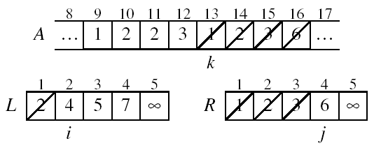
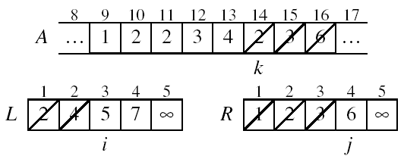
Example (cont.)

Slide 18
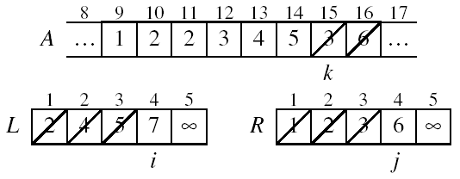
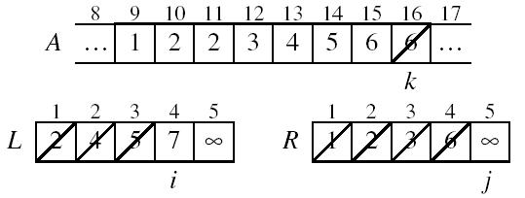
Example (cont.)

Slide 19
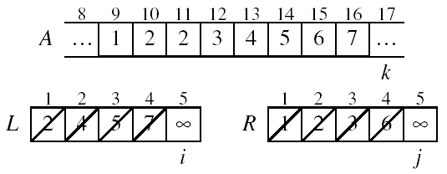
Example (cont.)
Done!

Slide 20
Merge - Pseudocode
p
q
r
Alg.: MERGE(A, p, q, r)
Compute n₁ and n₂
Copy the first n₁ elements into L[1 . . n₁ + 1] and the next n₂ elements into R[1 . . n₂ + 1]
L[n₁ + 1] ← ∞; R[n₂ + 1] ← ∞
i ← 1; j ← 1
for k ← p to r
do if L[ i ] ≤ R[ j ]
then A[k] ← L[ i ]
i ←i + 1
else A[k] ← R[ j ]
j ← j + 1
1
2
3
4
5
6
7
8
2
4
5
7
1
2
3
6
n₁
n₂
p
q
L
2
4
5
7
∞
q + 1
r
R
1
2
3
6
∞

Slide 21
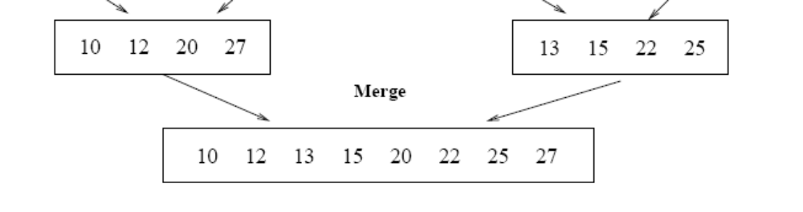
Running Time of Merge
(assume last for loop)
Initialization (copying into temporary arrays):
  Θ(n₁ + n₂) = Θ(n)
Adding the elements to the final array:
  - n iterations, each taking constant time ⇒ Θ(n)
Total time for Merge:
  Θ(n)

Slide 22
Analyzing Divide-and Conquer Algorithms
The recurrence is based on the three steps of the paradigm:
  T(n) – running time on a problem of size n
  Divide the problem into a subproblems, each of size n/b: takes D(n)
  Conquer (solve) the subproblems aT(n/b)
  Combine the solutions C(n)
Θ(1) if n ≤ c
T(n) = aT(n/b) + D(n) + C(n) otherwise

Slide 23
MERGE-SORT Running Time
Divide:
  compute q as the average of p and r: D(n) = Θ(1)
Conquer:
  recursively solve 2 subproblems, each of size n/2 ⇒ 2T (n/2)
Combine:
  MERGE on an n-element subarray takes Θ(n) time ⇒ C(n) = Θ(n)
Θ(1) if n =1
T(n) = 2T(n/2) + Θ(n) if n > 1

Slide 24
Solve the Recurrence
T(n) = c if n = 1
2T(n/2) + cn if n > 1
Use Master’s Theorem:
Compare n with f(n) = cn
Case 2: T(n) = Θ(nlgn)

Slide 25
Merge Sort - Discussion
Running time insensitive of the input
Advantages:
  Guaranteed to run in Θ(nlgn)
Disadvantage
  Requires extra space ≈N

Slide 26
Sorting Challenge 1
Problem: Sort a file of huge records with tiny keys
Example application: Reorganize your MP-3 files
Which method to use?
  merge sort, guaranteed to run in time ∼NlgN
  selection sort
  bubble sort
  a custom algorithm for huge records/tiny keys
  insertion sort

Slide 27
Sorting Files with Huge Records and Small Keys
Insertion sort or bubble sort?
  NO, too many exchanges
Selection sort?
  YES, it takes linear time for exchanges
Merge sort or custom method?
  Probably not: selection sort simpler, does less swaps

Slide 28
Sorting Challenge 2
Problem: Sort a huge randomly-ordered file of small records
Application: Process transaction record for a phone company
Which sorting method to use?
  Bubble sort
  Selection sort
  Mergesort guaranteed to run in time ∼NlgN
  Insertion sort

Slide 29
Sorting Huge, Randomly - Ordered Files
Selection sort?
  NO, always takes quadratic time
Bubble sort?
  NO, quadratic time for randomly-ordered keys
Insertion sort?
  NO, quadratic time for randomly-ordered keys
Mergesort?
  YES, it is designed for this problem

Slide 30
Sorting Challenge 3
Problem: sort a file that is already almost in order
Applications:
  Re-sort a huge database after a few changes
  Doublecheck that someone else sorted a file
Which sorting method to use?
  Mergesort, guaranteed to run in time ∼NlgN
  Selection sort
  Bubble sort
  A custom algorithm for almost in-order files
  Insertion sort

Slide 31
Sorting Files That are Almost in Order
Selection sort?
  NO, always takes quadratic time
Bubble sort?
  NO, bad for some definitions of “almost in order”
  Ex: B C D E F G H I J K L M N O P Q R S T U V W X Y Z A
Insertion sort?
  YES, takes linear time for most definitions of “almost in order”
Mergesort or custom method?
  Probably not: insertion sort simpler and faster

Slide 32
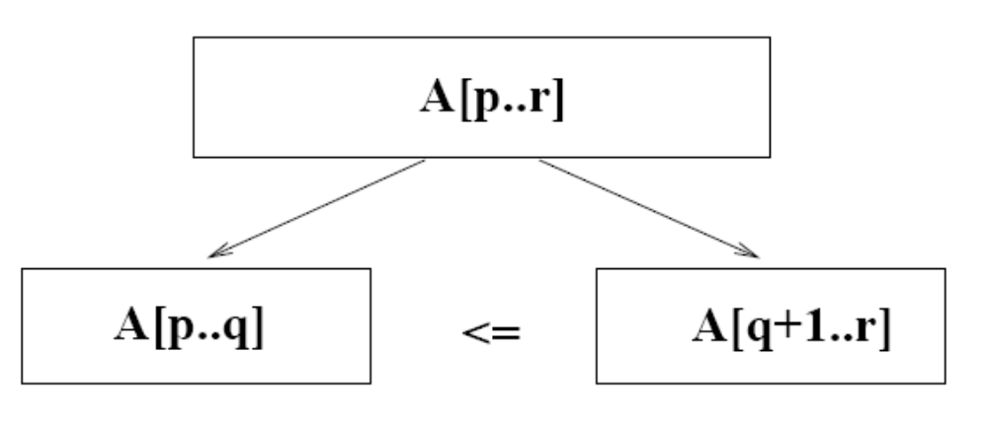
Quicksort
A[p…q]
≤
A[q+1…r]
Sort an array A[p…r]
Divide
  Partition the array A into 2 subarrays A[p..q] and A[q+1..r], such that each element of A[p..q] is smaller than or equal to each element in A[q+1..r]
  Need to find index q to partition the array

Slide 33
Quicksort
A[p…q]
≤
A[q+1…r]
Conquer
  Recursively sort A[p..q] and A[q+1..r] using Quicksort
Combine
  Trivial: the arrays are sorted in place
  No additional work is required to combine them
  The entire array is now sorted

Slide 34
QUICKSORT
Alg.: QUICKSORT(A, p, r)
if p < r
then q ← PARTITION(A, p, r)
QUICKSORT (A, p, q)
QUICKSORT (A, q+1, r)
Initially: p=1, r=n
Recurrence:
T(n) = T(q) + T(n – q) + f(n)
PARTITION())

Slide 35
Partitioning the Array
Choosing PARTITION()
  There are different ways to do this
  Each has its own advantages/disadvantages
Hoare partition (see prob. 7-1, page 159)
  Select a pivot element x around which to partition
  Grows two regions
A[p…i] ≤ x
x ≤ A[j…r]
A[p…i] ≤ x
x ≤ A[j…r]
i
j

Slide 36
Example
A[p…r]
pivot x=5
5
3
2
6
4
1
3
7
5
3
2
6
4
1
3
7
i
j
i
j
3
3
2
6
4
1
5
7
3
3
2
6
4
1
5
7
i
j
i
j
A[p…q]
A[q+1…r]
3
3
2
1
4
6
5
7
3
3
2
1
4
6
5
7
i
j
j
i

Slide 37
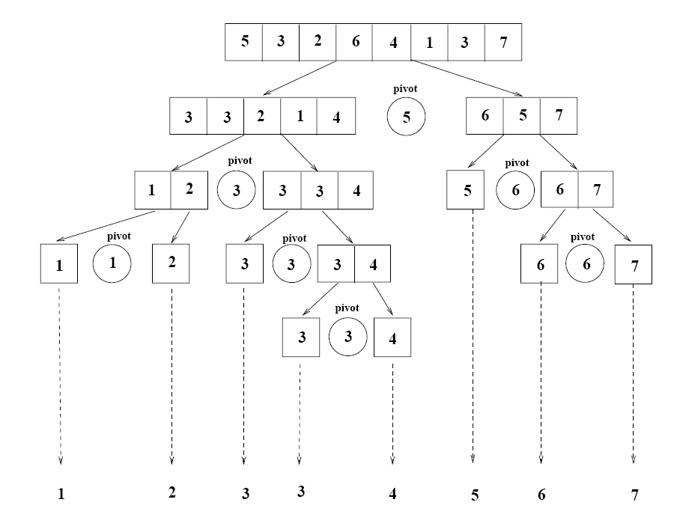
Example

Slide 38
Partitioning the Array
Alg. PARTITION (A, p, r)
x ← A[p]
i ← p – 1
j ← r + 1
while TRUE
do repeat i ← i + 1
until A[i] < x
do repeat j ← j - 1
until A[j] > x
if i < j
then exchange A[i] ↔ A[j]
else return j
p
r
A:
5
3
2
6
4
1
3
7
i
j
A[p…q]
≤
A[q+1…r]
A:
a_{p}
a_{r}
j=q
i
Each element is
visited once!
Running time: Θ(n)
n = r – p + 1

Slide 39
Recurrence
Alg.: QUICKSORT(A, p, r)
if p < r
then q ← PARTITION(A, p, r)
QUICKSORT (A, p, q)
QUICKSORT (A, q+1, r)
Initially: p=1, r=n
Recurrence:
T(n) = T(q) + T(n – q) + n

Slide 40
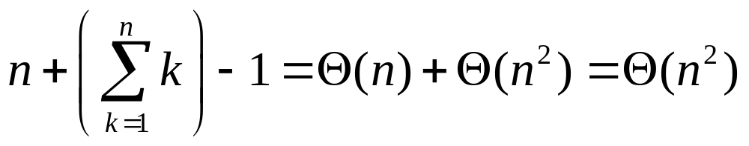
Worst Case Partitioning
Worst-case partitioning
  One region has one element and the other has n – 1 elements
  Maximally unbalanced
Recurrence: q=1
  T(n) = T(1) + T(n – 1) + n,
  T(1) = Θ(1)
  T(n) = T(n – 1) + n
  =
n
n
1
n - 1
n
1
n - 2
n - 1
n
1
n - 3
n - 2
1
2
3
1
1
2
Θ(n²)
When does the worst case happen?

Slide 41
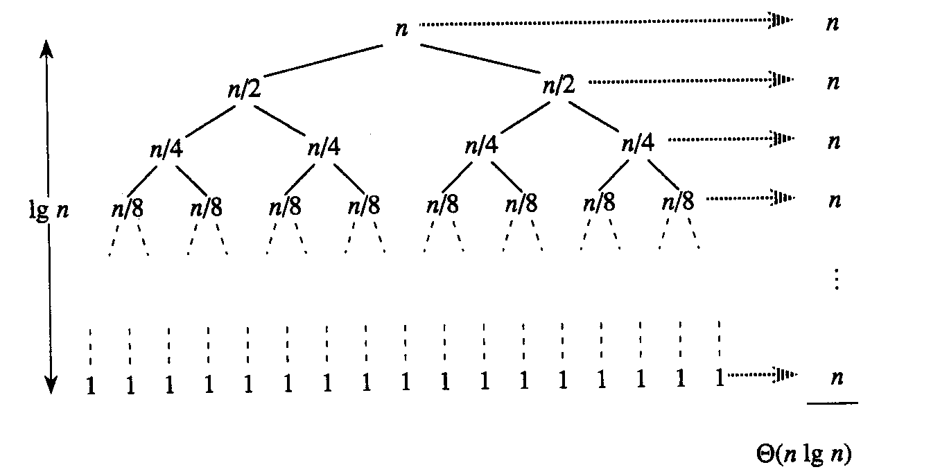
Best Case Partitioning
Best-case partitioning
  Partitioning produces two regions of size n/2
Recurrence: q=n/2
  T(n) = 2T(n/2) + Θ(n)
  T(n) = Θ(nlgn) (Master theorem)

Slide 42
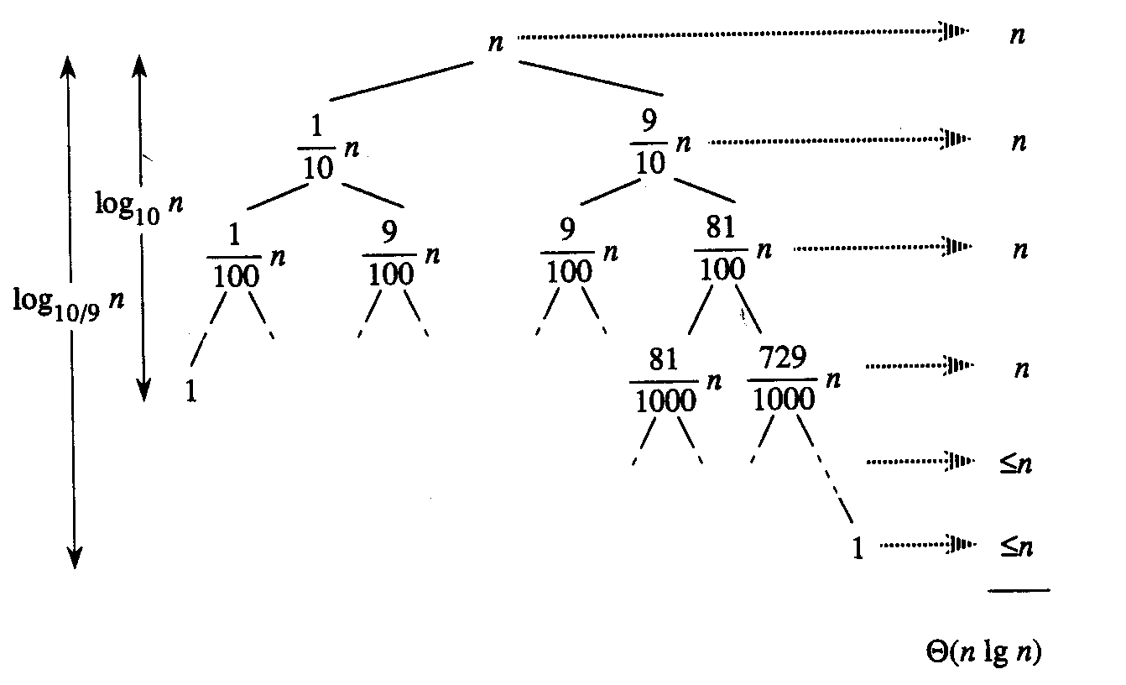
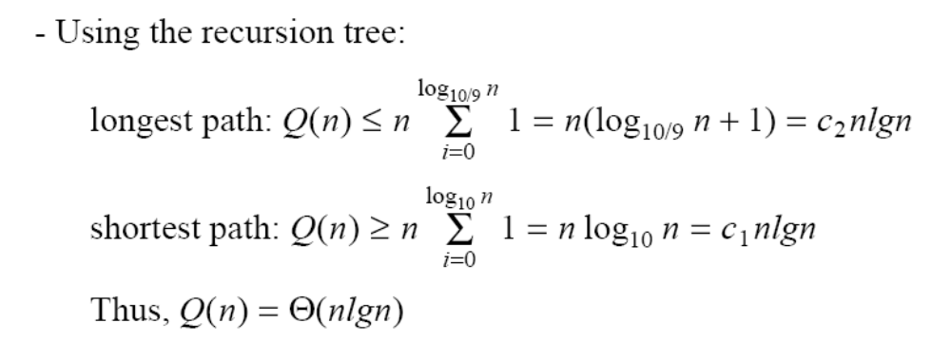
Case Between Worst and Best
9-to-1 proportional split
Q(n) = Q(9n/10) + Q(n/10) + n

Slide 43
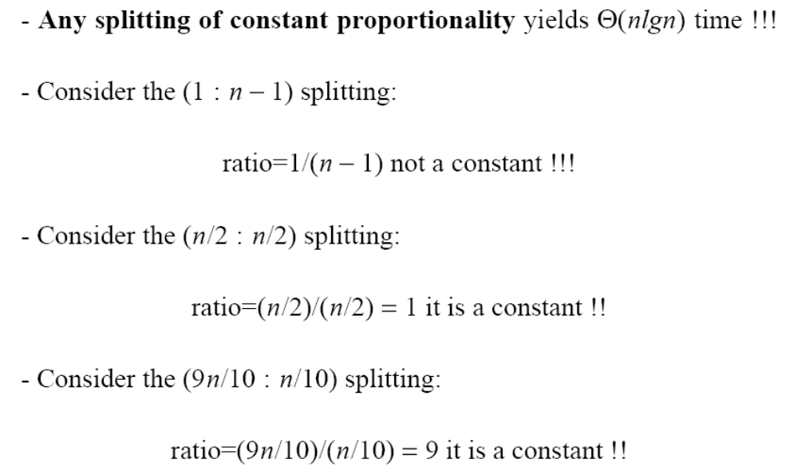
How does partition affect performance?

Slide 44
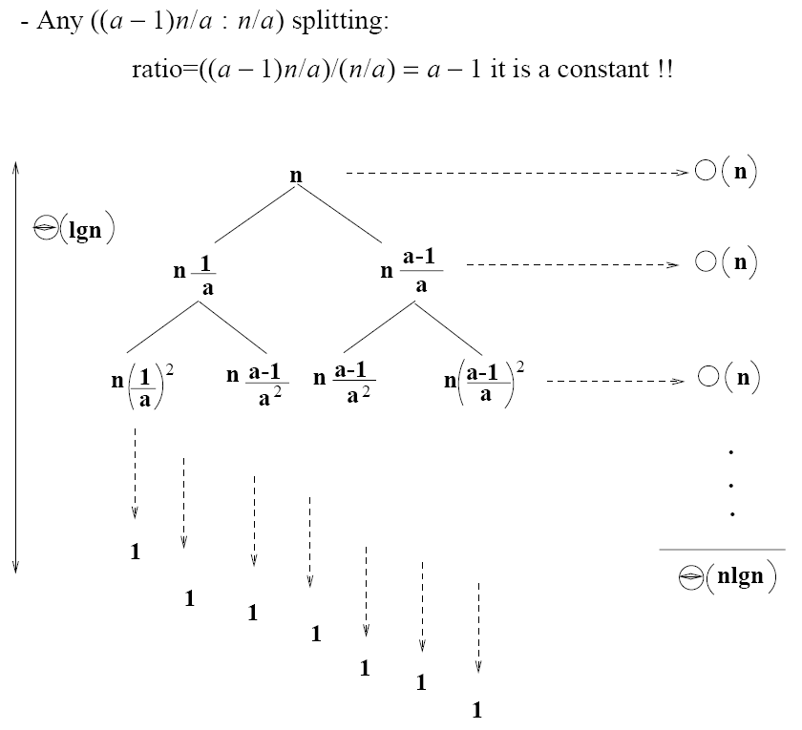
How does partition affect performance?

Slide 45
Performance of Quicksort
Average case
  All permutations of the input numbers are equally likely
  On a random input array, we will have a mix of well balanced and unbalanced splits
  Good and bad splits are randomly distributed across throughout the tree
partitioning cost:
n = Θ(n)
n
combined partitioning cost:
2n-1 = Θ(n)
n
1
n - 1
(n – 1)/2 + 1
(n – 1)/2
(n – 1)/2
(n – 1)/2
Alternate of a good
and a bad split
Nearly well
balanced split
Running time of Quicksort when levels alternate between good and bad splits is O(nlgn)

