Slide 1
Searching
Given a collection and an element (key) to find…
Output
  Print a message (“Found”, “Not Found)
  Return a value (position of key )
Don’t modify the collection in the search!

Slide 2
Searching Example
(Linear Search)

Slide 3
Linear Search: A Simple Search
A search traverses the collection until
  The desired element is found
  Or the collection is exhausted
If the collection is ordered, I might not have to look at all elements
  I can stop looking when I know the element cannot be in the collection.

Slide 4
Un-Ordered Iterative Array Search
procedure Search(my_array Array,
target Num)
i Num
i <- 1
loop
exitif((i > MAX) OR (my_array[i] = target))
i <- i + 1
endloop
if(i > MAX) then
print(“Target data not found”)
else
print(“Target data found”)
endif
endprocedure // Search
Scan the array

Slide 5
procedure Search(my_array Array,
target Num)
i isoftype Num
i <- 1
loop
exitif((i > MAX) OR (my_array[i] = target))
i <- i + 1
endloop
if(i > MAX) then
print(“Target data not found”)
else
print(“Target data found”)
endif
endprocedure // Search
my_array
7
12
5
22
13
32
target = 13
1
2
3
4
5
6

Slide 6
procedure Search(my_array isoftype in NumArrayType,
target isoftype in Num)
i isoftype Num
i <- 1
loop
exitif((i > MAX) OR (my_array[i] = target))
i <- i + 1
endloop
if(i > MAX) then
print(“Target data not found”)
else
print(“Target data found”)
endif
endprocedure // Search
my_array
7
12
5
22
13
32
target = 13
1
2
3
4
5
6

Slide 7
procedure Search(my_array isoftype in NumArrayType,
target isoftype in Num)
i isoftype Num
i <- 1
loop
exitif((i > MAX) OR (my_array[i] = target))
i <- i + 1
endloop
if(i > MAX) then
print(“Target data not found”)
else
print(“Target data found”)
endif
endprocedure // Search
my_array
7
12
5
22
13
32
target = 13
1
2
3
4
5
6

Slide 8
procedure Search(my_array isoftype in NumArrayType,
target isoftype in Num)
i isoftype Num
i <- 1
loop
exitif((i > MAX) OR (my_array[i] = target))
i <- i + 1
endloop
if(i > MAX) then
print(“Target data not found”)
else
print(“Target data found”)
endif
endprocedure // Search
my_array
7
12
5
22
13
32
target = 13
1
2
3
4
5
6

Slide 9
procedure Search(my_array isoftype in NumArrayType,
target isoftype in Num)
i isoftype Num
i <- 1
loop
exitif((i > MAX) OR (my_array[i] = target))
i <- i + 1
endloop
if(i > MAX) then
print(“Target data not found”)
else
print(“Target data found”)
endif
endprocedure // Search
my_array
7
12
5
22
13
32
target = 13
1
2
3
4
5
6

Slide 10
procedure Search(my_array isoftype in NumArrayType,
target isoftype in Num)
i isoftype Num
i <- 1
loop
exitif((i > MAX) OR (my_array[i] = target))
i <- i + 1
endloop
if(i > MAX) then
print(“Target data not found”)
else
print(“Target data found”)
endif
endprocedure // Search
my_array
7
12
5
22
13
32
target = 13
1
2
3
4
5
6

Slide 11
procedure Search(my_array isoftype in NumArrayType,
target isoftype in Num)
i isoftype Num
i <- 1
loop
exitif((i > MAX) OR (my_array[i] = target))
i <- i + 1
endloop
if(i > MAX) then
print(“Target data not found”)
else
print(“Target data found”)
endif
endprocedure // Search
my_array
7
12
5
22
13
32
target = 13
1
2
3
4
5
6

Slide 12
procedure Search(my_array isoftype in NumArrayType,
target isoftype in Num)
i isoftype Num
i <- 1
loop
exitif((i > MAX) OR (my_array[i] = target))
i <- i + 1
endloop
if(i > MAX) then
print(“Target data not found”)
else
print(“Target data found”)
endif
endprocedure // Search
Target data found
my_array
7
12
5
22
13
32
target = 13
1
2
3
4
5
6

Slide 13
procedure Search(my_array isoftype in NumArrayType,
target isoftype in Num)
i isoftype Num
i <- 1
loop
exitif((i > MAX) OR (my_array[i] = target))
i <- i + 1
endloop
if(i > MAX) then
print(“Target data not found”)
else
print(“Target data found”)
endif
endprocedure // Search
my_array
7
12
5
22
13
32
target = 13
1
2
3
4
5
6

Slide 14
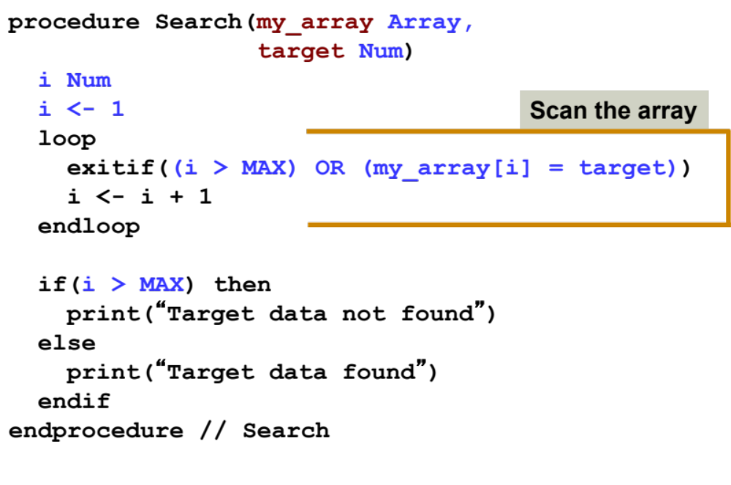
Linear Search Analysis: Best Case
Best Case:
1 comparison
Best Case: match with the first item
7
12
5
22
13
32
target = 7

Slide 15
Linear Search Analysis: Worst Case
Worst Case:
N comparisons
Worst Case: match with the last item (or no match)
7
12
5
22
13
32
target = 32

Slide 16
Searching Example
(Binary Search on Sorted List)

Slide 17
The Scenario
We have a sorted array
We want to determine if a particular element is in the array
  Once found, print or return (index, boolean, etc.)
  If not found, indicate the element is not in the collection
7 12 42 59 71 86 104 212

Slide 18
A Better Search Algorithm
Of course we could use our simpler search and traverse the array
But we can use the fact that the array is sorted to our advantage
This will allow us to reduce the number of comparisons

Slide 19
Binary Search
Requires a sorted array or a binary search tree.
Cuts the “search space” in half each time.
Keeps cutting the search space in half until the target is found or has exhausted the all possible locations.

Slide 20
Binary Search Algorithm
look at “middle” element
if no match then
look left (if need smaller) or
right (if need larger)
1 7 9 12 33 42 59 76 81 84 91 92 93 99
Look for 42

Slide 21
The Algorithm
look at “middle” element
if no match then
look left or right
1 7 9 12 33 42 59 76 81 84 91 92 93 99
Look for 42

Slide 22
The Algorithm
look at “middle” element
if no match then
look left or right
1 7 9 12 33 42 59 76 81 84 91 92 93 99
Look for 42

Slide 23
The Algorithm
look at “middle” element
if no match then
look left or right
1 7 9 12 33 42 59 76 81 84 91 92 93 99
Look for 42

Slide 24
The Binary Search Algorithm
Return found or not found (true or false), so it should be a function.
When move left or right, change the array boundaries
  We’ll need a first and last

Slide 25
The Binary Search Algorithm
calculate middle position
if (first and last have “crossed”) then
“Item not found”
elseif (element at middle = to_find) then
“Item Found”
elseif to_find < element at middle then
Look to the left
else
Look to the right

Slide 26
Looking Left
Use indices “first” and “last” to keep track of where we are looking
Move left by setting last = middle – 1
7 12 42 59 71 86 104 212
F
L
M
L

Slide 27
Looking Right
Use indices “first” and “last” to keep track of where we are looking
Move right by setting first = middle + 1
7 12 42 59 71 86 104 212
F
M
F
L

Slide 28
Binary Search Example – Found
7 12 42 59 71 86 104 212
F
M
L
Looking for 42

Slide 29
Binary Search Example – Found
7 12 42 59 71 86 104 212
F
M
L
Looking for 42

Slide 30
Binary Search Example – Found
7 12 42 59 71 86 104 212
F
M
L
42 found – in 3 comparisons

Slide 31
Binary Search Example – Not Found
7 12 42 59 71 86 104 212
F
M
L
Looking for 89

Slide 32
Binary Search Example – Not Found
7 12 42 59 71 86 104 212
F
M
L
Looking for 89

Slide 33
Binary Search Example – Not Found
7 12 42 59 71 86 104 212
F
L
M
Looking for 89

Slide 34
Binary Search Example – Not Found
7 12 42 59 71 86 104 212
L
F
89 not found – 3 comparisons

Slide 35
Binary Search Function
Function Find return boolean (A Array, first, last, to_find)
middle <- (first + last) div 2
if (first > last) then
return false
elseif (A[middle] = to_find) then
return true
elseif (to_find < A[middle]) then
return Find(A, first, middle–1, to_find)
else
return Find(A, middle+1, last, to_find)
endfunction

Slide 36
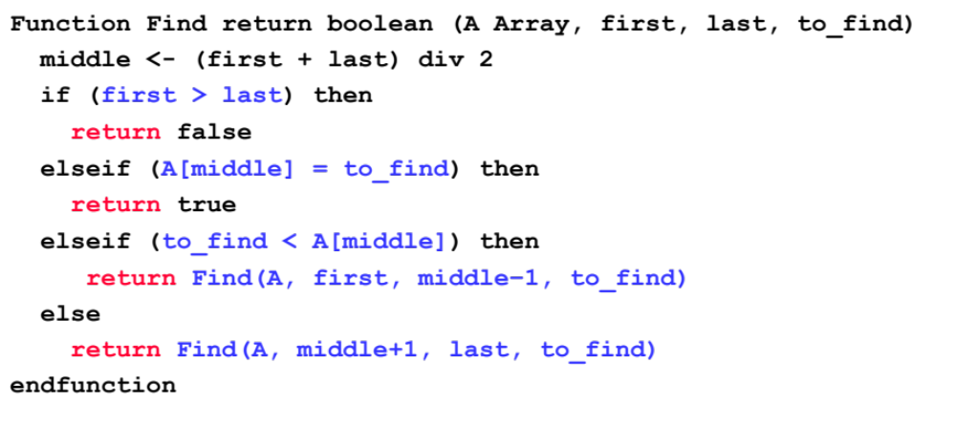
Binary Search Analysis: Best Case
Best Case:
1 comparison
Best Case: match from the firs comparison
1 7 9 12 33 42 59 76 81 84 91 92 93 99
Target: 59

Slide 37

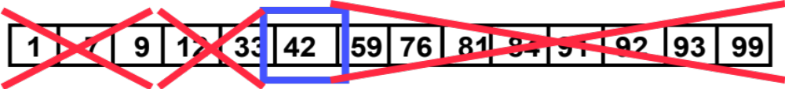
Binary Search Analysis: Worst Case
How many comparisons??
Worst Case: divide until reach one item, or no match.

Slide 38
Binary Search Analysis: Worst Case
With each comparison we throw away ½ of the list
N
…………
1 comparison
N/2
…………
1 comparison
Number of steps is at
most ➔Log₂N
N/4
…………
1 comparison
N/8
…………
1 comparison
.
.
.
1
…………
1 comparison

Slide 39
Summary
Binary search reduces the work by half at each comparison
If array is not sorted ➔ Linear Search
  Best Case O(1)
  Worst Case O(N)
If array is sorted ➔ Binary search
  Best Case O(1)
  Worst Case O(Log₂N)

