Slide 1
Trees

Slide 2

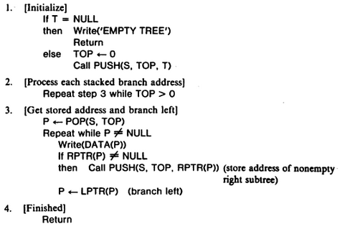
Iterative Preorder Traversal

Slide 3
Preorder(T)
1. [process the root node]
if T!= NULL
then Write Data(T)
else Write “empty Tree”
2. [process the left subtree]
if lptr(T) != NULL
call Rpreorder(lptr(T))
3. [process the right subtree]
if rptr(T) != NULL
call Rpreorder(rptr(T))
4. [Finished]
return.

Slide 4
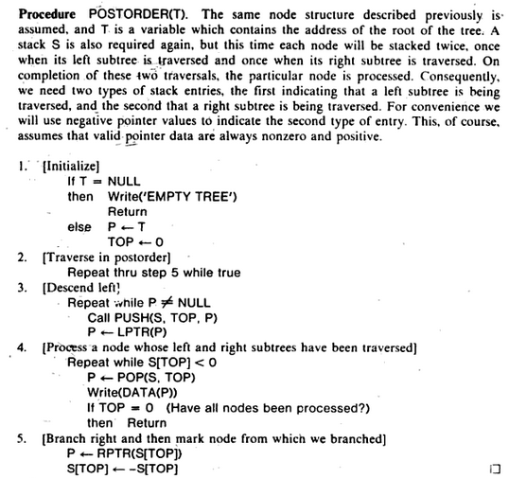
Iterative Postorder Traversal

Slide 5
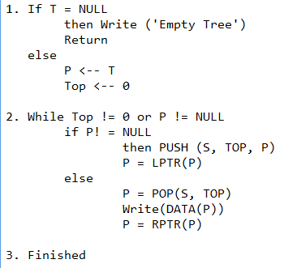
Iterative Inorder Traversal

Slide 6
Types of Trees
Expression tree
Binary Search tree
Heap tree
Threaded binary tree
Height balanced tree (AVL tree)
B Tree

Slide 7
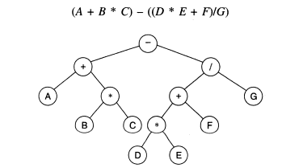
Expression Tree
It is a binary tree which stores an arithmetic expression.
The leaves of an expression tree are operands, such as constants or variable names, and all internal nodes are for operators.
An expression tree is always a binary tree because an arithmetic expression contains either binary operators or unary operators (hence an internal node has at most two children).

Slide 8
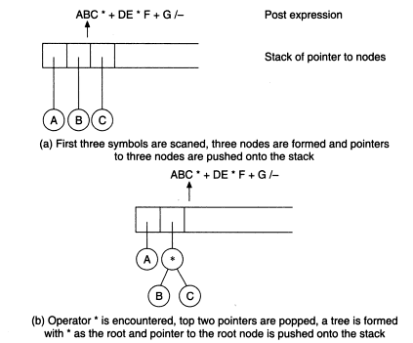
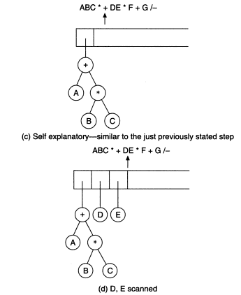
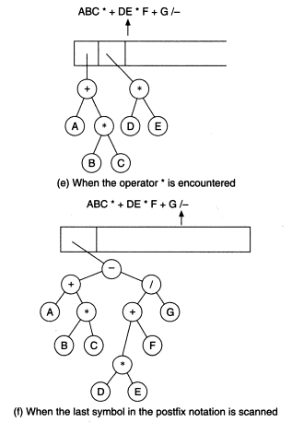
Construction of Expression Tree
Postfix expression: A B C * + D E * F + G / -

Slide 9
Types of Binary Trees
1. Full/Strictly Binary tree
2. Complete binary tree
3. Extended binary tree

Slide 10
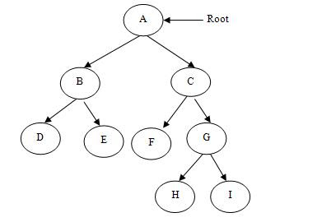
Full/Strictly binary tree
A full binary tree is a binary tree in which every node other than the leaves has two children. This is also called full or strictly binary tree.

Slide 11
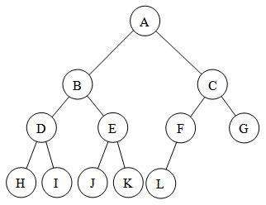
Complete Binary tree
A binary tree T with n levels is complete binary tree, if all levels except possibly the last are completely full, and the last level has all its nodes to the left side.

Slide 12
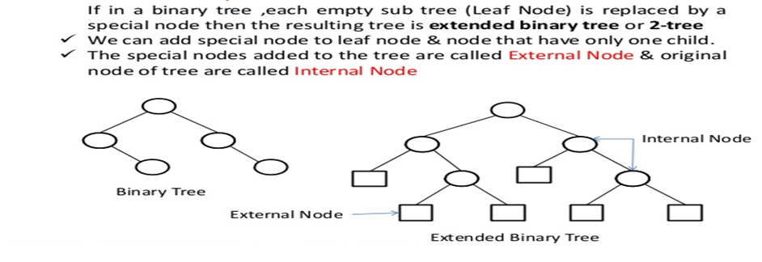
Extended Binary tree

Slide 13
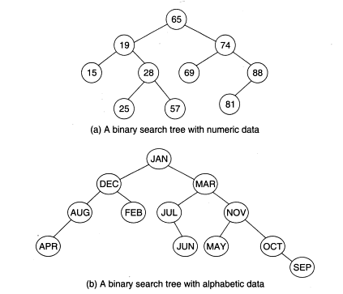
Binary Search Tree
A binary tree T is termed binary search tree (or binary sorted tree) if each node N of T satisfies the following property:
The value at N is greater than every value in the left sub-tree of N
The value at N is less than every value in the right sub-tree of N
Binary search tree operations:
Searching
Inserting
Deleting
Traversing

Slide 14
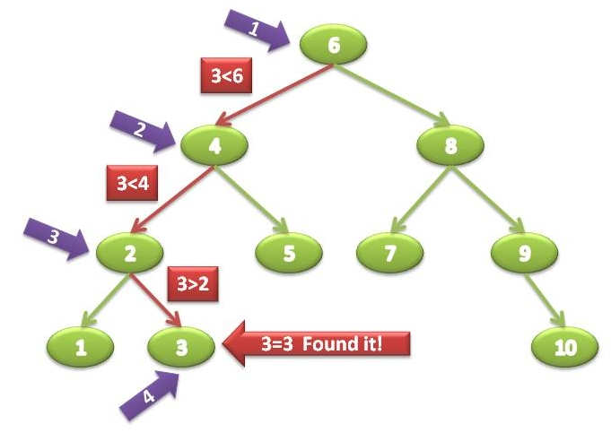
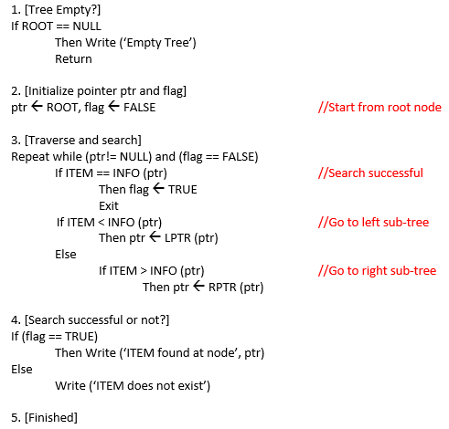
Searching in BST

Slide 15
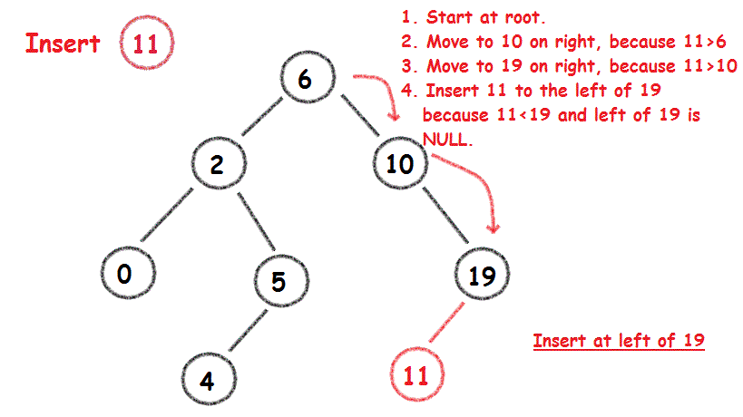
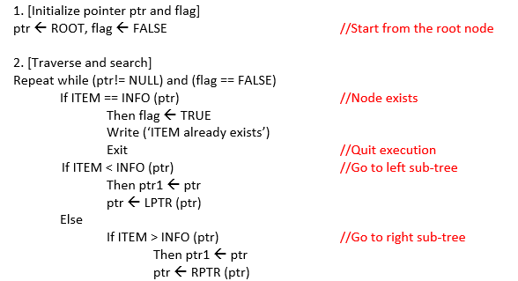
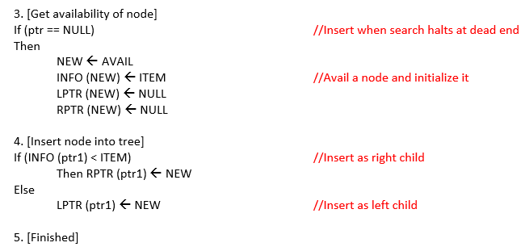
Insertion in BST

Slide 16
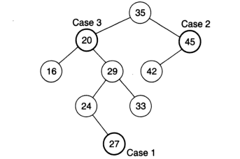
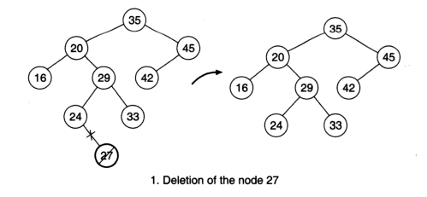
Deletion in BST
If N is leaf node
N has exactly one child
N has two children
Case 1: N is deleted from T by simply setting the pointer of N in the parent node PARENT(N) by null value.

Slide 17
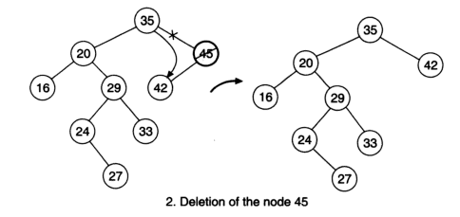
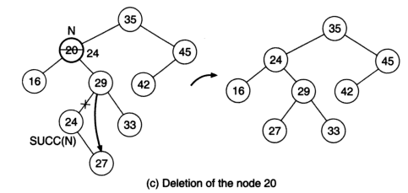
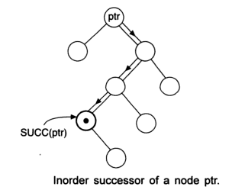
Deletion in BST
Case 2: N is deleted from T by simply replacing the pointer of N in PARENT(N) by the pointer of the only child of N.
Case 3: N is deleted from T by first deleting SUCC(N) from T (by using case1 or case2 it can be verified that SUCC(N) never has a child) and then replacing the data content in node N by the data content in node SUCC(N). Reset the left child of the parent of SUCC(N) by the right child of SUCC(N)

Slide 18
/*DECIDE THE CASE OF DELETION*/
IF(ptr->LCHILD=NULL) and (ptr->RCHILD=NULL) then
Case=1
ELSE
IF(ptr->LCHILD != NULL) and (ptr->RCHILD != NULL) then
Case=3
ELSE
Case=2
EndIf
EndIf
/*DELETION CASE 1*/
IF(case=1) then
If(parent->LCHILD = ptr) then
Parent->LCHILD = NULL
ELSE
Parent->RCHILD = NULL
EndIf
Return Node(ptr)
EndIf

Slide 19
/*DELETION Case 2*/
IF(case=2) then
If(parent->LCHILD = ptr) then
If(ptr->LCHILD=Null) then
Parent->LCHILD = ptr->RCHILD
ELSE
Parent->LCHILD = ptr->LCHILD
EndIf
Else
If(parent->RCHILD = ptr) then
If(ptr->LCHILD=NULL) then
Parent->RCHILD = ptr->RCHILD
Else
Parent->RCHILD = ptr->LCHILD
EndIf
EndIf
EndIf
ReturnNode(ptr)
EndIf
/*DELETION Case 3*/
If (case=3)
ptr2=SUCC(ptr1)
Item1=ptr2->DATA
Delete_BST(item1)
ptr1->DATA=item1
EndIf
Stop
SUCC(ptr)
PTR = ptr-> RCHILD
If (PTR != NULL) then
while (PTR -> LCHILD != NULL)
PTR= PTR-> LCHILD
Return(PTR)

Slide 20
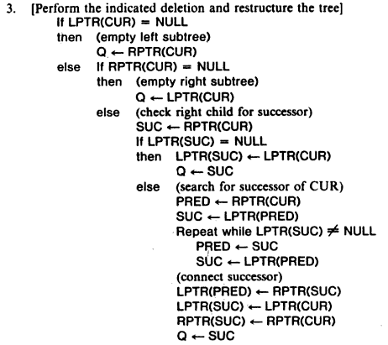
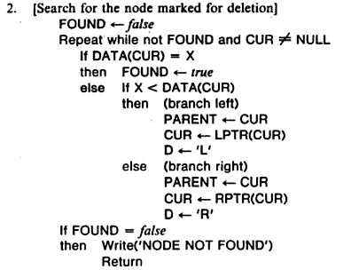


Deletion in BST

Slide 21
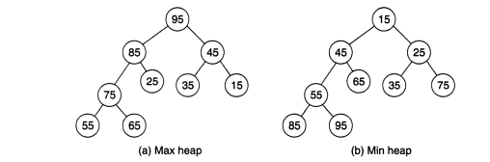
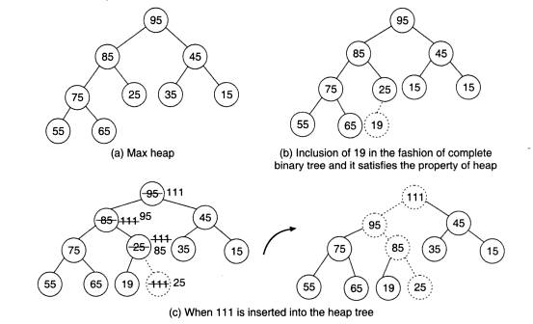
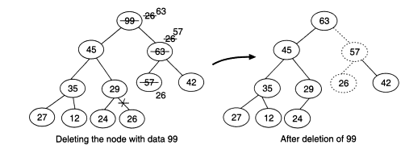
Heap

Slide 22
Create Heap / Insertion in Heap

Slide 23
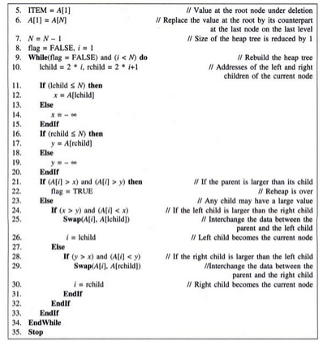
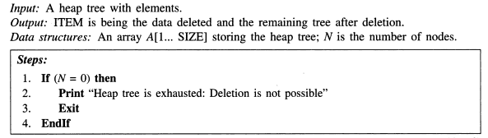
Deletion in Heap

Slide 24
Heap Sort

Slide 25
THANK YOU!!
ANY QUESTIONS??

