Slide 1


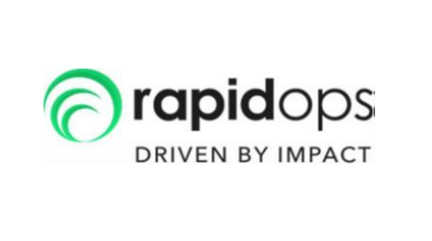
SPONSERS : rapidops
TEAM NAME : The_coders
TEAM MEMBERS :3
VARAD ACHARYA (21BCE006)
VISHAL ARYA (22BCE501)
PRATHAM GUPTA(22BCE508)

Slide 2
PROBLEM STATEMENT E-Commerce bot
Develop an e-commerce text or voice bot (plus points) that can assist customers in finding products, answering queries, and providing recommendations, thus enhancing the overall shopping experience and increasing sales.

Slide 3
INTRODUCTION :
Developing an e-commerce text or voice bot powered by language models like GPT (Large Language Models) and fine-tuned specifically for your e-commerce domain can greatly enhance customer experience and boost sales. Let's break down how this works:
Introduction to Language Models (LLMs): Language models like GPT (Generative Pre-trained Transformer) are powerful AI models trained on vast amounts of text data. They can understand and generate human-like text based on the input they receive. These models have been pre-trained on a wide range of text from the internet, making them capable of understanding and generating text across various topics and domains.
Fine-tuning Language Models for E-commerce: While pre-trained language models like GPT are proficient in understanding general language, fine-tuning them for specific domains like e-commerce can significantly enhance their performance and relevance. Fine-tuning involves training the model further on domain-specific data, such as product descriptions, customer queries, and transactional data from your e-commerce platform.
Benefits of Fine-tuning for E-commerce:
Improved Relevance: Fine-tuning allows the language model to better understand the nuances and specifics of your e-commerce domain, leading to more relevant and accurate responses.
Personalization: By fine-tuning on your e-commerce data, the model can learn about customer preferences, purchase history, and browsing behavior, enabling it to provide personalized recommendations and responses.
Enhanced Customer Experience: A language model fine-tuned for e-commerce can assist customers in finding products, answering queries, and providing recommendations in a more natural and conversational manner, leading to a smoother and more satisfying shopping experience.
Increased Sales: By providing tailored recommendations, answering customer queries promptly, and assisting them throughout their shopping journey, the e-commerce text or voice bot can help drive conversions and increase sales.

Slide 4
Capabilities of the E-commerce Bot:
Product Discovery: The bot can help customers discover products by understanding their preferences, suggesting relevant items, and guiding them through the product catalog.
Query Resolution: It can answer customer queries about products, pricing, availability, shipping, and returns policies, providing accurate and up-to-date information.
Recommendations: Based on the customer's browsing history, purchase behavior, and preferences, the bot can offer personalized product recommendations to enhance the shopping experience.
Order Assistance: The bot can assist customers in placing orders, tracking shipments, and handling post-purchase inquiries or issues.
Integration and Deployment:
Once the language model is fine-tuned for e-commerce, it can be integrated into your existing chatbot or voice assistant platform.
The bot can be deployed on your e-commerce website, mobile app, messaging platforms, or voice-enabled devices to interact with customers in real-time.

Slide 5
Our approach :
By leveraging language models like GPT and fine-tuning them for your e-commerce domain, you can create a sophisticated text or voice bot that revolutionizes customer engagement, drives sales, and provides a seamless shopping experience for your customers.
Technologies Used :
Python
AI/ML
NLP
LLM
API

Slide 6
Why should one choose your solution?
Choosing our solution, which leverages the CodeT5+ model, offers several compelling advantages for code generation tasks. Here are some key steps highlighting the reasons to opt for our approach:
State-of-the-Art Performance: Our Custom LLM built from gradientAI API key has demonstrated state-of-the-art performance in code generation tasks. Through extensive experimentation and evaluation, we observed superior results in terms of code quality, accuracy, and relevance.
Versatility and Adaptability: Our Custom LLM architecture provides a versatile framework for text-to-text tasks, making it highly adaptable to various programming languages and coding scenarios. It excels in understanding and generating diverse code structures, catering to a wide range of use cases.
Fine-Tuning for Code: Our solution involves fine-tuning our custom model specifically for recommendation and query-answering tasks. This focused training ensures that the model is optimized to comprehend user’s natural languages, coding conventions, and syntax, resulting in more contextually relevant and accurate code snippets.
Incorporating Lessons from Previous Models: Our approach builds upon the lessons learned from experimenting with other prominent language models such as GPT-2, LLMa, and BERT. By selecting the most effective elements from these models, we have crafted a solution that combines the strengths of various approaches for enhanced performance.
Robustness and Generalization: Our custom model exhibits robust generalization capabilities, allowing it to generate code snippets that perform well across a diverse set of inputs and scenarios. This ensures consistent and reliable performance in real-world applications.
Community Support and Updates: Our solution benefits from continuous community support and updates. Leveraging the latest advancements in transformer-based models and actively participating in the open-source community ensures that our approach stays at the forefront of advancements in natural language processing and code generation.
User-Friendly Integration: We provide user-friendly integration options, making it easy for developers and data scientists to seamlessly incorporate our code generation solution into their workflows. Clear documentation and support further facilitate a smooth implementation process.

Slide 7
Limitations of your solution
While leveraging Language Models (LLMs) like our custom model for e-commerce text or voice bots offers numerous benefits, there are some limitations to consider:
Data Bias: Fine-tuning on a specific dataset may introduce biases, leading to skewed or inaccurate responses, especially if the dataset is not representative or diverse enough.
Context Understanding: LLMs may struggle to grasp complex or nuanced contexts, resulting in occasional misinterpretations or inadequate responses to customer queries.
Domain Specificity: Fine-tuning on e-commerce data may improve relevance, but the model may still lack deep domain expertise, leading to limitations in understanding specialized product categories or industry jargon.
Data Privacy: Using customer data to fine-tune models raises privacy concerns. Safeguarding sensitive information and adhering to data protection regulations is crucial to maintain customer trust.
Scalability: As the volume of data and user interactions grows, scalability becomes a concern. Ensuring the model can handle increased workload and maintain performance levels is essential for long-term viability.
Model Updates: Language models require regular updates to stay relevant and effective. Managing model updates while ensuring consistency and coherence in responses poses a challenge.
Interpretability: LLMs often operate as black boxes, making it difficult to understand how they arrive at certain responses. Lack of interpretability can hinder trust and transparency in the decision-making process.

Slide 8
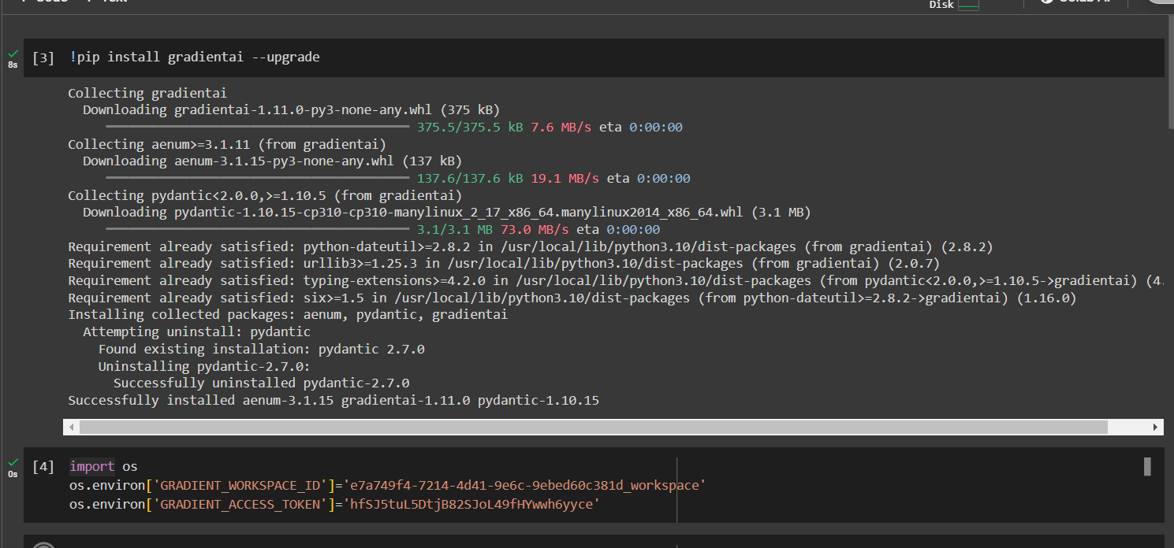
Screenshot/Demonstration of your solution in the form of a video or live demo:

Slide 9
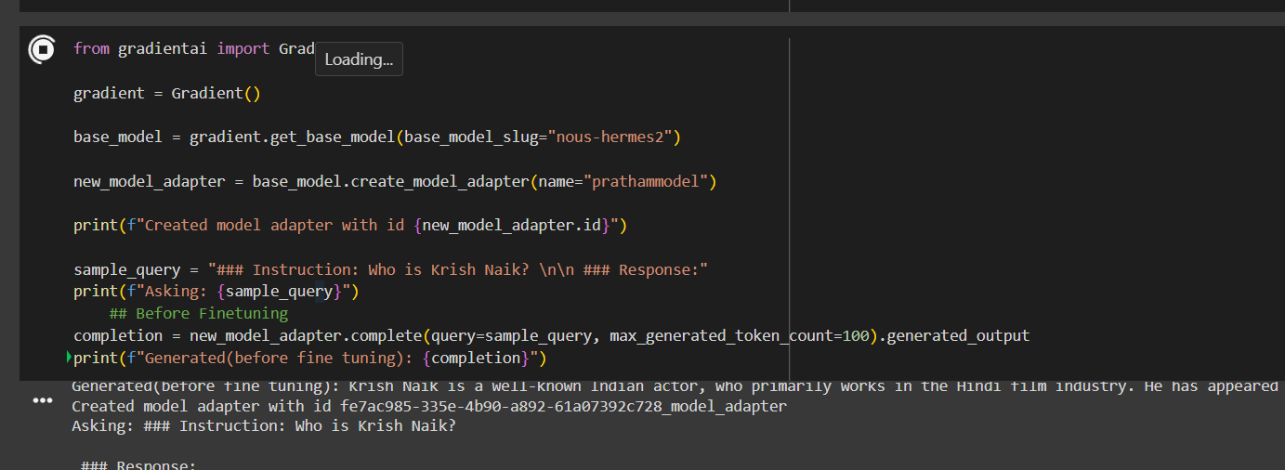

Slide 10
