Slide 1




SPONSERS : INTECH
TEAM NAME : Smash_coder
TEAM MEMBERS :
VARAD ACHARYA (21BCE006)
ARKIN GAMIT(21BCE072)
VISHAL ARYA (22BCE501)
PRATHAM GUPTA(22BCE508)
PRIT DHUDIA(22BCE505)

Slide 2
PROBLEM STATEMENT : CodeGenXpert AI Based solution
The primary objective of this project is to develop an AI-based interactive code generation platform that can learn from a company-specific codebase and generate code aligned with its architecture, functionalities, and coding standards. The solution will automate the generation of boilerplate code, scaffolding, and other repetitive tasks, thereby enabling rapid development with high coding standards. Below diagram illustrates the workflow of the AI-based code generation process.
● It begins with feeding the company-specific codebase to AI/ML components.
● Next, an AI/ML module is expected to learn the codebase by finding various patterns within the same.
● Then the developer may state the requirements to the AI/ML component and then it generates new code snippets or modules, which are expected to be aligned with the project's architecture and coding standards.
● Here the main focus should be to design AI/ML modules that are required to be designed from scratch. INTECH will provide a sample code repository which one can use as a codebase for this system.

Slide 3
INTRODUCTION :
The process involves adapting the model to understand and generate code snippets or perform tasks related to programming languages. Here's a general outline of the steps:
Dataset Preparation:
Gather a dataset containing code snippets in web languages like HTML, CSS, JavaScript, Python, etc.
Annotate the dataset for the specific task you want the model to perform, such as code completion, summarization, or similarity checking.
Tokenization:
Tokenize the code snippets using the same tokenization strategy used for natural language text. You can use a tokenizer compatible with RoBERTa.
Model Fine-Tuning:
Fine-tune the pre-trained RoBERTa model on your code dataset. You can use popular deep learning frameworks like PyTorch or TensorFlow.
Design a task-specific head or modify the final layers of RoBERTa to suit your task.
Training:
Train the modified model on your code dataset. Monitor training metrics like loss and validation performance.
Evaluation:
Evaluate the fine-tuned model on a separate code dataset to ensure it generalizes well to new examples.
Inference:
Use the fine-tuned RoBERTa model for code-related tasks. You can integrate it into your applications or services.

Slide 4
OUR PROPOSED APPROACH :
In our quest to enhance code generation capabilities, we systematically experimented with various language models, including GPT-2, LLMa, BERT, and others. After thorough evaluation, we found that the CodeT5+ model consistently outperformed the others in terms of generating high-quality and contextually relevant code snippets. Leveraging the strengths of T5, a text-to-text transformer architecture, specifically fine-tuned for code-related tasks, our approach capitalizes on the model's ability to understand and generate code sequences effectively. This choice was driven by the need for a robust and versatile language model that excels in capturing intricate programming patterns and syntax, making it an ideal candidate for our code generation tasks.

Slide 5
Why should one choose your solution?
Choosing our solution, which leverages the CodeT5+ model, offers several compelling advantages for code generation tasks. Here are some key steps highlighting the reasons to opt for our approach:
State-of-the-Art Performance: CodeT5+ has demonstrated state-of-the-art performance in code generation tasks. Through extensive experimentation and evaluation, we observed superior results in terms of code quality, accuracy, and relevance.
Versatility and Adaptability: The T5 architecture provides a versatile framework for text-to-text tasks, making it highly adaptable to various programming languages and coding scenarios. It excels in understanding and generating diverse code structures, catering to a wide range of use cases.
Fine-Tuning for Code: Our solution involves fine-tuning the T5 model specifically for code-related tasks. This focused training ensures that the model is optimized to comprehend programming languages, coding conventions, and syntax, resulting in more contextually relevant and accurate code snippets.
Incorporating Lessons from Previous Models: Our approach builds upon the lessons learned from experimenting with other prominent language models such as GPT-2, LLMa, and BERT. By selecting the most effective elements from these models, we have crafted a solution that combines the strengths of various approaches for enhanced performance.
Robustness and Generalization: CodeT5+ exhibits robust generalization capabilities, allowing it to generate code snippets that perform well across a diverse set of inputs and scenarios. This ensures consistent and reliable performance in real-world applications.
Community Support and Updates: Our solution benefits from continuous community support and updates. Leveraging the latest advancements in transformer-based models and actively participating in the open-source community ensures that our approach stays at the forefront of advancements in natural language processing and code generation.
User-Friendly Integration: We provide user-friendly integration options, making it easy for developers and data scientists to seamlessly incorporate our code generation solution into their workflows. Clear documentation and support further facilitate a smooth implementation process.

Slide 6
Limitations of your solution
Contextual Understanding: The model's understanding is contextually limited to the training data it has been exposed to. It may struggle with highly specialized or niche coding patterns that deviate significantly from the training set.
Ambiguity Handling: CodeT5+ may face challenges in handling ambiguous requirements or poorly defined input specifications. Ambiguities in the prompt might lead to less precise or varied code outputs.
Debugging Logic Errors: While proficient at syntax and structure, the model may not effectively identify logical errors in the code. Developers should exercise caution and conduct thorough testing to ensure the generated code functions as intended.
Security Concerns: Like any language model, CodeT5+ might inadvertently generate code that contains security vulnerabilities or flaws. It is crucial to conduct security reviews and audits of the generated code before deployment in a production environment.
Limited Knowledge Horizon: The model's knowledge is based on data available up to its training cut-off date. It might lack awareness of the latest programming languages, frameworks, or coding best practices that emerged after that date.
Dependency on Training Data Quality: The performance of CodeT5+ heavily relies on the quality and diversity of the training data. Inadequate or biased data may result in the model producing less accurate or biased code outputs.

Slide 7
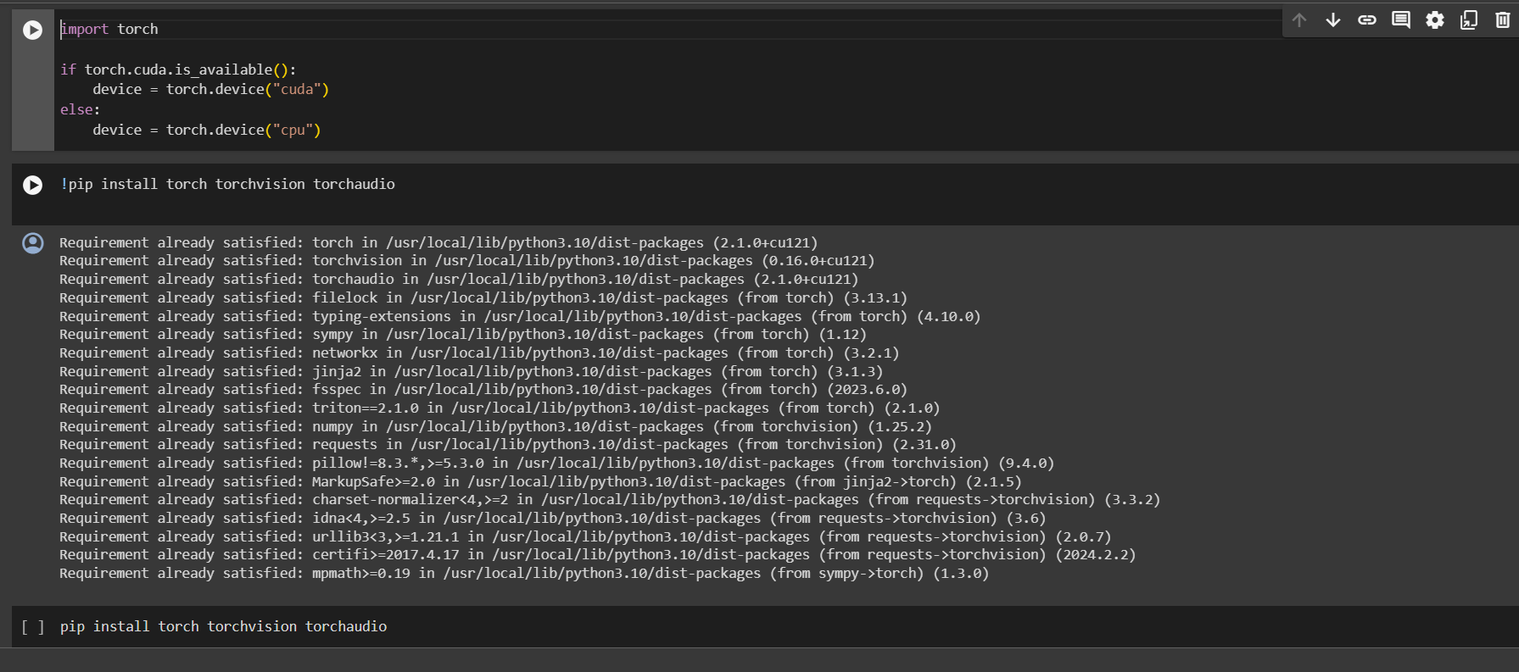
Screenshot/Demonstration of your solution in the form of a video or live demo:

Slide 8
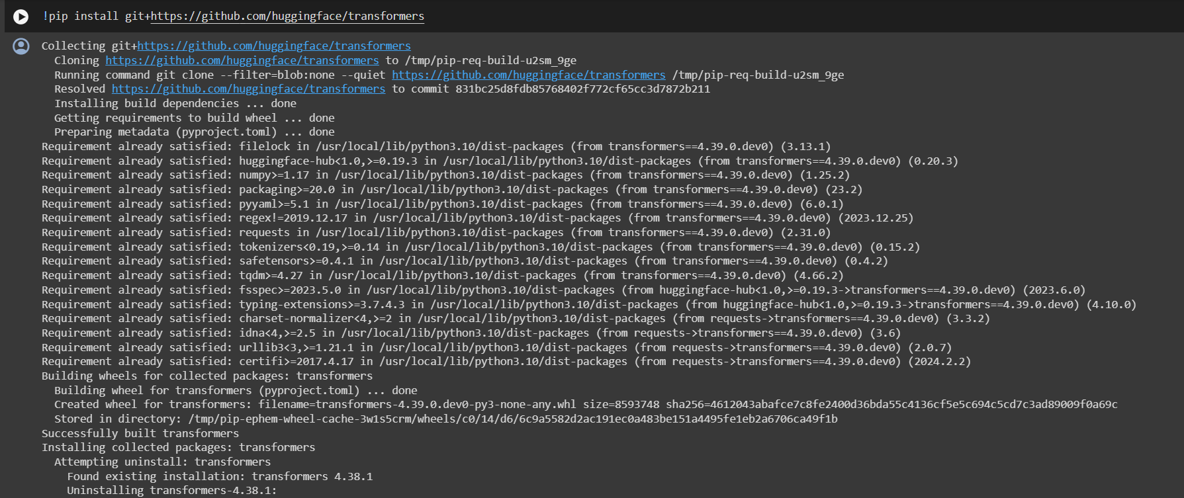

Slide 9
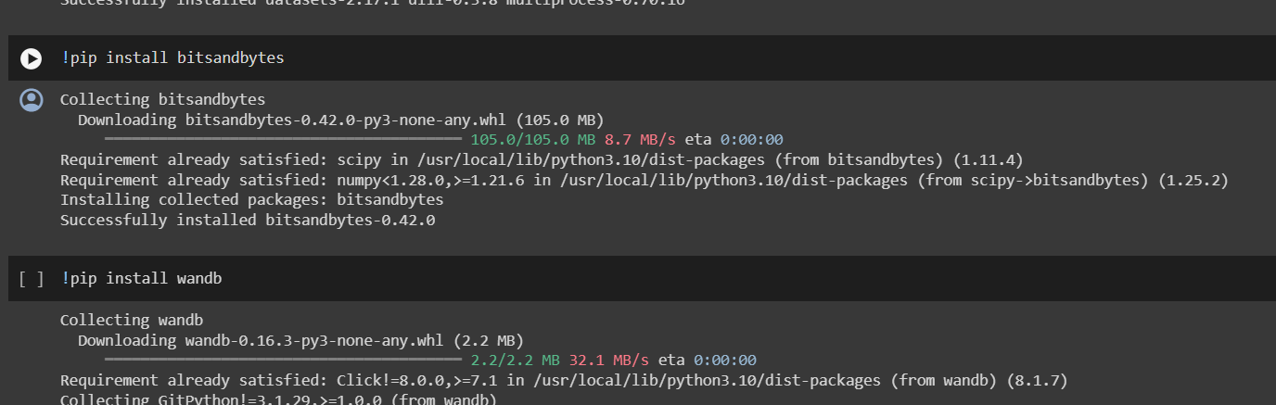

Slide 10
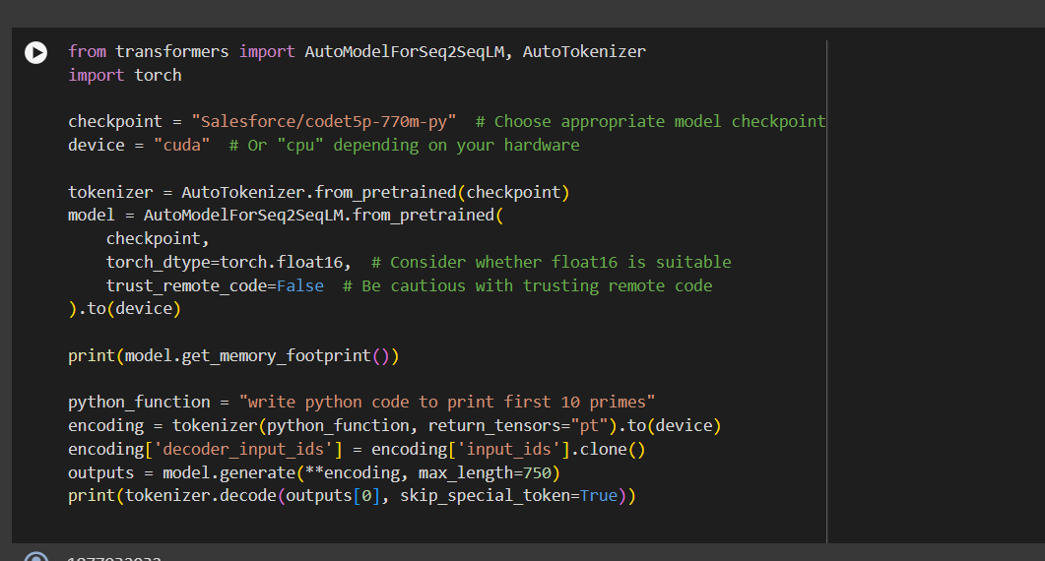

Slide 11
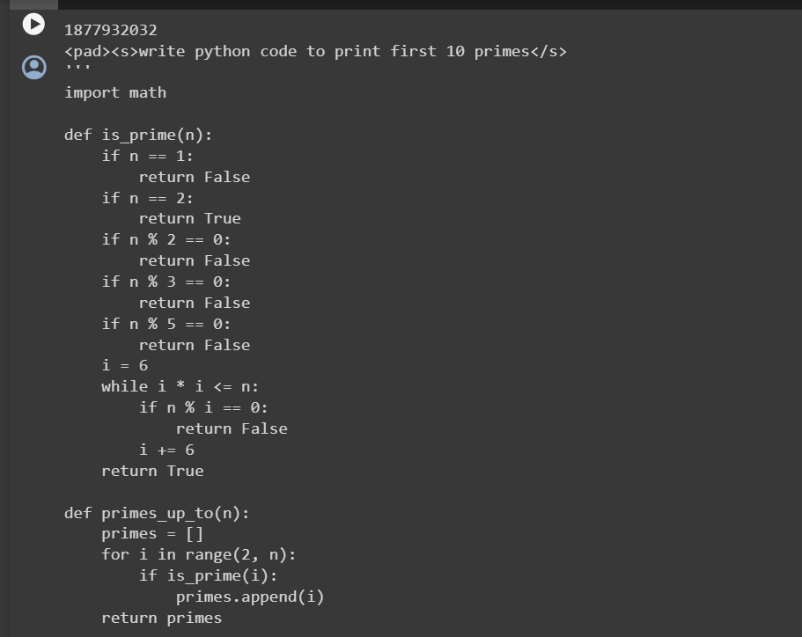

Slide 12
