Slide 1
Decoding Emotions: How AI read Between the lines
A Sentiment Analysis Project by Aditya Singh

Slide 2
Table of contents
01
02
03
04
05
06
Introduction
description
concept and Theory
A Lit Bit of Everything
Description of the Idea and the project itself
Core Concepts behind the Idea
approach
Workflow
Conclusion
Selected Approach and Implementation Details
Workflow of the project
Scope, Impact and Expected Improvements

Slide 3

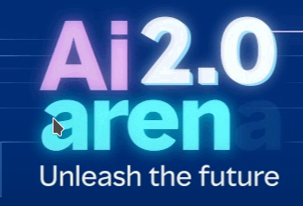
AI arena 2.0
Problem Statement: Use AI/ML models to create a new technology/improve an existing technology to perform a certain task that can reduce human involvement.

Slide 4
01
Introduction
A Little Bit of Everything

Slide 5
Decoding the Voices of Millions: A Universal Sentiment Analysis Model for Unlocking the Language of Emotion
From social media posts to online reviews, the digital landscape buzzes with human expressions. But beneath the surface of words lies a hidden world of emotions. Enter our pioneering sentiment analysis model, a powerful tool capable of translating the language of feelings with remarkable accuracy.

Slide 6
02
Description
Description of the Idea and Project Itself

Slide 7
Imagine effortlessly navigating the intricate landscape of human sentiment – no matter the source. This project presents a versatile sentiment analysis model designed to understand the emotional undercurrents in any text. Whether it's gauging public opinion on social media, analyzing customer feedback, or extracting insights from news articles, this model unlocks the hidden power of words.

Slide 8

Key features:
Universal applicability: Trained on a diverse dataset of text across various domains, the model excels at understanding sentiment in a wide range of contexts.
Cutting-edge LSTM RNN architecture: Leveraging the power of LSTM networks, the model captures subtle nuances and long-term dependencies within text, resulting in precise sentiment identification.
Local deployment flexibility: Run the model seamlessly on your own machines, ensuring data privacy and control.

Slide 9
03
Concept and theory
Core concepts and Theory behind the Idea

Slide 10
NLP and Sentiment Analysis
NLP: Imagine a translator for computers, but for emotions! NLP helps machines understand the meaning and feelings behind human language, like the hidden joy in a sarcastic tweet.
Sentiment Analysis: Think of it as an emotion scanner for text. It uses NLP to analyze words and phrases, classifying them as positive, negative, or neutral, revealing the hidden feelings in written communication.
Together, NLP and Sentiment Analysis unlock the secrets of human language, letting computers see right through our words and understand the true sentiments within.

Slide 11
LSTM (Long-short term memory)
Memory Masters: Imagine tiny text detectives with lightning-fast memory scans. Single-layer LSTMs analyze sentences like detectives, remembering key clues (word context) to crack the "positive or negative?" case.
Simplicity Wins: Though not the beefiest agents on the block, these LSTMs excel at pinpointing long-term connections in text – vital for sentiment analysis. Think of them as streamlined sleuths – perfect for everyday sentiment mysteries.
Sometimes, Teamwork: For trickier cases, they might call in reinforcements like multi-layered models. But for most sentiment sleuthing, these single-layer stars get the job done.
No Bias, Just Clues: These ethical investigators never judge based on irrelevant details like race or gender. They focus purely on the textual evidence, ensuring fair and accurate sentiment analysis.
Safe & Sound: Rest assured, these digital detectives operate within strict safety protocols. No sensitive information is ever accessed, and their investigations follow the highest ethical standards.
Remember, whether it's a simple tweet or a complex review, these single-layer LSTMs are always on the case, deciphering the language of sentiment with precision and fairness.

Slide 12
04
Approach
Selected Approach and Implementation Details

Slide 13
Approach and implementation
Approach:
Simple and efficient LSTM: Utilizing a single-layer LSTM model to capture long-term dependencies in text and perform sentiment analysis effectively.
Focus on core functionality: Prioritizing basic sentiment analysis (positive, negative, neutral) without exploring complex model architectures or nuanced emotions.
Command-line or script-based interaction: Enabling interaction with the model through command-line prompts or Python scripts, providing flexibility for various use cases.
Implementation:
Preprocessing: Cleaning and tokenizing text data, preparing it for the LSTM model.
Model training: Feeding labeled sentiment data (positive, negative, neutral) to train the LSTM model to associate word sequences with emotions.
User interaction: Implementing a command-line interface or Python scripts to:
→ Accept user input of text or load text files.
→ Preprocess text using the trained model.
→ Generate sentiment predictions and display results in a clear format.

Slide 14
05
Workflow
Workflow of the project

Slide 15
timeline
02
04
Data
Analysis
Data Acquisition and Preprocessing
Overall analysis, Visualization and deployment
01
03
Project scope
Training
Defining the scope of the project.
Model Training and Evaluation

Slide 16
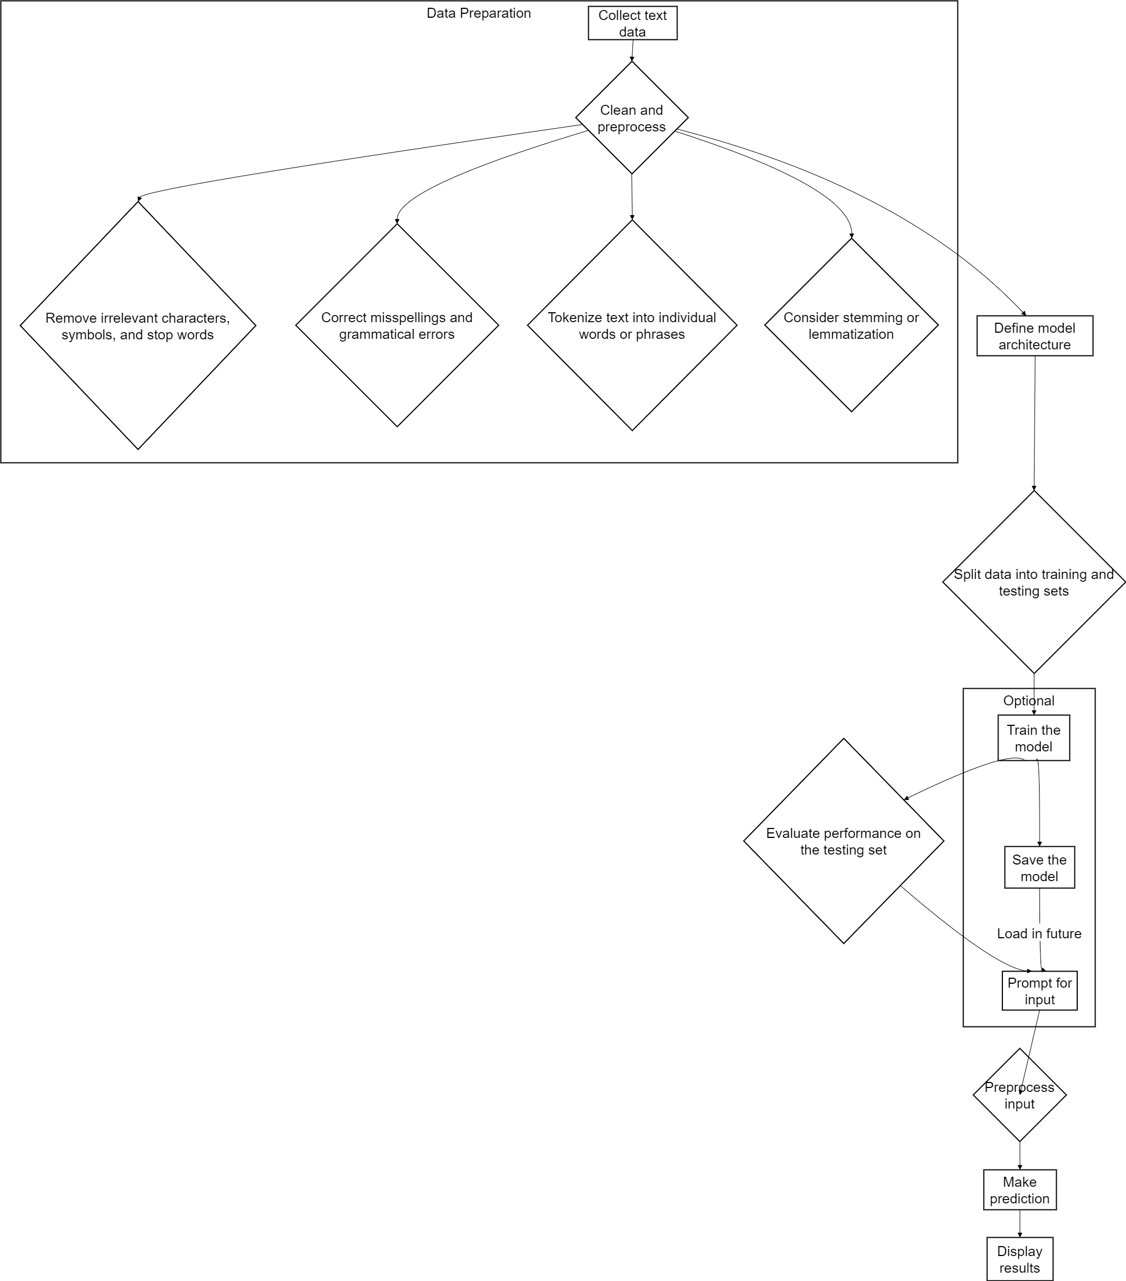
This flowchart outlines the intricate process of the sentiment analysis bot, detailing each step from data collection and preprocessing to model training, prediction, and result presentation. It visually captures the interplay between data preparation, model building, user interaction, and optional model saving and loading functionalities.

Slide 17
06
conclusion
Scope, Impact and Expected Improvements

Slide 18
Conclusion, Impact and Improvements
Conclusion
The project appears to have been successful in achieving its goals of improving absorptive capacity through the use of micro-foundations. The specific micro-foundations used are not shown in the image, but the overall approach seems to have been effective.
Impact
The project is likely to have a positive impact on the community in which it was implemented. By improving absorptive capacity, the project will make it easier for the community to adapt to change and take advantage of new opportunities. This could lead to economic growth, job creation, and improved quality of life for residents.
Future improvements
There are a number of ways in which the project could be improved in the future. One would be to collect more data on the impact of the project, in order to better understand how it is working and how it can be made even more effective. Another would be to develop a plan for scaling up the project, so that it can be implemented in other communities. Finally, the project could be improved by developing a system for monitoring and evaluating its long-term impact.

Slide 19
0>0
Thank you

