Slide 1
NBA Players Positions
Data Science Final Project

Slide 2
Our Project
Research question:
Can we predict the position of a player on the court from players data?
and what other conclusions can we observe from it?

Slide 3
Data sources
Crawling:
www.basketball-reference.com
Data acquisition
Data processing
EDA
Machine Learning
Conclusions

Slide 4
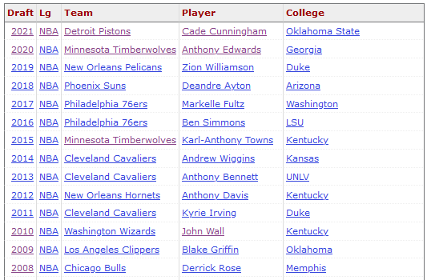

Crawling
We used ‘Beautiful soup’ library to pull the data from the html page and the requests library in order to send http requests.
.
We crawled in each link and
extracted the data for each year,
Inserting it into a dataframe
Data acquisition
Data processing
EDA
Machine Learning
Conclusions

Slide 5
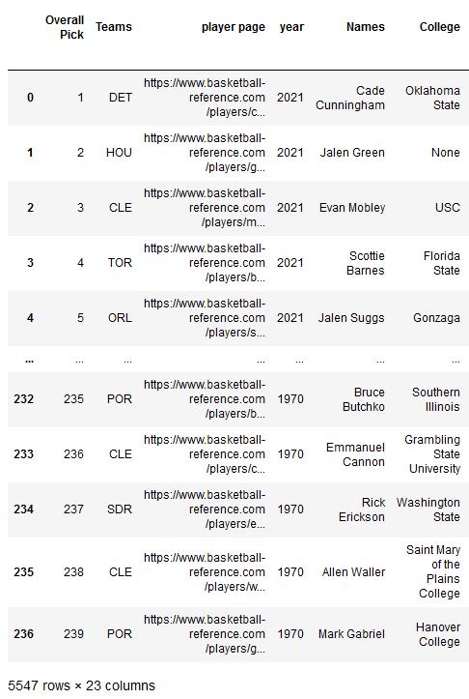
Crawling
Raw data:
Data acquisition
Data processing
EDA
Machine Learning
Conclusions

Slide 6
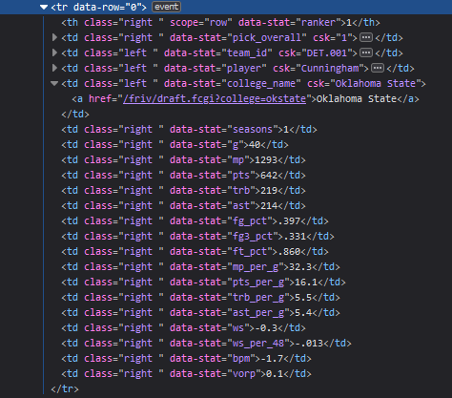
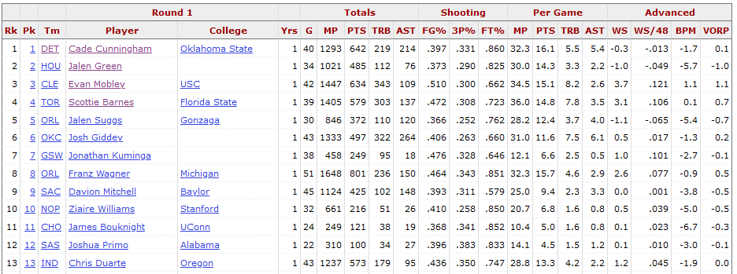
Crawling
Here we can see in each year how the html page is built and
Where we needed to get with the crawling
Data acquisition
Data processing
EDA
Machine Learning
Conclusions

Slide 7
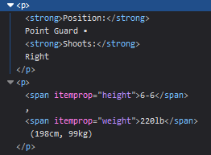
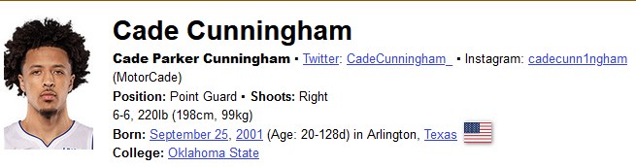
Crawling
We continued to create a Dataframe with each players stats: position,
Height and weight,
Cleaning it and merging it with the original Dataframe.
Data acquisition
Data processing
EDA
Machine Learning
Conclusions

Slide 8
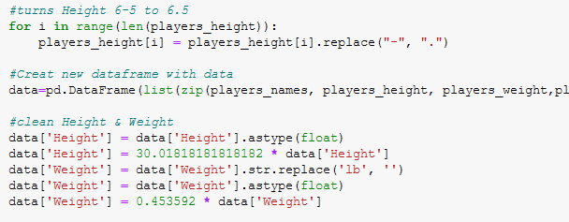
Cleaning the data
After we got a final Dataframe, we removed NaN values.
The height and weight we got were ‘str’, so we converted them to ‘float’
Values, removed any unwanted characters (“lb”) and turned the
Height to cm and weight to kg.
Data acquisition
Data processing
EDA
Machine Learning
Conclusions

Slide 9

Cleaning the data
For players who had more than one position, we split the str and cleaned the column so there will be only one position per column.
Data acquisition
Data processing
EDA
Machine Learning
Conclusions

Slide 10
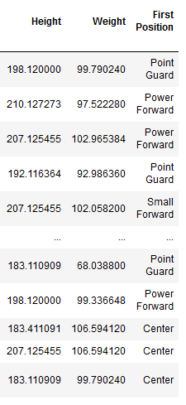
Cleaning the data
Data acquisition
Data processing
EDA
Machine Learning
Conclusions

Slide 11
EDA
Overall Pick
About our data:
Overall pick: which place the player was picked
Teams: which team picked the player
Year: which year he was picked
Names: player name
College: player college
Seasons in NBA: how many seasons the player has been playing to date
# Games
Minutes played
Points
Total rebound
Data acquisition
Data processing
EDA
Machine Learning
Conclusions

Slide 12
EDA
Overall Pick
Assists
Field goal %
3 point Field goal %
Free throw %
Minutes played per game
Point per game
Rebounds per game
Assists per game
Win shares: An estimate of the number of wins contributed by a player.
Win shared per 48 minutes:An estimate of the number of wins contributed by a player per 48 minutes (league average is approximately .100)
Data acquisition
Data processing
EDA
Machine Learning
Conclusions

Slide 13
EDA
Overall Pick
Box +-: A box score estimate of the points per 100 possessions a player contributed above a league-average player, translated to an average team.
VORP: A box score estimate of the points per 100 TEAM possessions that a player contributed above a replacement-level (-2.0) player, translated to an average team and prorated to an 82-game season.
Height
Weight
First position
Data acquisition
Data processing
EDA
Machine Learning
Conclusions

Slide 14
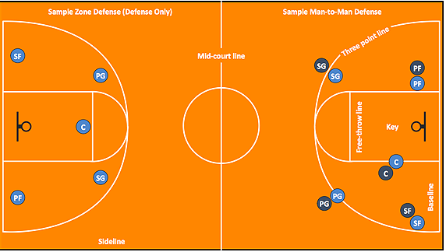
EDA
Overall Pick
Data acquisition
Data processing
EDA
Machine Learning
Conclusions

Slide 15
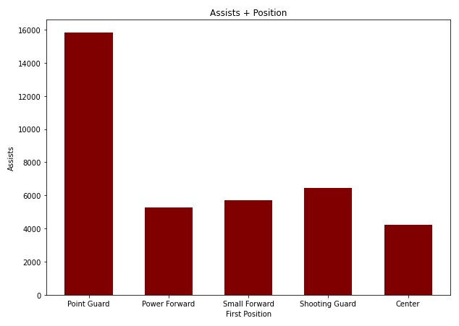
EDA
Overall Pick
We try to use plots to discovers connection between veriables.
We started with Assist and position:
We can see that the Point guard
Position has by far more
Assists than the other positions.
Data acquisition
Data processing
EDA
Machine Learning
Conclusions

Slide 16
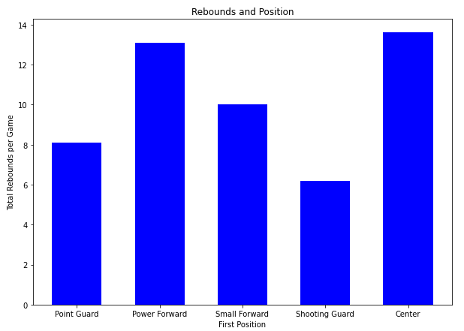
EDA
Overall Pick
Positions and rebound:
We can see that the Power forward
And center Positions have more
rebound than the other positions.
Data acquisition
Data processing
EDA
Machine Learning
Conclusions

Slide 17
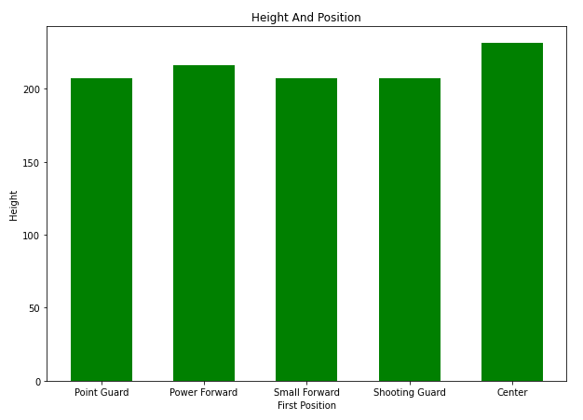
EDA
Overall Pick
When we looked at the height of
The players vs the player position,
We could see there is not a lot of
Difference – not one position that
Stood out.
So we checked it again in a different
Way.
Data acquisition
Data processing
EDA
Machine Learning
Conclusions

Slide 18
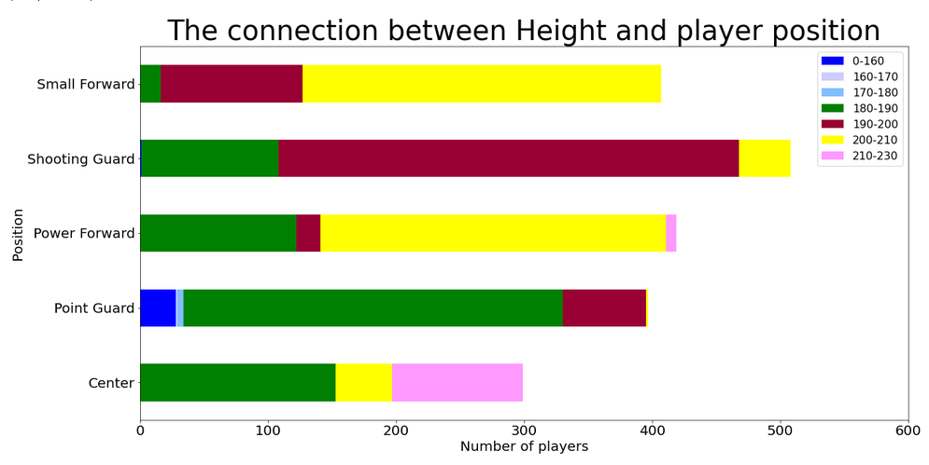
EDA
Overall Pick
We split the players into height groups, and than split them again
By position. Here we can see clearly that most players above 210cm are in the Center position, and that there are not a lot of players in that group height in comparison to the other height groups, which makes sense – humans rarely get above 2 meters.
The average height in the USA is only 175cm
Data acquisition
Data processing
EDA
Machine Learning
Conclusions

Slide 19
EDA
Overall Pick
Furthermore – we can see a small group which is up to 160cm that shows only in the Point Guard position.
Data acquisition
Data processing
EDA
Machine Learning
Conclusions

Slide 20
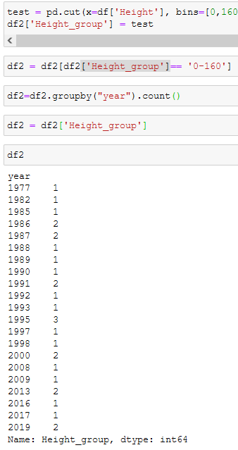
EDA
Overall Pick
After a quick check – there are 29
players in that group height, and they vary in years.
Data acquisition
Data processing
EDA
Machine Learning
Conclusions

Slide 21
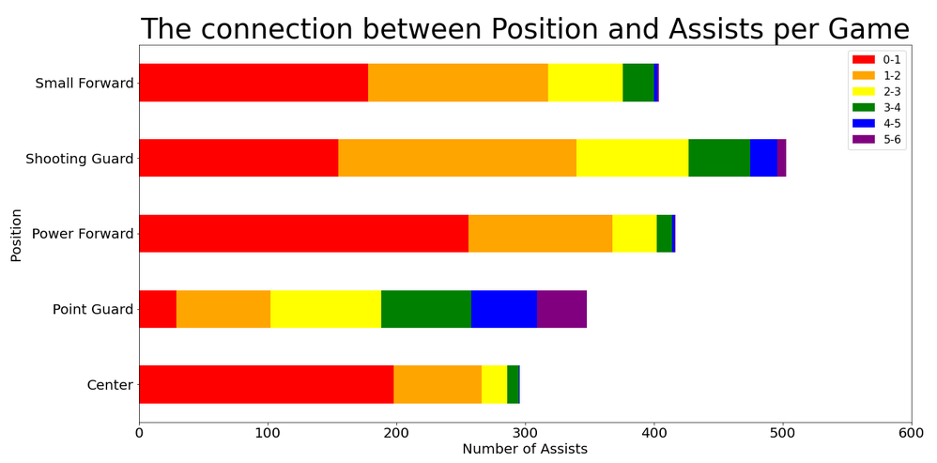
EDA
Overall Pick
We also checked if a player height and position affected the amount of assist per game.
We can see that the overall difference isn’t that large, but point guard do have more players with larger amount of assists per game.
Data acquisition
Data processing
EDA
Machine Learning
Conclusions

Slide 22
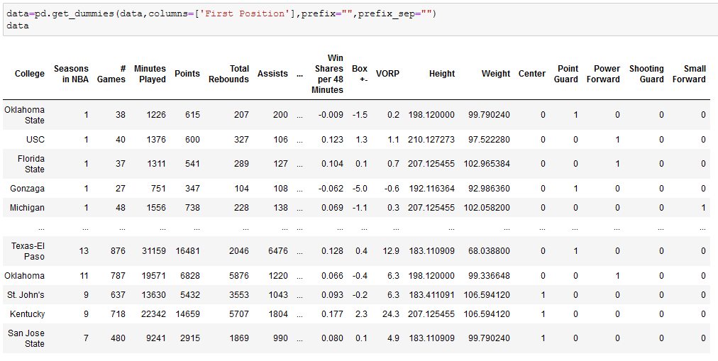
Machine learning
Overall Pick
Our research question was “Can we predict the position of a player on the court from players data?” which is a classification problem.
We started with
creating new
Dummy columns in
the Dataframe:
Data acquisition
Data processing
EDA
Machine Learning
Conclusions

Slide 23
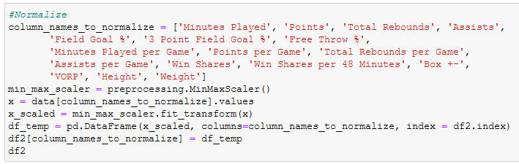
Machine learning
Overall Pick
We transformed any ‘str’ type columns to numeric:
And than we normalized all the numeric data columns:
Data acquisition
Data processing
EDA
Machine Learning
Conclusions

Slide 24

Machine learning
Overall Pick
We created new Dataframes for each position, so we could use our classification models on each one
Data acquisition
Data processing
EDA
Machine Learning
Conclusions

Slide 25
Classification Models
Overall Pick
We used 3 classification models:
KNN, Logistic Regression and Decision tree.
We ran each model on each position and checked to see which model would predict in the best way each positon.
Data acquisition
Data processing
EDA
Machine Learning
Conclusions

Slide 26
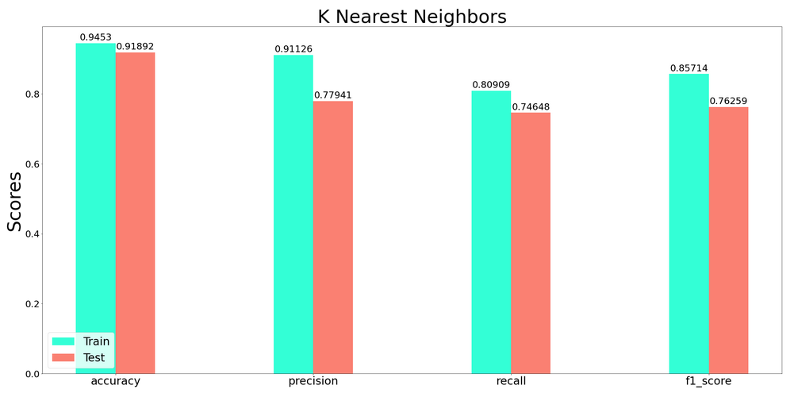
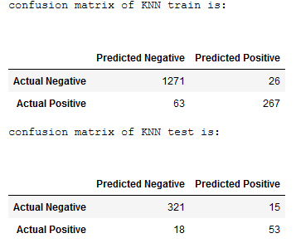
Machine learning
Overall Pick
Point guard: KNN
Data acquisition
Data processing
EDA
Machine Learning
Conclusions

Slide 27
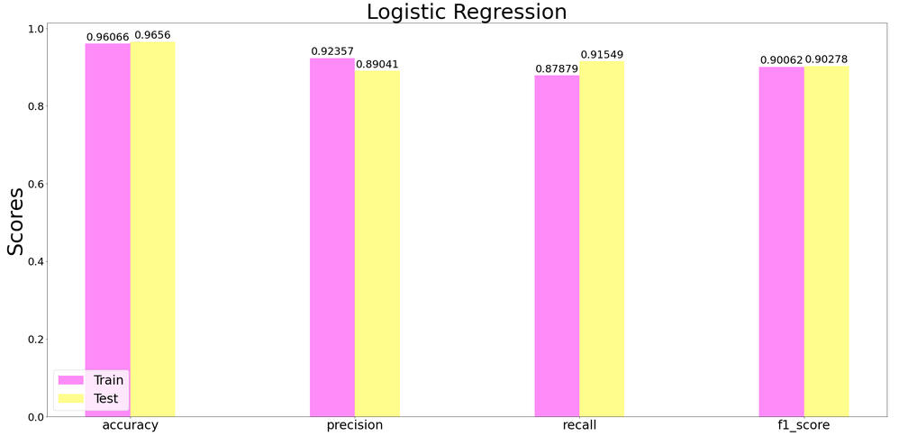
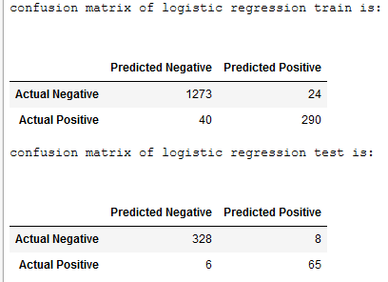
Machine learning
Overall Pick
Point guard: Logistic Regression
Data acquisition
Data processing
EDA
Machine Learning
Conclusions

Slide 28
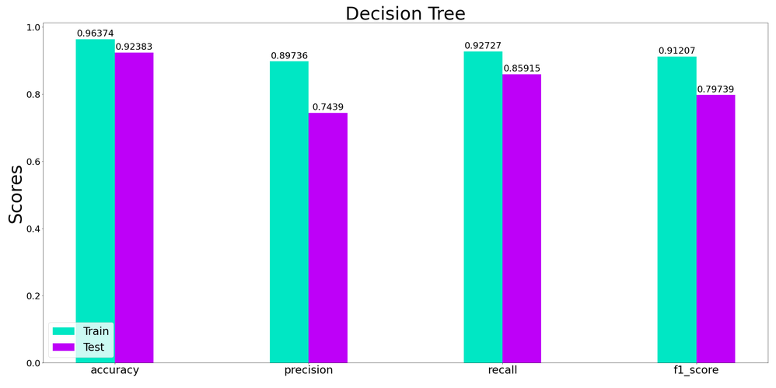
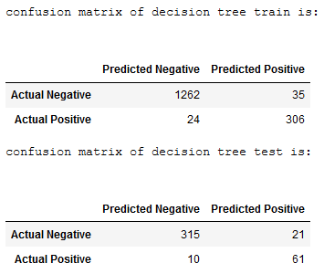
Machine learning
Overall Pick
Point guard: Decision Tree
Data acquisition
Data processing
EDA
Machine Learning
Conclusions

Slide 29
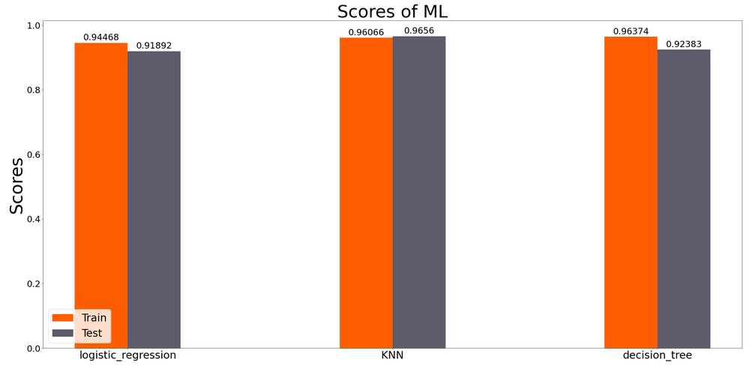
Machine learning
Overall Pick
Point guard: Models comparison
For the Point guard position, we can see that the KNN is the most accurate.
Data acquisition
Data processing
EDA
Machine Learning
Conclusions

Slide 30
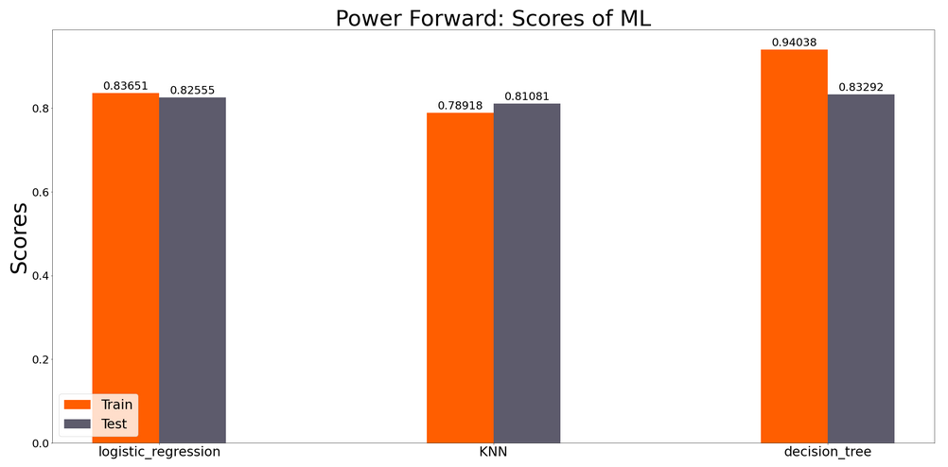
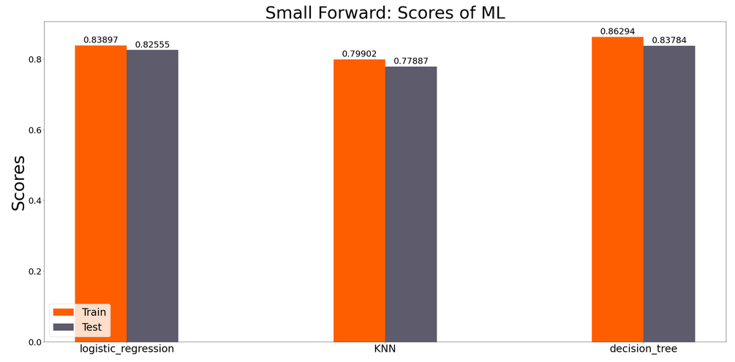
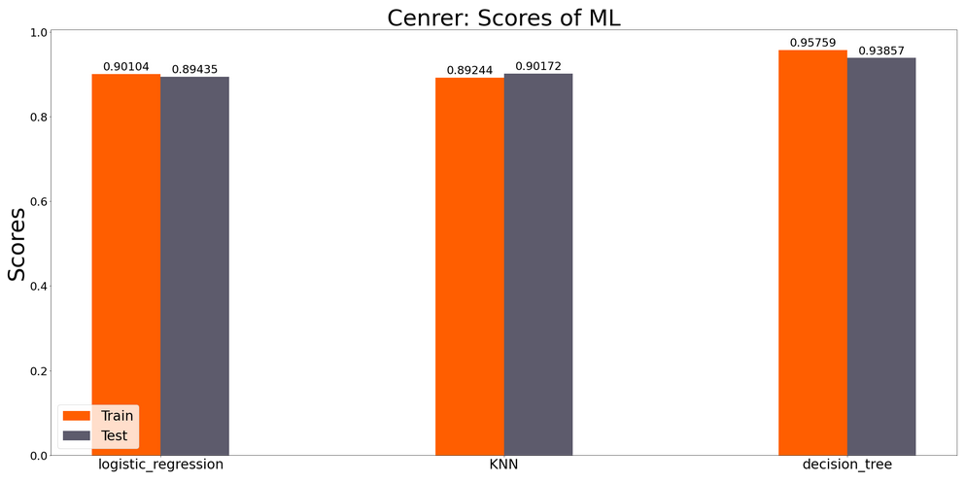
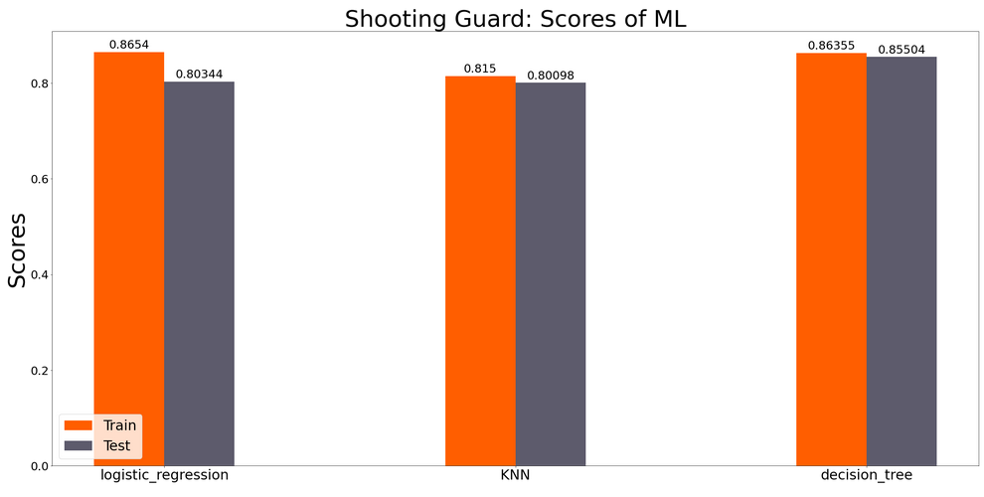
Machine learning
Overall Pick
We used all three models on the other positions:
Data acquisition
Data processing
EDA
Machine Learning
Conclusions

Slide 31
Conclusion
Overall Pick
As we can see, each position has a different model that works best for it.
We learned that we could predict a player “best” position based on his data (physical and game-wise) but only up to a certain precision.
Basketball is a dynamic game with a relatively small court and only 5 players per team, which means even though each player has his own position, they all must have a shared collective of skills which can explain why we could not predict the player position by 100%.
Data acquisition
Data processing
EDA
Machine Learning
Conclusions

Slide 32
Thank You!

